Slide 1
A3
B3
A2
B2
A1
B1
A0
B0
A3
B3
A2
B2
A1
B1
A0
B0
A3
B3
A2
B2
A1
B1
A0
B0
Bitwise AND
Bitwise OR
Bitwise XOR
and3
and2
and1
and0
or3
or2
or1
or0
xor3
xor2
xor1
xor0
and3
or3
xor3
and2
or2
xor2
and1
or1
xor1
and0
or0
xor0
10
01
00
10
01
00
10
01
00
s[0]
10
01
00
s[0]
s[0]
MUX3:1
s[0]
MUX3:1
MUX3:1
s[1]
MUX3:1
s[1]
s[1]
s[1]
Y2
Y1
Y0
Y3

Slide 2
ALU4
OPCODE[1] en
add_sub
A[3:0]
MUX1
OPCODE[4] s
0
A
A[3:0] a[3:0]
A[3:0]
y[3:0] out_as[3:0]
1
B[3:0] b[3:0]
0
s
OPCODE[2] en
and_or_xor
OPCODE[5:4] s[1:0]
MUX2
A[3:0] a[3:0]
Y
Y[3:0]
OPCODE[0]
y[3:0] out_aox[3:0]
B[3:0] b[3:0]
1
B[3:0]
B
B[3:0]
OPCODE[3] en
barrel_shift
y[3:0] out_bs[3:0]
s0
OPCODE[5:4] s[1:0]
2
s1
A[3:0] a[3:0]
3:2 encoder
OPCODE[5:0]
OPCODE[3:1]
opcode[5:0]

Slide 3
ALU4
OPCODE[1] en
add_sub
A[3:0]
mux
OPCODE[4] s
0
A
A[3:0] a[3:0]
A[3:0]
or
B[3:0] b[3:0]
y[3:0] out_as[3:0]
1
s
OPCODE[2] en
and_or_xor
OPCODE[5:4] s[1:0]
A[3:0] a[3:0]
Y
Y[3:0]
OPCODE[0]
y[3:0] out_aox[3:0]
B[3:0] b[3:0]
B[3:0]
B
B[3:0]
OPCODE[3] en
barrel_shift
y[3:0] out_bs[3:0]
OPCODE[5:4] s[1:0]
A[3:0] a[3:0]
OPCODE[5:0]
opcode[5:0]

Slide 4
mux
B
A
Y
barrel_shift
add_sub
or
and_or_xor

Slide 5
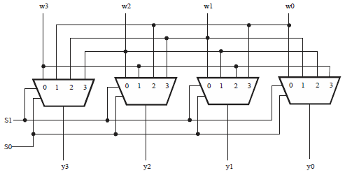
A[3]
A[2]
A[1]
A[0]

Slide 6
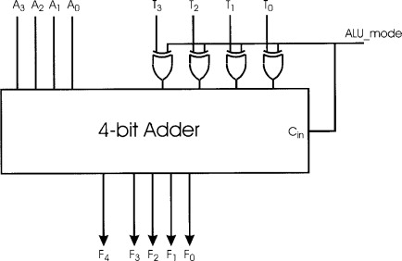
A[3] A[2] A[1] A[0]
B[3] B[2] B[1] B[0]
s
CO Y[3] Y[2] Y[1] Y[0]

Slide 7
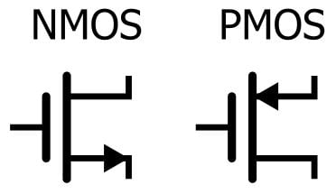
vdd
en
vdd
input
logic
output
gnd
gnd

Slide 8
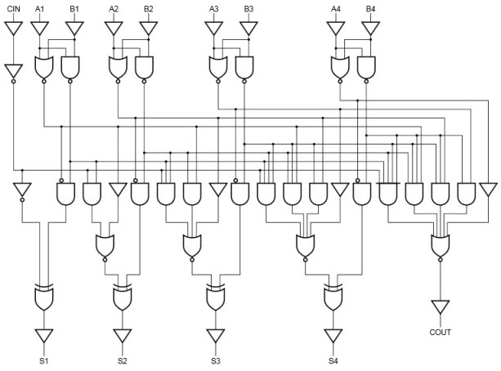
A[0]
B[0]
A[1]
B[1]
A[2]
B[2]
A[3]
B[3]
Y[0]
Y[1]
Y[2]
Y[3]

Slide 9
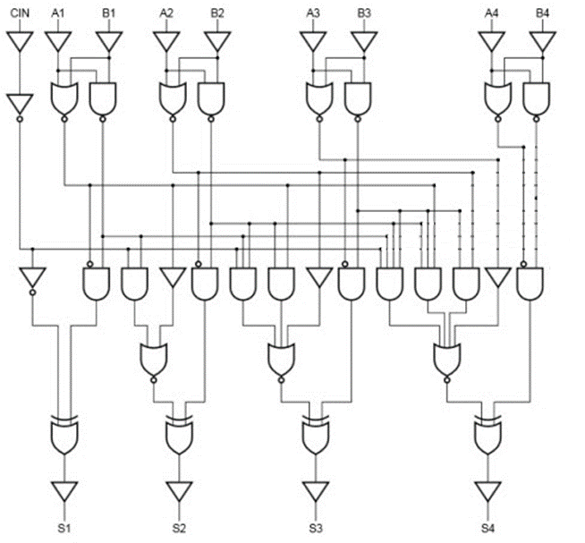
Y[0]
Y[1]
Y[2]
Y[3]

Slide 10
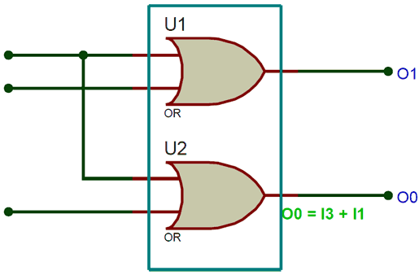
OPCODE[3]
S1
OPCODE[2]
OPCODE[1]
S0

Slide 11
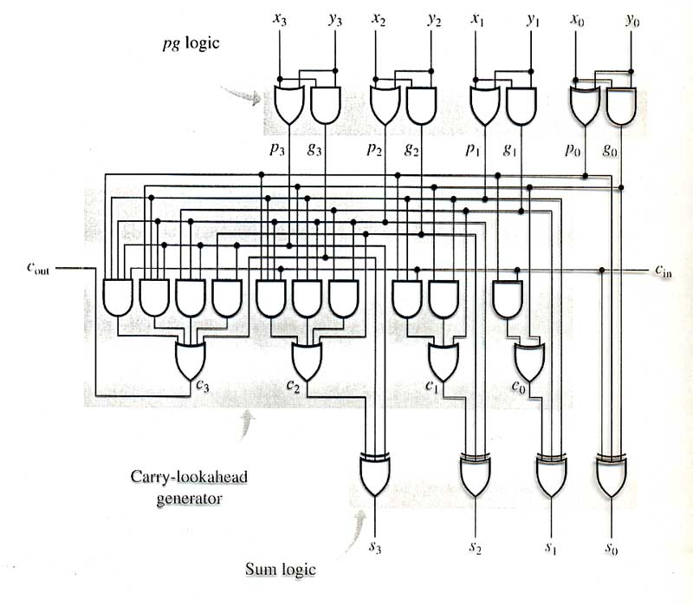

Slide 12
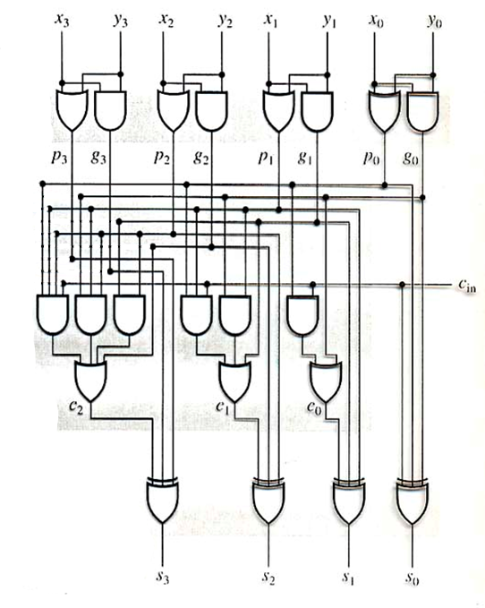
A[3]
B[3]
A[2]
B[2]
A[1]
B[1]
A[0]
B[0]
Y[3]
Y[2]
Y[1]
Y[0]

