Slide 1
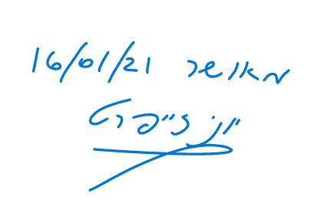
מס' פרויקט:
20-1-1-2187
שם הפרויקט: מימוש וסימולציה של מאיץ למערכות לומדות על רכיב FPGA
מגישים: שי צבר 208723627 חיים גרודה 312562721 מנחה:
יוני זייפרט
מקום ביצוע:
אוניברסיטה

Slide 2
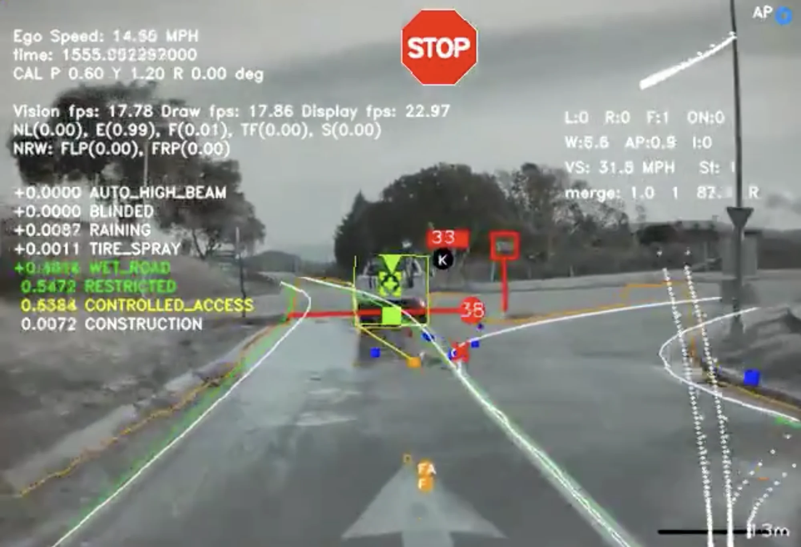
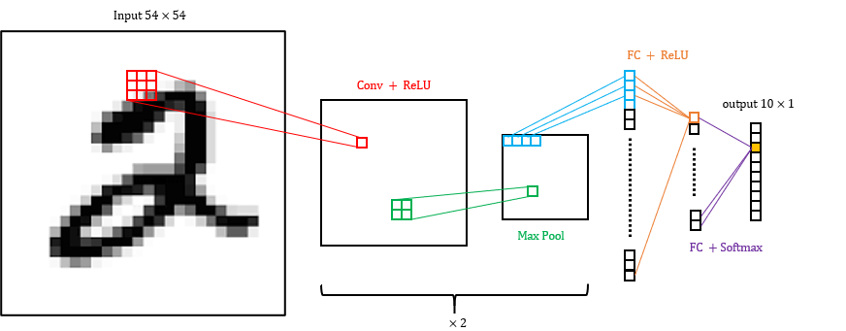
CNN – Convolutional Neural Network
Achieved great success in image classification, speech recognition and more.
Research hotspot in many scientific fields.
Widely used in the industry, such as for autonomous cars, security systems, health and more.
Figure: The “view” of a Tesla autonomous driving computer
CNN Structure
Convolution - Feature extraction using filters (85-90%)
Activation – Introduce nonlinearity
Pooling - Reduce spatial dimensions
Fully Connected - Final classification decision
Figure: Implemented CNN model

Slide 3
CNN Acceleration
Motivation
high accuracy comes with high computation time and high-power consumption
need to include such image recognition capabilities in embedded systems with tight real-time and power constraints
Objectives
Acceleration – by hardware parallelization
Accuracy – reduce loss due to fixed point arithmetic
Power – dedicated hardware processing elements
Utilization – FPGA resources
Computationally intensive, 85%-90% of computations [source]
Figure: 2D convolution. [source]

Slide 4
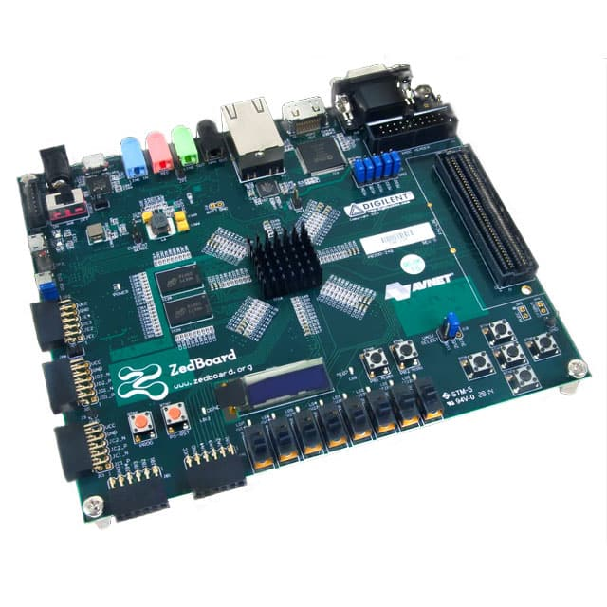
Method
Fixed Point Calculations:
Better computation time
Less hardware resources
Possible loss of accuracy
High Level Synthesis (HLS)
RTL abstraction
Efficiently build and verify hardware
Control design optimization
Simulation:
SW implementation of CNN
Comparison time HW vs SW
Compare accuracy HW vs SW
Evaluate power consumption

Slide 5
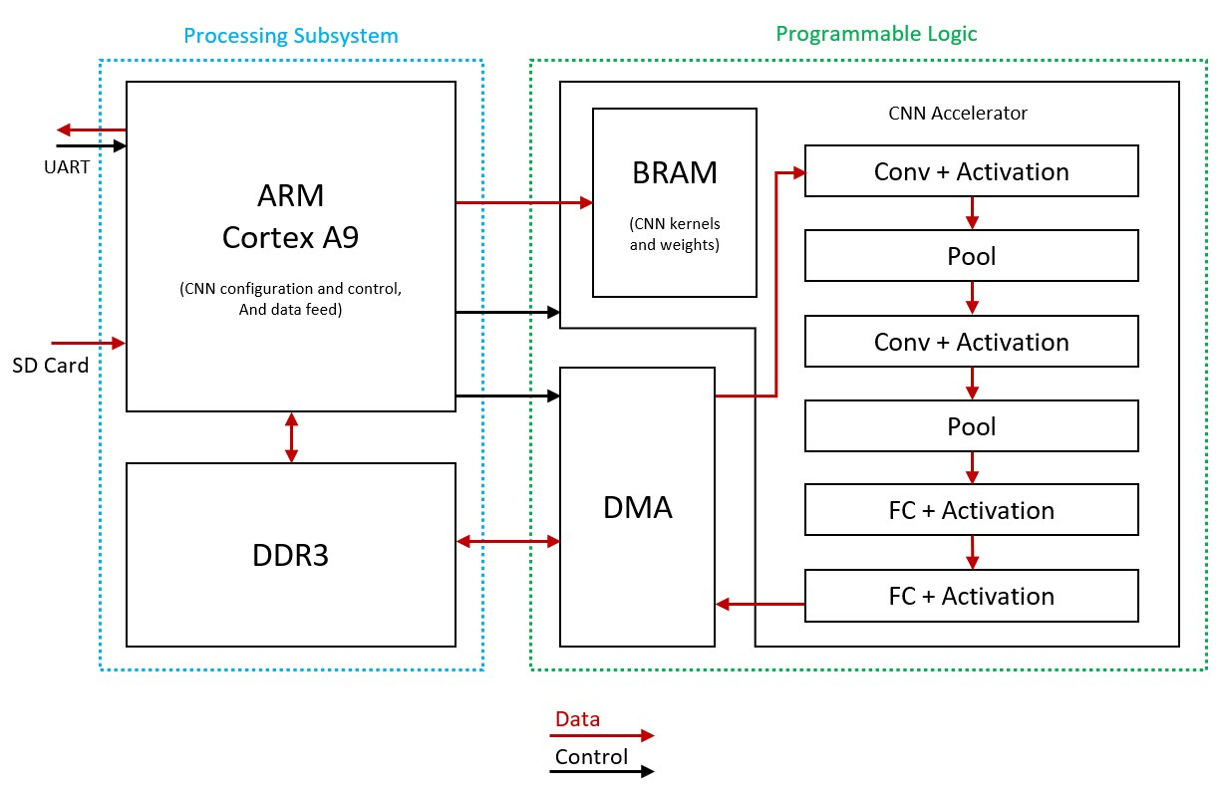
Design - Top
Processing system (PS):
CPU – Input, output, control and configuration
DDR – memory unit
Programmable Logic (PL):
AXI DMA controller
CNN core
AXI Stream\Lite interfaces
Stream – high throughput (input data)
Lite – static data (kernel/weights)

Slide 6
Design – CNN Core
FIFO implementation
Data is processed “on the fly”
No PL-PS bottleneck
AXI Stream for high throughput of processed data
AXI Lite for configuration / static data
FPGA resources can be utilized for more CNN layers, or for a bigger sliding window

Slide 7
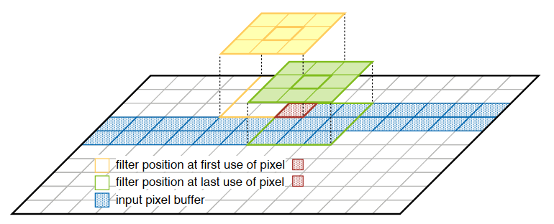
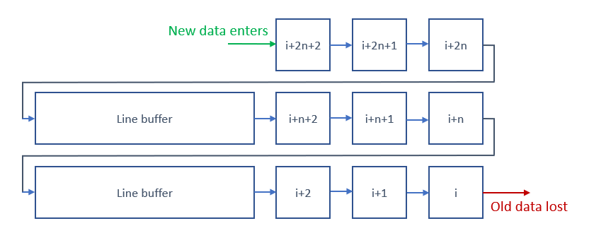
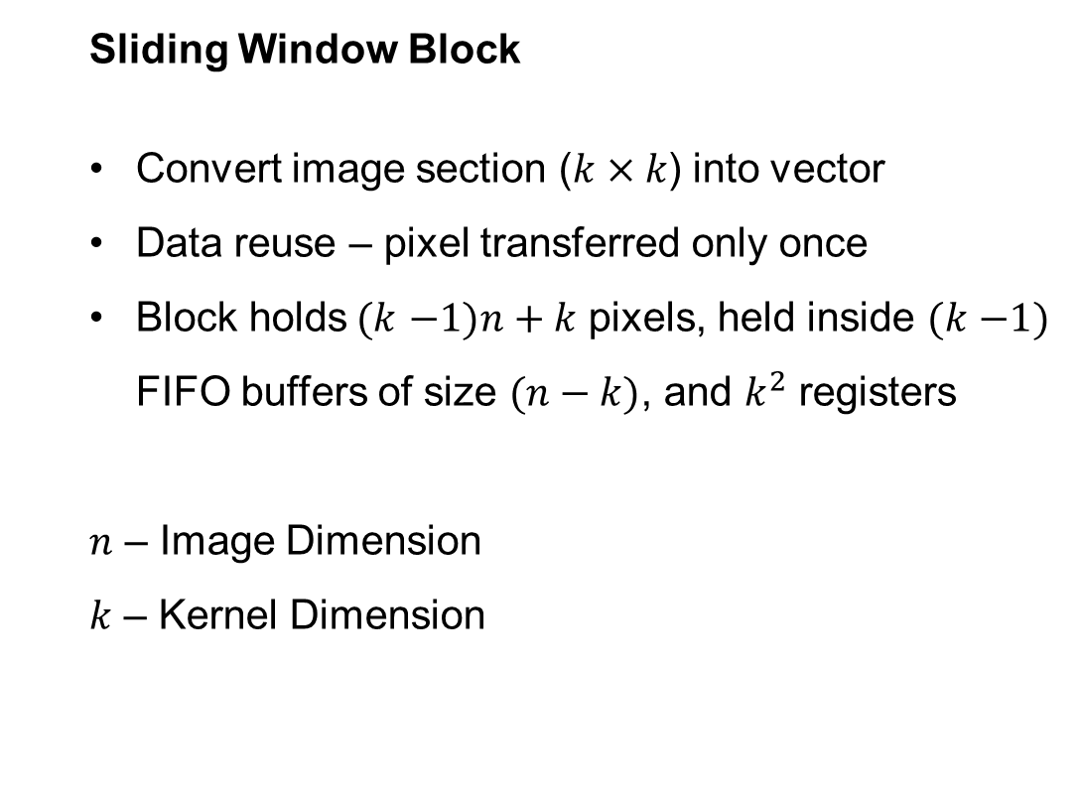
Design – Sliding Window
Sliding Window Block
Convert image section ($k×k$) into vector
Data reuse – pixel transferred only once
Block holds$(k$ $−1)n+k$ pixels, held inside $(k$ $−1)$ FIFO buffers of size $(n−k)$, and $k^{2}$ registers
$n$ – Image Dimension
$k$ – Kernel Dimension
Figure: Data reuse / sliding window illustration [source]
Figure: 3x3 neighborhood extractor architecture

Slide 8
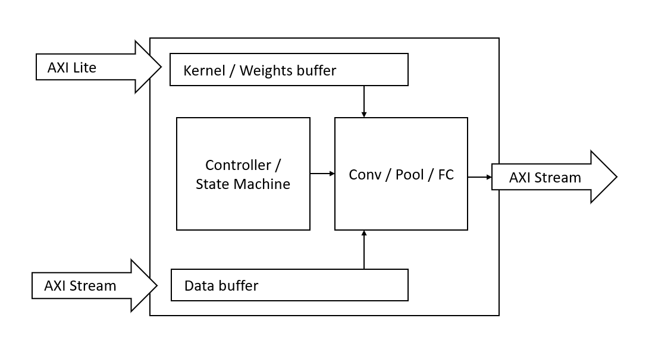
Design – Processing Element
Single CNN Layer computation
Convolution
Pooling (Max/Average)
Fully Connected
Stream input/output (AXI Stream)
Data enters block
Calculation preformed
Data streamed deeper into network
Memory Mapped input (AXI Lite)
Pass configuration / control data
Kernels / weights

Slide 9
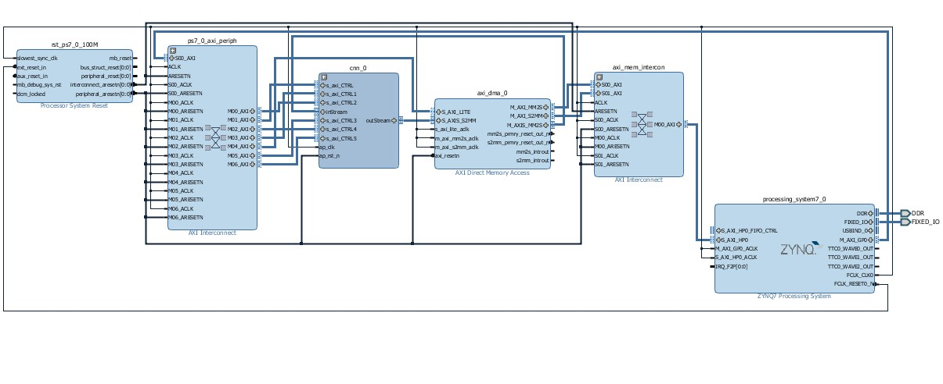
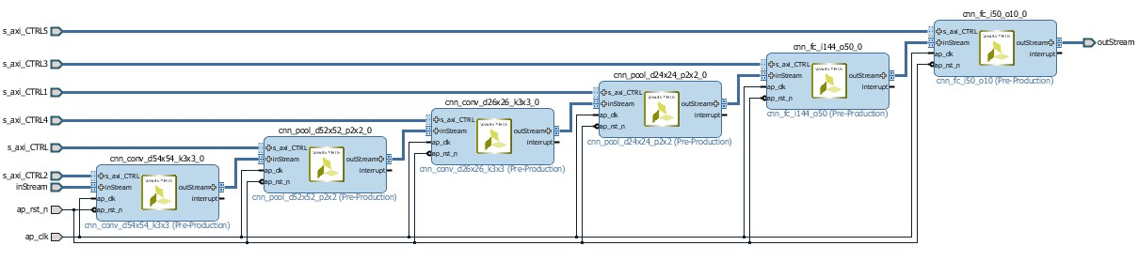
Implementation
Top level data-path
SW – HW communication
Input / Output infrastructure
Will be used as base for CNN data path
Figure: current project state. Vivado capture
Figure: Terminal output. TeraTerm capture

Slide 10
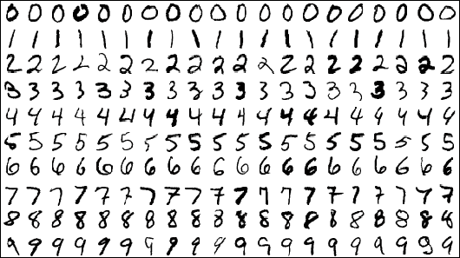

Simulation
MNIST
Keras
SD card FatFS
Stats

Slide 11
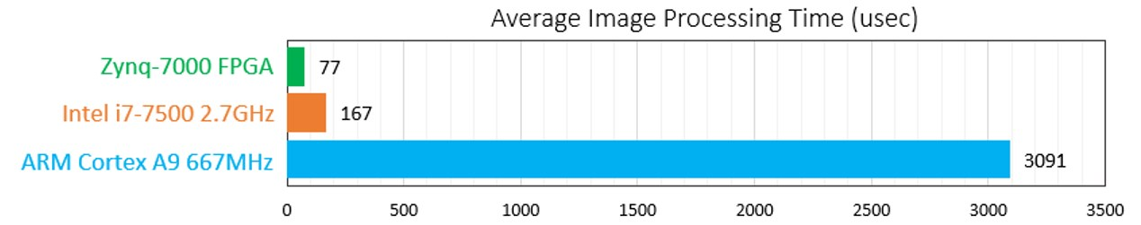
Results

Slide 12
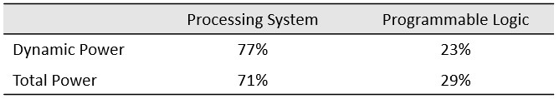
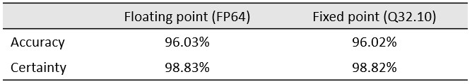
Results

Slide 13
Conclusion

