Slide 1
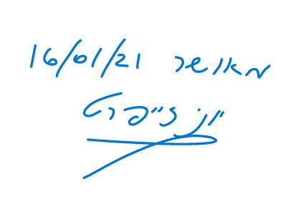
מס' פרויקט:
20-1-1-2187
שם הפרויקט: מימוש וסימולציה של מאיץ למערכות לומדות על רכיב FPGA
מגישים: שי צבר 208723627 חיים גרודה 312562721 מנחה:
יוני זייפרט
מקום ביצוע:
אוניברסיטה

Slide 2
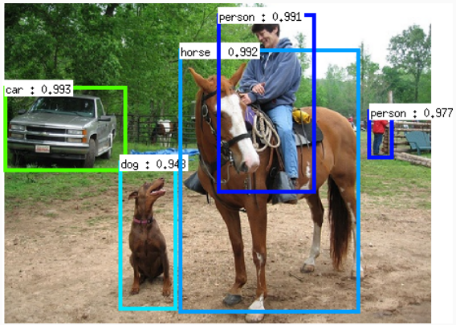
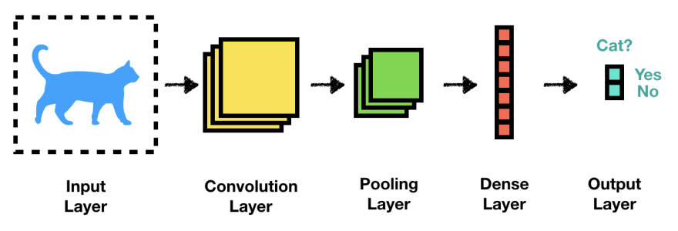
CNN – Convolutional Neural Network
Achieved great success in image classification, speech recognition and more.
Research hotspot in many scientific fields.
Widely used in the industry, such as autonomous robot vision.
CNN Structure
Convolution - Feature extraction using filters
Pooling - Reduce spatial dimensions
Fully Connected - Final classification decision
Figure: image recognition illustration [google]
Figure: CNN layers [google]

Slide 3
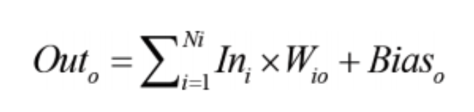
CNN Acceleration
Convolutional layers:
Computationally intensive
85%-90% of computations [source]
SW – sequential calculations using nested loops
HW – parallel calculations
Pooling
Reduce spatial dimensions by taking Max/Avg
Fully Connected
Matrix multiplications
Memory Heavy
Figure: 2D convolution. [source]

Slide 4
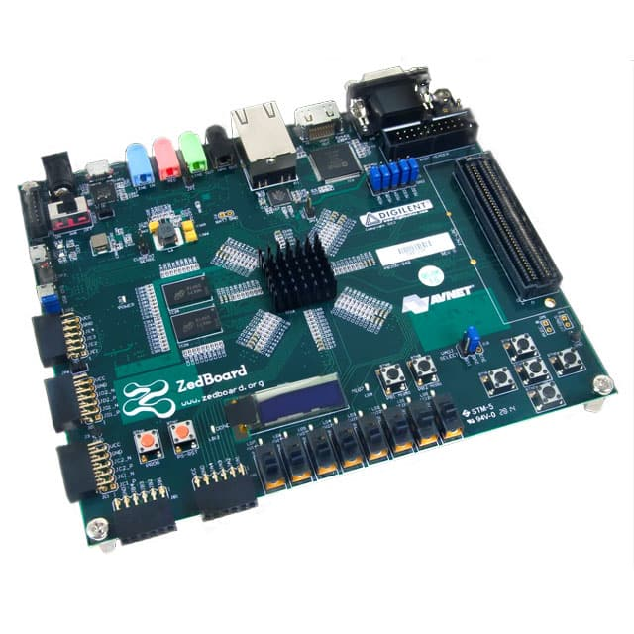
System Requirements
Flexible Implementation:
Adjustable for different CNN models
Varying Kernel size, Image size, number of network layers
Based on FPGA limits
Fixed Point Calculations:
Better computation time
Less hardware resources
Lower accuracy
High Level Synthesis (HLS)
RTL abstraction
Efficiently build and verify hardware
Better control over optimization of design architecture
Simulation:
Test CNN core operation
Time comparison with SW
Accuracy comparison with SW
SW will run on PS and laptop

Slide 5
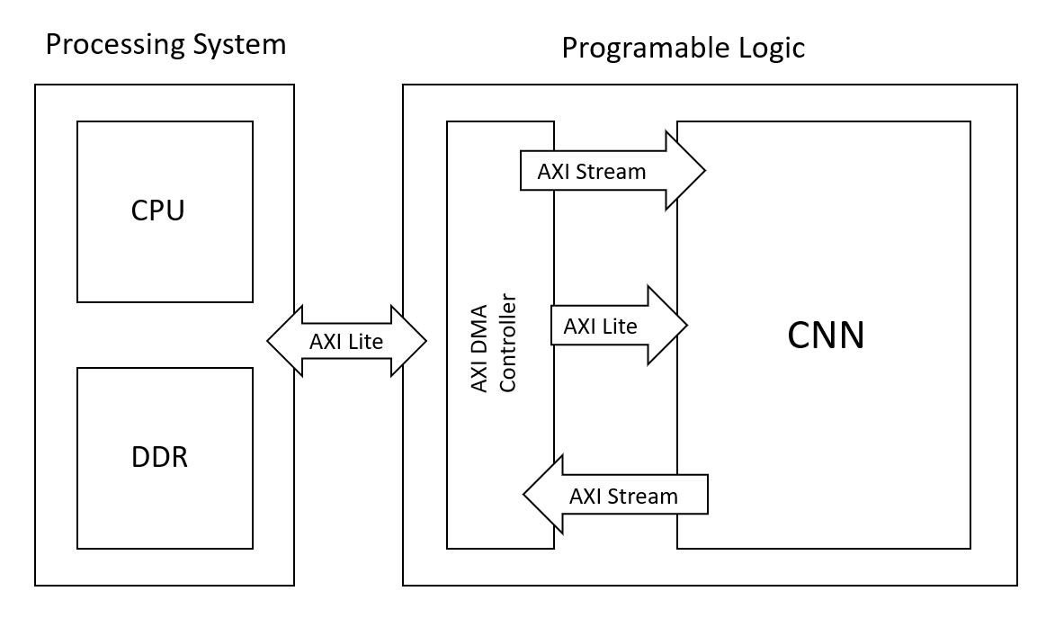
Design - Top
Processing system (PS):
CPU – Input, output, control and configuration
DDR – memory unit
Programmable Logic (PL):
AXI DMA controller
CNN core
AXI Stream\Lite interfaces
Stream – high throughput (input data)
Lite – static data (kernel/weights)

Slide 6
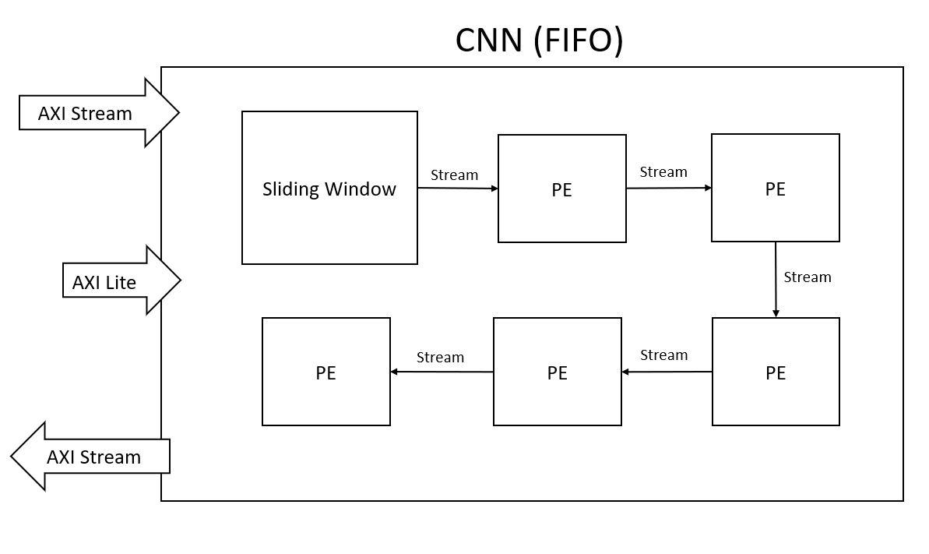
Design – CNN Core
FIFO implementation
Data is processed “on the fly”
No PL-PS bottleneck
AXI Stream for high throughput of processed data
AXI Lite for configuration / static data
FPGA resources can be utilized for more CNN layers, or for a bigger sliding window

Slide 7
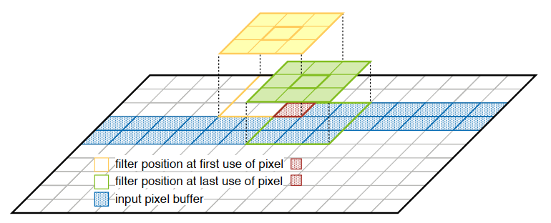
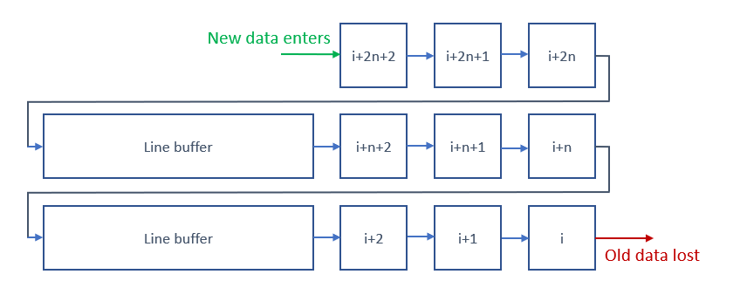
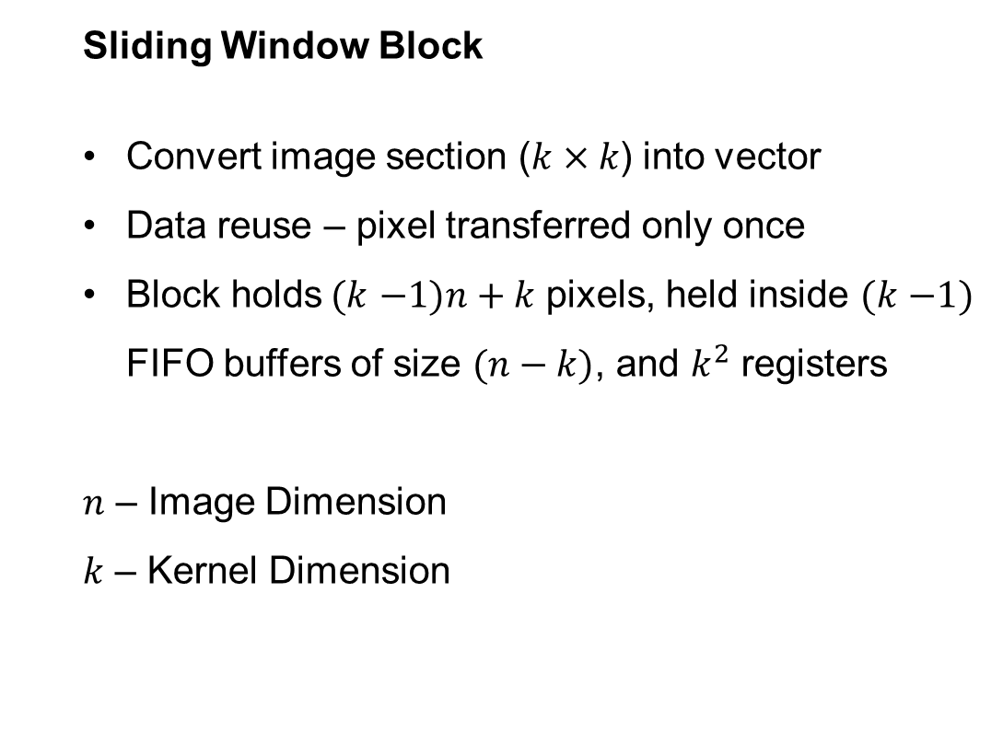
Design – Sliding Window
Sliding Window Block
Convert image section ($k×k$) into vector
Data reuse – pixel transferred only once
Block holds$(k$ $−1)n+k$ pixels, held inside $(k$ $−1)$ FIFO buffers of size $(n−k)$, and $k^{2}$ registers
$n$ – Image Dimension
$k$ – Kernel Dimension
Figure: Data reuse / sliding window illustration [source]
Figure: 3x3 neighborhood extractor architecture

Slide 8
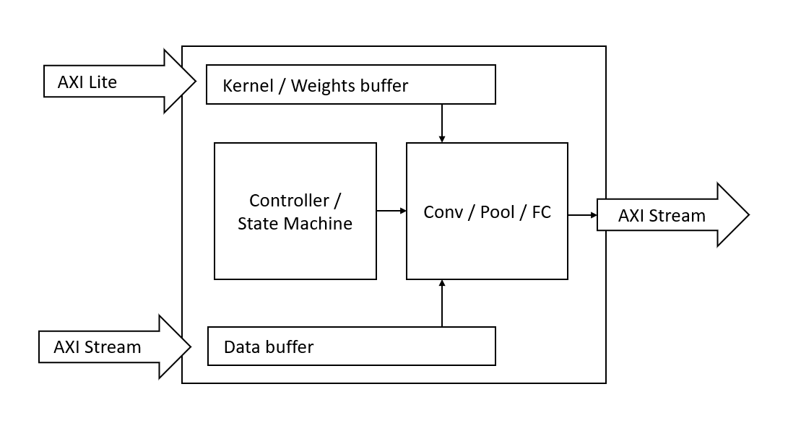
Design – Processing Element
Single CNN Layer computation
Convolution
Pooling (Max/Average)
Fully Connected
Stream input/output (AXI Stream)
Data enters block
Calculation preformed
Data streamed deeper into network
Memory Mapped input (AXI Lite)
Pass configuration / control data
Kernels / weights

Slide 9
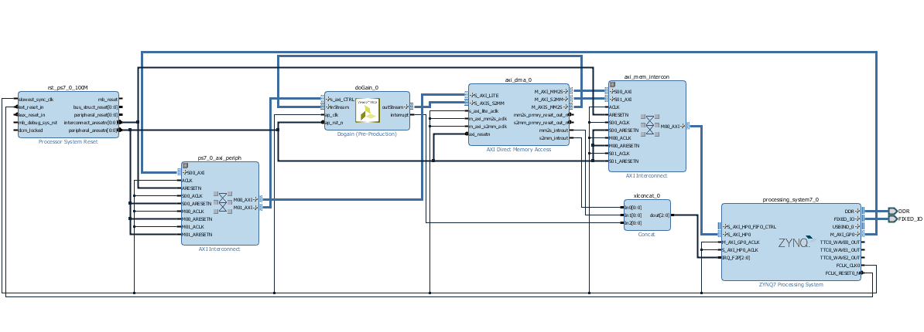
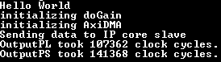
Current project development status
Top level data-path
SW – HW communication
Input / Output infrastructure
Will be used as base for CNN data path
PL
Test Block
PS
Taste of acceleration
Simple Test Block
Gain over 10K integer array
PL uses 25% less clock cycles compared to PS
That’s with no parallelism yet
Figure: current project state. Vivado capture
Figure: Terminal output. TeraTerm capture

Slide 10
Updated Timeline
Milestone | Description | Due/completion Date | Notes
CNN Background review | What is CNN? | 01.12.2020 | completed
Learning development tools | Verilog, Vivado, HLS, Zedboard, AXI | 01.12.2020 | completed
Operation Characterization | Complete System design | 15.12.2020 | completed
Top level Data Path infrastructure | implement main data flow interface | 10.01.2020 | completed
Mid-term presentation |  | 18.01.2021 | today
PE block | Implementation and testing | 01.03.2021
Sliding Window block | Implementation and testing | 01.04.2021
CNN integration | Integration of all blocks of the CNN Core and Testing. | 15.04.2021
TOP level integration | Integrating CNN in TOP design | 01.05.2021
Drivers | SW side of CNN | 15.05.2021
Submitting the poster |  | 20.05.2021
Performance improvements | Both HW and SW | 01.06.2021
CNN Simulation |  | 15.06.2021
Project submission |  | 20.06.2021

