Slide 1
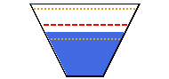
High
(90th pctl)
Average
Low
(10th pctl)
Current
Storage
Name
Current / Full Storage
% Full – % of Average
Date
High, Avg, and Low lines drawn with
respect to statistics for the day of the year

