Slide 1
OpenBazaar
Connor Sheehan
Danny Mandel
Shandelle Murray
A free, open, peer to peer marketplace for online trading of goods and services

Slide 2


Goals
Eliminate need for third party corporations involved in online trade (Amazon, eBay)
Eliminate extra fees and restrictions
Reduce overhead costs of trade
Allow global communication and trade

Slide 3
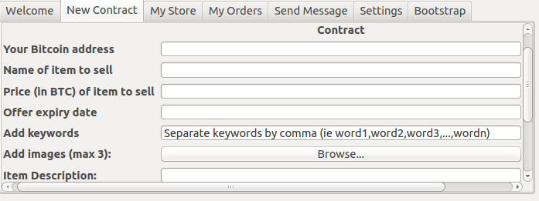
Sellers
Install program on computer
Create store
Generate contract(s) to list items/services in store
Send and receive messages from potential buyers

Slide 4
Buyers
Install program on computer
Search for items/services or browse through stores
Send and receive messages from sellers
Potentially select goods and services to purchase

Slide 5
Implementation Details
Kademlia-style Peer-to-Peer Network to allow the possibility of connecting millions of people
(Necessary? Any additional points?)

Slide 6
Ricardian Contract
To ensure fairness and to avoid unauthorized changes to the contract
Protects both buyers and sellers
States terms of contract and may include a third party notary
From the original OpenBazaar website:
A Ricardian Contract can be defined as a single document that is a) a contract offered by an issuer to holders, b) for a valuable right held by holders, and managed by the issuer, c) easily readable by people (like a contract on paper), d) readable by programs (parsable like a database), e) digitally signed, f) carries the keys and server information, and g) allied with a unique and secure identifier.
- Ian Grigg
Makes use of a chain of digitally signed and checksum hashed contracts to create an unalterable record of agreement
Digital signatures from involved parties provide proof of agreement
Hashes provide proof of authenticity because the tiniest change in the contract will show in the hash

Slide 7
Process
A contract describing the item and specifying the terms of sale is generated by seller and posted to their store
A buyer interested in purchasing the item can choose to do so
A third party notary may be selected in order to mediate the trade
The seller ships the item or provides the service
The buyer receives the item/service
If both parties agree that the contract is satisfied, the Bitcoin funds may transfer from one party to another
If there is a problem with the trade and the parties are in disagreement, they must provide proof of a discrepancy and the notary then decides how to proceed
If the notary decides that the seller has satisfied their part of the trade, the funds get transferred according to the terms of the contract
Otherwise, the notary may rule in favor of the buyer and the funds may not get transferred

Slide 8
Demonstration

