Slide 1

Injuries in the NFL from 2010-2020
By Christopher Spartz

Slide 2
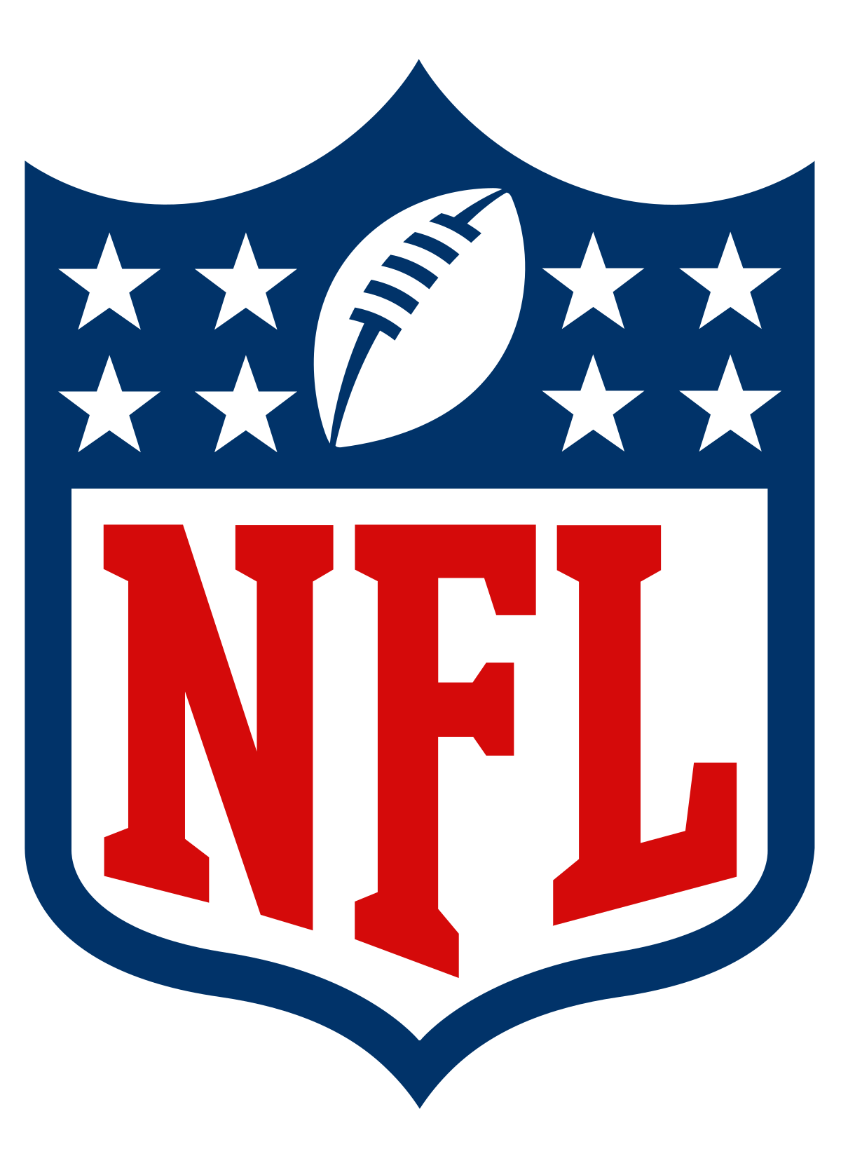
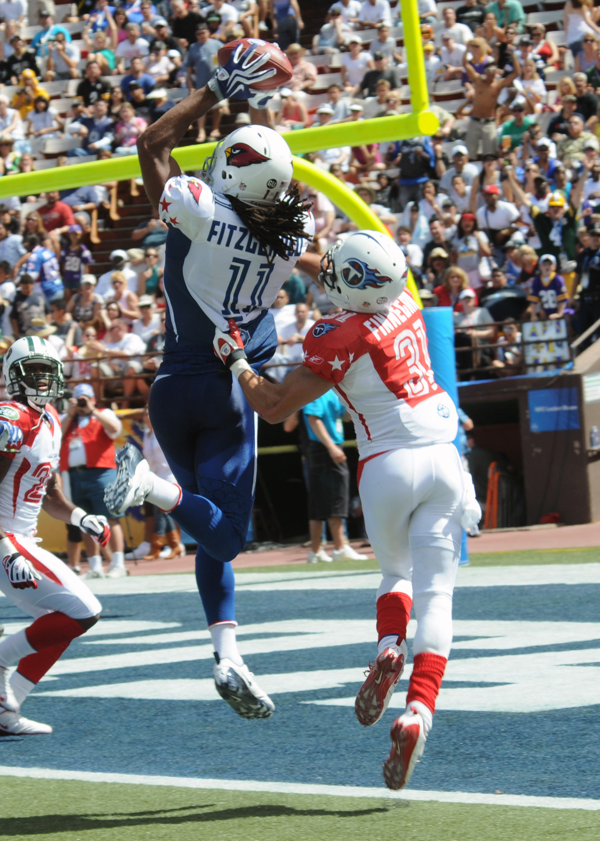
What is the NFL and American Football?
The NFL is the professional league of American Football in the U.S.
Most Popular sport in the U.S.
Goal of the game is to score points
-Score points by getting the ball into the endzone at one end of the field
--Offense tries to score points, defense tries to stop the offense by tackling players on the offense.
Football is a very physical game especially with players trying to tackle one another, which is why I am looking at the Injuries in the NFL.

Slide 3
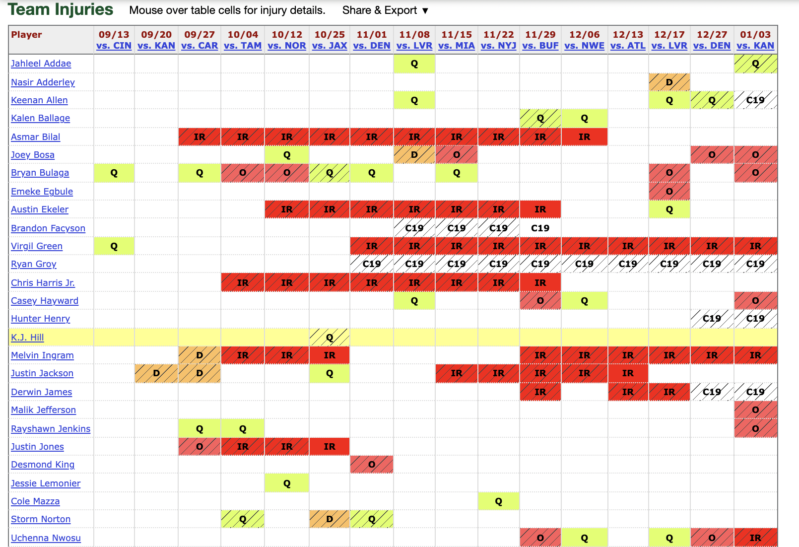
Where did I get the Data?
I got the data from Pro Football Reference
The Injury data looked like the picture
Link:https://www.pro-football-reference.com/teams/sdg/2020_injuries.htm
Link:https://www.pro-football-reference.com/teams/chi/lineups.htm
I had to scrape the data off both websites and clean it which required a lot of separate statements. After cleaning the data, I joined the two dataframes that I got off the websites based on the names and used that in my analysis.

Slide 4
Explanation of Injury Types
Injuries are split into 8 categories these represent: P stands for probable Q stands for questionable, D stands for doubtful O stands for out IR stands for Injured Reserve, PUP means the player is on the physically unable to perform list

Slide 5
Questions
1. Have the number of injuries to player gone up in recent years? 2. What position tends to get injured more than others? 3. How do injuries to players affect the winning percentage of teams? 4. What teams are the best at not getting injured? 5. What team can win despite injuries?

Slide 6
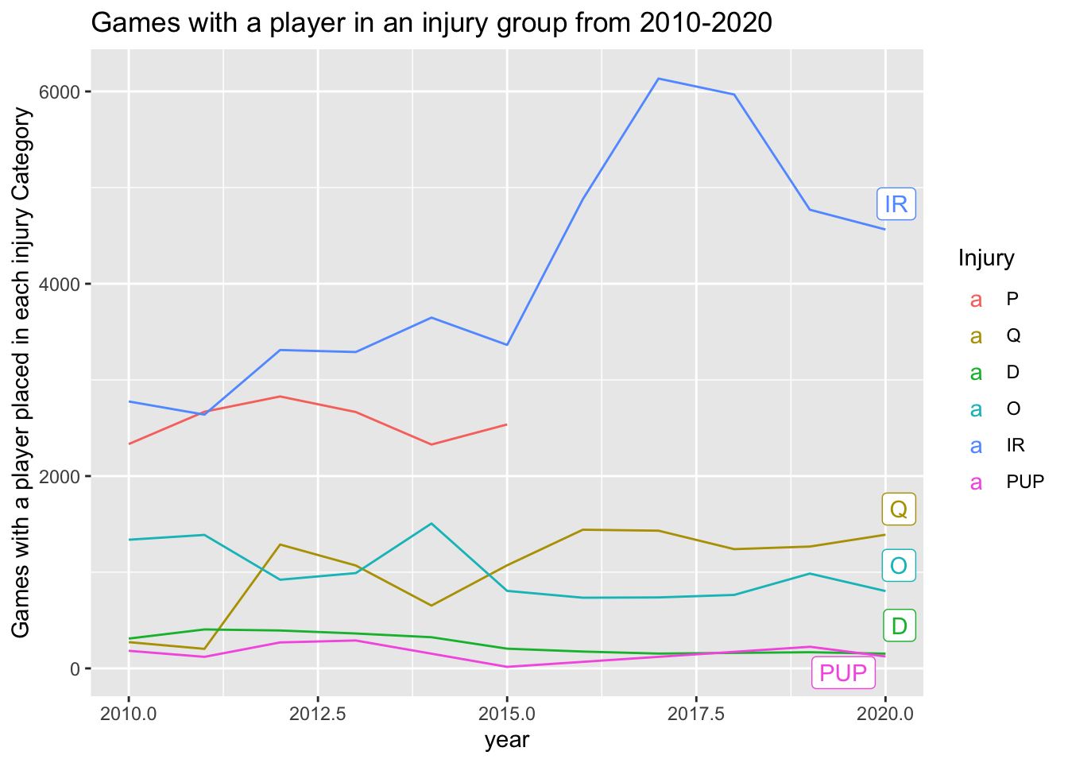
Injuries reported over 2010-2020
Over 11 season span most Injury designations have about same number of occurrences
Probable injuries no longer needed to be reported after 2015
Injured Reserve rule changes drastically increased number of weeks spent on the IR.

Slide 7
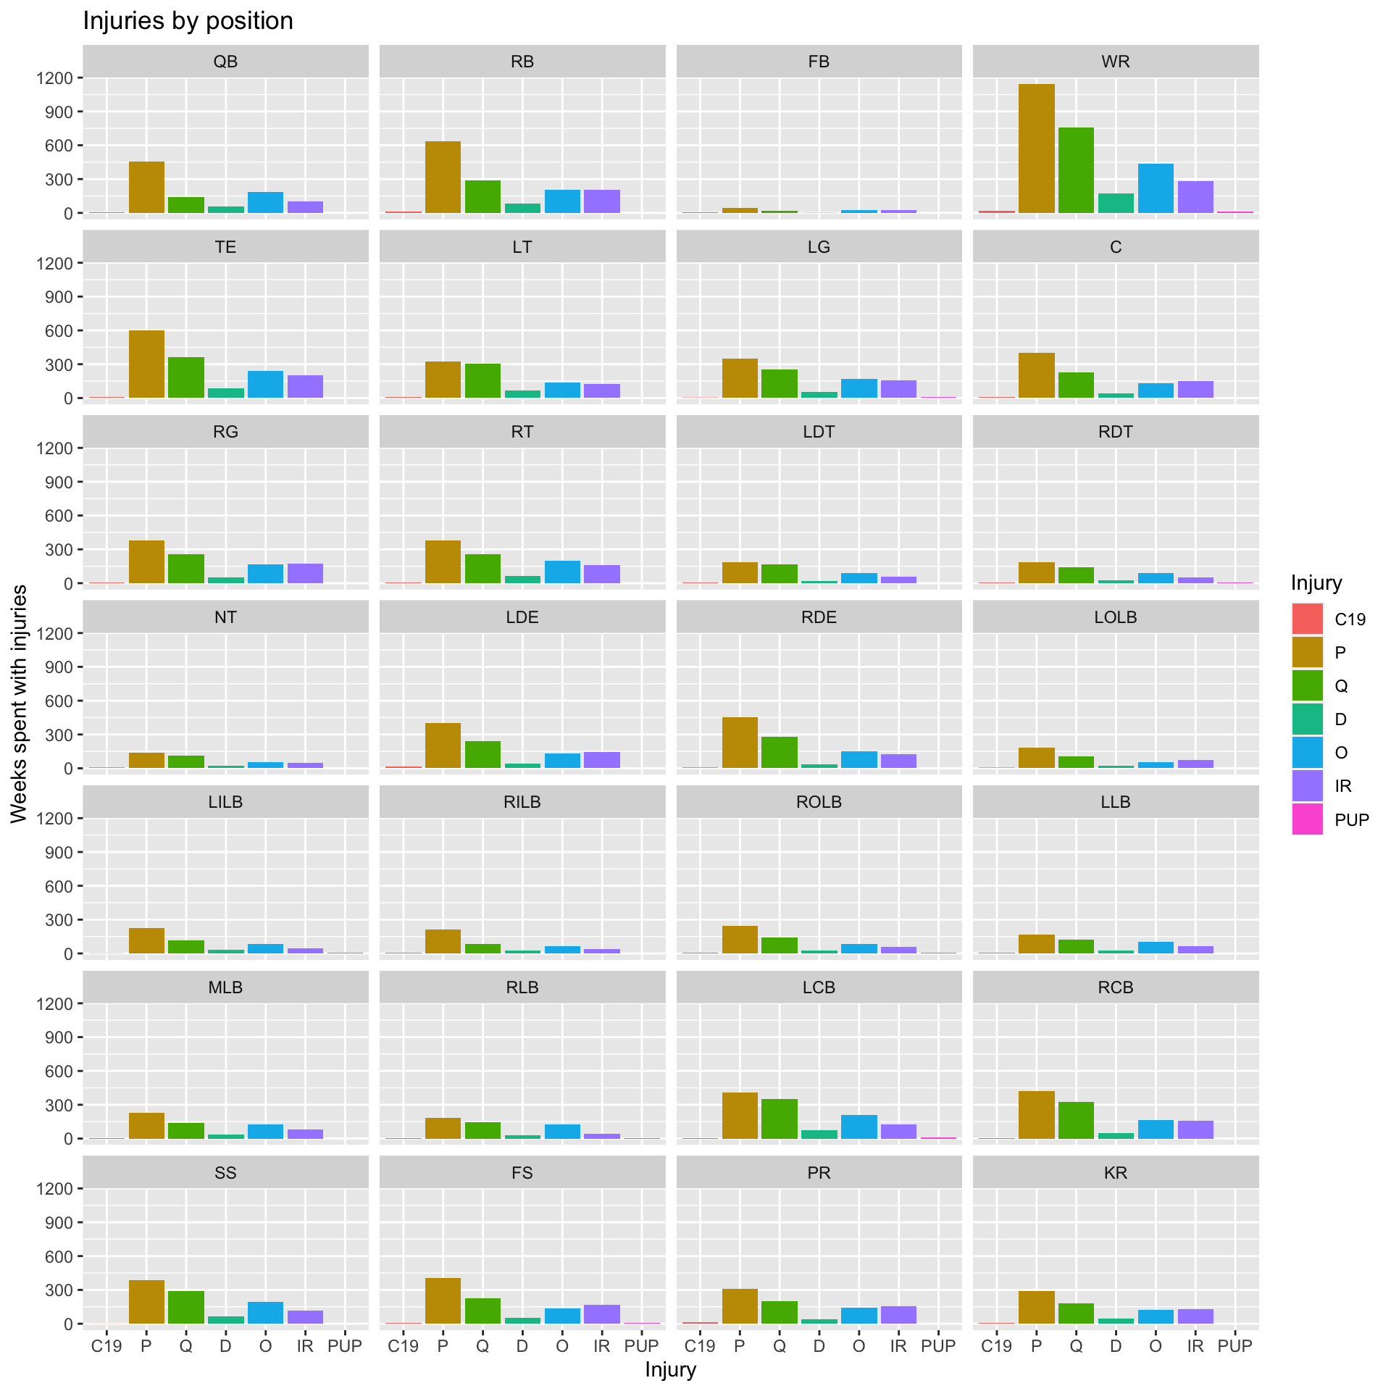
Injuries Reported by Position
WR has the most injuries, but that is partly since two players are counted as WR starters
RB, TE, and QB also have fair number of injuries
Offense tends to have more injuries than defense
Notes:
Mention that it is only starters in the data now

Slide 8
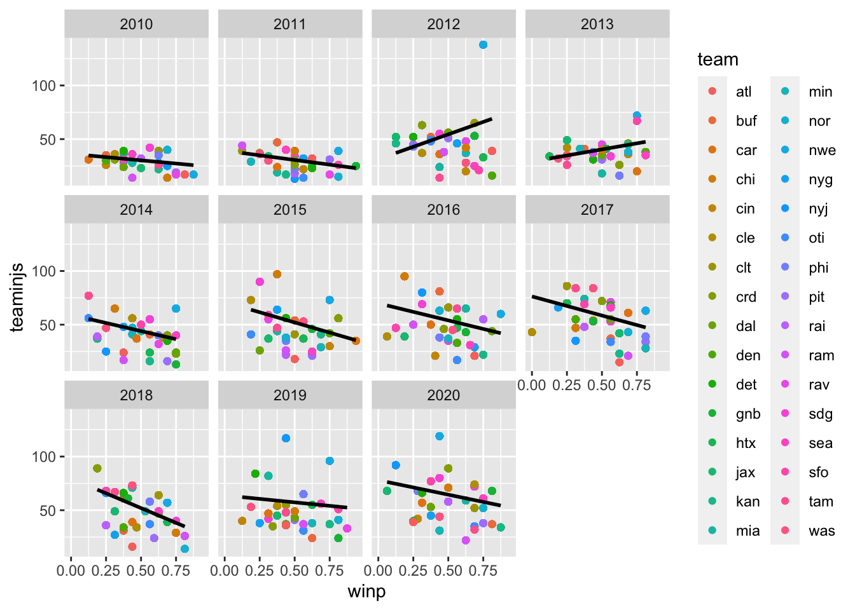
Team winning Percentage compared to Injuries Reported
On average the less injured teams wins a higher percentage of their games
2012 and 2013 are outliers with injured teams still winning
Will see specific teams in next slide

Slide 9
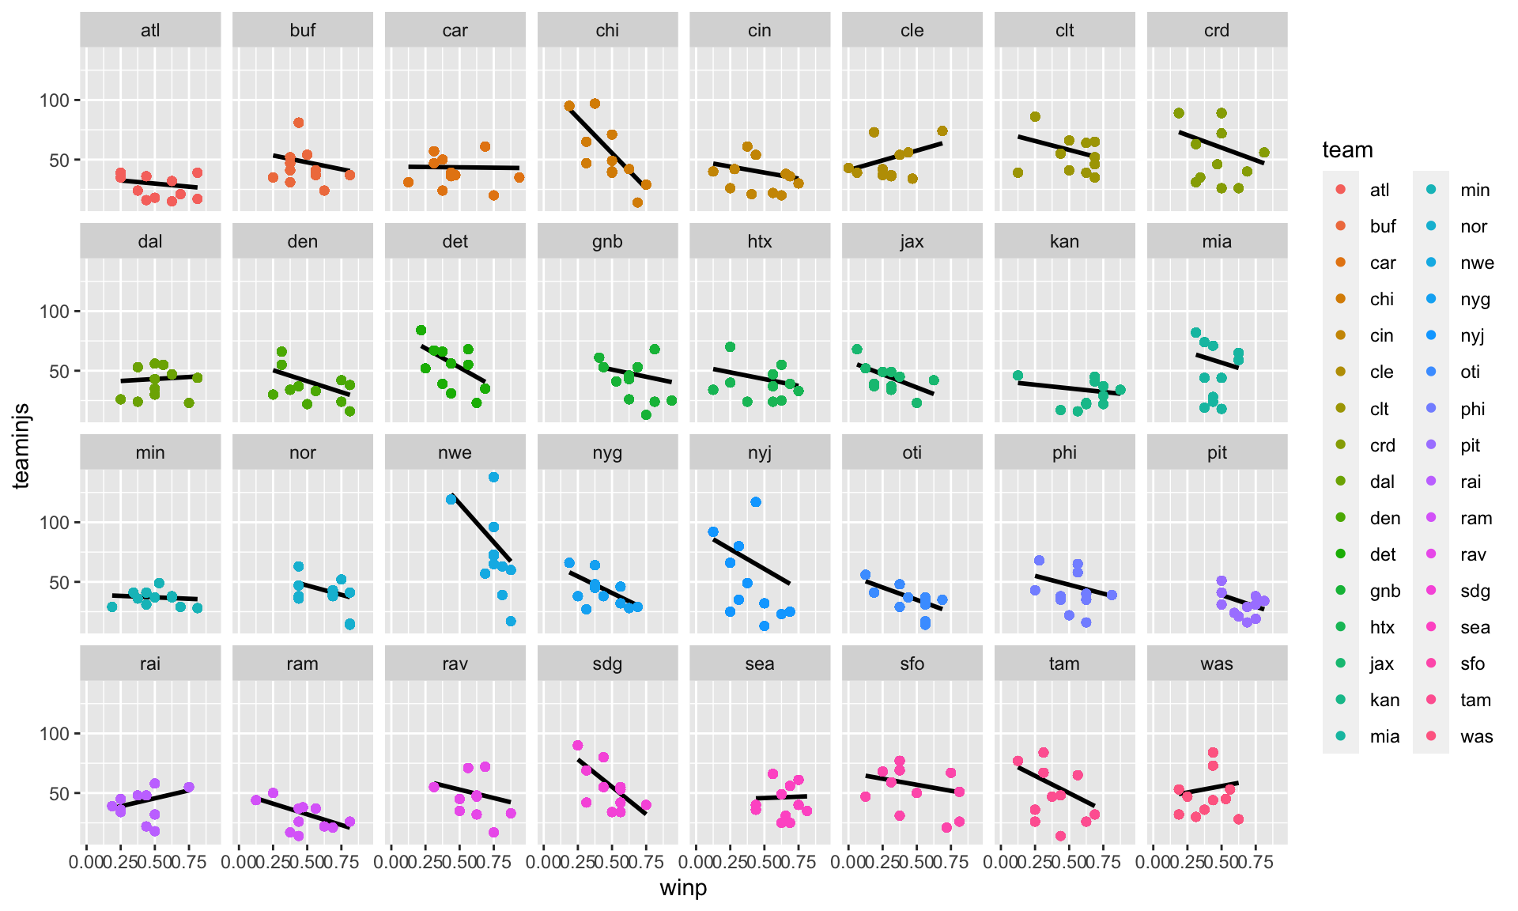
Injuries compared to Winning percentage by team
Some teams like Chi and Sdg cannot handle injuries very well
Atl and Pit don’t have many injuries and win more often

Slide 10
Conclusion
Injuries are still an issue in the NFL but they are not getting worse than they were in previous years in terms of volume. However, some NFL teams are much better at dealing with injuries that come their way and preventing injuries than other teams.

