Slide 1
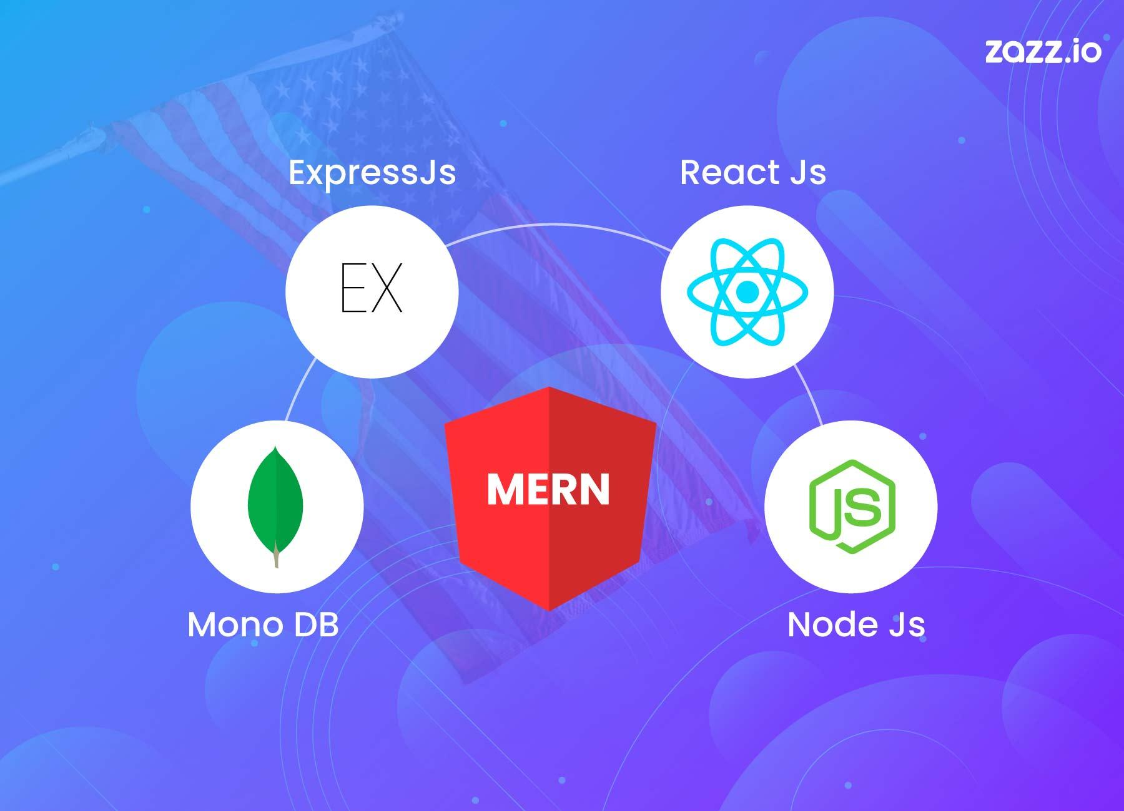
Deploying a MERN Stack Application
Step-by-step process for successful MERN deployment

Slide 2
Agenda
Overview of the MERN Stack Architecture
Preparation for Deployment
Backend Deployment Strategies
Frontend Deployment Strategies
Post-Deployment Considerations and Maintenance
Notes:
We will begin with an overview of the MERN stack architecture, followed by preparation steps for deployment. Then, we will explore backend and frontend deployment strategies, concluding with important post-deployment considerations and maintenance tips.

Slide 3
Overview of the MERN Stack Architecture
Notes:
Understanding the components of the MERN stack is essential. This section covers MongoDB, Express.js, and React and their roles in building full-stack applications.
The MERN stack architecture consists of:
MongoDB: A NoSQL database storing data in flexible JSON-like documents, designed for scalability.
Express.js: A minimal and flexible backend framework that handles routing and middleware.
React: A frontend library for building reusable UI components and interactive user interfaces.
Node.js: The runtime environment that supports Express.js and backend operations. This architecture supports modern, dynamic web application development.

Slide 4
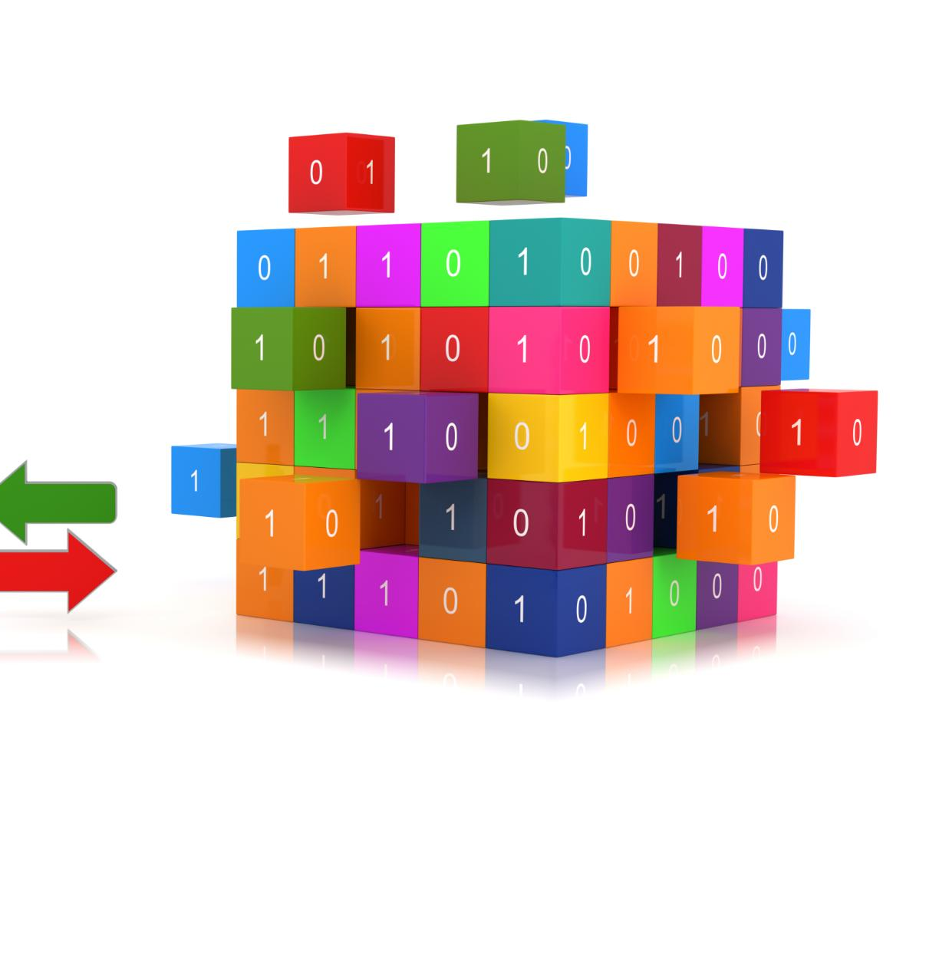
Understanding MongoDB's Role as the Database
NoSQL Document Storage
MongoDB stores data in flexible JSON-like documents instead of fixed tables, allowing dynamic schemas.
Scalability Features
Designed to scale horizontally, MongoDB efficiently handles growing data and user loads for applications.
Ideal for MERN Stack
MongoDB integrates seamlessly with the MERN stack, supporting modern, dynamic web applications development.
Notes:
--- MongoDB is a NoSQL database that stores data in flexible JSON-like documents. It provides scalability and flexibility, making it ideal for modern web applications in the MERN stack. Image source: Microsoft 365 content library

Slide 5
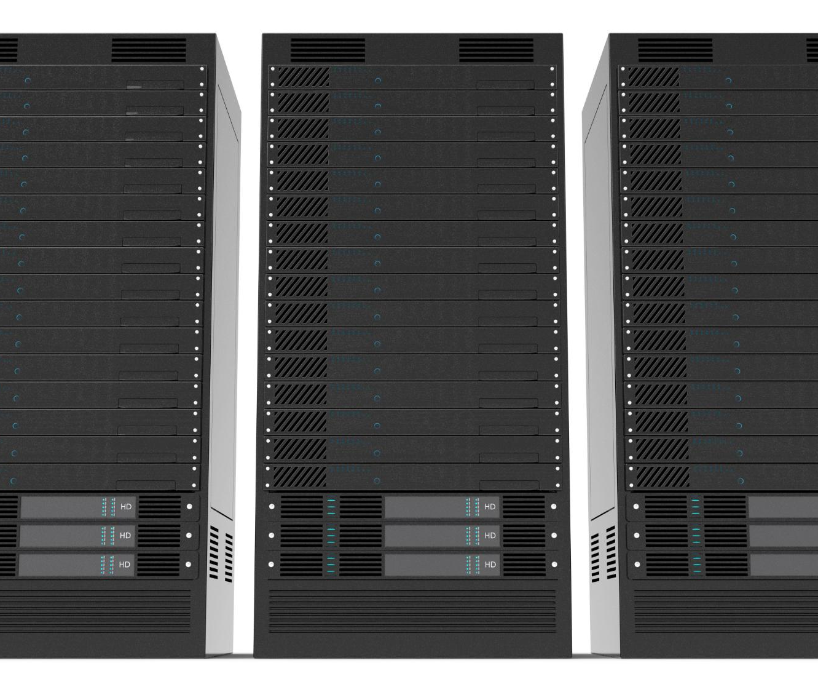
Integrating Express.js for Backend Routing
Minimal and Flexible Framework
Express.js offers a lightweight and adaptable framework for building robust backend applications with ease.
Simplified Backend Routing
Express.js streamlines routing processes, enabling developers to manage URL requests efficiently and effectively.
Middleware Implementation
Middleware support in Express.js allows for modular request handling and enhanced server functionality.
Server Backbone Role
Express.js acts as the backbone of Node.js servers, forming the foundation for scalable web applications.
Notes:
--- Express.js is a minimal and flexible Node.js web application framework that simplifies backend routing and middleware implementation, acting as the server backbone. Image source: Microsoft 365 content library

Slide 6

Leveraging React for Frontend User Interfaces
Reusable Components
React enables building UI with reusable components that simplify development and maintenance.
Interactive User Interface
React facilitates highly interactive and dynamic user experiences through efficient rendering.
Notes:
--- React is a powerful frontend library for building interactive user interfaces with reusable components, enabling a dynamic and responsive user experience. Image source: Microsoft 365 content library

Slide 7
Preparation for Deployment
Notes:
Before deploying, it's important to configure environment variables, optimize code, manage dependencies, and set up efficient build processes for both React and Node.js.

Slide 8

Container Benefits for MERN
“It works on my machine”
Portable applications.
Dependency conflicts
Consistent environments.
Environment setup complexity
Easy scaling.
Deployment inconsistencies
Simplified CI/CD.
Notes:
--- Securely managing environment variables and secrets such as API keys and database credentials is critical to protect sensitive information during deployment. Image source: Microsoft 365 content library

Slide 9
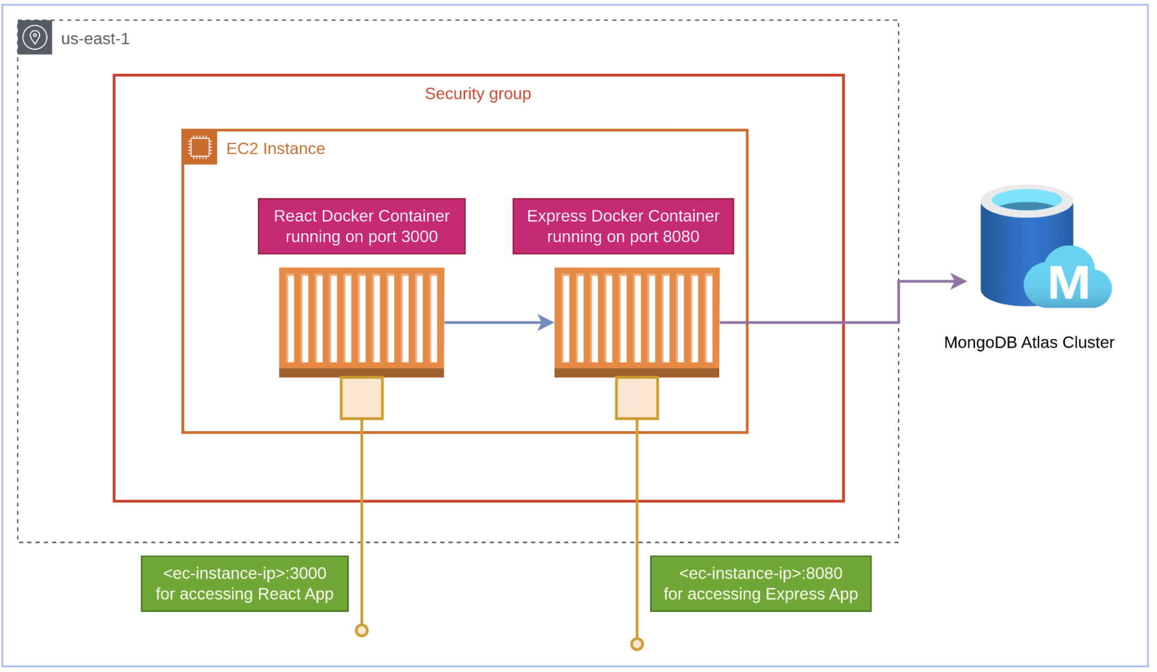
Container Architecture
Alpine Linux for smaller size
Smaller images download quicker, require less storage, and perform better.
Production dependencies only
Package only what you need, and use contain build tricks.
Build optimization
Use appropriate instance type. Open necessary ports (React: 3000, Express: 8080, MongoDB: 27017).
Notes:
--- Optimizing your application code and carefully managing dependencies helps ensure better performance and reduces the risk of version conflicts in production. Image source: Microsoft 365 content library

Slide 10

Setting up Build Processes for React and Node.js
React Frontend Build
Configure React build tools and scripts for optimized frontend performance and smooth user experience.
Node.js Backend Preparation
Set up Node.js backend with necessary scripts and bundlers for efficient server-side deployment.
Smooth Deployment
Integrate frontend and backend build processes to ensure seamless and efficient application deployment.
Notes:
--- Building the React frontend and preparing the Node.js backend with appropriate scripts and bundlers ensures smooth deployment and efficient performance. Image source: Microsoft 365 content library

Slide 11
Backend Deployment Strategies
Notes:
This section covers selecting a hosting platform, deploying the Express.js server, and connecting it with MongoDB, whether locally hosted or using cloud services.

Slide 12

Deploying and Managing the Express.js Server
Server Environment Setup
Setting up the server environment is crucial for stable and efficient Express.js backend deployment.
Process Manager Configuration
Using process managers like PM2 helps in managing and maintaining Express.js processes for reliability.
Server Operation and Log Monitoring
Continuous monitoring of server operation and logs ensures smooth functioning and quick issue resolution.
Notes:
--- Deploying the Express.js backend involves setting up server environments, configuring process managers like PM2, and ensuring smooth server operation and logs monitoring. Image source: Microsoft 365 content library

Slide 13
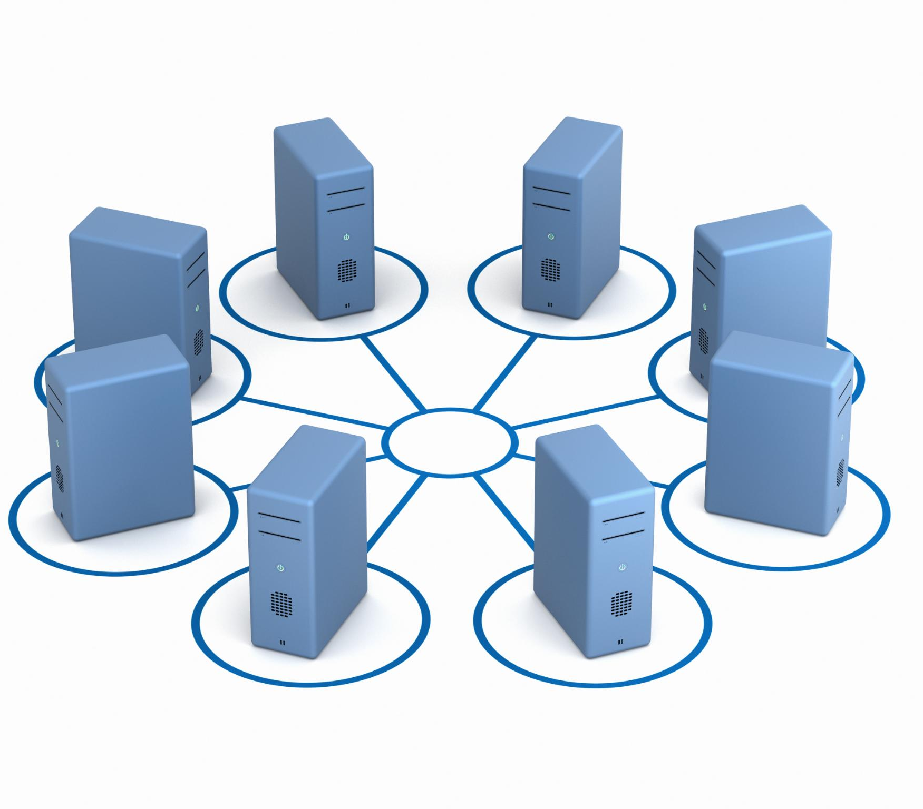
Connecting the Server to MongoDB (Local vs Cloud)
Local MongoDB Connection
Connecting to a local MongoDB instance offers full control but requires manual management and limited scalability.
Cloud MongoDB Connection
Using cloud MongoDB services provides scalability, easier management, and automated backups for backend servers.
Notes:
--- Connecting your backend server to MongoDB can be done using a local instance or cloud services like MongoDB Atlas, with cloud options offering scalability and easier management. Image source: Microsoft 365 content library

Slide 14
Frontend Deployment Strategies
Notes:
Deploying the React frontend requires building the app, serving static files, and configuring domain and SSL for secure access to users.

Slide 15

Building and Deploying the React Application
Building React Application
React apps are compiled into static files using build tools such as webpack for optimized performance.
Deploying to Servers and CDNs
Static files are deployed to servers or CDN networks to ensure fast, reliable access worldwide.
Notes:
--- The React app needs to be built into static files using build tools like webpack, then deployed to servers or CDNs for fast and reliable access. Image source: Microsoft 365 content library

Slide 16

Serving Static Files with Express.js
Express.js Static Middleware
Express.js uses static middleware to serve React's build files for client-side rendering.
Single Server Deployment
Serving frontend and backend from a single Express.js server simplifies deployment and reduces overhead.
Notes:
--- Express.js can be configured to serve React's static build files, enabling a seamless single server deployment for both frontend and backend. Image source: Microsoft 365 content library

Slide 17

Configuring Domain and SSL for Secure Access
Custom Domain Setup
Setting up a custom domain personalizes your application’s web address, improving brand recognition and accessibility.
SSL Certificate Importance
SSL certificates encrypt data between users and servers, ensuring secure connections and boosting user trust.
Enhanced Security and SEO
Secure websites with SSL improve search engine ranking and protect users from cyber threats.
Notes:
--- Configuring a custom domain and securing it with SSL certificates ensures your application is accessible securely, enhancing user trust and SEO. Image source: Microsoft 365 content library

Slide 18
Post-Deployment Considerations and Maintenance
Notes:
After deployment, ongoing monitoring, scaling, and security updates are essential to maintain optimal application performance and reliability.

Slide 19

Implementing Monitoring and Error Logging
Monitoring Tools Importance
Monitoring tools track application health continuously to ensure optimal performance and reliability.
Error Logging Benefits
Error logging services detect issues early by capturing detailed error information for quick resolution.
Enhancing User Experience
Effective monitoring and logging improve user experience by minimizing downtime and resolving issues fast.
Notes:
--- Implement monitoring tools and error logging services to track application health, detect issues early, and improve user experience. Image source: Microsoft 365 content library

Slide 20

Scaling the Application for High Traffic
Load Balancing
Distribute incoming traffic evenly across multiple servers to improve performance and reliability.
Database Scaling
Enhance database capacity and performance by scaling vertically or horizontally.
Horizontal Scaling
Add more servers or instances to handle increased user demand efficiently.
Notes:
--- Plan and implement scaling strategies such as load balancing, database scaling, and horizontal scaling to handle increasing user traffic effectively. Image source: Microsoft 365 content library

Slide 21

Routine Updates and Security Best Practices
Update Dependencies Regularly
Ensure all software dependencies are updated frequently to maintain security and functionality.
Patch Security Vulnerabilities
Apply security patches promptly to protect your application from known threats and exploits.
Follow Best Practices
Adhere to industry best practices to ensure your application remains secure and compliant.
Notes:
--- Regularly update dependencies, patch security vulnerabilities, and follow best practices to keep your application secure and up to date. Image source: Microsoft 365 content library

Slide 22
Conclusion
Comprehensive Deployment Stages
MERN stack deployment requires understanding architecture and careful planning through multiple stages.
Importance of Best Practices
Adhering to best practices guarantees application security, scalability, and smooth operation.
Post-Deployment Maintenance
Ongoing maintenance after deployment is crucial for application performance and user satisfaction.
Notes:
Deploying a MERN stack application involves multiple stages from architecture understanding to post-deployment maintenance. Following best practices ensures a successful, secure, and scalable application.

Slide 23

Questions?

