Slide 1

Cloud Computing & DevOps
Cloud Foundations
LinkedIn: https://linkedin.com/in/cgswong
@cgswong

Slide 2
Agenda
Brief history of Cloud Computing
What is Cloud Computing?
Benefits of Cloud Computing
Cloud Models
Service Models (IaaS, Paas, Saas)
Types of Services

Slide 3


Brief history of Cloud Computing
Before learning about Cloud Computing let’s go back to understand the need, for every journey has a start, with a why.
Salesforce was the first, but Amazon made it a service
A history of cloud computing, is a history of Amazon…
Notes:
<click>
In 1999, Salesforce was the example of using cloud computing successfully. They pioneered the idea of using the internet to deliver software programs to end users. The application could be accessed and downloaded by anyone over the internet. However, Amazon pioneered cloud services.
<click>
In early 2000s, Amazon was growing massively. Like other large companies, Amazon had was struggling with scale, had a jumbled mess of services, but also had significant underusage of infrastructure. Essentially, this was wasted resources or money. The expectation or strategy was made for all internal teams to build decoupled services, use APIs, and consume internal systems in such a manner. That was the start as without even knowing or realizing, they became a services company, via APIs. Application Programming Interfaces or API serve as a contract between a provider and consumer of services, to providing some capability or information. They are meant to be stable with infrequent changes, but should the contract change, the API gets a different version with the previous being deprecated, but both being available for an extended period of time until the previous is made unavailable when no longer used.
So, many an internal discussion continued to be held from an initial retreat on core competencies, excess infrastructure, expertise, and revenue streams. A few years later, that excess infrastructure, internal expertise in building data centers, managing infrastructure, and using APIs was used to launch EC2. First as SQS or simple queue service (in 2004), then storage as S3 (in March 2006), then compute with EC2 (in August 2006).
<click>
So, AWS was launched as the service arm of Amazon, and the rest is now present cloud ☺ .

Slide 4
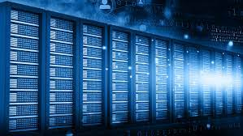
What is Cloud Computing?
Compute powers the processing and execution of tasks
Networking facilitates the communication and transfer of data between devices
Storage enables the retention and retrieval of data at various stages
The on-demand delivery of computer system resources, without direct, active management over the internet. Typically in a pay-as-you-go pricing model.
Using someone else’s computing resources over the internet!
Notes:
So, what is Cloud Computing? It is the delivery of services over a network. Being able to consume those services, whenever or on-demand, in a usage-based pricing model.
<click>
It is a technology that allows users to access and use computing resources, such as servers, <<click>> networking, <<click>> storage, databases, and software over the internet.
<click>
Instead of owning and maintaining physical hardware or infrastructure, users can leverage services provided by cloud service providers on a pay-as-you-go basis. This model offers flexibility, scalability, and cost-effectiveness, enabling individuals and businesses to deploy and manage applications and data without the need for significant upfront investments in hardware and IT infrastructure.
Cloud computing services can be categorized into Infrastructure as a Service (IaaS), Platform as a Service (PaaS), and Software as a Service (SaaS), each providing different levels of abstraction and management control.

Slide 5
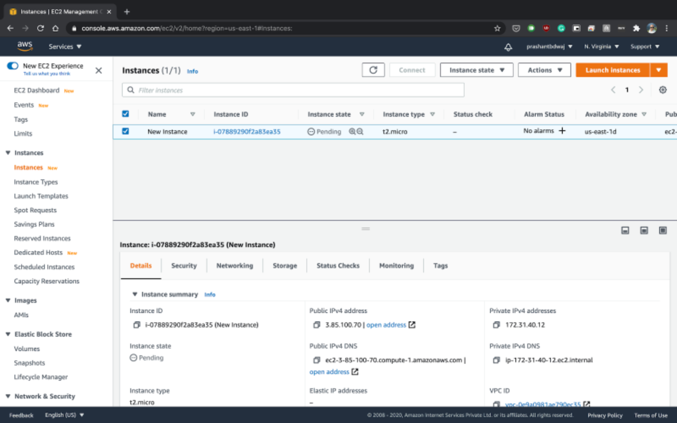
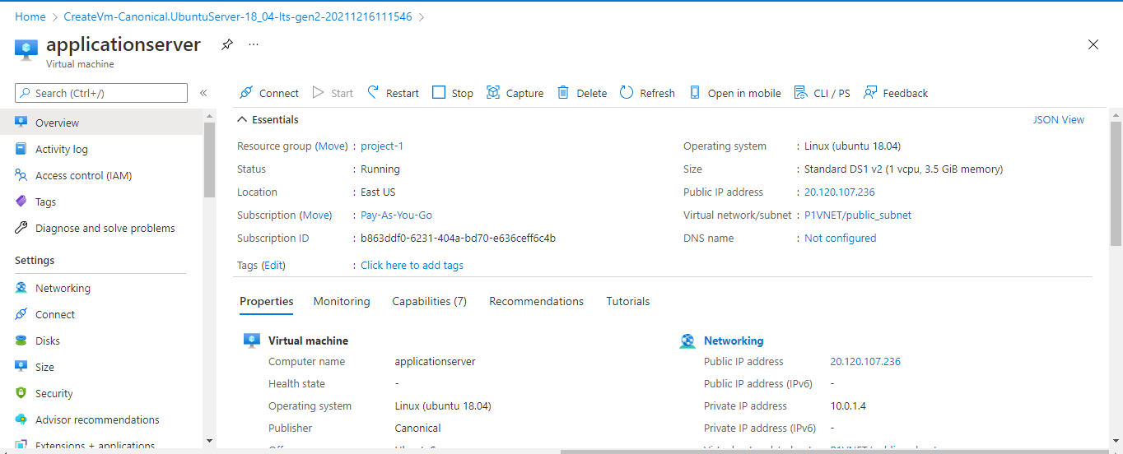
Virtual Machines
EC2
Virtual Machines
Azure VMs
Notes:
Virtualization in the cloud lets multiple users run their own virtual computers on the same physical hardware, so they can use the cloud resources as if they were dedicated to them, even though they're sharing them with others.
Cloud providers may present the service in different ways via the web console, but concepts are similar. For example, both providers have the same attributes - IP, tag, location, status, network, subnet, etc.

Slide 6
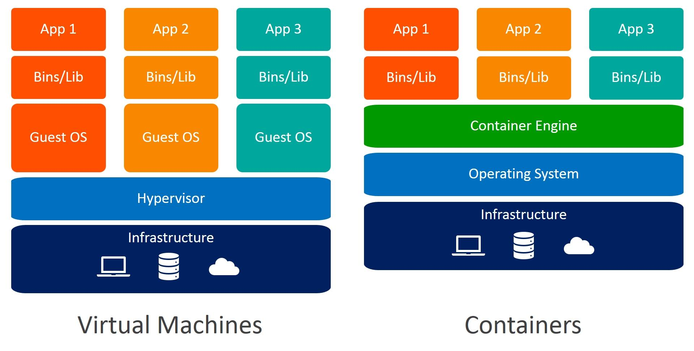
VMs and Containers
Notes:
Virtual Machines
A virtual machine is a digital copy of a physical machine. You can have multiple virtual machines with their own individual operating systems running on the same host operating system. In addition you can create a virtual machine that contains everything required to run your application. The physical computer is called the host computer and the virtual machine is called the guest.
- Purpose: Historically, virtual machine technology was developed to efficiently use increasing physical hardware capacity and processing power. Running a single application environment on a single physical server underutilized hardware resources. Virtual machines allow organizations to install multiple operating systems and create multiple environments on the same physical machine.
Containers
A container is a software code package containing an application’s code, its libraries, and other dependencies. Containerization makes your applications portable so that the same code can run on any device. Containers virtualize the operating system so the application can run independently on any platform.
Purpose: Containers were created to package and run applications in a predictable and repeatable way across multiple environments. Instead of recreating the environment, you packaged the application to run on all types of physical or virtual environments.
Choosing
Virtual machines are full-stack systems and can be laborious to build and regenerate. Any modifications are time-consuming to validate as you have to regenerate the environment. Virtual machines take up more storage space and require you to provision more hardware in your on-premises data centers. Switching to cloud instances reduces costs but migrating your entire environment brings its own challenges.
Containers are a better choice if you want to build, test, and release new features frequently. As they only include high-level software, they are very fast to modify and iterate on. Containers take up less space and are easier to scale. More importantly, containers provide granular control on application scalability by allowing you to use microservices.
References:
https://www.weave.works/blog/a-practical-guide-to-choosing-between-docker-containers-and-vms

Slide 7
Containers & Virtual Machines
Characteristic | Container | Virtual Machine
What is it? | Docker is a software platform to create and run containers. A container is an emulation of a user-space instance, the part of the OS where user processes run. | Emulation of a physical machine running an operating system.
Virtualization | Container abstracts operating system details from the application code – virtualizes the OS | Abstracts hardware details from application, encapsulating the operating system, all software, and multiple applications
Resource Sizing | Size in terms of MB | Size in terms of GB
Managed by | Container engine coordinates with underlying operating system for resources | Hypervisor coordinates between the machine’s physical hardware and virtual machine.
Architecture | Shares resources with the underlying host kernel; less control of environment outside container | Runs its own kernel and operating system; more control over entire environment
Control & Flexibility | Highly scalable with granular scalability with microservices; more flexible, quick migration between environments | Scale can be costly; less flexibility, migration challenges

Slide 8
Containers & Virtual Machines – When to use
Containers
Virtual Machines
Lightweight resource requirements or a microservice architecture
A distributed physical infrastructure environment, including cloud-based servers
Rapid deployment cycles (Dockerfiles are easier to manage than VM configurations)
A rapid scalability requirement
Operating system-specific dependencies
Substantial hardware resource requirements
A need to set various controls in operating systems
Legacy applications that no longer run on modern operating systems
Different operating system requirements with a single underlying physical infrastructure available

Slide 9
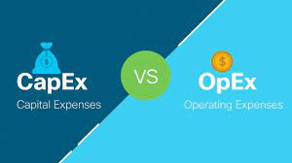
Cloud Computing and CapEx vs. OpEx
Capital Expenditure (CapEx)
Up-front payment on physical resources
Resources are owned
Value of resources depreciate over time
Ongoing costs hidden
Operational Expenditure (OpEx)
Spend on products and services as needed, or pay-as-you-go
No resource ownership
Billed immediately
Transparent costs
Notes:
OpEx is a common business case for cloud computing. CFO may be even more interested than CIO and CTO.
SWOT – Strengths, Weaknesses, Opportunities, Threats
Strength - increases

Slide 10
Benefits of Cloud Computing
Scalability
Scale infrastructure up or down based on demand
Cost Efficiency
No upfront capital expense or physical hardware
Accessibility
Access from anywhere with an internet connection
Reliability and Redundancy
Reduced risk of data loss and downtime through high levels of reliability through data replication and redundancy.
Security
Physically secured infrastructure and compliance certifications
Innovation
Wide range of tools and services allowing rapid business innovation
Global Reach
Worldwide, global reach, with multiple data centers
Flexible cost optimization supporting fluctuating business workloads
Pay for what you use, on-demand
Enable remote work, collaboration, and data access
Often better than individual organizations
Avoid ground-up builds
Easy expansion and global presence
Notes:
Cloud computing emerged as a response to the limitations of traditional on-premises infrastructure. It offers cost-efficiency, scalability, accessibility, and a wide array of services that empower businesses and individuals to harness the power of computing without the need for extensive upfront investments in hardware and infrastructure. This has led to the widespread adoption of cloud computing across various industries and use cases.

Slide 11
Cloud Service Models
Public Cloud : A model where a service provider makes resources, such as applications and storage, available to the general public over the internet
Private Cloud : A set of cloud computing services enabled in an internal data center of an organization
Hybrid Cloud : Any combination of Public, Private & Community.
E.g. - any cloud (one or more) along with any static in-house data center (one or more) are integrated
Notes:
Public cloud
A third-party cloud service provider manages the underlying computing resources. The provider is responsible for resource maintenance and guarantees availability, reliability, and security through service-level agreements. You don’t buy, own, and maintain physical data centers and servers; instead, you access technology services on an as-needed basis. In addition, several tasks, such as runtime resource scaling, are automated for operational efficiency.
Private cloud compared to public cloud
It is almost impossible to replicate public cloud infrastructure privately. You get significantly more breadth and depth of services from a public cloud provider because it is fully dedicated to scaling and improving its offerings. You also get more innovation, access to a global community, and proven operational expertise.
Private Cloud – Organizations kept hardware in their internal on-premises data centers and co-location facilities to support their IT operations. After AWS was launched, companies attempted to replicate the cloud computing model on their internal infrastructure. The term private cloud was introduced to distinguish between these internal cloud environments and third-party, public cloud services provided by organizations such as AWS.
Types of Private Cloud:
On-premises private cloud - You can deploy on your own resources in an internal data center. You must purchase the resources, maintain and upgrade them, and ensure security. On-premises private cloud management is expensive and requires heavy initial investment and ongoing expenses.
Managed private cloud - A single-tenant environment fully managed by a third party. For example, the IT infrastructure for your organization could be purchased and maintained by a third-party organization in its data center. The third party provides maintenance, upgrades, support, and remote management of your private cloud resources. While managed private clouds are expensive, they are more convenient than on-premises solutions.
Virtual private cloud - A private cloud that you can deploy within a public cloud infrastructure. It is a secure, isolated environment where private cloud users can run code, host websites, store data, and perform other tasks that require a traditional data center. Virtual private clouds efficiently give you the convenience and scalability of public cloud computing resources along with additional control and security.
Hybrid cloud
A hybrid cloud is an IT infrastructure design that seamlessly integrates a company's public and private clouds. As a result, you can store your data and run your applications across multiple environments without noticing a difference. Your hybrid cloud environment consolidates your infrastructure, so that you can provision, scale, and centrally manage all your compute resources.
Private cloud compared to hybrid cloud
Hybrid cloud services extend your private cloud computing model into the public cloud. For example, your private cloud applications can access public cloud resources when there is a spike in traffic that your data center cannot handle. You can also use hybrid cloud computing services to transition smoothly from private cloud environments to public clouds.

Slide 12
Managed Services
Managed cloud services are services that offer partial or complete management of a client’s cloud resources or infrastructure.
Provides out-of-the-box solutions for multiple use-cases.
Multiple configurations and pricing models are available so that you can select the one which is the best fit for your use-case.

Slide 13
Cloud Deployment Models
Infrastructure as a Service(IaaS) :A cloud computing service where enterprises rent or lease servers for compute and storage in the cloud.
Platform as a Service (PaaS) : A cloud computing model where a third-party provider delivers hardware and software tools to users over the internet.
Software as a Service (SaaS) : A method of software delivery and licensing in which software is accessed online via a subscription, rather than bought and installed on an individual computer
Container as a Service (CaaS) : Containers as a service ( CaaS ) is a cloud-based service that allows software developers and IT departments to upload, organize, run, scale, and manage containers by using container-based virtualization.
Serverless Deployment : Serverless is a cloud-native development model that allows developers to build and run applications without having to manage servers. There are still servers in serverless, but they are abstracted away from app development
Notes:
SPIDERS: SasS, PaaS, IaaS, bigData, Elastic, Resilient, Subscription
On-premises: If you decide to build your house from scratch, you do everything yourself. You’ll need to source the raw materials and tools, put everything together, and run to the store every time you need anything. This is similar to running an application on-premises, where you own everything from the hardware to your applications and scaling.
Infrastructure as a service: If you are busy, you might consider hiring a contractor to do the work. You tell them how you want the house to look and how many rooms you want, and they take the instructions and build your home. IaaS works in a similar way for your applications. You rent the hardware to run your application on, but you are responsible for managing the OS, runtime, scale, and all the data.
Containers as a service: If buying a home is just too much work due to the maintenance it comes with, you can choose to rent instead. The basic utilities are included, but you bring your own furniture and make the space yours. With containers, you can bring a containerized application, so you don't have to worry about the underlying operating system but still have control over scale and runtime.
Platform as a service: If you don’t want to worry about furnishing your living space, you can rent a furnished house. PaaS lets you bring your own code and deploy it but leaves the server management and scaling up to the cloud provider.
Function as a service: If you just need a small dedicated place to work away from your home, you can rent a desk in a coworking workspace. Similarly, FaaS allows you to build and deploy a small piece of code, or a function, that performs a specific task. The cloud provider adds scale if needed when a function executes.
Software as a service: Now, imagine you move into a finished house (rented or purchased), but you have to pay for upkeep, such as cleaning or lawn care. SaaS is the same—you pay to use a complete application for a specific purpose that is managed, maintained, and secured by the cloud provider, but you are responsible for taking care of your own data.

Slide 14
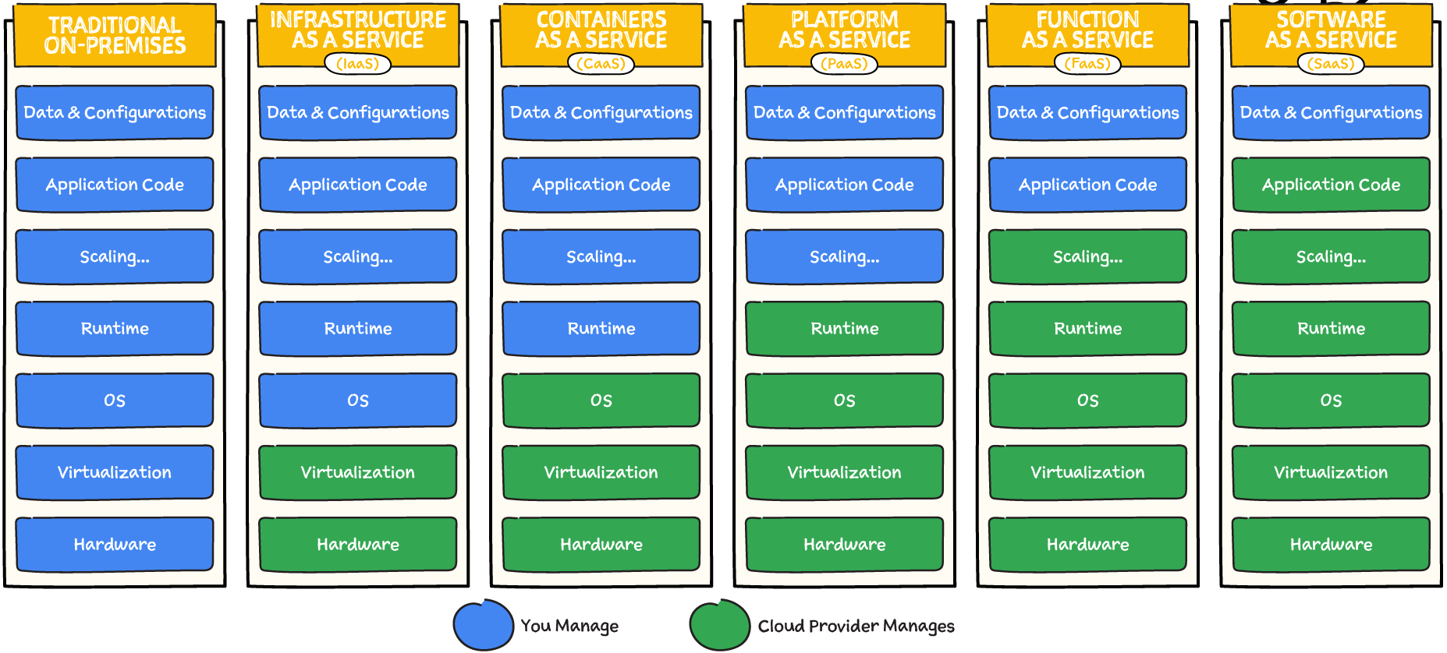
Notes:
Please explain the On-Prem elements briefly (this is IMP, learners always ask) then compare to Cloud
Runtime can be a little difficult to grasp for folks
The runtime environment ensures that the software can utilize system resources effectively and provides an execution environment that is consistent across different platforms
The runtime provides an abstraction layer between the application and the underlying hardware and operating system.
It encompasses the libraries, frameworks, and other components required to run and manage the execution of the software.

Slide 15
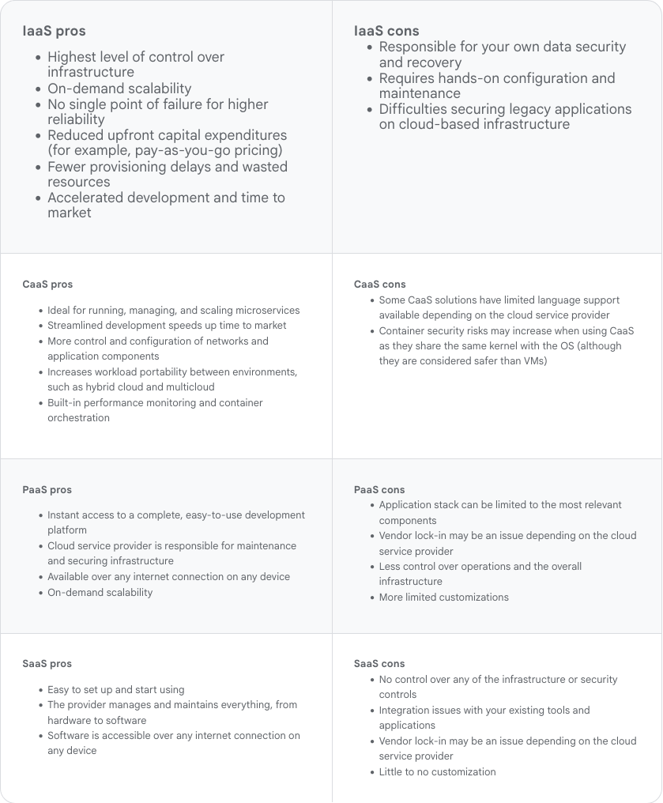

Slide 16
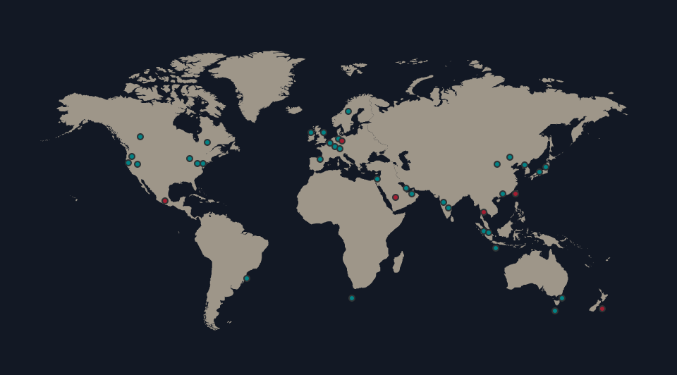
AWS Global Infrastructure Map
Notes:
34 launched regions
108 availability zones
600+ Points of Presence (POPs) - CloudFront
13 regional edge caches (CloudFront)
200+ services
Region: Independent geographic area
Availability Zone: multiple isolated locations or data centers within a region
Edge Locations: Locations with caching devices near populated areas. May be a rack or more in a shared location, not necessarily a large data center.
Point of Presence (POP): Physical location where two or more networks or communication devices build a connection from one place to the rest of the internet. It's essentially a junction point where different networks intersect
Reference:
- https://aws.amazon.com/about-aws/global-infrastructure/

Slide 17
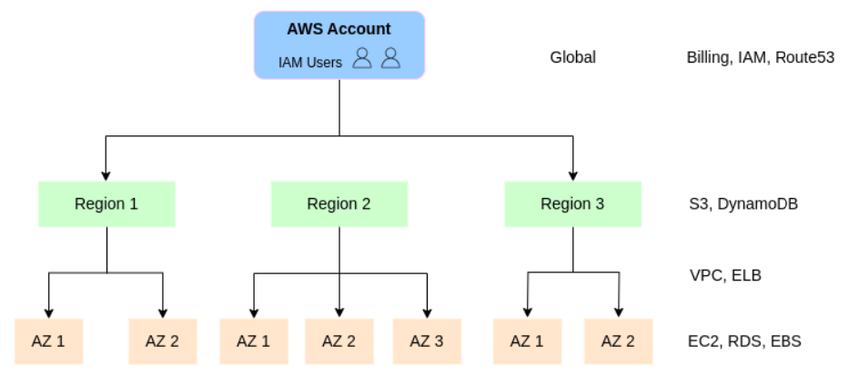

Slide 18
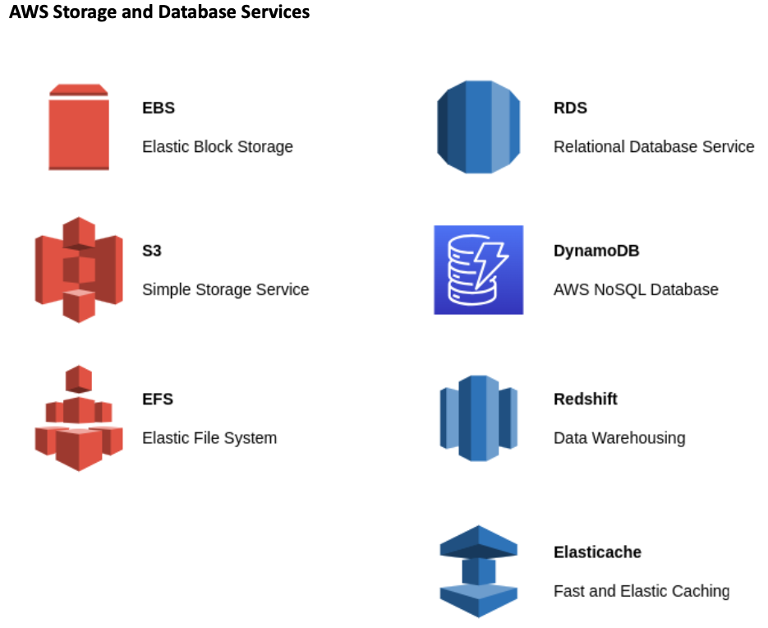
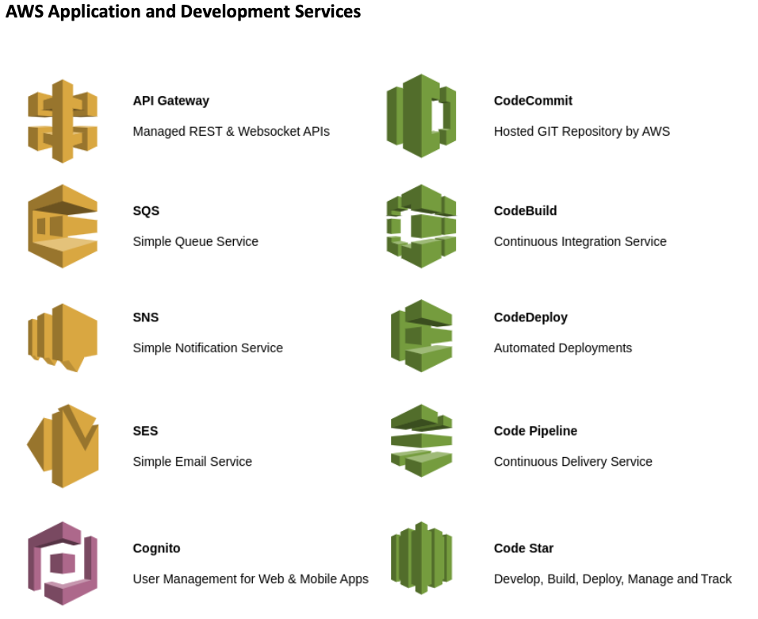
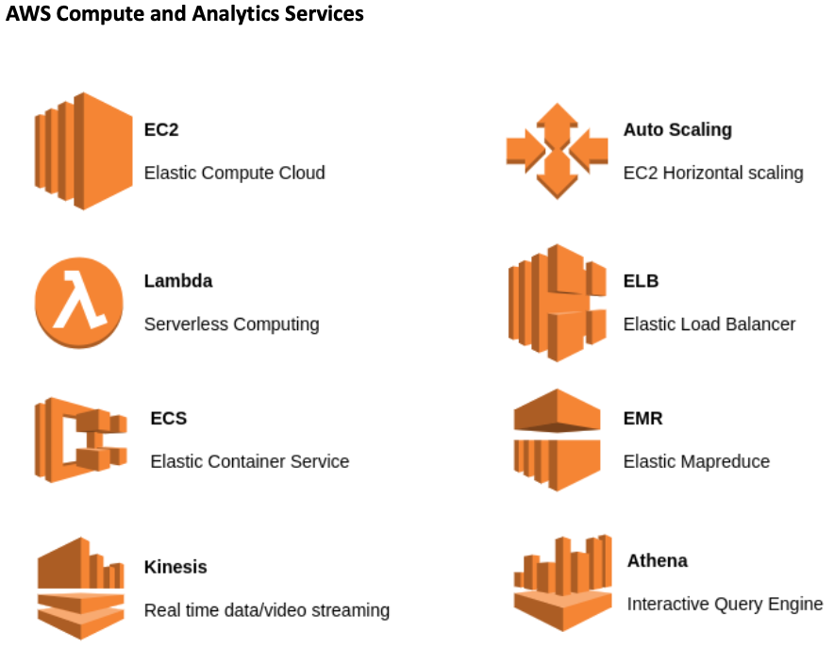
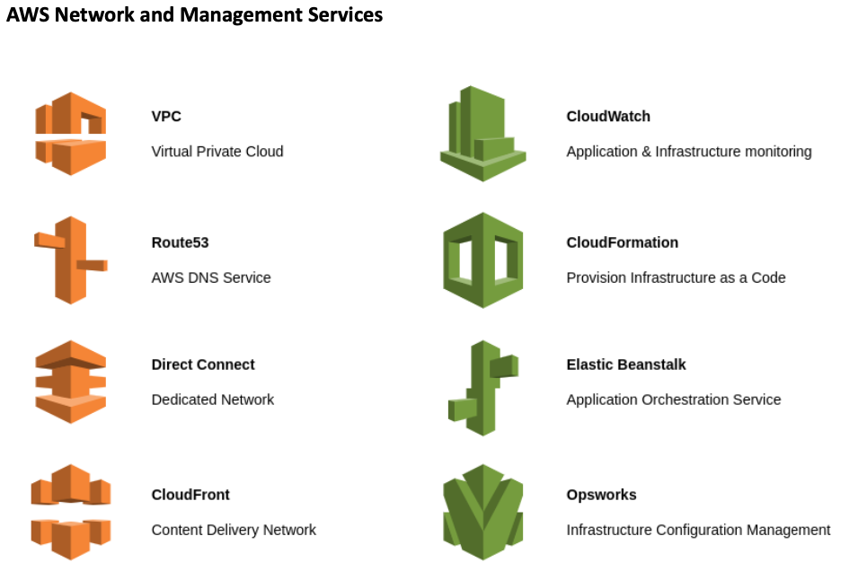
Type of Services

Slide 19

Guided Launch
And
Q&A

Slide 20
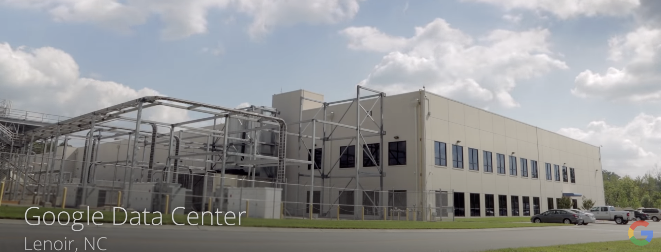
The cloud is actually physical….
Explore a Google Data Center:
https://www.youtube.com/watch?v=avP5d16wEp0
Inside Amazon’s Massive Data Center:
https://www.youtube.com/watch?v=q6WlzHLxNKI

Slide 21
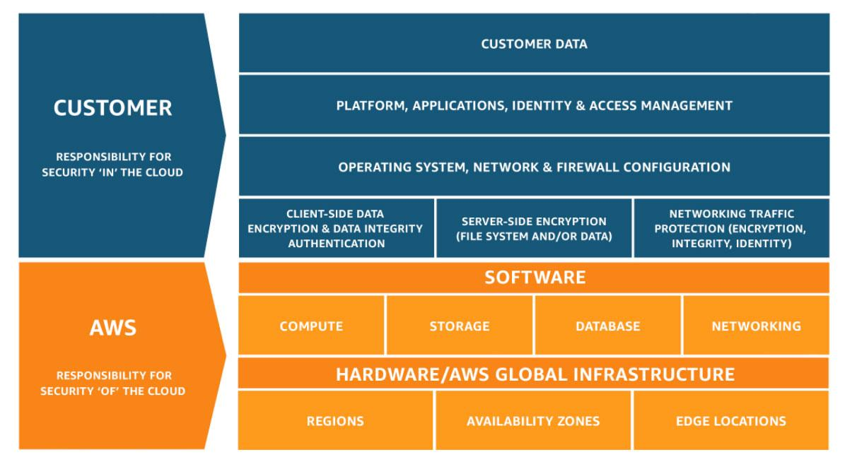
Shared Responsibility Model
Notes:
References:
https://aws.amazon.com/compliance/shared-responsibility-model/

Slide 22
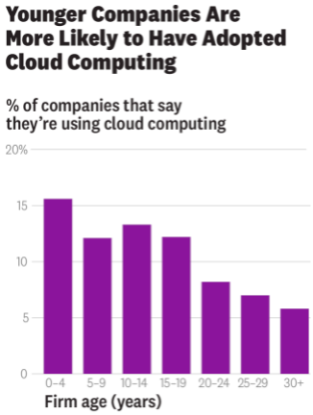
Research: Cloud Computing Is Helping Smaller, Newer Firms Compete
KenSci is a small Seattle-based healthcare analytics company, which uses machine learning techniques to analyze hundreds of variables about patients’ conditions to provide real-time predictions
Pivothead is a firm with 25 employees producing wearable technologies to help the blind and visually impaired
These anecdotes suggest that cloud computing has “democratized computing” by bringing it to the masses of firms.
“In this paper we use the records from more than 150,000 U.S. firms with information on their adoption of cloud computing.” (as on 2016)
  Less than 0.5% of firms had adopted it in 2010, whereas 7% had by 2016, which is an annualized growth rate of almost 50%.
  Firms with fewer than 25 employees have adoption rates of 10% to 15% on average
  Although we don’t have data on how cloud computing affects firm performance, it’s not hard to imagine that lowering computing costs would substantially improve younger and smaller companies’ chances
2020+ question has changed - “Why do we need cloud?” to “Why we don’t need cloud?”
Notes:
Harvard Business Review - “Research: Cloud Computing Is Helping Smaller, Newer Firms Compete” https://hbr.org/2018/08/research-cloud-computing-is-helping-smaller-newer-firms-compete
You know cloud is not just a big boys game! The corporations with deep pockets! Not at all! What you and I have as individuals is the SAME as that of GE, Unilever, you name it!
Remember on thing though - is cloud the differentiator? NO, it provides the tools which can be used to create that “differentiator” quickly, and to fail fast so that you can pivot quickly !
Notes:
Benefits across industries or organization types (startup or traditional)
Key Takeaways:
Low cost of entry due to usage based pricing
startups mostly leveraging to become profitable, but also legacy/traditional to reduce operating costs and become more nimble
Agility, being immediately able to create applications and become productive (day 1)
here again, startups can quickly launch services and compete, but also legacy/traditional enterprises must become more nimble to compete with startups!
being able to build an app in a few hours to days (depending) or launch a product in even 20 days (depending)
References:
Monzo (UK bank), finacial services
8 engineers manage infrastructure for 4+ million customers
real-time statements instead of typical 48 hours or more
also migrated to multi-account setup in less than a day
Robinhood (US financial services)
2 DevOps engineers

Slide 23

The Everywhere Enterprise
From an IT planner perspective, the primary difference between cloud and data center infrastructures revolves around how you deliver a given workload to your business. A simplified view is that data centers own the physical infrastructure and deliver business value via that infrastructure.
In some cases, cloud computing could be an ideal solution; In other cases, on-premises computing may be the best solution
Gartner clients consistently tell us that the real benefits of cloud computing are enterprise agility — or developing and deploying workloads quickly
Gartner predicts that by 2025, 85% of infrastructure strategies will integrate on-premises, colocation, cloud and edge delivery options, compared with 20% in 2020.
IT leaders today are dealing with competing objectives: to keep the lights on — running mission-critical applications while protecting the business from outages — and to enable the business to react to market changes quickly and adopt new technologies or services when they need them (not necessarily when IT is ready or has the cash to spend on them)
Notes:
Gartner - “The everywhere enterprise” https://www.gartner.com/en/conferences/hub/cloud-conferences/insights/swg-the-everywhere-enterprise-a-gartner-qa-with-david-cappuccio
Q: Have you noticed a common theme in all these case studies - “Doing something FAST, be agile & not fragile :)”
Another important point - Historically enterprises that were restricted by the complexity of data center ops worldwide have broken free! Indeed it is now a level playing field.
Notes:
cloud and DC difference is about delivery, the how (including financing going from CapEx to OpEx)
enterprises are moving to a hybrid approach, where it makes sense
having deployment options (cloud or DC, edge/pop, regions) is "everywhere enterprise"
** Key takeaways:**
multiple options for enterprises such as regional expansions, and growth, DC or cloud
cloud enabled scale and focus on value add activities
cloud also has its own challenges and cautions!
the usual: security, latency, networking, configurations
people, processes and procedures are the most common challenges. Need to think different and make some changes!
References:
HBO Max global rollout across 30 markets using event-driven architecture
services 70+ million global customers
Comcast uses hybrid environment to deploy Xfinity X1 features several times a week instead of once every 12-18 months (from previous architecture)

Slide 24
How Cloud Computing Is Changing Management
Theories and practices of management often spring from the opportunities created by new technologies. Interchangeable parts spurred ideas about structuring assembly lines and logistics.
The complex calculations of the field known as Operations Research were enabled by mainframe computing.
Client-server technology begat enterprise resource planning systems, and the consequent system-wide visibility that was required for what we call business process management (BPM).
That makes it imperative to start thinking about how management will be changed by the most impactful information technology of our time: cloud computing.
History suggests that the main way information technology changes management is through changes in how information is gathered
  eg BPM reflected the interactions of different stakeholders, from product creation through supply chain to final assembly
Notes:
Harvard Business Review - “How Cloud Computing Is Changing Management” https://hbr.org/2018/02/how-cloud-computing-is-changing-management
The likely outcomes of the move to cloud include changing how products are designed; where we can experience closer collaboration between IT and other business units, including sales, finance and forecasting; and more customer interaction, even to a point of jointly developing products with their consumers. In particular, new ways of writing and deploying software will encourage new types of faster-acting organizational designs.
And this is a big one - historically IT has been looked at as a cost center (INTERNAL: describe what a cost center is), now there is a distinct shift where IT is generating business again by providing the tools that is allowing the business to grow and innovate at an unprecidented velocity! Revenue transfer to cloud teams/business unit is a reality.
The shift to “cloud native” organizations - “Cloud native” software approaches stresses ease of use and low-impact alteration of components of any given software application. Massive applications are subdivided into a series of “microservices” that can be tweaked with little effect on a running piece of software.
I have to say this - “IT seems to be not just supporting the business but is helping defining it as well”! Well this is good for us!
Notes:
Shift to "product" centric thinking which combines business units (and customers!) to jointly develop customer services, and plan for the entire product lifecycle and ongoing financing
a "project" based thinking approach uses defined timeperiod for launches, and features, defined or separate teams (""throw-over the wall" to operations), and struggles with IT financing
Agile, or incremental approach to services and updates (low-impact and shortened feedback loop approach to testing)
Cloud first and cloud native thinking
Microservices (one example) for reduced blast radius, and incremental changes
Shorter feedback loop
Key Takeaways:
Focus on product and service, not just single aspect or business unit
IT as value enabler, not cost center
Data driven approach to features and changes
Smaller, more rapid incremental changes
Shifting to ""cloud native", which is using cloud services first (reduce and eliminate non-differentiated activites allowing focus on core business).
References:
3M Health and Information Systems (healthcare) went all in on AWS.
not an IT company, allowed focus of R&D on healthcare analytics
apps are glue between patients, healthcare providers, and payers
benefits?
reduced provisioning time from 10+ weeks to minutes allowing focus on other areas
allow massive scale to support spike in customer demands for large data processing requests
faster innovation, with deployments down to weekly instead of 6 weeks

Slide 25
Set Up Your Organization for cloud
A cloud center of excellence is the best-practice approach to drive cloud-enabled transformation.
  How do we develop and enforce organization-wide cloud computing policies in a way that allows us to be flexible, without exposing us to unacceptable levels of organizational risk?
  How do we guide our internal users in selecting the right cloud providers to find the best fit and manage vendor-related risk?
  How do we manage and mitigate security and regulatory compliance risks while ensuring confidentiality, integrity and availability?
  How do we govern our costs and forecast our future costs?
  How do we get “smarter about cloud” and make our organization aware of best practices, and keep up with the rate of change introduced by cloud providers?
  How can we drive cloud-enabled transformation across the business and help our stakeholders think through the business possibilities enabled by cloud?
CCOE has three core pillars
  Governance: Create policies in collaboration with a cross-functional team and select governance tools to provide financial and risk management.
  Brokerage: Assist users in selecting cloud providers, architect the cloud solution(s) and collaborate with the sourcing team for contract negotiation and vendor management.
  Community: Raise the level of cloud knowledge in the organization and capture and disseminate best practices through a knowledge base, source code repository, training events, outreach throughout the organization, and more.
Notes:
Gartner - “Setup your organization for cloud adoption success” https://www.gartner.com/en/conferences/hub/cloud-conferences/insights/how-to-build-a-cloud-center-of-excellence
“Enterprise architecture” was and “is” all about business and less about tech. Do you think there is a stark similarity of the enterprise architecture charter with CCOE?
It is also about “Citizen driven development”, give the power at the hands of the grass root foot soldiers, you know like you and me, the people who deliver stuff for our customers. We know what it takes, we know what the problems and how to tackle them. All this knowledge was bottled up, now with democratized tech, we can be product creators! Creators of reusable assets, define best practices, define automation, limitless possibilities! Isn’t it?
Notes:
need right skills and organizational structure
Will not be as successful (successful) if conforming to old norms, practices, and organization structures
Key takeways:
Adopt Cloud Center of Excellence (CCoE) to drive practices, provide guidance and oversight and drive innovation
build up knowledge communities and develop skills
lunch and learn, developer forums, etc.
Develop policies, patterns and blueprints, but let teams innovate for their particular use case

Slide 26
Capturing the value of the cloud
It has been more than a decade since the first corporate experiments with external cloud platforms, and the verdict is long in on their business value. Companies that adopt the cloud well bring new capabilities to market more quickly, innovate more easily, and scale more efficiently—while also reducing technology risk.
Unfortunately, the verdict is still out on what constitutes a successful cloud implementation to actually capture that value.
Defining the cloud opportunity too narrowly with siloed business initiatives, such as next-generation application hosting or data platforms, almost guarantees failure
Companies that reap value from cloud platforms treat their adoption as a business-technology transformation
Twenty years ago, a single small application might run on a $25,000 server. Today, a similar-size application might run on a $5,000 server shared with ten other applications.
Notes:
Reference - https://www.mckinsey.com/business-functions/mckinsey-digital/our-insights/how-cios-and-ctos-can-accelerate-digital-transformations-through-cloud-platforms

Slide 27
Capturing the value of the cloud
These realities have led an overwhelming majority of large institutions to experience one or more of the following failure modes:
  Pilot stall: Companies have succeeded in implementing a few greenfield applications on public-cloud platforms, but the value derived from these programs has been limited. This makes further progress impossible because tech leaders cannot make a convincing business case to extend the use of the cloud platform into the heart of IT’s technology environment.
  Cloud gridlock: Cloud initiatives become jammed up in long queues because IT cannot build out the automation or reference architectures required to use public-cloud-platform services in a secure, resilient, and compliant fashion.
  No value from “lift and shift”: The migration of significant portions of the technology environment—largely by replacing on-premises virtual machines with off-premises ones without taking advantage of cloud-optimization levers—has failed to significantly reduce costs or increase flexibility. Support for cloud initiatives subsequently collapses.
  Cloud chaos: Tech leadership does not have an aligned vision and does not provide the required guidance or management oversight, leaving developers largely to their own devices in configuring cloud services. This leads to very divergent approaches and tooling with significant security, resiliency, and compliance risks.
Alright, what about technical challanges ...
Notes:
Reference - https://www.mckinsey.com/business-functions/mckinsey-digital/our-insights/how-cios-and-ctos-can-accelerate-digital-transformations-through-cloud-platforms

Slide 28
Capturing the value of the cloud
Outdated technology environments make change expensive.
Rigid and brittle infrastructures choke on the data required for sophisticated analytics.
Decisions about cloud architecture and sourcing carry significant risk and cost implications—to the tune of hundreds of millions of dollars for large companies.
Success requires CIOs and tech leaders to do three things.
  Focus cloud investments in business domains where cloud platforms can enable increased revenues and improved margins
  Select a technology, sourcing, and migration model that aligns with economic and risk constraints
  Change operating models to capture cloud value
Notes:
Reference - https://www.mckinsey.com/business-functions/mckinsey-digital/our-insights/how-cios-and-ctos-can-accelerate-digital-transformations-through-cloud-platforms

