Slide 1
AWS Managed Services
CloudWatch, Kinesis, Cloud Architecture

Slide 2
AWS Managed Services - Advantages
Eliminate operation overhead
No change management*
No infrastructure
Agility
Scalability
Availability
Redundancy
Security
Cost
Notes:
- Change Management can/will be used for some managed services where updates are user controlled. For example, RDS major upgrades, or minor updates.

Slide 3
AWS Managed Services – Maybe Not?
Not fit for specific use case
Too vendor specific, need hybrid
Existing investments
Expire current licenses
Notes:
- Not fit for specific use case example is RDS, where specific OS extensions are needed, and not supported by Managed Service, such as RDS.
- Expire current licenses will possible mean missed features, and continued ops overhead (if not outsourced)

Slide 4
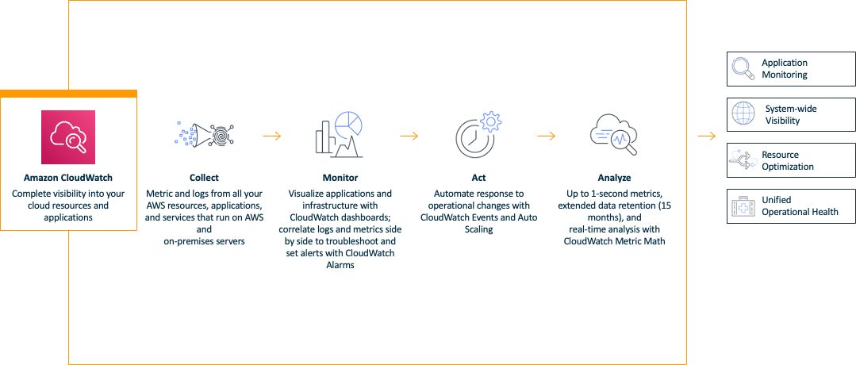
CloudWatch
Notes:
CloudWatch collects monitoring and operational data in the form of logs, metrics, and events, and visualizes it using automated dashboards so you can get a unified view of your AWS resources, applications, and services that run in AWS and on-premises.
You can correlate your metrics and logs to better understand the health and performance of your resources.
You can also create alarms based on metric value thresholds you specify, or that can watch for anomalous metric behavior based on machine learning algorithms.
To take action quickly, you can set up automated actions to notify you if an alarm is triggered and automatically start auto scaling, for example, to help reduce mean-time-to-resolution.
You can also dive deep and analyze your metrics, logs, and traces, to better understand how to improve application performance.

Slide 5
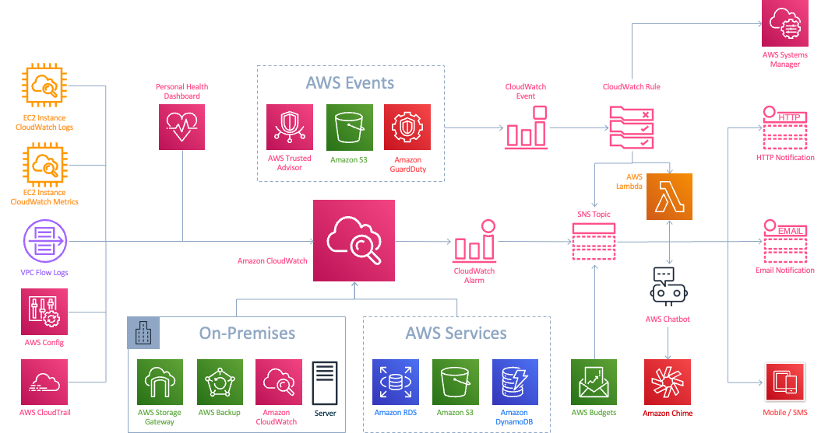
CloudWatch Integration
Notes:
CloudWatch collects logs and metrics from:
•EC2 Instances
•On-Premises Servers
•VPC Flow Logs
•Config
•CloudTrail
•Personal Health Dashboard
•More than 70 AWS Services
CloudWatch can respond to changes in your environment with CloudWatch Events
Alarms and Rules can be used to trigger notifications or automations.
Examples:
An alarm can trigger a Lambda Function to start an automated runbook in Systems Manager.
An alarm can trigger a notification to Amazon Chime or Slack (where CLI commands can be run)
An alarm can simply trigger a notification or integrate with a third party paging application
An event can create an Ops Item in Systems Manager

Slide 6
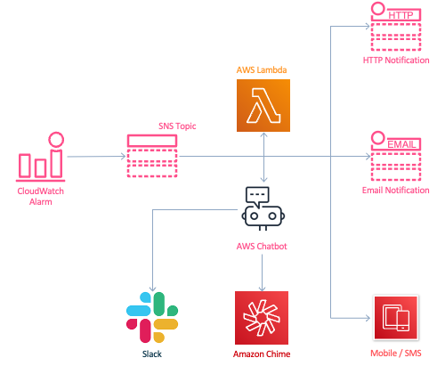
Acting - Automation
CloudWatch Alarms can send a notification to SNS, from there, you can trigger a Lambda function or push a message to Slack or Amazon Chime via AWS Chatbot. This allows you to do almost anything, including:
Trigger a Systems Manager Automation
Resize an instance
Send a message to Chime or Slack
Respond with CLI commands
Invoke disaster recovery
Update security groups
Automate deployments
Instigate backups and snapshots
Responding to security events

Slide 7
Automation
CloudWatch Alarms can send a notification to SNS, from there, you can trigger a Lambda function or push a message to Slack or Amazon Chime via AWS Chatbot. This allows you to do almost anything, including:
•Trigger a Systems Manager Automation
•Resize an instance
•Send a message to Chime or Slack
•Respond with CLI commands
•Invoke disaster recovery
•Update security groups
•Automate deployments
•Instigate backups and snapshots
•Responding to security events
•
•
•
•

Slide 8
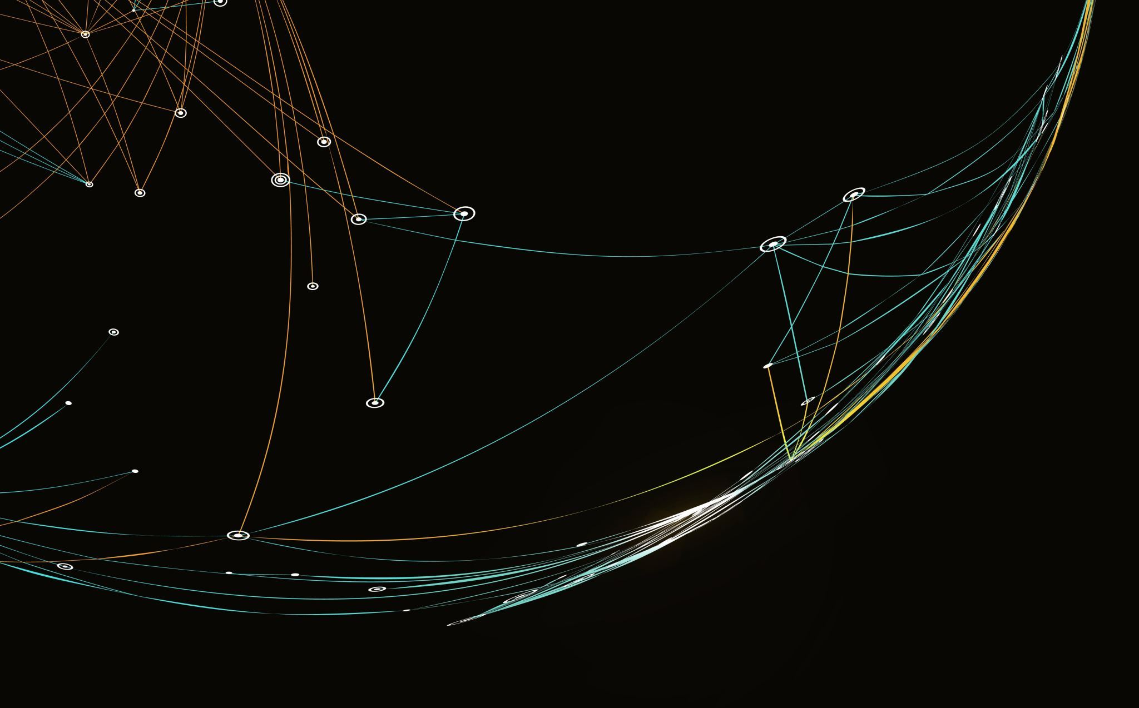
Amazon Kinesis
A massively scalable and durable real-time data streaming and processing service

Slide 9
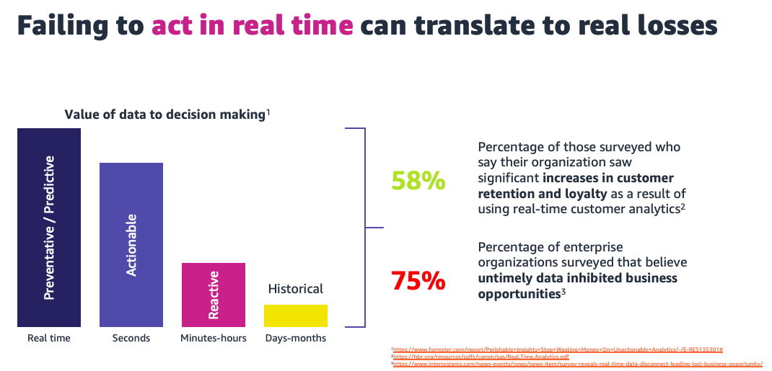
Notes:
According to Forrester, insights from data are perishable and can lose value quickly
Stream processing allows analytical insights to be gathered and acted upon instantly.
Batch processing data doesn’t allow for real-time risk mitigation or customer authentication. And the customer experience can be ruined - and is hard to recover - if action isn’t taken in real time.
Acting on real-time data can help prevent fraud and increase customer loyalty. Untimely data, on the other hand, can inhibit your firm’s ability to grow.
1.https://www.forrester.com/report/Perishable+Insights+Stop+Wasting+Money+On+Unactionable+Analytics/-/E-RES135301#
2.https://hbr.org/resources/pdfs/comm/sas/Real.Time.Analytics.pdf
3.https://www.intersystems.com/news-events/news/news-item/survey-reveals-real-time-data-disconnect-leading-lost-business-opportunity/
4.https://research.tabbgroup.com/report/v06-007-value-millisecond-finding-optimal-speed-trading-infrastructure
5.https://blog.turbonomic.com/blog/on-turbonomic/cost-of-latency-in-the-data-center-part-1
6.https://info.streaml.io/speed-of-data-survey-report

Slide 10
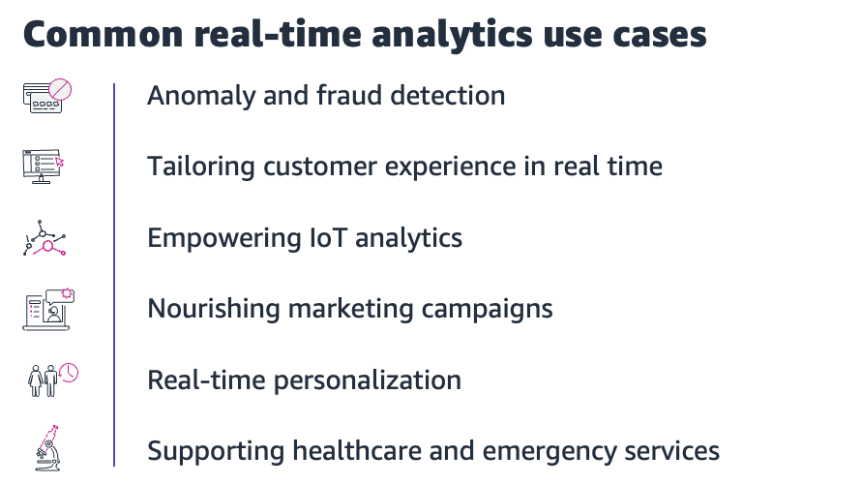
Notes:
Anomaly and Fraud Detection in real-time: Organizations must be able to identify security breaches, network outages or machine failures in real time. In financial services, companies can respond to potential fraudulent credit card transactions or sign-in attempts by joining a real-time activity stream with historic account usage data in real-time.
Tailoring customer experience in real-time: Online businesses continuously push features on their websites to respond to ever changing competition, drive higher sales and enhance customer satisfaction. With the help of real-time streaming analytics, businesses can understand a given feature’s adoption and tailor the pushed feature to drive more traffic in real-time to ensure success.
Empowering IoT Analytics: Industrial and commercial IoT sectors have many use cases that can take advantage of real-time streaming analytics such as manufacturing, oil and gas, transportation, smart cities and smart buildings. Potential use cases range from predicting the failure conditions in a manufacturing process based on the live sensor data to reducing scrap and improving yields to detecting anomalies in an oil rig drilling station.
Predictive Maintenance: In manufacturing and supply chain, the low-hanging fruit is predictive maintenance, enabling servicing with minimal disruption and cost. Beyond the factory, supply chains for spare parts and raw materials can be optimized, as can forward capacity planning, process improvement and quality management.
Nourishing Marketing campaigns: For improved advertising and marketing campaigns, streaming analytics can combine data from multiple sources such as ad inventory, web traffic, click logs and both customer demographic and behavioral data to uncover insights that improve audience targeting, pricing strategies and conversion rates, increase campaign ROI and create new revenue opportunities.
Real-time personalization: A real-time personalization experience results in a meaningful impact on sales. Retail businesses can use real-time streaming analytics to help improve search relevance with a dynamically changing product catalog in terms of price and availability as well as user preferences based on current and past behavior.
Supporting healthcare and emergency services: In clinical healthcare, real-time analytics provides the ability to monitor patient safety, personalize patient results, and assess clinical risk as well as reduce patient readmission that results in improved organizational efficiency and better patient experience. Wearable health device data combined with geospatial data can proactively notify relatives, caregivers or incident commanders for a timely response.

Slide 11
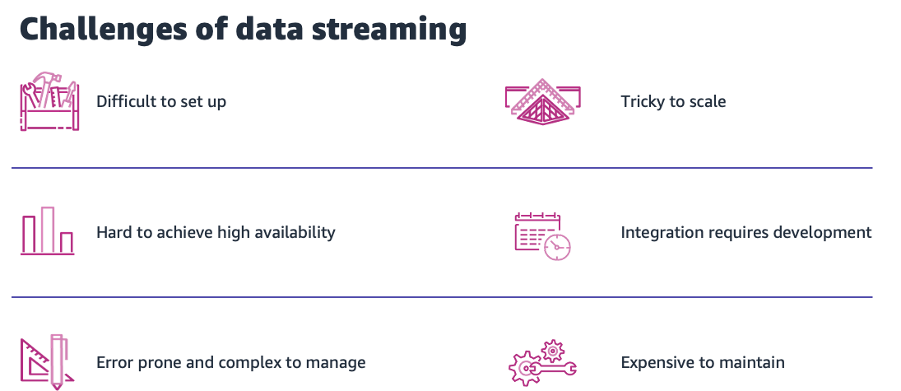

Slide 12
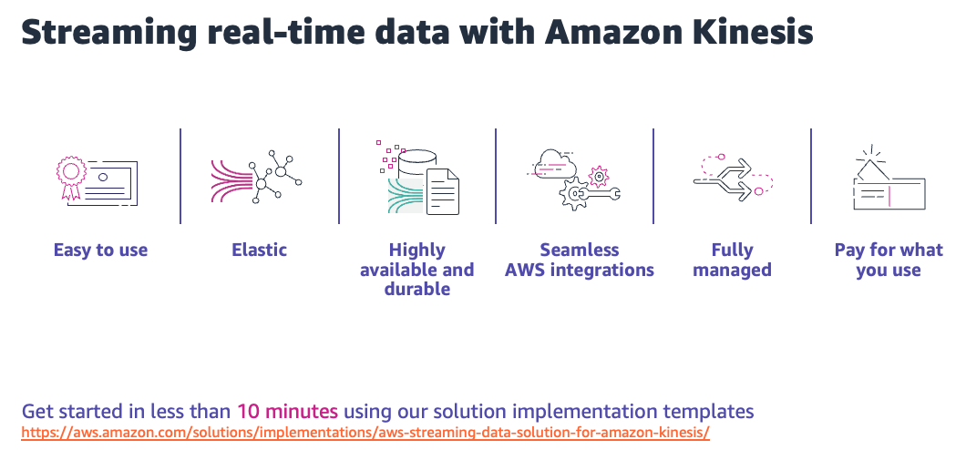

Slide 13
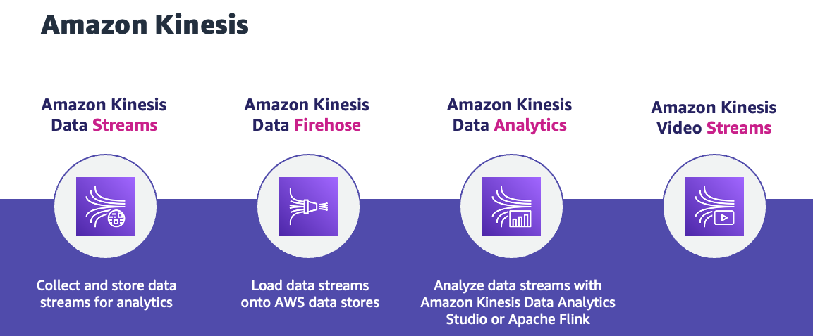

Slide 14

Cloud Architecture
Principles

Slide 15

Cloud Architecture
Design for failure, and nothing fails
Assume everything fails, and design backwards
Plan for different levels of failure modes
Thing through the stabilization process
Build loosely coupled systems
The looser they are coupled, the bigger they scale
Decompose monoliths
Microservice patterns
Implement Elasticity
Do not assume fixed identifiers
Be resilient with reboot, scale-out, scale-in
Scale on demand, and on prediction
Notes:
Assume everything fails, and design backwards
Avoid any and all single points of failure
Fault avoidance:
Multi- AZ
Multi Region
Pilot Light
Have a coherent backup and restore strategy for your data
Think about failure modes, resource, resource group, service, AZ, region.
Applications should continue to function even if the underlying physical hardware fails or is removed or replaced, and if it cannot:
Fail whale
Build process threads that resume on reboot,
Allow the state of the system to re-sync by reloading messages from queues
Keep pre-configured and pre-optimized AMIs to reduce boot time provisioning
Avoid in-memory sessions or stateful user context, move that to data stores.
Think about what happens on recovery?
Thundering Herd - Use exponential retries
Fail back?
The looser they're coupled, the bigger they scale:
Decompose Monoliths:
Break applications into connected tiers along business processes,
Peeling the onion
Use external persistence as a buffer, i.e queueing
Use Microservice patterns
Don’t assume health or fixed IDs, IP address, hostname or location of components
Use designs that are resilient to reboot and re-launch
Enable dynamic configuration management
Proactive scaling
Periodic/Cyclic scaling that occurs at fixed interval (daily, weekly, monthly, quarterly)
Advance warning – event-driven. i.e. major website launch, marketing event
Auto-scaling based on demand.
Application Latency
CPU Utilization
Stickiness
Session preservation
Load Balancing
Responsiveness

Slide 16
Cloud Architecture
Build security in every layer
Design with security in mind (defense in-depth)
Limit the blast radius
Develop a security model
Do not fear constraints
Question constraints
Scale around limitations
"We have always done it this way"
Notes:
Design with Security in mind
Limit the blast radius of misadventures
Scope policies to VPCs
Use VPC Endpoints for compute to access services
Use CloudFormation stack update policies
Your VPC and AWS account topology is your foundation
Security model:
No defaults
Leverage Encryption, KMS key, kms key policy, kms key usage, customer managed keys
Separation of duties
Auditability
Logging
Question constraints
5 whys
Validate requirements
Scale around limitations
You will run into a point where a single service or resource has a constraint eventually, so think tactically
Horizontal only works to a point, vertical scale for peak demand
Better IOPS on a database?
Multiple read-only / sharding / DB clustering , Split read/write
We have always done it this way.
Sometimes you have to solve for people and processes before you can get to the technology

Slide 17
Cloud Architecture
Think parallel, think asynchronous
Event driven (serverless)
Decompose processes and data
Leverage different storage and processing options
Storage: persistent, non-persistent / block, file, object
Processing: edge, streaming
Databases: schema, no schema, time series, data warehouse
Notes:
Event driven architecture
Process images on s3, poll from ec2 no, use object events
CloudWatch Alarms as Events
Strexaming event
API call
Decompose a complex process into its components
Breaking large serial task into many smaller parallel tasks
“Shared nothing” - No state stored on individual instances.
There are many unique use cases, each with their own read/write distribution, protocol and distribution requirements. Each has its own strengths and weaknesses.
Object Storage (S3) Limitless storage of objects with http(s) and can leverage authorization
Persistent Storage (EBS) High performance GP3 (SSD)
In-memory cache (ElastiCache) Clustered in-memory storage
Ephemeral storage (Instance Store) Index/Summary data.
Network Storage (Storage Gateway) iSCSI LUN target available as disk volumes or tape libraries
RDBMS (RDS) Managed SQL database as a service
Constant Throughput (DynamoDB) NoSQL engine with consistent, single-digit millisecond latency at any scale
DataWarehouse (RedShift) Massively parallel SQL data store
Search & Index (CloudSearch) Managed and scalable search solution
CDN (CloudFront) Global distribution of streaming media, objects in S3 and web applications
Streaming Input (Kinesis) Managed real-time processing of large, distributed data streams. Event driven (Lambda) Compute-less execution of code

Slide 18


Slide 19

Bonus Content

Slide 20
Serverless Architecture Principles
Speedy, simple, singular: Functions are concise, short, single purpose and their environment may live up to their request lifecycle. Transactions are efficiently cost aware and thus faster executions are preferred.
Think concurrent requests, not total requests: Serverless applications take advantage of the concurrency model, and trade-offs at the design level are evaluated based on concurrency.
Share nothing: Runtime environment and underlying infrastructure are short-lived, local resources are not guaranteed. State can be manipulated within a state machine execution lifecycle, and persistent storage is preferred for highly durable requirements.
Assume no hardware affinity: Underlying infra will change. Leverage code or dependencies that are hardware-agnostic as CPU flags, for example, may not be available consistently.
Orchestration with state machines, not functions: Chaining Lambda executions within the code to orchestrate the workflow of your application results in a monolithic and tightly coupled application. Instead, use a state machine to orchestrate transactions and communication flows.
Use events to trigger transactions: Events such as writing a new Amazon S3 object or an update to a database allow for transaction execution in response to business functionalities. This asynchronous event behavior is often consumer agnostic and drives just-in-time processing to ensure lean service design.
Design for failures and duplicates: Operations triggered from requests/events must be idempotent as failures can occur and a given request/event can be delivered more than once. Include appropriate retries for downstream calls.

Slide 21
Microservice Decomposition Principles
Ready - The application architecture must be stable. This is a non-negotiable.
QA - A service must be testable, which means knowing what is should do, and how it should perform.
Related – a service should implement a small set of strongly related functions.
Blast Radius - Things that change together should be packaged together - to ensure that each change affect only one service,
Loose coupling - each service as an API that encapsulates its implementation. The implementation can be changed without affecting clients,
Agile - Each service is owned by a “two pizza” team, i.e. a team of 6-10 people
Autonomous - A team must be able to independently develop, test and deploy their services with minimal reliance on other teams.

Slide 22
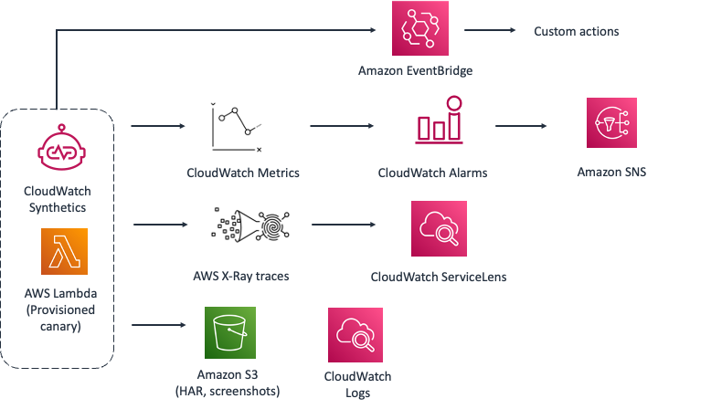
Amazon CloudWatch Synthetics – How it works
Notes:
Automated actions through Event Bridge: automatic rollbacks or custom lambda actions
Get alerted through alarms
View ServiceLens to debug through metrics logs and traces

Slide 23
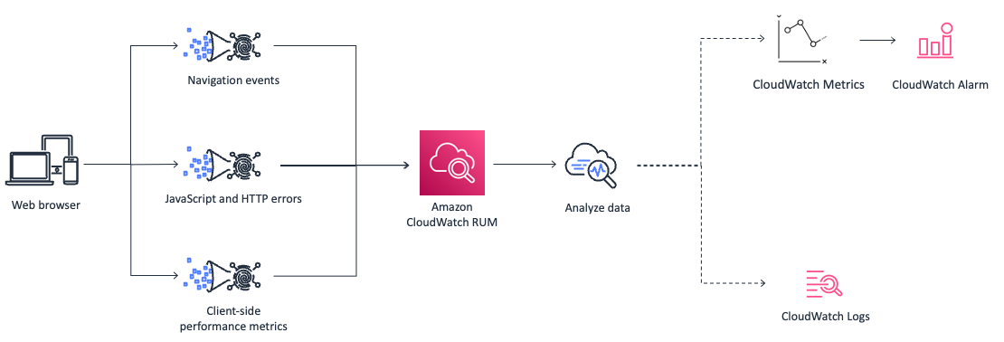
Amazon CloudWatch RUM – How it works
Notes:
When you add the CloudWatch RUM Web Client to the html header of your applications, you will be able to collect the performance telemetry, including navigation events, JavaScript and HTTP errors, and the client-side performance metrics. You will be able to visualize the data using CloudWatch RUM and derive insights to improve your application’s client-side performance. You can also set alarms for key metrics, including number of errors, page load times, and core web vitals.

Slide 24
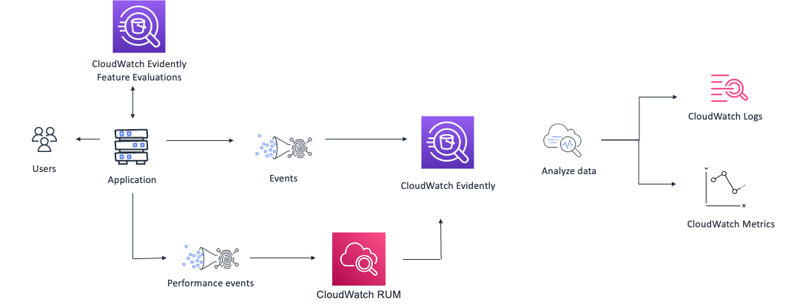
Amazon CloudWatch Evidently – How it works
Notes:
Firstly, when you add Evidently evaluations to your application, the application serves the required traffic split to your end users.
After this, you can gather the events, which Evidently analyzes to inform you on how a variation is performing and maintains the number of assignments. When you run an experiment, Evidently will run the statistical analysis to make recommendations
Evidently’s rich visualization
You can optionally, use CloudWatch RUM performance events to view performance metrics as well.

Slide 25
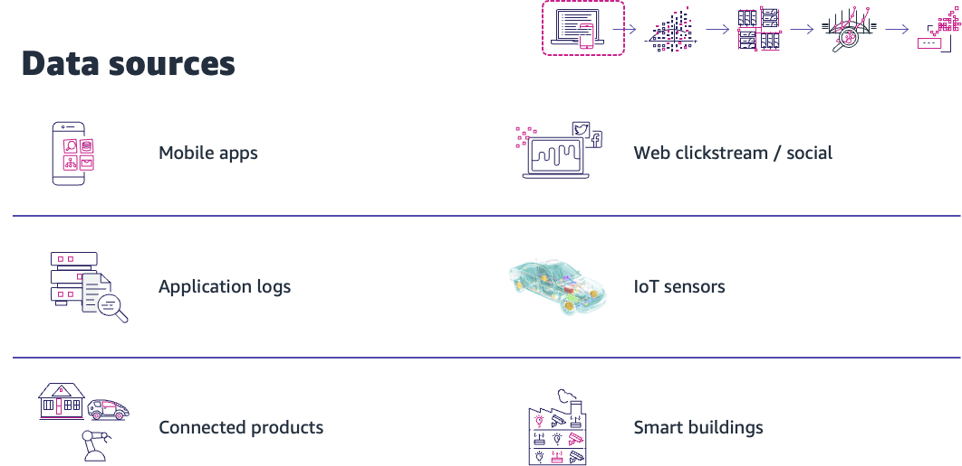

Slide 26
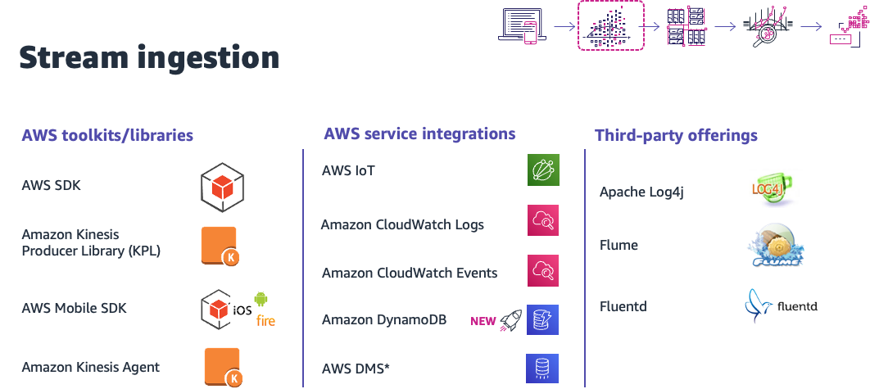

Slide 27
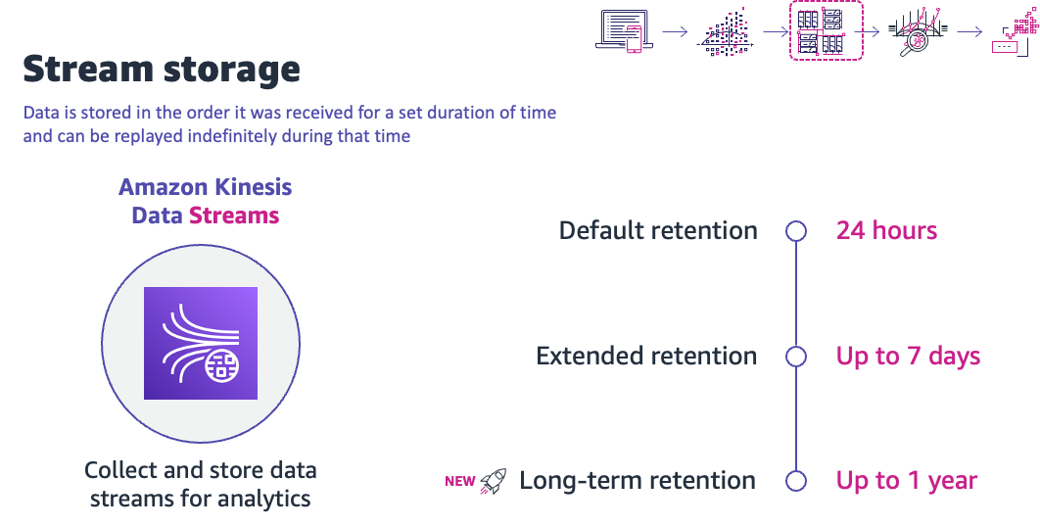

Slide 28
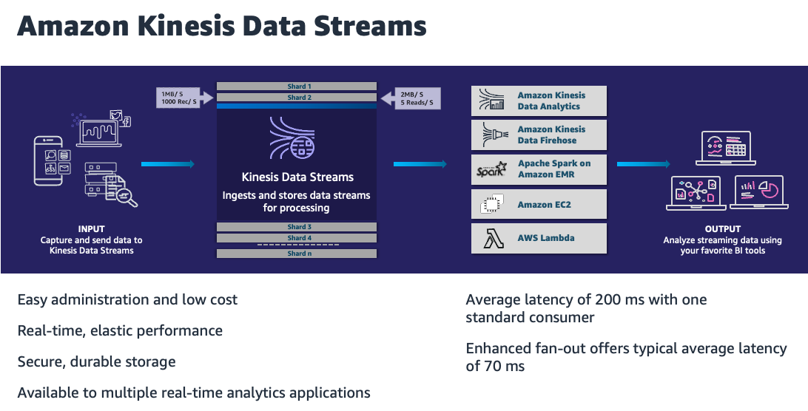

Slide 29
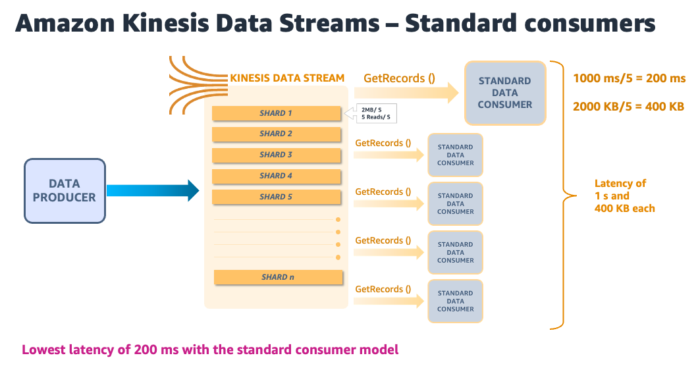

Slide 30
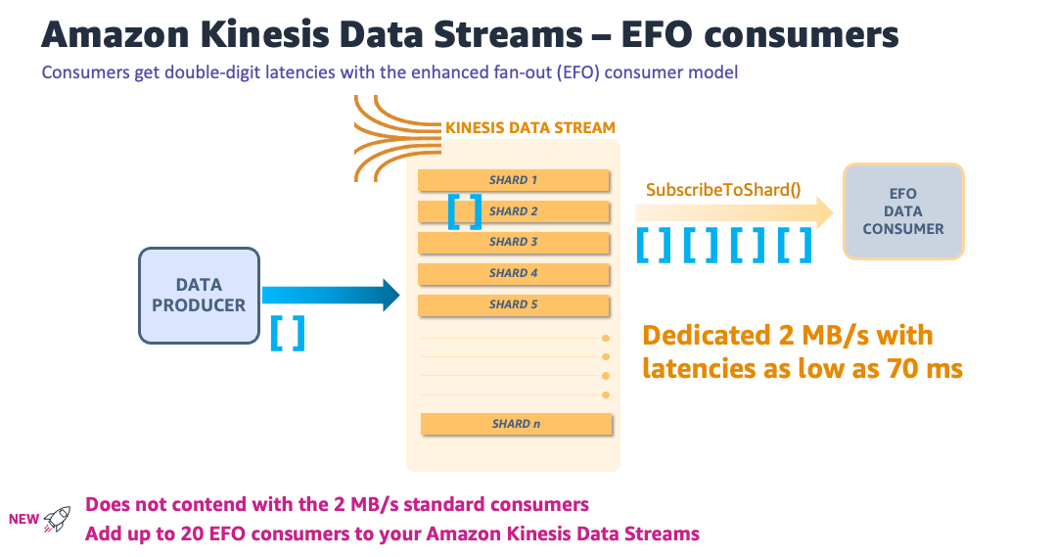

Slide 31
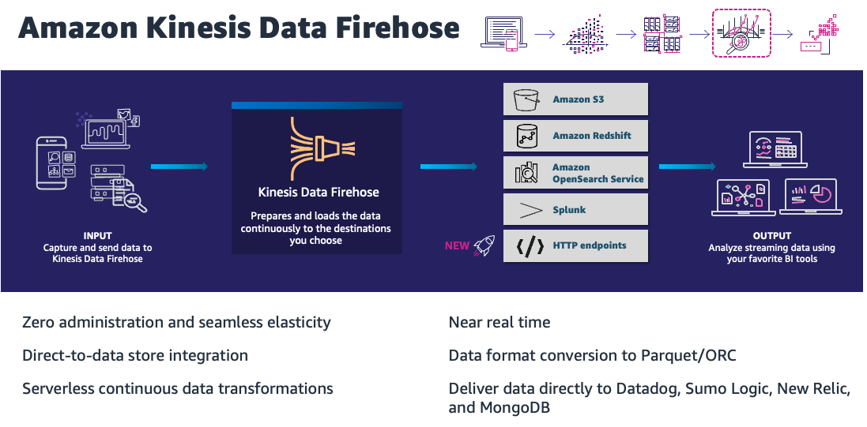

Slide 32
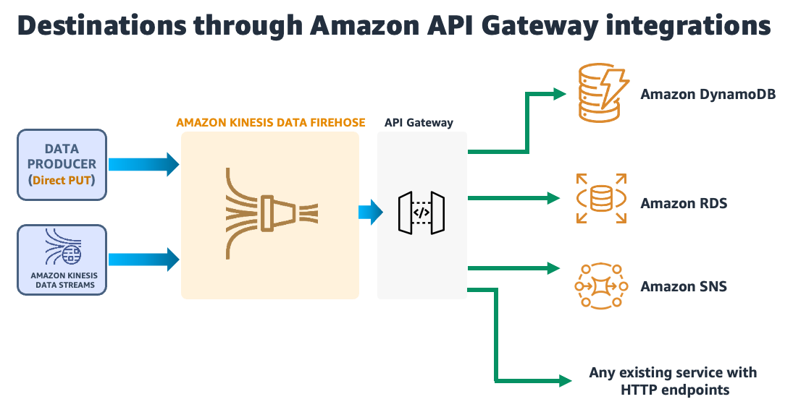

Slide 33
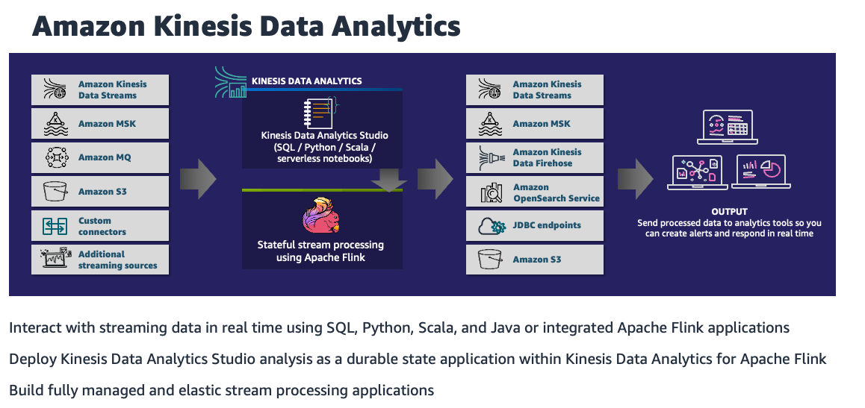

Slide 34
