Slide 1
PGPCC - Cloud Foundations
Mentor Session

Slide 2

Agenda
Total duration 120 mins
Case studies (45 mins)
Cloud Computing Elasticity (15 mins)
Digital Transformation (15 mins)
General participant Q&A (45 mins)

Slide 3
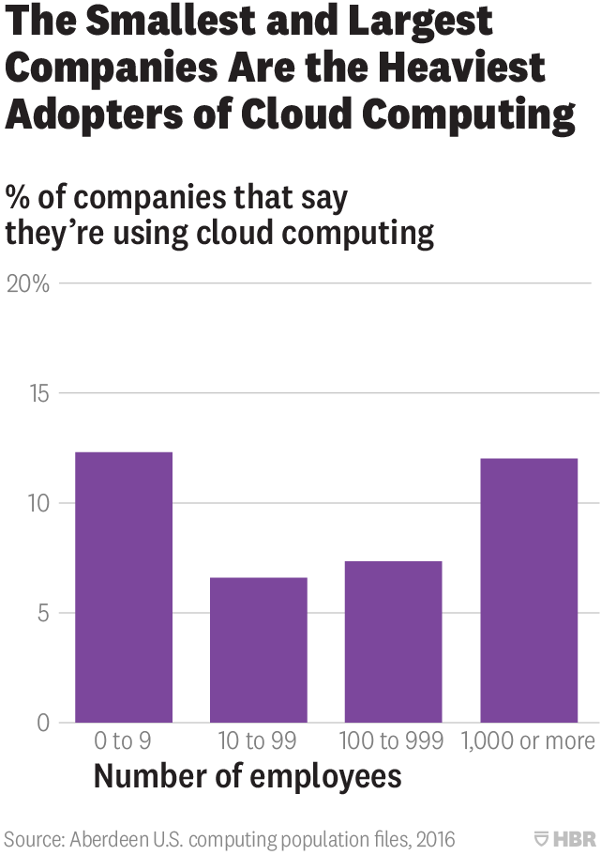
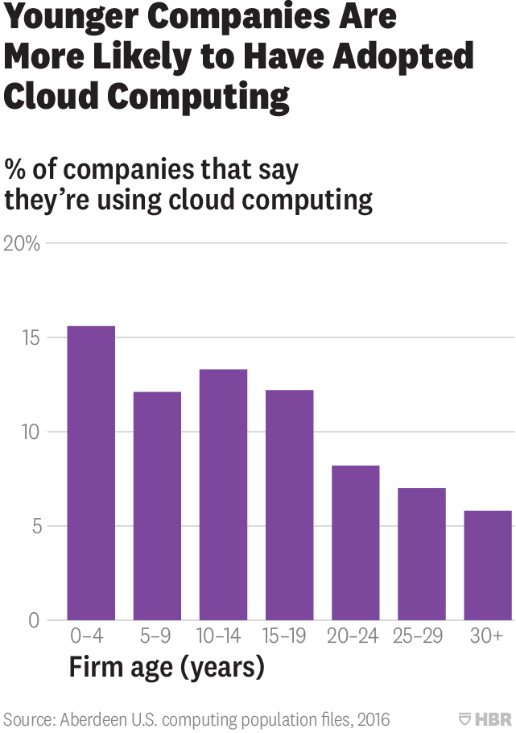
Case Studies - Cloud Computing is Helping Smaller, Newer Firms Compete
Harvard Business Review - “Research: Cloud Computing Is Helping Smaller, Newer Firms Compete”
https://hbr.org/2018/08/research-cloud-computing-is-helping-smaller-newer-firms-compete
Summary: Cloud computing has brought “utility” computing to all. Cloud computing has seen massive growth with annualised growth rate of almost 50% between 2010 (< 0.5% adoption) and 2016 (7% adoption). Unlike PCs and e-commerce adoption has been driven primarily by smaller and new younger companies.
Key drivers:
Finance
Agility
Notes:
References:
https://www.gartner.com/en/conferences/hub/cloud-conferences/featured-content
https://best4businesses.com/how-long-startup-to-launch/
https://data.worldbank.org/indicator/IC.REG.DURS
Average app build 2 - 10 weeks
Average business launch: 20 days in 2018 vs 50 days in 2004

Slide 4
Case Studies - Cloud Computing Management Changes
Harvard Business Review - “How Cloud Computing Is Changing Management”
https://hbr.org/2018/02/how-cloud-computing-is-changing-management
Summary: Cloud computing is changing how products and services are discussed and designed, with close collaborations between IT departments and other business units, jointly developing products and services. New ways of developing software is encouraging organizations to be more agile. A ”cloud native” software approach stresses ease of use and low-impact modifications to software components. Monolithic applications are broken up into smaller “microservices” that can be tweaked individually with little effect on the service.
Key takeaways:
Product and service discussions and focus
Data or software centric views
Rapid product and service changes
Shift to “cloud native” organizations
IT as a value unit or enabler
Notes:
References:
https://www.gartner.com/en/conferences/hub/cloud-conferences/featured-content
Data or software centric view is using data to drive further decisions. Data is continually ingested, enriched, and analysed.
Cloud native shift is when teams throughout the organization are thinking in terms of cloud native software and services. Cloud first. Thinking about microservices, smaller software components that make changes more manageable (frequent) and reducing blast radius. More feedback loops among teams.
IT as value unit is closer collaboration with IT and business units, i.e. product/service departments. Also brings cost optimisations as simple as closing data centers to more evolved as product savings being passed on to smaller businesses and customers.
With all these changes, and increasing data, one area that is getting more focused thinking is security and compliance. How to secure data? How to protect the data and customers?

Slide 5
Case Studies - The Everywhere Enterprise
Gartner - “The everywhere enterprise”
https://www.gartner.com/en/conferences/hub/cloud-conferences/insights/swg-the-everywhere-enterprise-a-gartner-qa-with-david-cappuccio
Summary: Today infrastructure is everywhere and constantly evolving as Infrastructure & Operations (I&O) leaders face increasing pressure to govern dynamic application environments and ensure optimized costs.
Key takeaways:
Enterprises have multiple options
Cloud enables global scale, and reduces non-value add activities
Cloud is not a silver bullet and has its own challenges
Notes:
References:
https://www.gartner.com/en/conferences/hub/cloud-conferences/featured-content
Enterprise Everywhere is deploying where it makes sense (multiple criteria) such as co-location (edge location), on-premise, hosting, cloud, etc.
Cloud enables global reach, and importantly allows enterprises to focus on core business, reducing non-value add areas such as DCs, infrastructure, and operations.
Cloud is not a silver bullet: Consider laws around data sovereignty (data location), and latency, so still need for on-premise, which means hybrid cloud enterprise. Of course, cloud vendors are addressing by bringing the cloud to enterprise data centers. Also considering specialized hardware use cases, data centers will continue to be a viable solution. Key decisions take place around appropriate deployment option.

Slide 6
Case Studies - Setup for cloud adoption success
Gartner - “Setup your organization for cloud adoption success”
https://www.gartner.com/en/conferences/hub/cloud-conferences/insights/how-to-build-a-cloud-center-of-excellence
Summary: To ensure cloud adoption success, organizations must have the right skills and structure in place. The optimal way to achieve this is by setting up a centralized cloud center of excellence (CCoE), a centralized governance function for the organization that acts in a consultative role for central IT, business-unit IT and cloud service consumers in the business.
Key takeaways:
Adopt CCoE
Develop governance policies
Address organizational challenges
Build knowledge communities/teams and develop skills
Notes:
References:
https://www.gartner.com/en/conferences/hub/cloud-conferences/featured-content
New enterprise architecture is CCoE. Cloud Center of Excellence (CCoE) are being adopted which is key to drive cloud adoption success, and organise around DevOps practices. It advises on various aspects of cloud adoption, such as governance, structure, communities, people, and technology.
Cloud adoption success also depends on organization culture and structure. Culture will trump any changes, and structure reflects practices.
Organisation success depends on people. People need to embrace change, to update skills in order to remain relevant or useful (simple fact).

Slide 7
Cloud Computing Elasticity
Cloud Computing Elasticity: https://en.wikipedia.org/wiki/Elasticity_(cloud_computing)
Summary: Cloud Elasticity is the degree to which a system is able to adapt to workload changes by provisioning and de-provisioning resources in an automated manner, such that at each point in time the available resources match the current demand as closely as possible. Over-provisioning, i.e., allocating more resources than required, should be avoided as the service provider often has to pay for the resources that are allocated to the service. Under-provisioning, i.e., allocating fewer resources than required, must be avoided, otherwise the service cannot serve its users with a good service. In the above example, under-provisioning the website may make it seem slow or unreachable.
Key takeaways:
Account for provisioning time
Ensure appropriate monitoring
Decide on appropriate scaling measures
Multiple levels of control
Notes:
References:
https://en.wikipedia.org/wiki/Elasticity_(cloud_computing)
Under-provisioning example is certain federal government website that provided a marketplace for healthcare insurance. Based on assumed estimates of user traffic, hardware was acquired and provisioned. The reality was quite different as the product was massively popular, but the site was not able to meet the demand and resulted in a very bad user experiences (long response times, crashes, and site unavailability) and a tarnished reputation (for several involved stakeholders). Lost customers, and less profit.
Over-provisioning example is when estimated demand is much lower than expected, so great user experience for those accessing the product or service, but wasted finances and operations overhead for the company (example having purchased 20 servers with only 2 being used and operations time spent on provisioning). Less profit based on excessive capital investment/expenses.
Account for different control areas: Any application has different layers, example is 3-tiered IaaS where elasticity can be at web tier, app tier, and database tier. Each tier can be independently scaled, and must be accounted for.

Slide 8
Digital Transformation
McKinsey - “Capturing the value of the cloud” from the cloud consumer’s perspective
https://www.mckinsey.com/business-functions/mckinsey-digital/our-insights/how-cios-and-ctos-can-accelerate-digital-transformations-through-cloud-platforms
Summary: Exploiting cloud services and tooling requires change across all of IT and many business functions as well. Companies that reap value from cloud platforms treat their adoption as a business-technology transformation by doing three things:
Focusing investments on business domains where cloud can enable increased revenues and improved margins
Selecting a technology and sourcing model that aligns with business strategy and risk constraints
Developing and implementing an operating model that is oriented around the cloud
Key takeaways:
Focus cloud investment on value areas
Base selections (technology, provider, migration model) on economic & risk constraints
Change operating model to capture cloud value
Notes:
References:
https://www.mckinsey.com/business-functions/mckinsey-digital/our-insights/capturing-value-in-the-cloud
Digital Transformation is about taking a business and technology based approach to the enterprise by integrating IT with business units, taking a value-led approach to cloud, and changing your operating model to align with a cloud-based approach.
Changing operating model: Change thinking from projects, to making everything a product with an aligned lifecycle to that product. Enhance the developer experience, letting them focus on making great software products in a more efficient way. Integrate IT with the business and collaborate on products. Use IaC and software defined everything, and develop patterns for reuse. Use agile techniques. Most importantly, change the security perspective and integrate security,

Slide 9

General Q&A
Open forum, ask anything!

Slide 10
Thank you
Happy Learning!

Slide 11
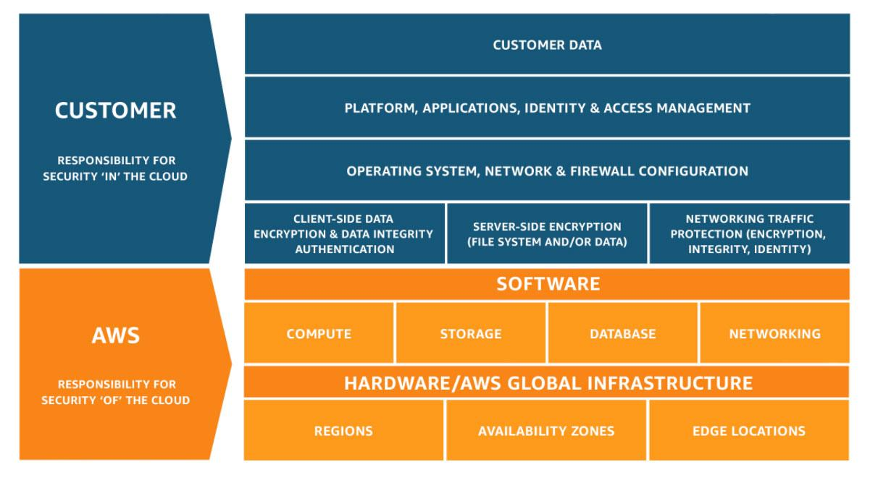
Shared Responsibility Model
Notes:
References:
https://aws.amazon.com/compliance/shared-responsibility-model/

Slide 12
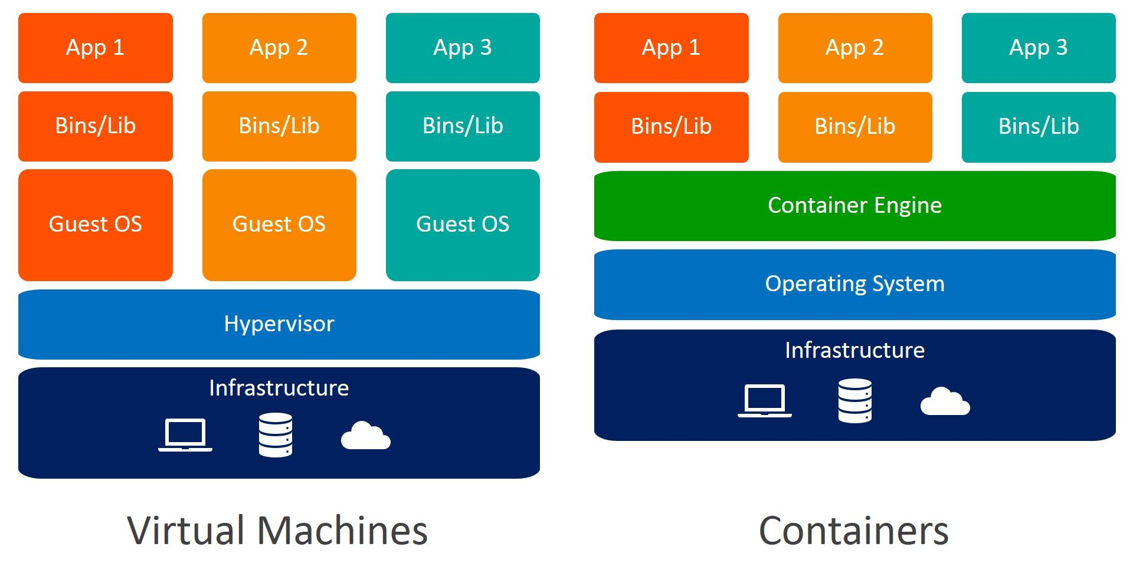
VMs and Containers
Notes:
References:
https://www.weave.works/blog/a-practical-guide-to-choosing-between-docker-containers-and-vms

