Slide 1

Fundamentals of Cloud Computing
Cloud Foundations
LinkedIn: https://linkedin.com/in/cgswong
@cgswong

Slide 2
Agenda
Brief history of Cloud Computing
What is Cloud Computing?
Cloud Models
Benefits of Cloud Computing
Service Models (IaaS, Paas, Saas)
Types of Services

Slide 3


Brief history of Cloud Computing
Before learning about Cloud Computing let’s go back to understand the need, for every journey has a start, with a why.
Salesforce was the first, but Amazon made it a service
A history of cloud computing, is a history of Amazon…
Notes:
In 1999, Salesforce was the example of using cloud computing successfully. They pioneered the idea of using the internet to deliver software programs to end users. The application could be accessed and downloaded by anyone over the internet. However, Amazon pioneered cloud services.

Slide 4

Brief history of Cloud Computing
AWS: Officially launched in 2006, but its origins can be traced back to the early 2000s when Amazon.com faced significant challenges due to its rapidly growing infrastructure needs.
In the late 1990s and early 2000s, Amazon.com experienced exponential growth as an online retailer. To support its operations, Amazon had built a robust and highly scalable infrastructure consisting of numerous servers, storage systems, and networking equipment.
However, the company realizes that it had excess computing capacity that remained idle during non-peak times and recognizing the potential value of this spare capacity, Amazon's internal teams started exploring ways to leverage it and generate additional revenue.
Amazon aimed to transform its surplus computing power into a service that could be offered to external customers, allowing them to access scalable and cost-effective computing resources over the internet
Notes:
In early 2000s, Amazon was growing massively. Like other large companies, Amazon had was struggling with scale, had a jumbled mess of services, but also had significant underusage of infrastructure. Essentially, this was wasted resources or money. The expectation or strategy was made for all internal teams to build decoupled services, use APIs, and consume internal systems in such a manner. That was the start as without even knowing or realizing, they became a services company, via APIs. Application Programming Interfaces or API serve as a contract between a provider and consumer of services, to providing some capability or information. They are meant to be stable with infrequent changes, but should the contract change, the API gets a different version with the previous being deprecated, but both being available for an extended period of time until the previous is made unavailable when no longer used.
So, many an internal discussion continued to be held from an initial retreat on core competencies, excess infrastructure, expertise, and revenue streams. A few years later, that excess infrastructure, internal expertise in building data centers, managing infrastructure, and using APIs was used to launch EC2. First as SQS or simple queue service, then storage as S3, then compute with EC2.
So, AWS was launched as the service arm of Amazon, and the rest is now present cloud ☺ .
So, what is Cloud Computing? It is the delivery of services over a network. Being able to consume those services, whenever or on-demand, in a usage-based pricing model.

Slide 5
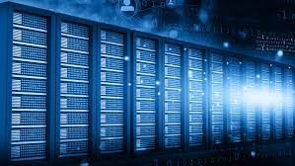
What is Cloud Computing?
Compute powers the processing and execution of tasks
Networking facilitates the communication and transfer of data between devices
Storage enables the retention and retrieval of data at various stages
The on-demand delivery of computer system resources, without direct, active management over the internet. Typically in a pay-as-you-go pricing model.
Using someone else’s computing resources over the internet!
Notes:
Cloud computing is a technology that allows users to access and use computing resources (such as servers, storage, databases, networking, software) over the internet. Instead of owning and maintaining physical hardware or infrastructure, users can leverage services provided by cloud service providers on a pay-as-you-go basis. This model offers flexibility, scalability, and cost-effectiveness, enabling individuals and businesses to deploy and manage applications and data without the need for significant upfront investments in hardware and IT infrastructure. Cloud computing services can be categorized into Infrastructure as a Service (IaaS), Platform as a Service (PaaS), and Software as a Service (SaaS), each providing different levels of abstraction and management control.

Slide 6
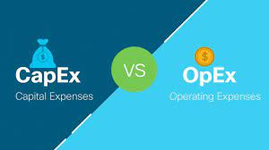
Cloud Computing and CapEx vs. OpEx
Capital Expenditure (CapEx)
Up-front payment on physical resources
Resources are owned
Value of resources depreciate over time
Ongoing costs hidden
Operational Expenditure (OpEx)
Spend on products and services as needed, or pay-as-you-go
No resource ownership
Billed immediately
Transparent costs

Slide 7
Cloud Models
Public Cloud
Underlying resources managed and operated by third-party provider
No ownership or operational overhead for computing resources
Computing resources delivered on-demand
Usage-based pricing model
Private Cloud
Resources dedicated to single organization
Typically service delivery over private network
Organization controls computing resources
Tighter control, and higher maintenance
Hybrid Cloud
Integration of public and private cloud
Use existing investments in data centers
Higher control on resources and data
More flexibility in deployment options
Notes:
Public cloud
A third-party cloud service provider manages the underlying computing resources. The provider is responsible for resource maintenance and guarantees availability, reliability, and security through service-level agreements. You don’t buy, own, and maintain physical data centers and servers; instead, you access technology services on an as-needed basis. In addition, several tasks, such as runtime resource scaling, are automated for operational efficiency.
Private cloud compared to public cloud
It is almost impossible to replicate public cloud infrastructure privately. You get significantly more breadth and depth of services from a public cloud provider because it is fully dedicated to scaling and improving its offerings. You also get more innovation, access to a global community, and proven operational expertise.
Private Cloud – Organizations kept hardware in their internal on-premises data centers and co-location facilities to support their IT operations. After AWS was launched, companies attempted to replicate the cloud computing model on their internal infrastructure. The term private cloud was introduced to distinguish between these internal cloud environments and third-party, public cloud services provided by organizations such as AWS.
Types of Private Cloud:
On-premises private cloud - You can deploy on your own resources in an internal data center. You must purchase the resources, maintain and upgrade them, and ensure security. On-premises private cloud management is expensive and requires heavy initial investment and ongoing expenses.
Managed private cloud - A single-tenant environment fully managed by a third party. For example, the IT infrastructure for your organization could be purchased and maintained by a third-party organization in its data center. The third party provides maintenance, upgrades, support, and remote management of your private cloud resources. While managed private clouds are expensive, they are more convenient than on-premises solutions.
Virtual private cloud - A private cloud that you can deploy within a public cloud infrastructure. It is a secure, isolated environment where private cloud users can run code, host websites, store data, and perform other tasks that require a traditional data center. Virtual private clouds efficiently give you the convenience and scalability of public cloud computing resources along with additional control and security.
Hybrid cloud
A hybrid cloud is an IT infrastructure design that seamlessly integrates a company's public and private clouds. As a result, you can store your data and run your applications across multiple environments without noticing a difference. Your hybrid cloud environment consolidates your infrastructure, so that you can provision, scale, and centrally manage all your compute resources.
Private cloud compared to hybrid cloud
Hybrid cloud services extend your private cloud computing model into the public cloud. For example, your private cloud applications can access public cloud resources when there is a spike in traffic that your data center cannot handle. You can also use hybrid cloud computing services to transition smoothly from private cloud environments to public clouds.

Slide 8
Benefits of Cloud Computing
High availability
Fault Tolerance
Disaster Recovery
Global Reach
Scalability
Elasticity
Security
Low Latency
Agility
Predictive Pricing

Slide 9
Cloud computing service models
IaaS
Infrastructure as a Service
PaaS
Platform as a Service
SaaS
Software as a Service
A model in which a third-party provider hosts servers, storage and other virtualized compute resources and makes them available to customers over the internet.
EXAMPLES:
AWS EC2, Microsoft Azure Blob Storage, Google Compute Engine
A model in which a third-party hosts application development platforms and tools on its own infrastructure and make them available to customers over the internet.
EXAMPLES:
AWS Elastic Beanstalk, Google App Engine, Heroku
A software distribution model in which a third-party provider hosts applications and makes them available to customers over the internet
EXAMPLES:
Salesforce, Netsuite, Concur, Office365

Slide 10
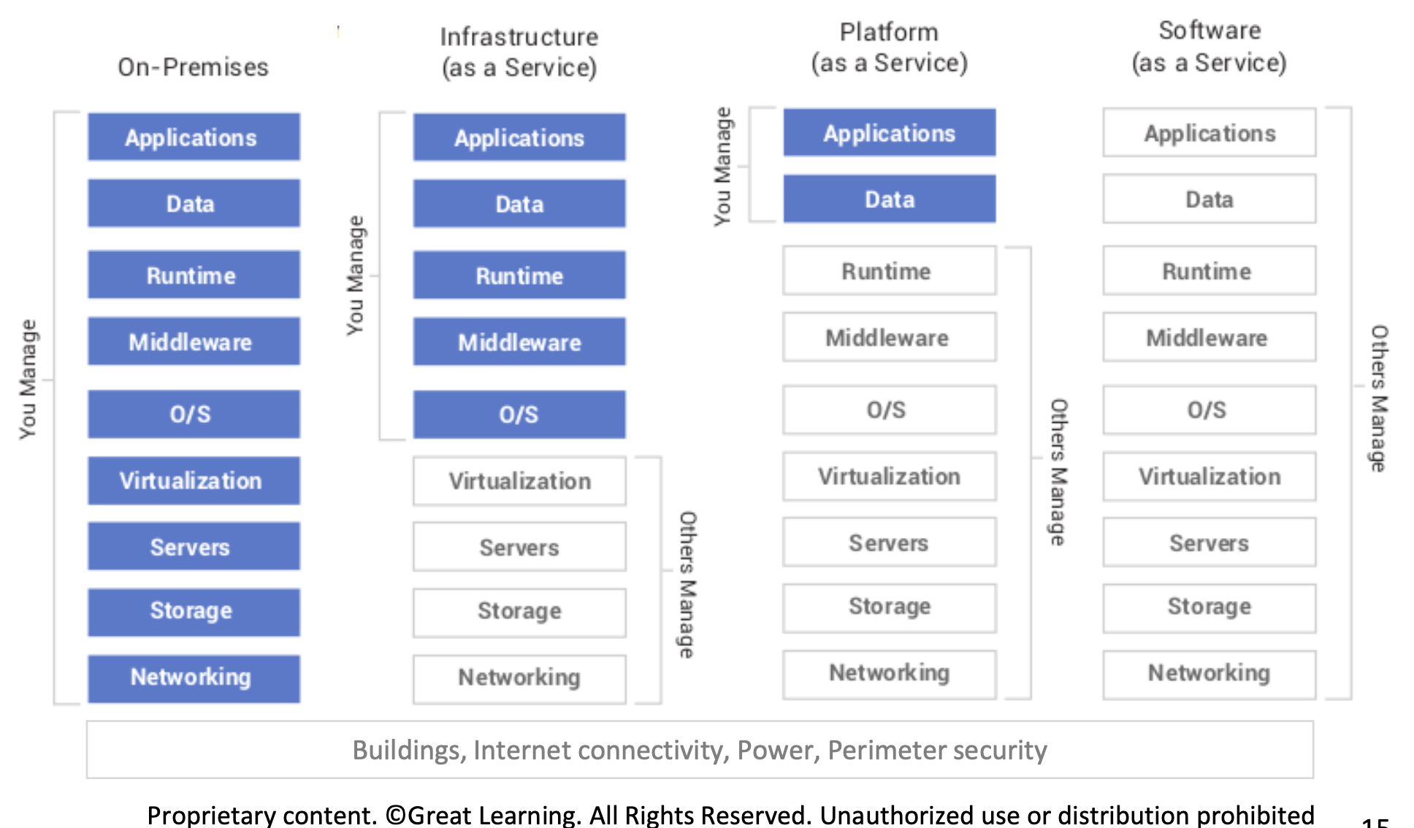
Notes:
Please explain the On-Prem elements briefly (this is IMP, learners always ask) then compare to Cloud
Runtime can be a little difficult to grasp for folks
The runtime environment ensures that the software can utilize system resources effectively and provides an execution environment that is consistent across different platforms
The runtime provides an abstraction layer between the application and the underlying hardware and operating system.
It encompasses the libraries, frameworks, and other components required to run and manage the execution of the software.

Slide 11
Types of Services
Compute
Networking
Storage
Databases
Web Services
Internet of Things (IoT)
Big Data and Analytics
Identity and access management
Artificial Intelligence (AI) and Machine Learning (ML)
Monitoring
DevOps

Slide 12
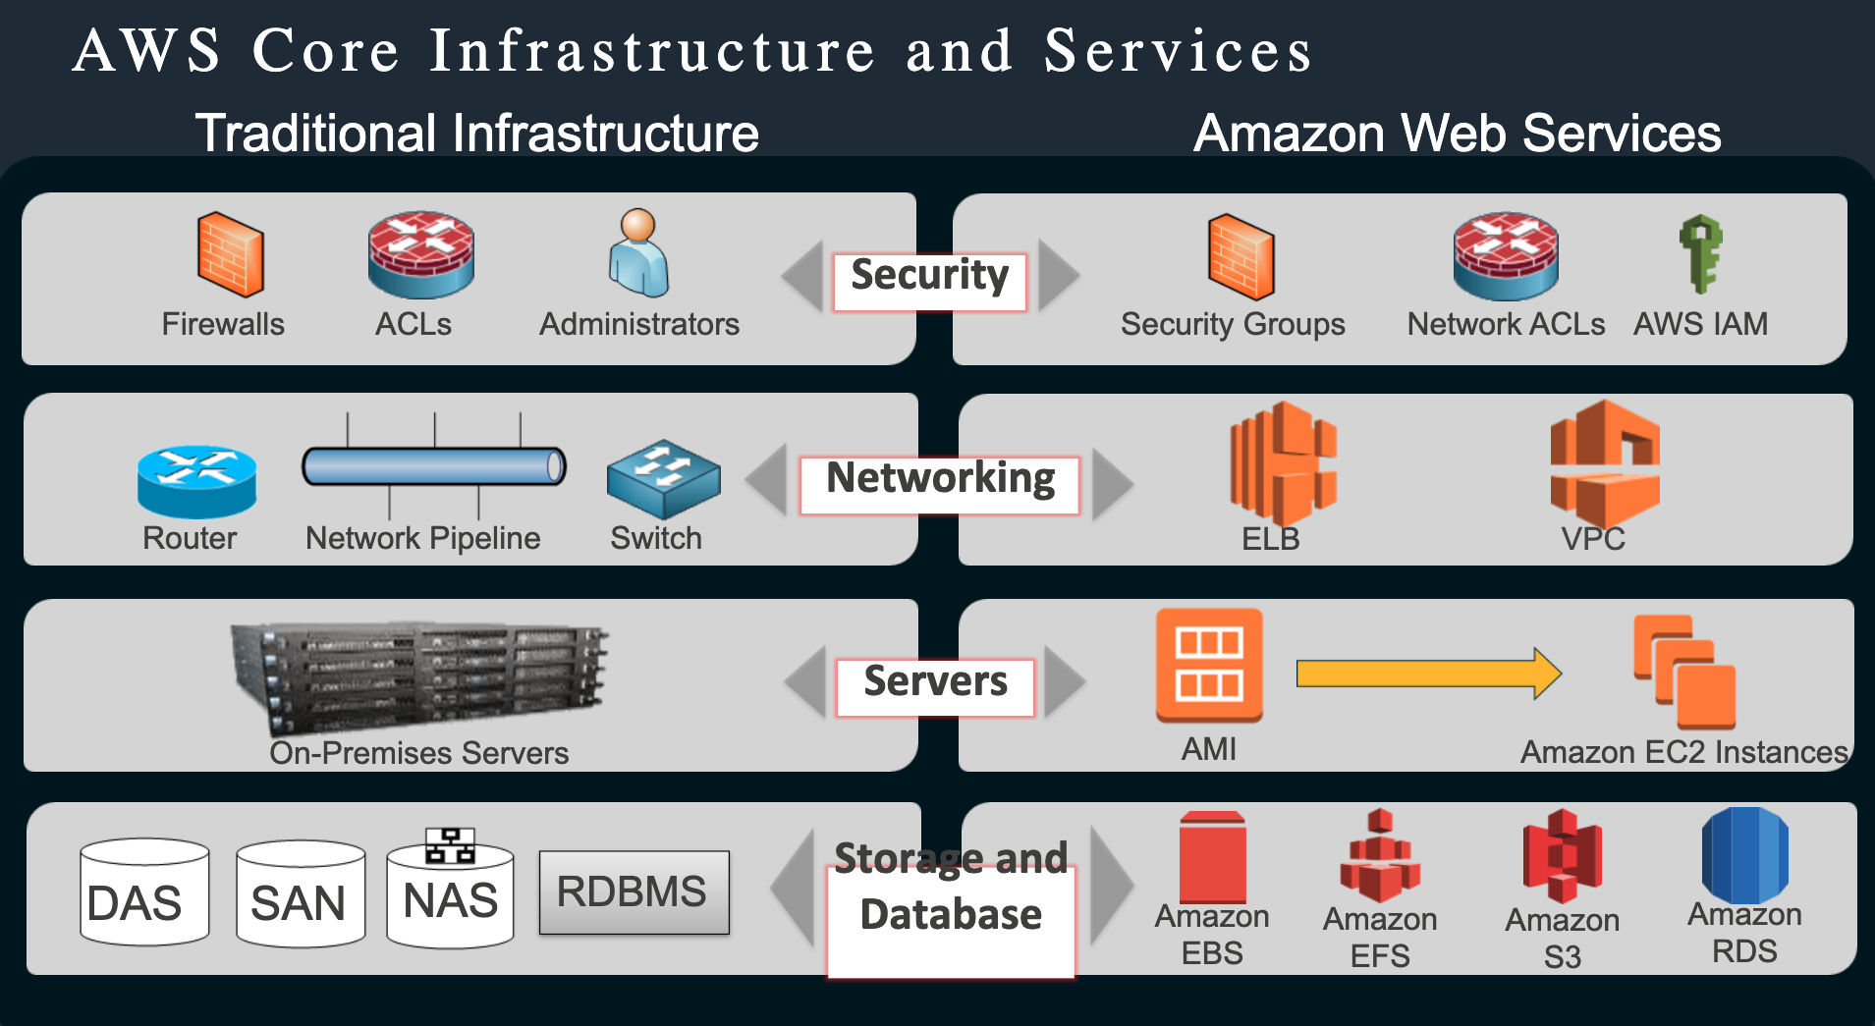
AWS Turkey Roadshow Presentation - AWS Core Services (Compute, Network, Storage)
© 2018, Amazon Web Services, Inc. or its Affiliates

Slide 13

Q&A

Slide 14
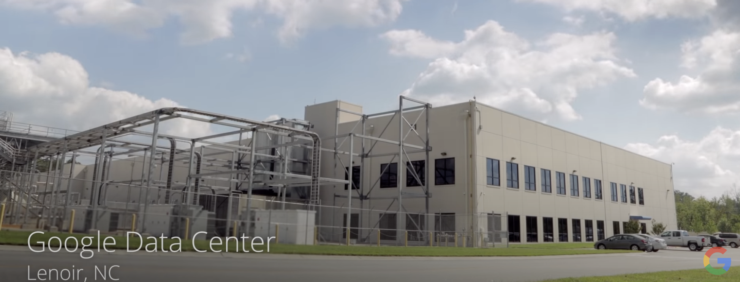
The cloud is actually physical….
Explore a Google Data Center:
https://www.youtube.com/watch?v=avP5d16wEp0
Inside Amazon’s Massive Data Center:
https://www.youtube.com/watch?v=q6WlzHLxNKI

Slide 15
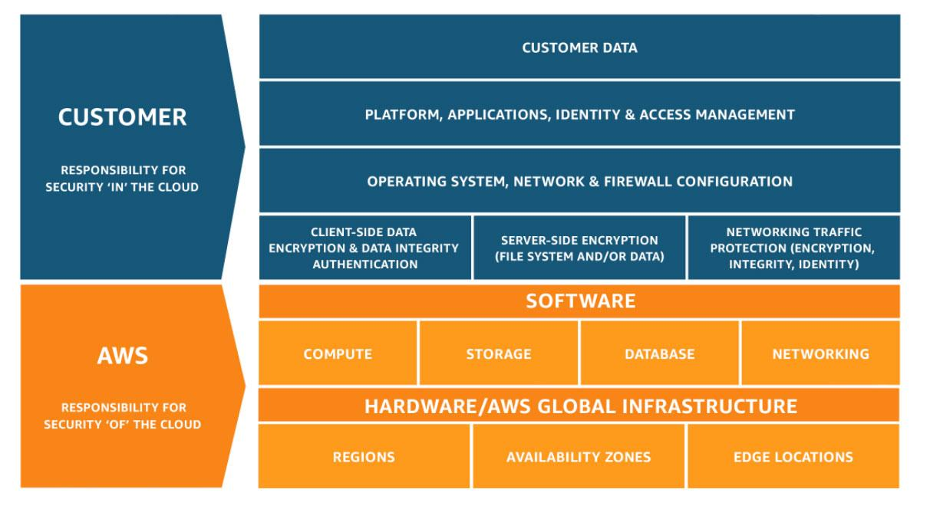
Shared Responsibility Model
Notes:
References:
https://aws.amazon.com/compliance/shared-responsibility-model/

Slide 16
