Slide 1
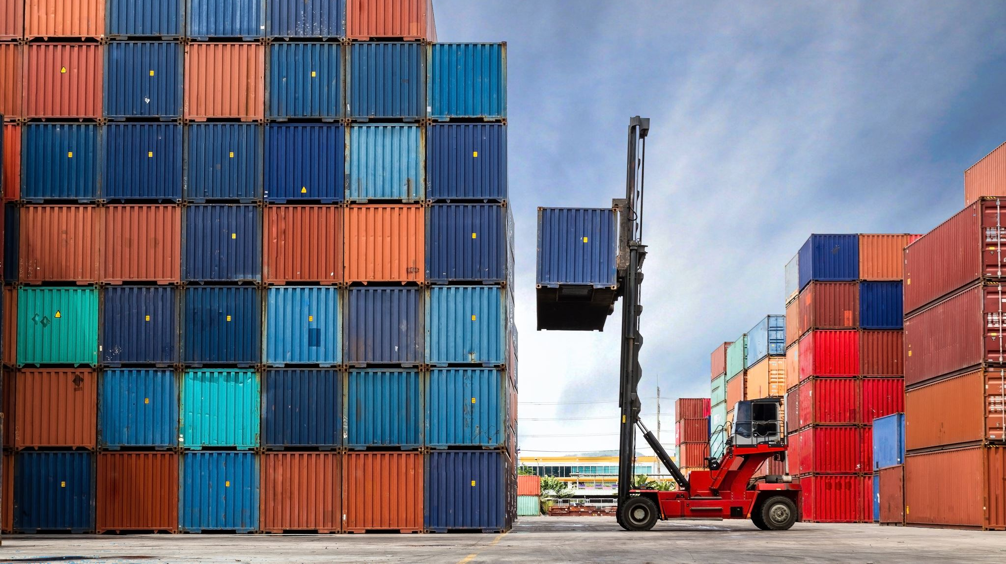
Container Fundamentals
With Carrington Wong

Slide 2
Why Containers?
Business
Agility
Innovation speed
Time to market
Cost savings (increase utilization)
Technical
Stability (standardize software development lifecycle or SDLC process)
Developer productivity
Works on my machine!
Reduced provisioning time (includes DR time)

Slide 3
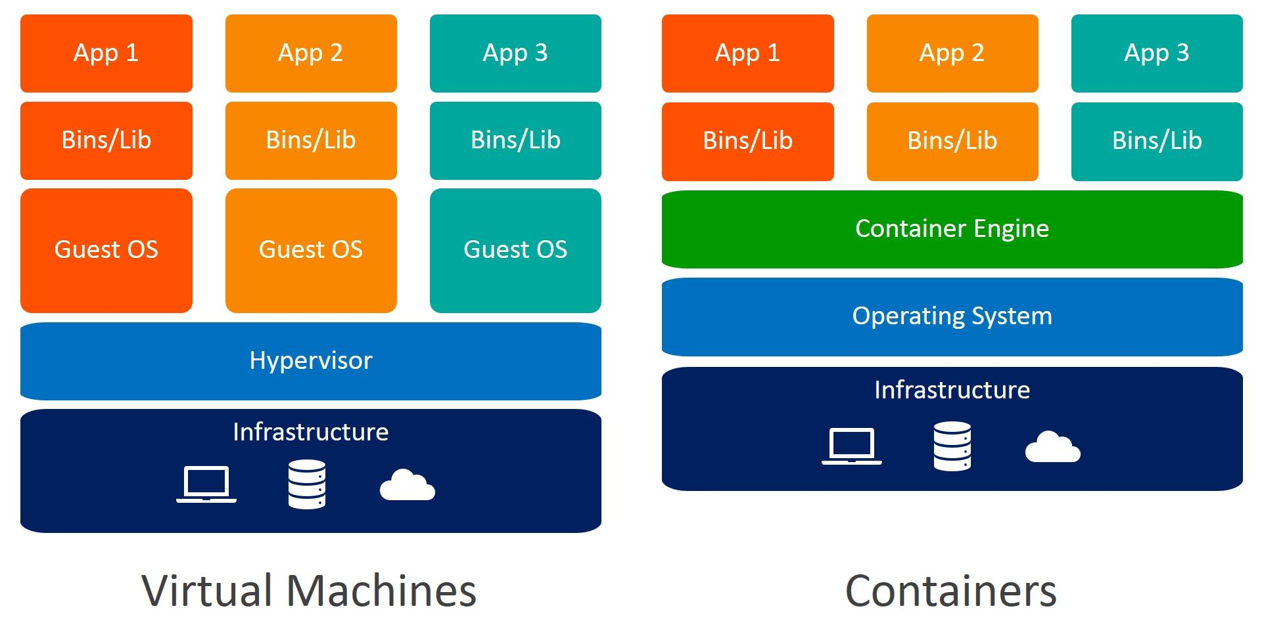
VMs and Containers
Notes:
References:
https://www.weave.works/blog/a-practical-guide-to-choosing-between-docker-containers-and-vms

Slide 4
The Container Ecosystem
Docker client loads the image, and this is how users interact with Docker.
Docker daemon executes the image, creating the process and starting any activity inside the container
Process start, no OS build time!
Runs small hypervisor if underlying machine is not Linux
Container is run as an isolated OS process
Images are built Dockerfiles, available to run as containers.
Store locally, or in shared repository (Docker Hub, AWS ECR, Jfrog Artifactory, etc.)
Layers are each execution command (modification) in a Dockerfile
Lots of containers (at scale), require some type of orchestration
Avoid overwhelming running machine
Automation scaling (horizontal, vertical)
Provide dependency tracking or chaining
Kubernetes, AWS EKS, AWS ECS, etc.
Notes:
What is the container ecosystem?
Docker client
Docker daemon
Images
Processes and containers
VMs and containers together (containers run on top of a VM!)
What is container orchestration

Slide 5

Q&A

