Slide 1
PGPCC - Mentor session
Flow and Structure for MS2
Course 2 Week 1
“AWS IAM, Compute, Load Balancing”

Slide 2
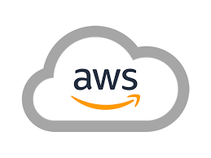
Agenda
Total duration 120 mins
Case studies (15 mins)
Questions to ponder (15 mins)
Cost reductions (15 mins)
Reliability Pillar (15 mins)
Identity NIST CyberSecurity (15 mins)
New changes! (15 mins)
Q&A from participants (30 mins)

Slide 3
Case Studies
Edmunds.com Cuts Costs and Boosts Availability by Using AWS Fargate Spot
https://aws.amazon.com/solutions/case-studies/edmunds-fargate-spot
S&P Global Ratings Uses AWS to Speed Application Migration, Drive Innovation
https://aws.amazon.com/solutions/case-studies/s-and-p-global-case-study
TymeBank, South Africa’s first digital bank, migrates its core systems to AWS
https://aws.amazon.com/solutions/case-studies/TymeBank-Case-Study
Mortgage Closings in 15 Minutes with Snapdocs on AWS
https://aws.amazon.com/solutions/case-studies/snapdocs-case-study

Slide 4
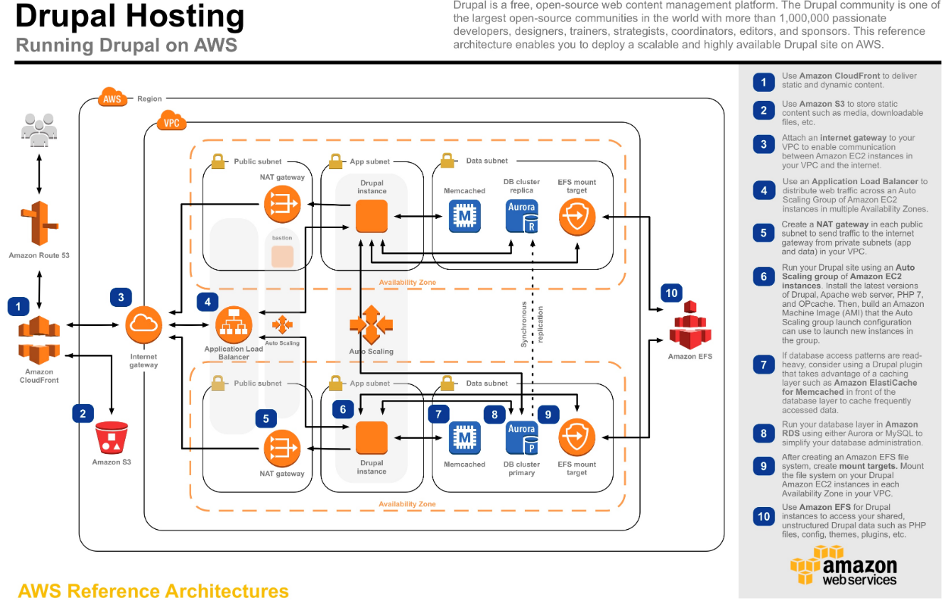
Questions to ponder about
Examine the following architecture keeping in mind the topics of the current week and think about -
What could be the disadvantages if the load balancer was not part of the architecture?
Do you think it makes sense to use the NLB instead of ALB? Debate!
It is suggested that Drupal be installed on EC2, why not use PaaS? Debate!
Notes:
Reference hhttps://aws.amazon.com/efs/resources/aws-refarch-drupal/

Slide 5
Infrastructure cost reduction
Identify Amazon EC2 instances with low-utilization and reduce cost by stopping or rightsizing
Review networking and reduce costs by deleting idle load balancers
Use Amazon EC2 Spot Instances to reduce EC2 costs
Use Reserved Instances (RI) to reduce costs
Use Compute Savings Plans to reduce EC2 costs
Using Budgets, you can set up an alert on forecasted costs too (apart from actual). This gives you the ability to get ahead of the problem and reduce costs proactively.
Notes:
Reference https://aws.amazon.com/blogs/compute/10-things-you-can-do-today-to-reduce-aws-costs/

Slide 6
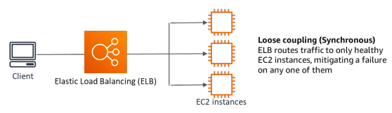
Well architected framework - Reliability Pillar
Implement loosely coupled dependencies: Dependencies such as queuing systems, streaming systems, workflows, and load balancers are loosely coupled. Loose coupling helps isolate behavior of a component from other components that depend on it, increasing resiliency and agility.
“Observe your infrastructure” - CloudWatch Logs can be enabled for Amazon Classic Load Balancers, and Application Load Balancers.
Little’s Law helps calculate how many instances of compute (EC2 instances) that you need.
L = λW
L = number of instances (or mean concurrency in the system)
λ = mean rate at which requests arrive (req/sec)
W = mean time that each request spends in the system (sec)
For example, at 100 rps, if each request takes 0.5 seconds to process, you will need 50 instances to keep up with demand.
Notes:
Reference https://docs.aws.amazon.com/wellarchitected/latest/reliability-pillar/wellarchitected-reliability-pillar.pdf#reliability

Slide 7
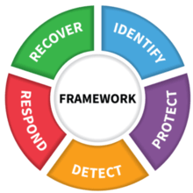
NIST Cybersecurity framework - “Protect!”
The Protect Function outlines appropriate safeguards to ensure delivery of critical infrastructure services. The Protect Function supports the ability to limit or contain the impact of a potential cybersecurity event.
Examples of outcome Categories within this Function include:
Protections for Identity Management and Access Control within the organization including physical and remote access
Empowering staff within the organization through Awareness and Training including role based and privileged user training
Establishing Data Security protection consistent with the organization’s risk strategy to protect the confidentiality, integrity, and availability of information
Implementing Information Protection Processes and Procedures to maintain and manage the protections of information systems and assets
Protecting organizational resources through Maintenance, including remote maintenance, activities
Managing Protective Technology to ensure the security and resilience of systems and assists are consistent with organizational policies, procedures, and agreements
IAM module in AWS helps in creating users, groups, roles & policies
Notes:
Reference https://www.nist.gov/cyberframework/online-learning/five-functions

Slide 8
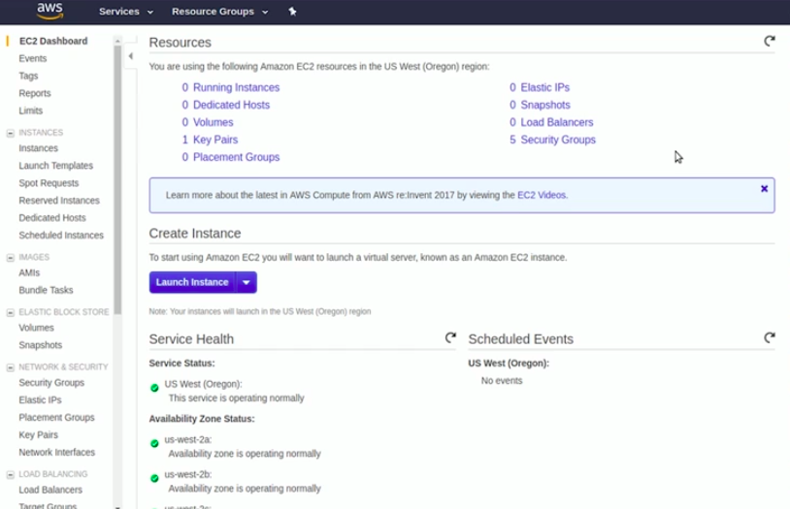
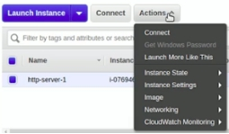
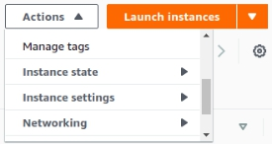
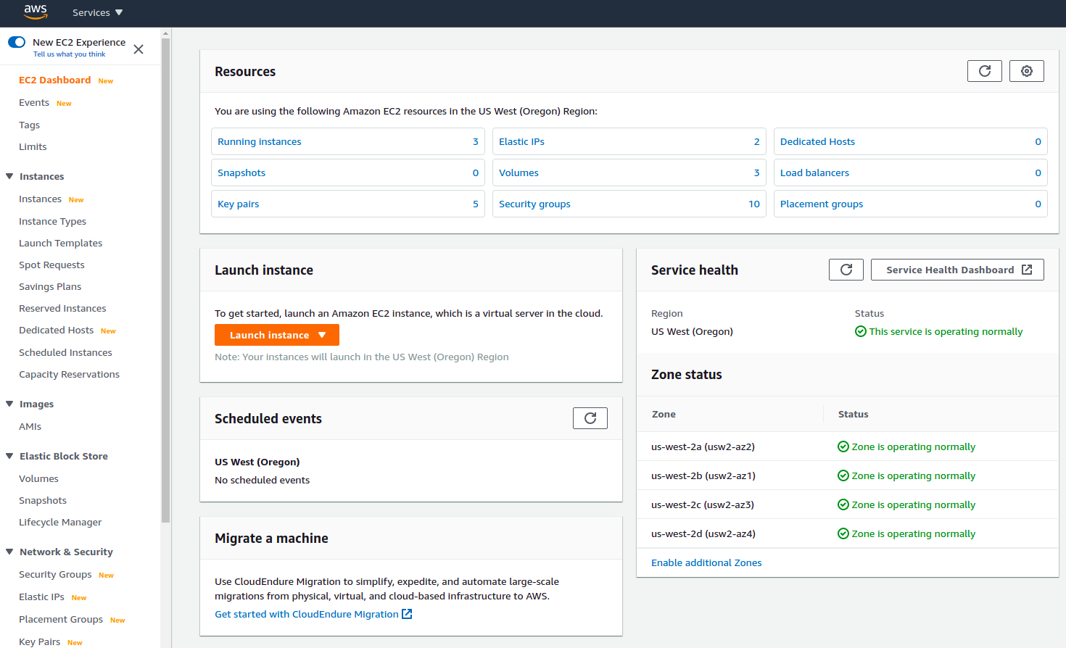
Cloud has different colors but its function remains the same!

Slide 9
What else?
Anything else the participants need to ask
Any use cases that you would like to talk about

Slide 10
Thank you
Happy Learning!

