Slide 1
Amazon VPC Amazon Route53 AWS WAF
with Carrington Wong (Stuart if you prefer :-) )

Slide 2
Contents
VPCs explained
DNS in AWS (Route 53)
Web Application Firewall (WAF)
Open Discussion (Q&A)

Slide 3
VPCs Explained
All about VPCs (or near enough)

Slide 4
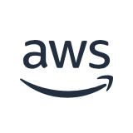


VPCs Explained, but first some basics
AWS Cloud
1 Region = Multiple AZ (3+)
1 AZ = Cluster of DC
Each AZ is independently powered, cooled, and maintained, but interconnected via redundant, ultra low-latency, high speed links
Region
Availability Zone – us-east-1a
Availability Zone – us-east-1b
Availability Zone – us-east-1c
Notes:
DCs within an AZ are interconnected, and AZs are connected by high speed links.
While regions are dispersed across geographic regions to avoid catastrophic events, AZs within a region are localized within several miles (let's say 60 miles) which may not align with certain federal or industry criteria for DR or BC.
Note that AZs are different across accounts. This is intentional to provide some isolation and avoid wide-spread customer outages. In cases where using the same AZ across accounts is important, the AZ-ID should be used to provide alignment.

Slide 5

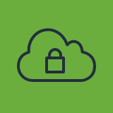
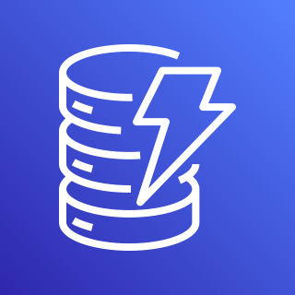
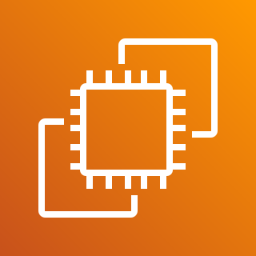
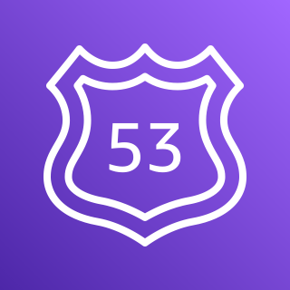

Resource Service Types
AWS Cloud
Region
VPC
AWS (IAM)
Amazon DynamoDB
Amazon Elastic Compute Cloud (Amazon EC2)
Amazon Route 53
Amazon S3
Notes:
VPC (associated with AZs), region and global services

Slide 6





VPCs Explained
AWS Cloud
Region
VPC – 10.1.0.0/16
Internet gateway
Availability Zone (us-east-1b)
Availability Zone (us-east-1d)
Public subnet – 10.1.0.0/25
Public subnet – 10.1.3.0/25
NAT gateway
NAT gateway
Private subnet – 10.1.2.0/24
Private subnet – 10.1.4.0/24
Notes:
CIDR is Classless Inter-Domain Routing, and is simply a short form of how network is divided.
Maximum CIDR is /16, minimum is /28
CIDR calculator: https://www.subnet-calculator.com/cidr.php
10.0.0.0: Network address.
10.0.0.1: AWS reserved for the VPC router.
10.0.0.2: AWS reserved for the VPC DNS router service (always located in the primary CIDR). AWS also reserves the base of each subnet range plus two for all CIDR blocks in the VPC. Reference Amazon DNS server.
10.0.0.3: AWS reserved for future use.
10.0.0.255: AWS reserved for the network broadcast address (note that AWS does not support broadcast in a VPC).
NAT Gateways have Elastic IPs (can be used in accept list since they are static).
NAT Gateway does have throughput and connection limits which should be considered. One per AZ is recommended for HA, but also throughput.

Slide 7


VPC Routing (How your instance talks)
Public Route Table
VPC – 10.1.0.0/16
Destination | Target
10.1.0.0/16 | local
0.0.0.0/0 | igw-123456789
Internet gateway
Availability Zone (us-east-1b)
Availability Zone (us-east-1d)
Public subnet – 10.1.0.0/25
Public subnet – 10.1.3.0/25
NAT gateway
NAT gateway
Private Route Table
Private subnet – 10.1.2.0/24
Private subnet – 10.1.4.0/24
Destination | Target
10.1.0.0/16 | local
0.0.0.0/0 | nat-123456789
Notes:
Routing is crucial!!
Public subnet is any that has route to IGW.
NAT Gateway must be in public subnet
Can use one or more route table, but a subnet must be associated to a single route table
Shortest (most specific) route takes precedence

Slide 8

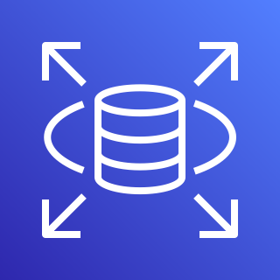


Multi-AZ
AWS Cloud
Region
VPC – 10.1.0.0/16
Internet gateway
Availability Zone (us-east-1b)
Availability Zone (us-east-1d)
Public subnet – 10.1.0.0/25
Public subnet – 10.1.3.0/25
ALB
EC2
EC2
Private subnet – 10.1.2.0/24
Private subnet – 10.1.4.0/24
Amazon RDS
Amazon RDS (replica)

Slide 9

Multi-AZ – Public ALB with Private EC2
AWS Cloud
Region
VPC – 10.1.0.0/16
Internet gateway
Availability Zone (us-east-1b)
Availability Zone (us-east-1d)
Public subnet – 10.1.0.0/25
Public subnet – 10.1.3.0/25
ALB
Private subnet – 10.1.2.0/24
Private subnet – 10.1.4.0/24
EC2
EC2

Slide 10
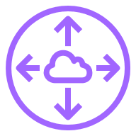

Inter-VPC Routing (Talking across networks)
VPC-A (10.1.0.0/16)
VPC-B (10.4.0.0/16)
VPC-A Route Table
Availability Zone (us-east-1b)
Availability Zone (us-east-1d)
Destination | Target
10.1.0.0/16 | local
0.0.0.0/0 | igw-123456789
10.4.0.0/16 | pcx-12456
Private subnet – 10.1.0.0/24
Private subnet – 10.4.0.0/24
Peering connection
VPC-B Route Table
Destination | Target
10.4.0.0/16 | local
0.0.0.0/0 | nat-123456789
10.1.0.0/24 | pcx-445566
Notes:
Routes cannot overlap
Gets complicated (management) as VPCs grow and mesh network takes shape
Alternative options exist such as shared VPCs, and Transit Gateway (next slide)

Slide 11
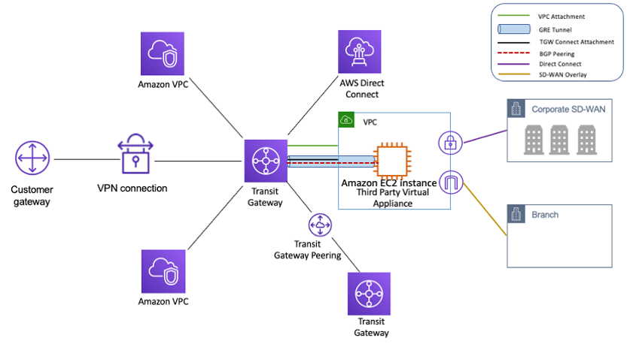
Inter-VPC Routing (Talking across networks)
Notes:
Preferred solution is Transit Gateway for routing across VPCs, as well as between VPCs and on-premise
Some use cases, such as really high volume traffic (100's of TB) would prefer VPC peering to minimize costs. Use TGW in general, and VPC Peering for edge case.

Slide 12
DNS in AWS (Route 53)
Amazon Route 53
The what, why and how of Domain Name Service (DNS)

Slide 13
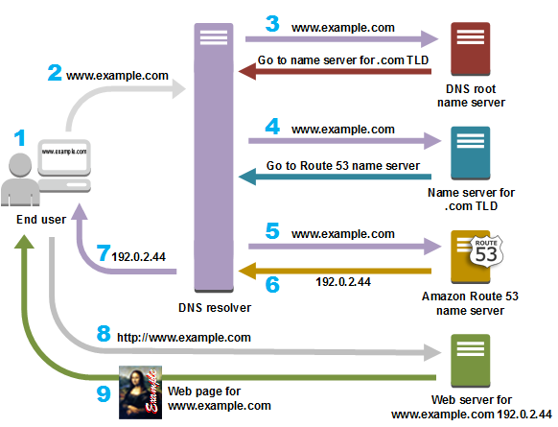
AWS DNS Explained
1/1
DNS is directory service which provides a human readable address, i.e. greatlearning.com, for an IP address, i.e. 54.34.1.5. Look up the name, and get the physical address or hosting location/network.
Hierarchical structure (root and sub-domains)
Both public and private
Only AWS service with 100% SLA!
Runs on port 53 (TCP/UDP), hence Route 53!
Can use your own DNS servers, but not recommended (scale, performance, management, cost)

Slide 14
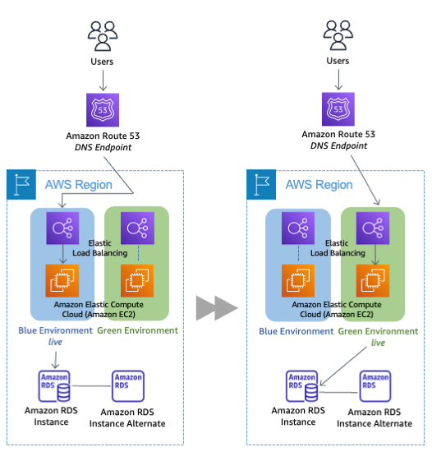
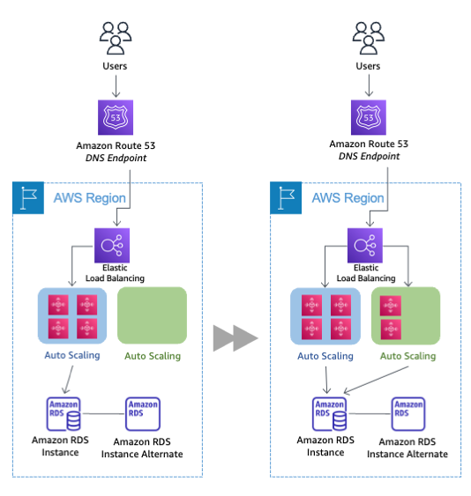
Some cool DNS Techniques
1/1
Blue/Green Deployment or Failover
ASG Swap
Notes:
Blue/Green: Updating the alias record, you can route traffic from the blue environment to the green environment. You can shift traffic all at once or you can do a weighted distribution. For weighted distribution with Amazon Route 53, you can define a percentage of traffic to go to the green environment and gradually update the weights until the green environment carries the full production traffic. This provides the ability to perform canary analysis where a small percentage of production traffic is introduced to a new environment. You can test the new code and monitor for errors, limiting the blast radius if any issues are encountered. It also allows the green environment to scale out to support the full production load if you’re using Elastic Load Balancing(ELB), for example. If issues arise during the deployment, you can roll back by updating the DNS record to shift traffic back to the blue environment. Although DNS routing is simple to implement for blue/green, you should take into consideration how quickly can you complete a rollback. DNS Time to Live (TTL) determines how long clients cache query results. However, with earlier clients and potentially clients that aggressively cache DNS records, certain sessions may still be tied to the previous environment.
ASG swap: A blue group carries the production load while a green group is staged and deployed with the new code. When it’s time to deploy, you simply attach the green group to the existing load balancer to introduce traffic to the new environment. For HTTP/HTTPS listeners, the load balancer favors the green Auto Scaling group because it uses a least outstanding requests routing algorithm. As you scale up the green Auto Scaling group, you can take blue Auto Scaling group instances out of service by either terminating them or putting them in Standby state

Slide 15
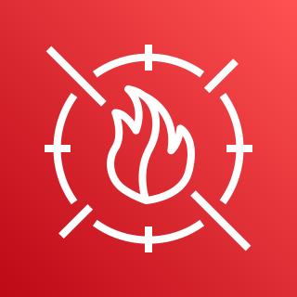
Web Application Firewall (WAF)
Cloud scale firewall for applications
AWS WAF

Slide 16
AWS WAF Explained
1/1
Monitor or controls access to applications (HTTP/HTTPS)
Firewall device associated to
Amazon CloudFront distribution
Amazon API Gateway REST API
Application Load Balancer
AWS AppSync GraphQL API
Use Web ACLs, rules, and rule groups

Slide 17
Open Discussion
Q&A

