Slide 1
PGPCC - Mentor session
Flow and Structure for MS5
Course 2 Week 4
“VPC, R53, WAF”

Slide 2
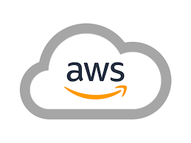
Agenda
Total duration 120 mins
Case analysis (45)
Component section process (5 mins)
VPC at scale (5 mins)
Local and Wavelength zones (5 mins)
Q&A from participants (60 mins)

Slide 3
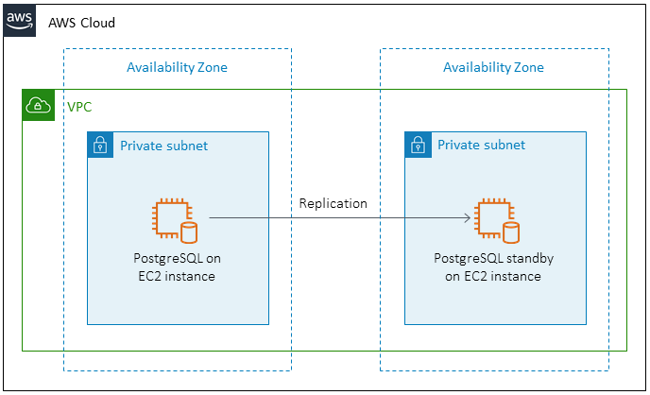
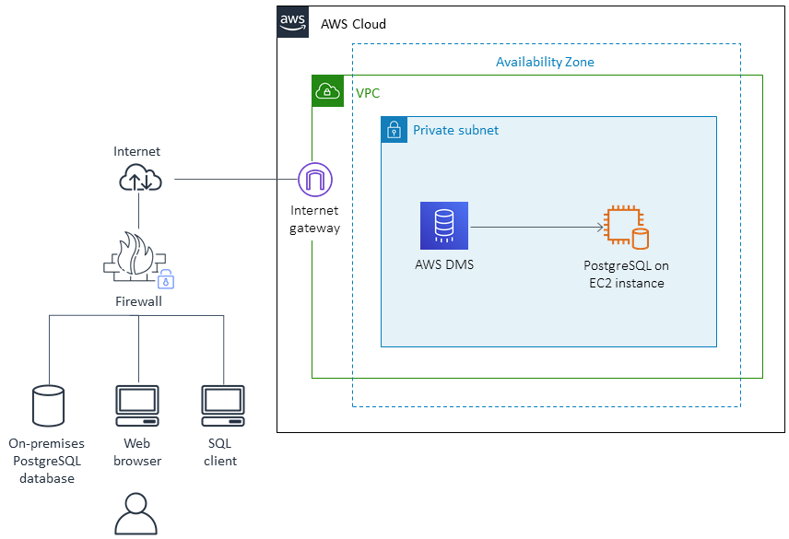
Case: Application & Database migration
https://docs.aws.amazon.com/prescriptive-guidance/latest/patterns/migrate-an-on-premises-postgresql-database-to-amazon-ec2.html
In the above link go to “Epics” subsection and walk through the whole DB migration process -
Analyze the migration - DBA
Infra configure - Cloud Ops (includes VPC)
Prepare EC2 for DB - DBA
Migration - DBA
Migrate app - Dev/Ops + DBA
Cut over - DBA + Dev/Ops
Project closure - All stakeholders
Debate - what if the VPC planning was inaccurate? 60% of the steps and possibly 80%+ of effort is done after VPC planning!
Notes:
Ref -> https://docs.aws.amazon.com/prescriptive-guidance/latest/patterns/migrate-an-on-premises-postgresql-database-to-amazon-ec2.html

Slide 4
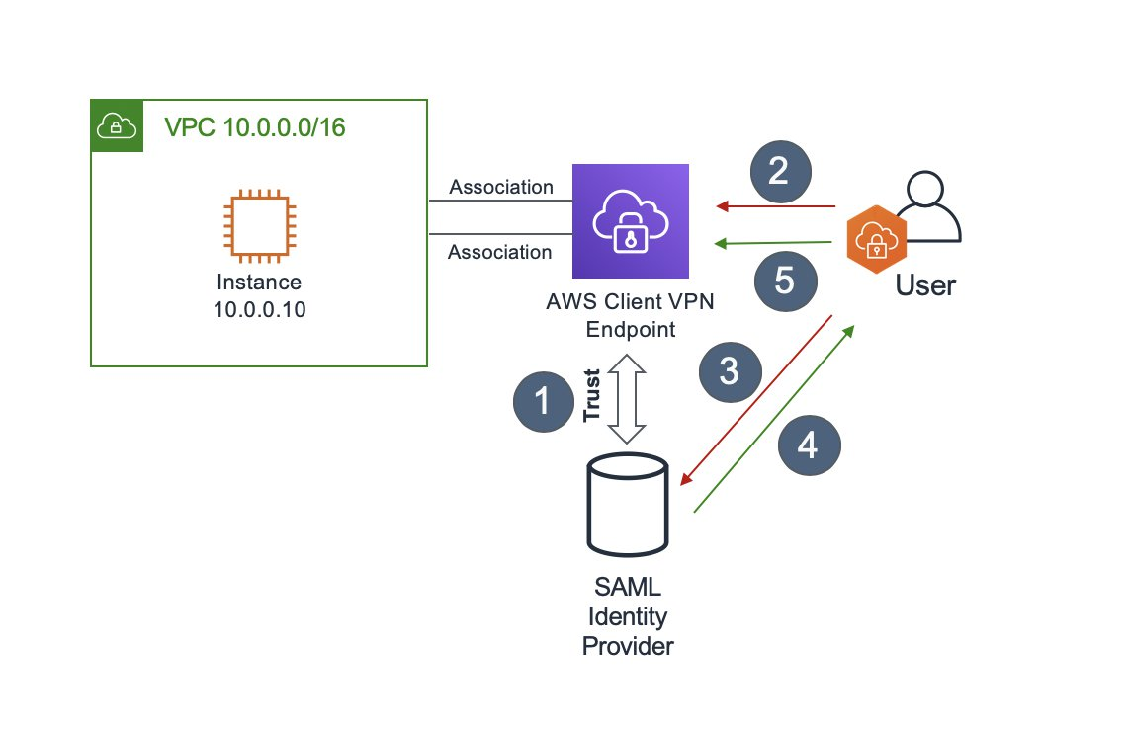
Case: how to integrate AWS Client VPN with Okta?
If you are setting up SAML integration for the first time, you must establish trust between the IdP and the service provider (AWS Client VPN, in this case).
User attempts to create a VPN connection to the Client VPN endpoint using AWS Client VPN software. If that user hasn’t authenticated before, they are redirected to the IdP in their default browser.
User authenticates to the IdP in their browser by providing their credentials and, if enabled, a second authentication factor.
On successful authentication the IdP generates a signed SAML response. This is also called a SAML assertion and includes details about the user like their email and group membership.
Client VPN software forwards the SAML assertion to the Client VPN endpoint. Because Client VPN trusts the IdP, this is accepted as proof that the user is authenticated and the session can be established. At that point, the group membership information can be used to authorize access to specific resources.
Notes:
Ref-> https://aws.amazon.com/blogs/networking-and-content-delivery/authenticate-aws-client-vpn-users-with-saml/

Slide 5
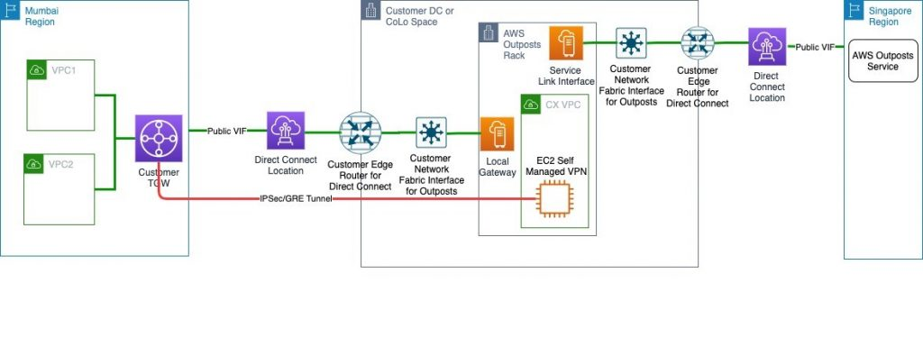
Case: Setting Up Disaster Recovery in a Different Seismic Zone Using AWS Outposts
Notes:
Ref-> https://aws.amazon.com/blogs/architecture/field-notes-setting-up-disaster-recovery-in-a-different-seismic-zone-using-aws-outposts
Walk through the blog while keeping the pic in display. Focus on the various networking components. No reasoning can be given for many choices; we can only guess.
Requirements:
AWS Mumbai Region for their mission-critical workload.
Workload needs a DR setup to comply with local regulation and the DR setup needs to be in a different seismic zone than the one for Mumbai
Because of the nature of the regulated business, the user/sensitive data needs to be stored within India.
Explanation:
The Primary Region in this example is AWS Mumbai Region.
VPN will be provisioned via Local Gateway and DX public VIF. This ensures that data plane traffic will not traverse any network out of the country (India) to comply with data localization mandated by the regulators.
AWS Outpost parent Region will be the closest Region other than AWS Mumbai, in this case Singapore.
Customers will provision an AWS Direct Connect public VIF locally for a Service Link to the Singapore Region. This ensures that the control plane stays available via the AWS Singapore Region even if there is an outage in AWS Mumbai Region affecting control plane availability.
Can then launch and manage AWS Outposts supported resources in the AWS Outposts rack.

Slide 6
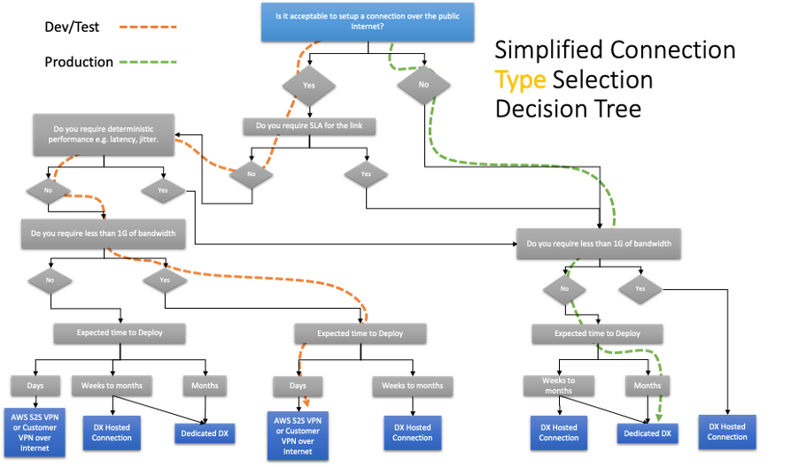
Process: Selecting & Designing Your Hybrid Connectivity Model
Notes:
Ref-> https://aws.amazon.com/blogs/architecture/new-whitepaper-selecting-designing-your-hybrid-connectivity-model
Walk through the blog while keeping the pic in display

Slide 7
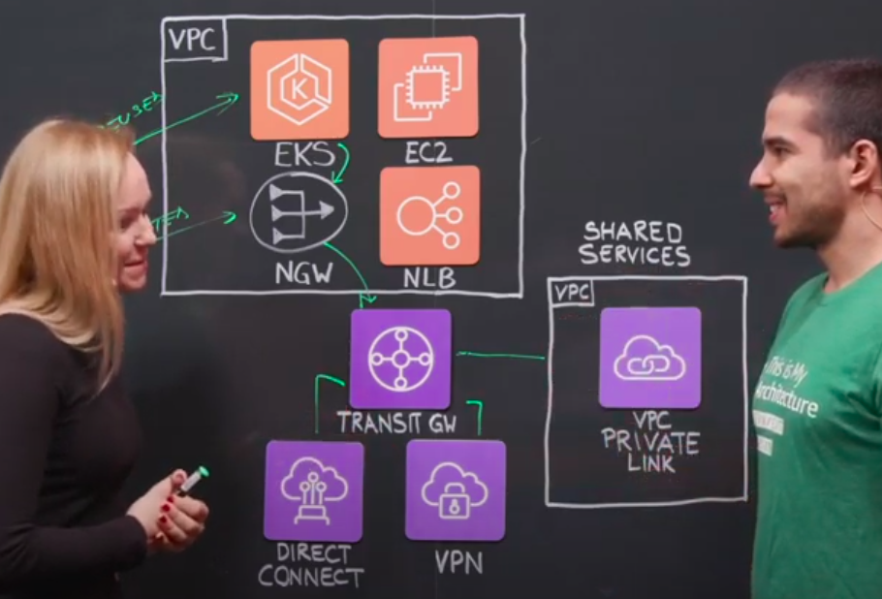
1000’ of VPCs @Adobe
1000’ of AWS accounts and hence 1000’ of VPCs, manage that!
@58sec - issues of the above setup, lots of confusion, obviously
@1min 34sec - IP CIDR allocation strategy [Reuse CIDR, Routed CIDR]
@2min 25sec - all VPCs are connecting to the “Transit Gateway” for information exchange and apps connecting to each other
@3min 11sec - an example of 3rd party/ customers exposing services via “VPC Private link” for private data sharing with Adobe
☆
Notes:
Reference -> https://www.youtube.com/watch?v=QnmmTIYZxNI
Overview of private link from here https://docs.aws.amazon.com/vpc/latest/userguide/endpoint-service.html

Slide 8
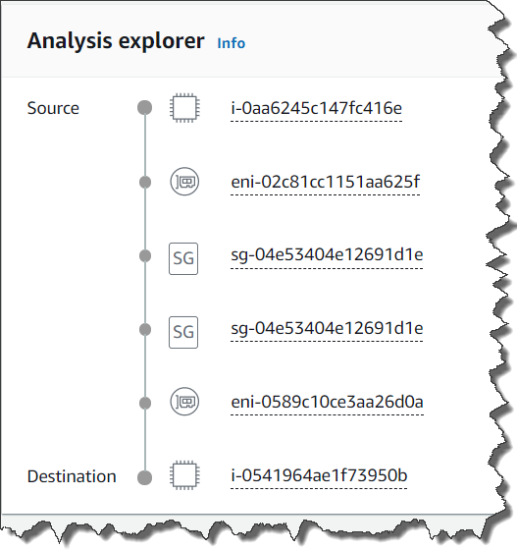
What’s new?
VPC Reachability Analyzer
Ensuring Your Network Configuration is as Intended
You have full control over your virtual network environment, including choosing your own IP address range, creating subnets, and configuring route tables and network gateways.
You can also easily customize the network configuration of your VPC.
Security-sensitive backend systems such as databases and application servers can be placed on private subnets that do not have internet access.
You can use multiple layers of security, such as security groups and network access control list (ACL), to control access to entities of each subnet by protocol, IP address, and port number.
Notes:
Ref-> https://docs.aws.amazon.com/vpc/latest/reachability/how-reachability-analyzer-works.html
https://aws.amazon.com/blogs/aws/new-vpc-insights-analyzes-reachability-and-visibility-in-vpcs/

Slide 9
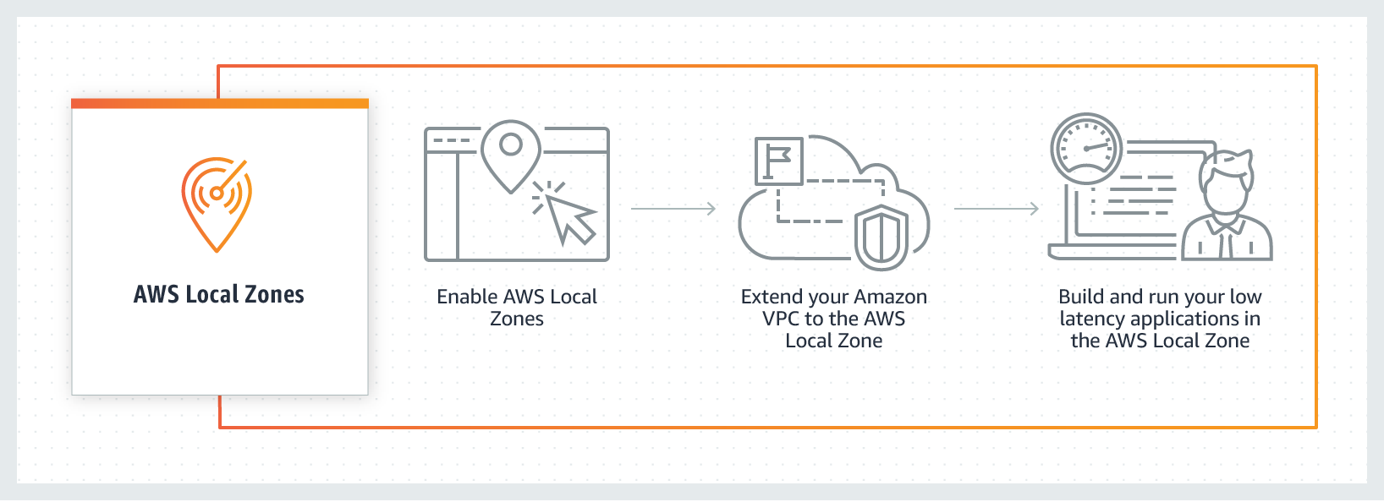
Local zones
AWS Local Zones are a type of AWS infrastructure deployment that places AWS compute, storage, database, and other select services close to large population, industry, and IT centers.
You can easily run applications that need single-digit millisecond latency closer to end-users in a specific geography.
Ideal for use cases such as media & entertainment content creation, real-time gaming, live video streaming, and machine learning inference.
They are an extension of an AWS Region where you can run your latency-sensitive applications using AWS services
Notes:
Ref-> https://aws.amazon.com/about-aws/global-infrastructure/localzones/
Note - Local zones are not available in all countries and also is available in very limited cities.

Slide 10
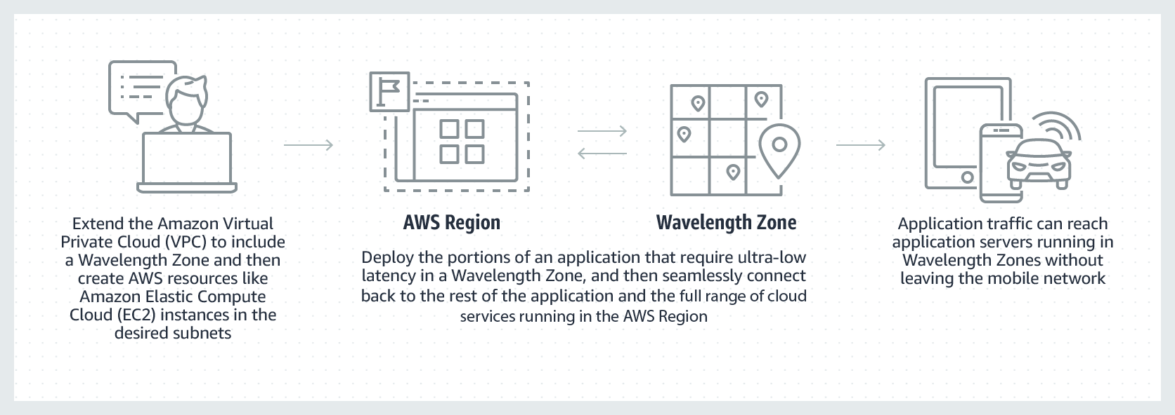
Wavelength zones
AWS Wavelength is an AWS Infrastructure offering optimized for mobile edge computing applications.
Wavelength Zones are AWS infrastructure deployments that embed AWS compute and storage services within communications service providers’ (CSP) datacenters at the edge of the 5G network, so application traffic from 5G devices can reach application servers running in Wavelength Zones without leaving the telecommunications network.
This avoids the latency that would result from application traffic having to traverse multiple hops across the Internet to reach their destination, enabling customers to take full advantage of the latency and bandwidth benefits offered by modern 5G networks.
Notes:
Note - Wavelength zones are not available in all countries.

Slide 11
Q&A

Slide 12
Thank you
Happy Learning!

