Slide 1

Fundamentals of Cloud Computing
Cloud Foundations
LinkedIn: https://linkedin.com/in/cgswong
@cgswong

Slide 2
Agenda
Brief history of Cloud Computing
What is Cloud Computing?
Cloud Models
Benefits of Cloud Computing
Service Models (IaaS, Paas, Saas)
Types of Services

Slide 3


Brief history of Cloud Computing
Before learning about Cloud Computing let’s go back to understand the need, for every journey has a start, with a why.
Salesforce was the first, but Amazon made it a service
A history of cloud computing, is a history of Amazon…
Notes:
In 1999, Salesforce was the example of using cloud computing successfully. They pioneered the idea of using the internet to deliver software programs to end users. The application could be accessed and downloaded by anyone over the internet. However, Amazon pioneered cloud services.

Slide 4

Brief history of Cloud Computing
AWS: Officially launched in 2006, but its origins can be traced back to the early 2000s when Amazon.com faced significant challenges due to its rapidly growing infrastructure needs.
In the late 1990s and early 2000s, Amazon.com experienced exponential growth as an online retailer. To support its operations, Amazon had built a robust and highly scalable infrastructure consisting of numerous servers, storage systems, and networking equipment.
However, the company realizes that it had excess computing capacity that remained idle during non-peak times and recognizing the potential value of this spare capacity, Amazon's internal teams started exploring ways to leverage it and generate additional revenue.
Amazon aimed to transform its surplus computing power into a service that could be offered to external customers, allowing them to access scalable and cost-effective computing resources over the internet
Notes:
In early 2000s, Amazon was growing massively. Like other large companies, Amazon had was struggling with scale, had a jumbled mess of services, but also had significant underusage of infrastructure. Essentially, this was wasted resources or money. The expectation or strategy was made for all internal teams to build decoupled services, use APIs, and consume internal systems in such a manner. That was the start as without even knowing or realizing, they became a services company, via APIs. Application Programming Interfaces or API serve as a contract between a provider and consumer of services, to providing some capability or information. They are meant to be stable with infrequent changes, but should the contract change, the API gets a different version with the previous being deprecated, but both being available for an extended period of time until the previous is made unavailable when no longer used.
So, many an internal discussion continued to be held from an initial retreat on core competencies, excess infrastructure, expertise, and revenue streams. A few years later, that excess infrastructure, internal expertise in building data centers, managing infrastructure, and using APIs was used to launch EC2. First as SQS or simple queue service (in 2004), then storage as S3 (in March 2006), then compute with EC2 (in August 2006).
So, AWS was launched as the service arm of Amazon, and the rest is now present cloud ☺ .
So, what is Cloud Computing? It is the delivery of services over a network. Being able to consume those services, whenever or on-demand, in a usage-based pricing model.

Slide 5

What is Cloud Computing?
Compute powers the processing and execution of tasks
Networking facilitates the communication and transfer of data between devices
Storage enables the retention and retrieval of data at various stages
The on-demand delivery of computer system resources, without direct, active management over the internet. Typically in a pay-as-you-go pricing model.
Using someone else’s computing resources over the internet!
Notes:
Cloud computing is a technology that allows users to access and use computing resources (such as servers, storage, databases, networking, software) over the internet. Instead of owning and maintaining physical hardware or infrastructure, users can leverage services provided by cloud service providers on a pay-as-you-go basis. This model offers flexibility, scalability, and cost-effectiveness, enabling individuals and businesses to deploy and manage applications and data without the need for significant upfront investments in hardware and IT infrastructure. Cloud computing services can be categorized into Infrastructure as a Service (IaaS), Platform as a Service (PaaS), and Software as a Service (SaaS), each providing different levels of abstraction and management control.

Slide 6
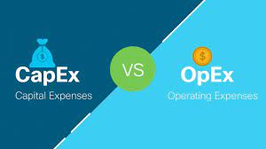
Cloud Computing and CapEx vs. OpEx
Capital Expenditure (CapEx)
Up-front payment on physical resources
Resources are owned
Value of resources depreciate over time
Ongoing costs hidden
Operational Expenditure (OpEx)
Spend on products and services as needed, or pay-as-you-go
No resource ownership
Billed immediately
Transparent costs
Notes:
OpEx is a common business case for cloud computing. CFO may be even more interested than CIO and CTO.
SWOT – Strengths, Weaknesses, Opportunities, Threats
Strength - increases

Slide 7
Cloud Models
Public Cloud
Underlying resources managed and operated by third-party provider
No ownership or operational overhead for computing resources
Computing resources delivered on-demand
Usage-based pricing model
Private Cloud
Resources dedicated to single organization
Typically service delivery over private network
Organization controls computing resources
Tighter control, and higher maintenance
Hybrid Cloud
Integration of public and private cloud
Use existing investments in data centers
Higher control on resources and data
More flexibility in deployment options
Notes:
Public cloud
A third-party cloud service provider manages the underlying computing resources. The provider is responsible for resource maintenance and guarantees availability, reliability, and security through service-level agreements. You don’t buy, own, and maintain physical data centers and servers; instead, you access technology services on an as-needed basis. In addition, several tasks, such as runtime resource scaling, are automated for operational efficiency.
Private cloud compared to public cloud
It is almost impossible to replicate public cloud infrastructure privately. You get significantly more breadth and depth of services from a public cloud provider because it is fully dedicated to scaling and improving its offerings. You also get more innovation, access to a global community, and proven operational expertise.
Private Cloud – Organizations kept hardware in their internal on-premises data centers and co-location facilities to support their IT operations. After AWS was launched, companies attempted to replicate the cloud computing model on their internal infrastructure. The term private cloud was introduced to distinguish between these internal cloud environments and third-party, public cloud services provided by organizations such as AWS.
Types of Private Cloud:
On-premises private cloud - You can deploy on your own resources in an internal data center. You must purchase the resources, maintain and upgrade them, and ensure security. On-premises private cloud management is expensive and requires heavy initial investment and ongoing expenses.
Managed private cloud - A single-tenant environment fully managed by a third party. For example, the IT infrastructure for your organization could be purchased and maintained by a third-party organization in its data center. The third party provides maintenance, upgrades, support, and remote management of your private cloud resources. While managed private clouds are expensive, they are more convenient than on-premises solutions.
Virtual private cloud - A private cloud that you can deploy within a public cloud infrastructure. It is a secure, isolated environment where private cloud users can run code, host websites, store data, and perform other tasks that require a traditional data center. Virtual private clouds efficiently give you the convenience and scalability of public cloud computing resources along with additional control and security.
Hybrid cloud
A hybrid cloud is an IT infrastructure design that seamlessly integrates a company's public and private clouds. As a result, you can store your data and run your applications across multiple environments without noticing a difference. Your hybrid cloud environment consolidates your infrastructure, so that you can provision, scale, and centrally manage all your compute resources.
Private cloud compared to hybrid cloud
Hybrid cloud services extend your private cloud computing model into the public cloud. For example, your private cloud applications can access public cloud resources when there is a spike in traffic that your data center cannot handle. You can also use hybrid cloud computing services to transition smoothly from private cloud environments to public clouds.

Slide 8
Benefits of Cloud Computing
High availability
Fault Tolerance
Disaster Recovery
Global Reach
Scalability
Elasticity
Security
Low Latency
Agility
Predictive Pricing

Slide 9
Cloud computing service models
IaaS
Infrastructure as a Service
PaaS
Platform as a Service
SaaS
Software as a Service
A model in which a third-party provider hosts servers, storage and other virtualized compute resources and makes them available to customers over the internet.
EXAMPLES:
AWS EC2, Microsoft Azure Blob Storage, Google Compute Engine
A model in which a third-party hosts application development platforms and tools on its own infrastructure and make them available to customers over the internet.
EXAMPLES:
AWS Elastic Beanstalk, Google App Engine, Heroku
A software distribution model in which a third-party provider hosts applications and makes them available to customers over the internet
EXAMPLES:
Salesforce, Netsuite, Concur, Office365
Notes:
SPIDERS: SasS, PaaS, IaaS, bigData, Elastic, Resilient, Subscription

Slide 10
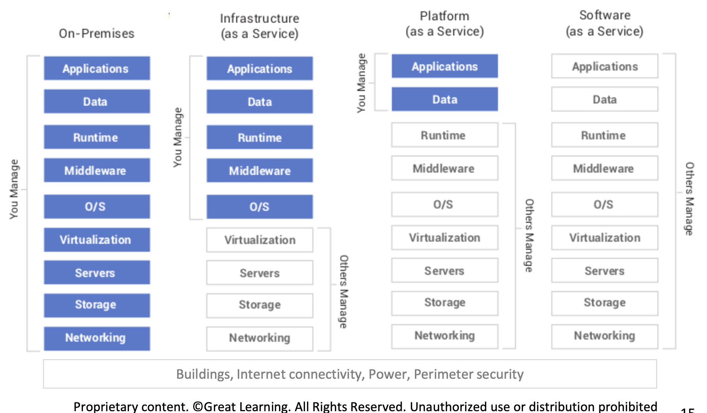
Notes:
Please explain the On-Prem elements briefly (this is IMP, learners always ask) then compare to Cloud
Runtime can be a little difficult to grasp for folks
The runtime environment ensures that the software can utilize system resources effectively and provides an execution environment that is consistent across different platforms
The runtime provides an abstraction layer between the application and the underlying hardware and operating system.
It encompasses the libraries, frameworks, and other components required to run and manage the execution of the software.

Slide 11
Types of Services
Compute
Networking
Storage
Databases
Web Services
Internet of Things (IoT)
Big Data and Analytics
Identity and access management
Artificial Intelligence (AI) and Machine Learning (ML)
Monitoring
DevOps

Slide 12
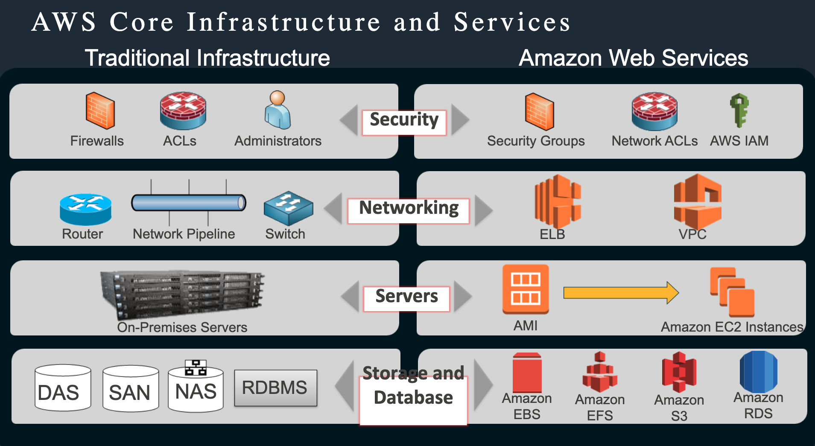
AWS Turkey Roadshow Presentation - AWS Core Services (Compute, Network, Storage)
© 2018, Amazon Web Services, Inc. or its Affiliates

Slide 13

Q&A

Slide 14
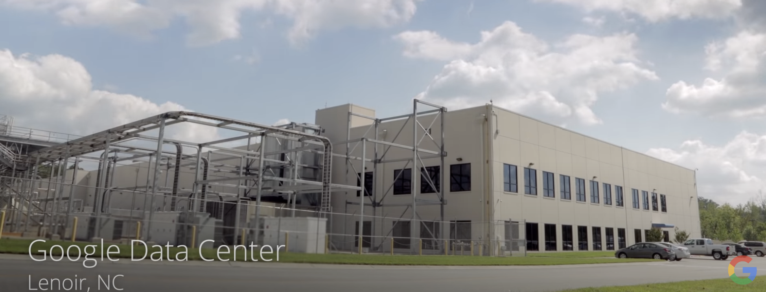
The cloud is actually physical….
Explore a Google Data Center:
https://www.youtube.com/watch?v=avP5d16wEp0
Inside Amazon’s Massive Data Center:
https://www.youtube.com/watch?v=q6WlzHLxNKI

Slide 15
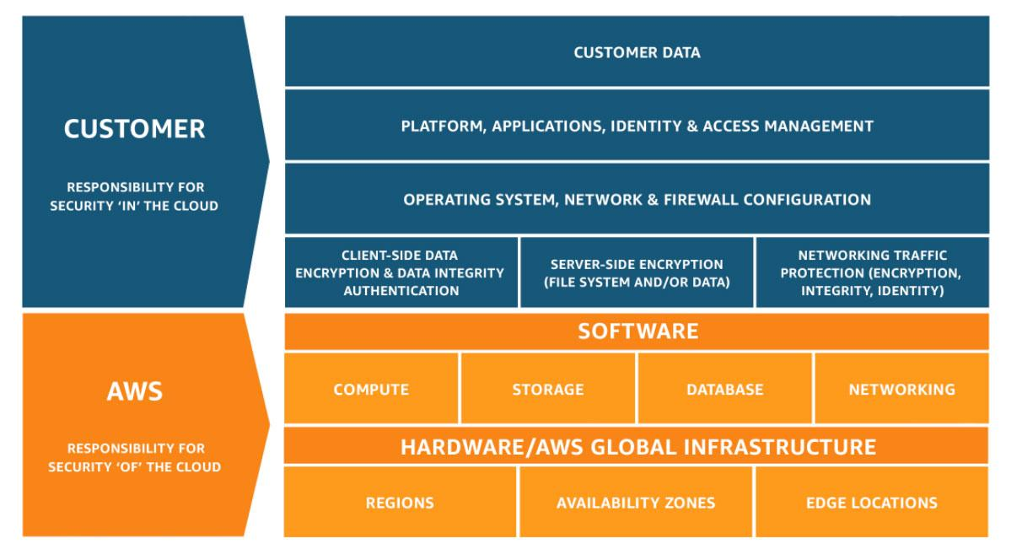
Shared Responsibility Model
Notes:
References:
https://aws.amazon.com/compliance/shared-responsibility-model/

Slide 16
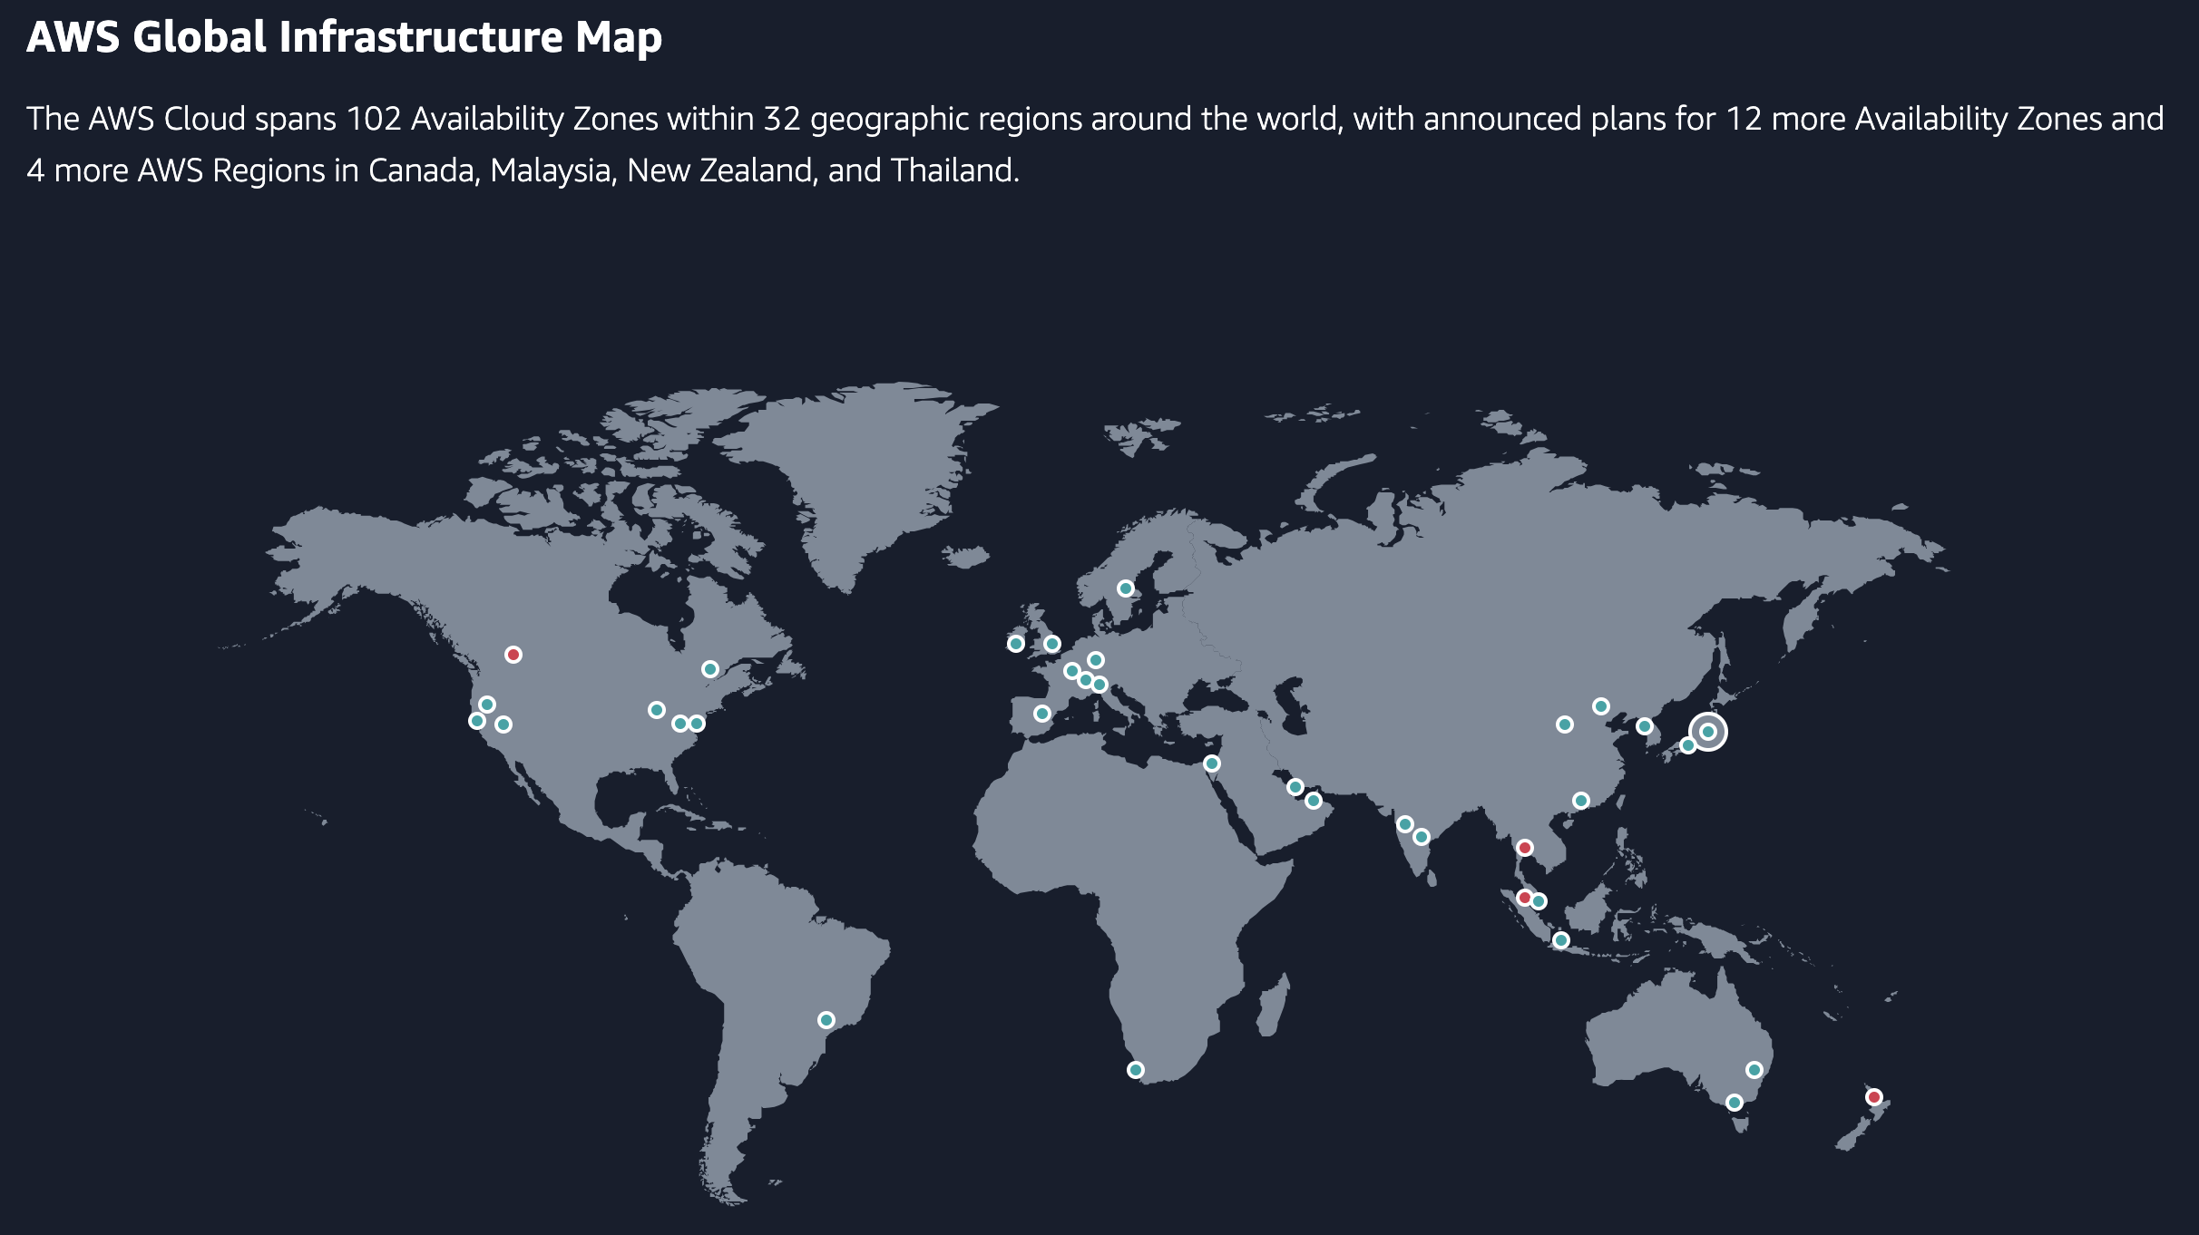

Slide 17
Annexures

Slide 18
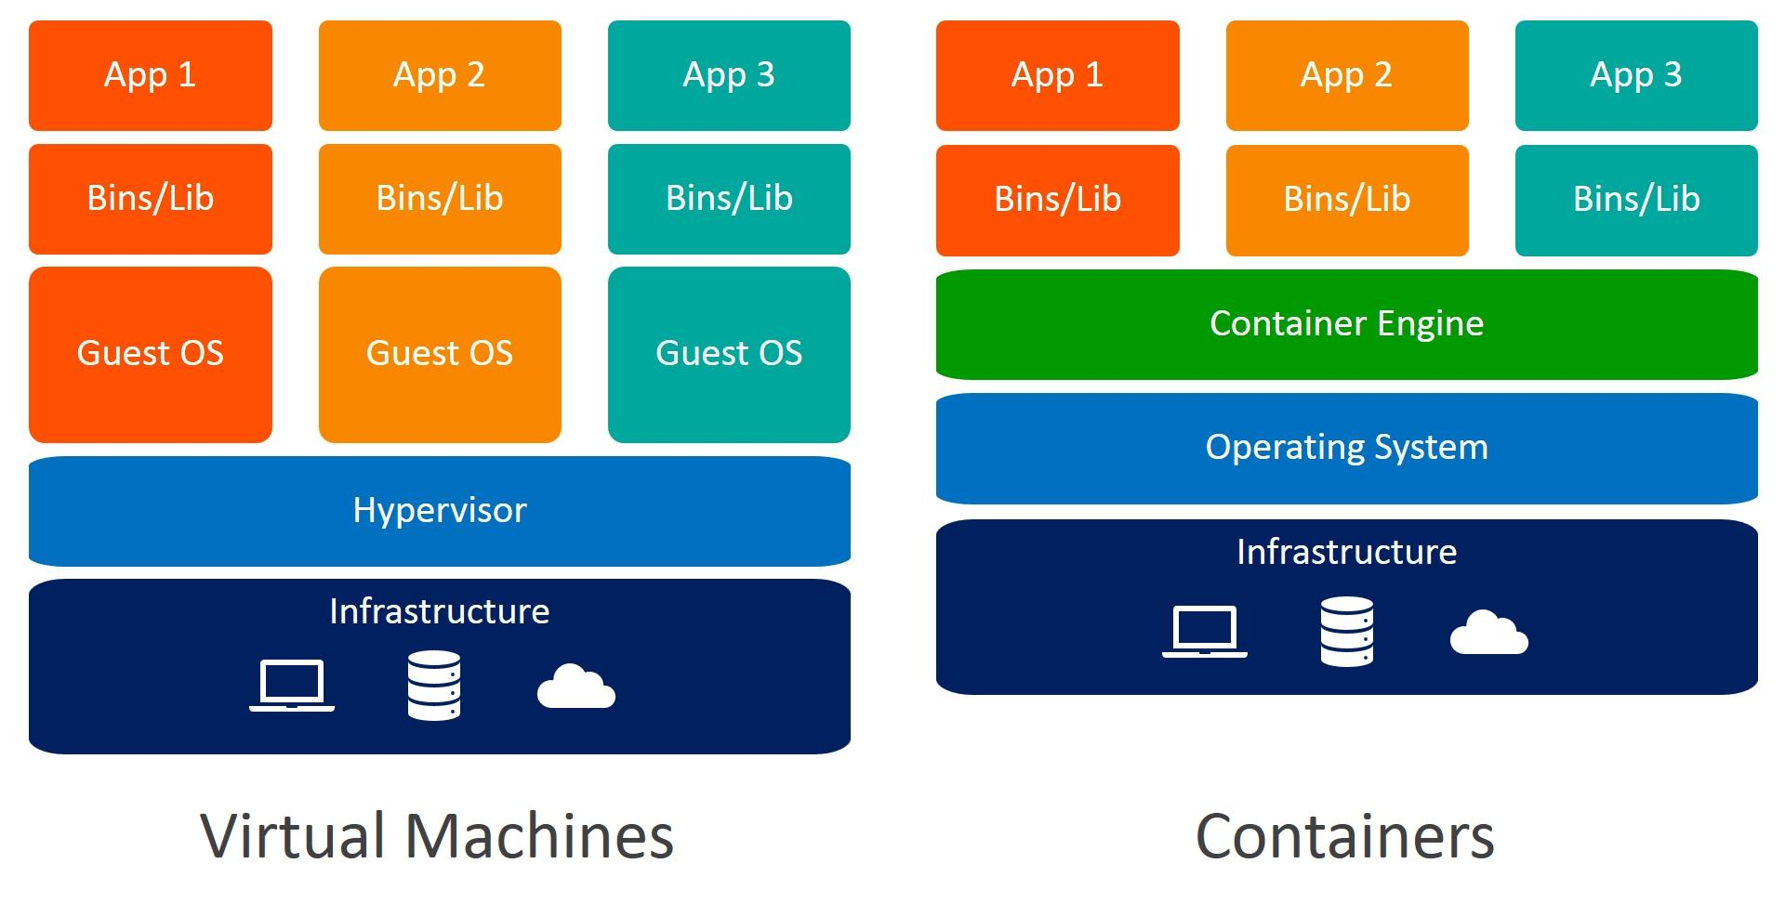
VMs and Containers
Notes:
References:
https://www.weave.works/blog/a-practical-guide-to-choosing-between-docker-containers-and-vms

Slide 19
Set Up Your Organization for cloud
A cloud center of excellence is the best-practice approach to drive cloud-enabled transformation.
How do we develop and enforce organization-wide cloud computing policies in a way that allows us to be flexible, without exposing us to unacceptable levels of organizational risk?
How do we guide our internal users in selecting the right cloud providers to find the best fit and manage vendor-related risk?
How do we manage and mitigate security and regulatory compliance risks while ensuring confidentiality, integrity and availability?
How do we govern our costs and forecast our future costs?
How do we get “smarter about cloud” and make our organization aware of best practices, and keep up with the rate of change introduced by cloud providers?
How can we drive cloud-enabled transformation across the business and help our stakeholders think through the business possibilities enabled by cloud?
CCOE has three core pillars
Governance: Create policies in collaboration with a cross-functional team and select governance tools to provide financial and risk management.
Brokerage: Assist users in selecting cloud providers, architect the cloud solution(s) and collaborate with the sourcing team for contract negotiation and vendor management.
Community: Raise the level of cloud knowledge in the organization and capture and disseminate best practices through a knowledge base, source code repository, training events, outreach throughout the organization, and more.
Notes:
Gartner - “Setup your organization for cloud adoption success” https://www.gartner.com/en/conferences/hub/cloud-conferences/insights/how-to-build-a-cloud-center-of-excellence
“Enterprise architecture” was and “is” all about business and less about tech. Do you think there is a stark similarity of the enterprise architecture charter with CCOE?
It is also about “Citizen driven development”, give the power at the hands of the grass root foot soldiers, you know like you and me, the people who deliver stuff for our customers. We know what it takes, we know what the problems and how to tackle them. All this knowledge was bottled up, now with democratized tech, we can be product creators! Creators of reusable assets, define best practices, define automation, limitless possibilities! Isn’t it?
Notes:
need right skills and organizational structure
Will not be as successful (successful) if conforming to old norms, practices, and organization structures
Key takeways:
Adopt Cloud Center of Excellence (CCoE) to drive practices, provide guidance and oversight and drive innovation
build up knowledge communities and develop skills
lunch and learn, developer forums, etc.
Develop policies, patterns and blueprints, but let teams innovate for their particular use case

Slide 20
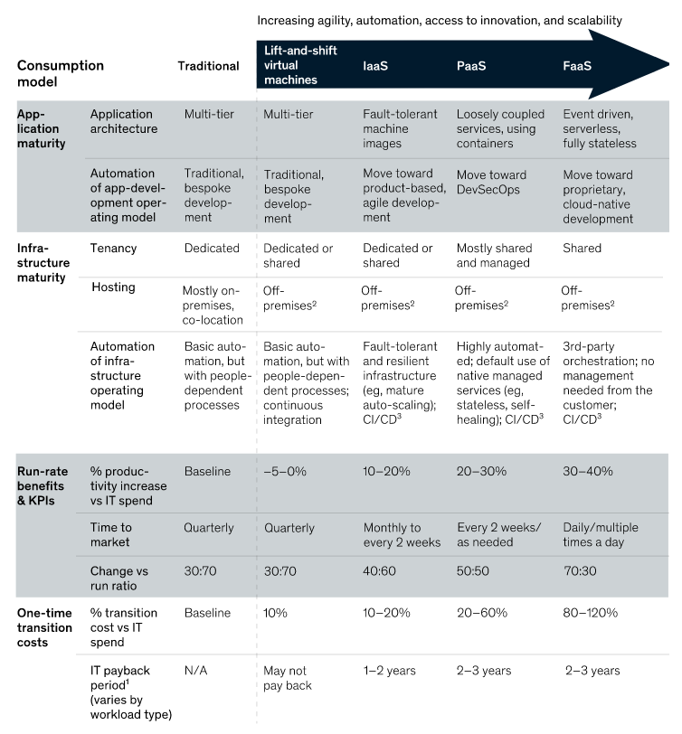
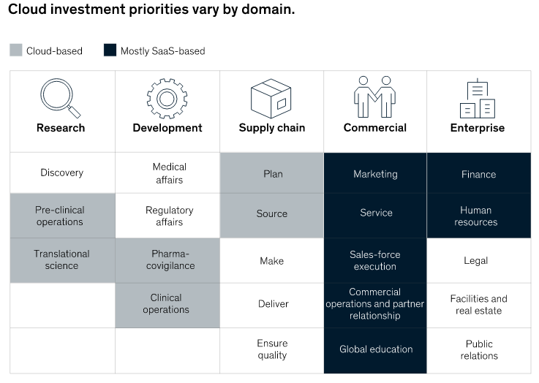
Capturing the value of the cloud
McKinsey - “Capturing the value of the cloud” from the cloud consumer’s perspetive
https://www.mckinsey.com/business-functions/mckinsey-digital/our-insights/how-cios-and-ctos-can-accelerate-digital-transformations-through-cloud-platforms
Notes:
Reference - https://www.mckinsey.com/business-functions/mckinsey-digital/our-insights/capturing-value-in-the-cloud

Slide 21
Capturing the value of the cloud
It has been more than a decade since the first corporate experiments with external cloud platforms, and the verdict is long in on their business value. Companies that adopt the cloud well bring new capabilities to market more quickly, innovate more easily, and scale more efficiently—while also reducing technology risk.
Unfortunately, the verdict is still out on what constitutes a successful cloud implementation to actually capture that value.
Defining the cloud opportunity too narrowly with siloed business initiatives, such as next-generation application hosting or data platforms, almost guarantees failure
Companies that reap value from cloud platforms treat their adoption as a business-technology transformation
Twenty years ago a single small application might run on a $25,000 server. Today, a similar-size application might run on a $5,000 server shared with ten other applications.
Contd ...
Notes:
Reference - https://www.mckinsey.com/business-functions/mckinsey-digital/our-insights/how-cios-and-ctos-can-accelerate-digital-transformations-through-cloud-platforms

Slide 22
Capturing the value of the cloud
These realities have led an overwhelming majority of large institutions to experience one or more of the following failure modes:
Pilot stall: Companies have succeeded in implementing a few greenfield applications on public-cloud platforms, but the value derived from these programs has been limited. This makes further progress impossible because tech leaders cannot make a convincing business case to extend the use of the cloud platform into the heart of IT’s technology environment.
Cloud gridlock: Cloud initiatives become jammed up in long queues because IT cannot build out the automation or reference architectures required to use public-cloud-platform services in a secure, resilient, and compliant fashion.
No value from “lift and shift”: The migration of significant portions of the technology environment—largely by replacing on-premises virtual machines with off-premises ones without taking advantage of cloud-optimization levers—has failed to significantly reduce costs or increase flexibility. Support for cloud initiatives subsequently collapses.
Cloud chaos: Tech leadership does not have an aligned vision and does not provide the required guidance or management oversight, leaving developers largely to their own devices in configuring cloud services. This leads to very divergent approaches and tooling with significant security, resiliency, and compliance risks.
Alright, what about technical challanges ...
Notes:
Reference - https://www.mckinsey.com/business-functions/mckinsey-digital/our-insights/how-cios-and-ctos-can-accelerate-digital-transformations-through-cloud-platforms

Slide 23
Capturing the value of the cloud
Outdated technology environments make change expensive.
Rigid and brittle infrastructures choke on the data required for sophisticated analytics.
Decisions about cloud architecture and sourcing carry significant risk and cost implications—to the tune of hundreds of millions of dollars for large companies.
Success requires CIOs and tech leaders to do three things.
Focus cloud investments in business domains where cloud platforms can enable increased revenues and improved margins
Select a technology, sourcing, and migration model that aligns with economic and risk constraints
Change operating models to capture cloud value
Notes:
Reference - https://www.mckinsey.com/business-functions/mckinsey-digital/our-insights/how-cios-and-ctos-can-accelerate-digital-transformations-through-cloud-platforms

