Slide 1

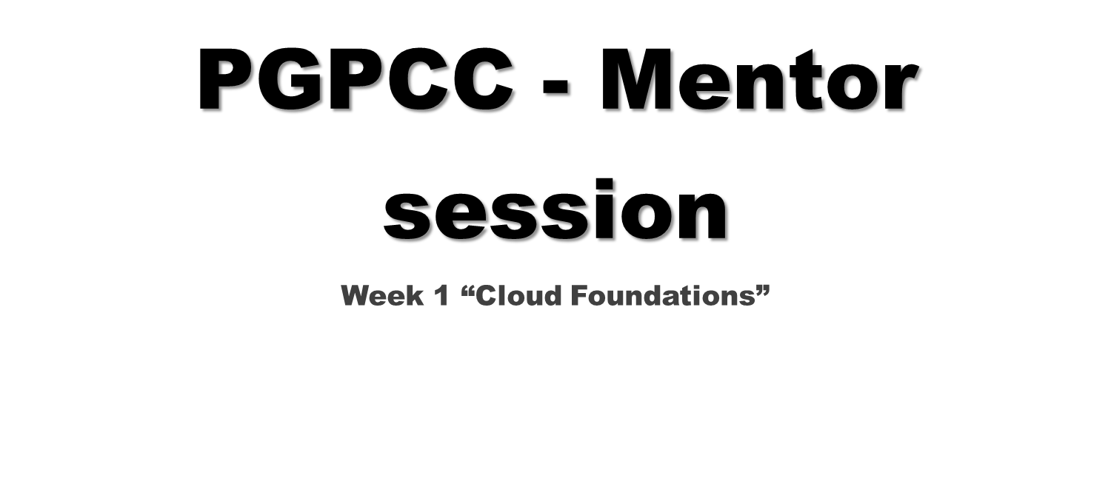

Slide 2
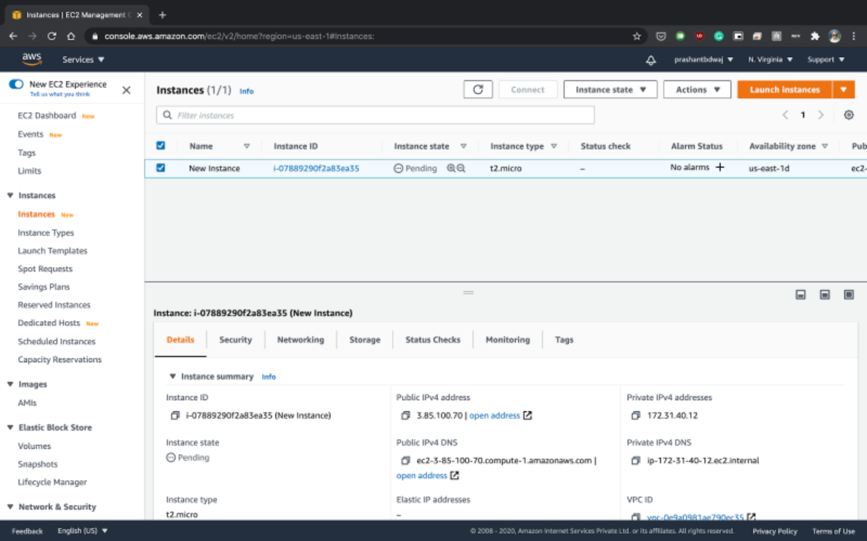
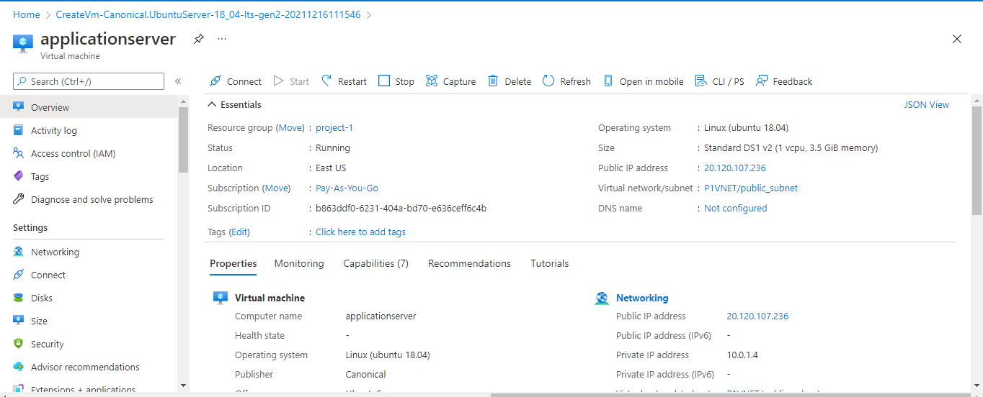
Virtual Machines
EC2
Virtual Machines
Azure VMs
Notes:
Cloud providers may present the service in different ways via the web console, but concepts are similar. For example, both providers have the same attributes - ip, tag, location, status, network, subnet etc

Slide 3
Elasticity
Autoscaling Groups : Amazon EC2 Auto Scaling helps you ensure that you have the correct number of Amazon EC2 instances available to handle the load for your application. You create collections of EC2 instances, called Auto Scaling groups.
Elasticity
VM Scale Sets : Azure virtual machine scale sets let you create and manage a group of load balanced VMs. The number of VM instances can automatically increase or decrease in response to demand or a defined schedule.
Notes:
Cloud elasticity is the ability of a cloud computing system to automatically adjust the amount of resources allocated to it based on the current demand. This means that the system can scale up or down its resources as needed, without any manual intervention. Elasticity is important because it allows cloud systems to handle sudden spikes in traffic or usage without crashing or slowing down.
Scalability, on the other hand, refers to the ability of a system to handle increasing amounts of work by adding more resources. While scalability is also important, it differs from elasticity in that it requires manual intervention to add more resources. In other words, scalability is a proactive approach to handling increased demand, while elasticity is a reactive approach.
To summarize, cloud elasticity is the ability of a cloud system to automatically adjust its resources based on demand, while scalability is the ability of a system to handle increased demand by adding more resources manually.
Think of scalability and elasticity as two tools for managing your cloud resources. Scalability helps you handle predictable growth, while elasticity helps you deal with unexpected spikes in demand.

Slide 4
Load Balancing
Elastic Load Balancer : Elastic Load Balancing automatically distributes your incoming traffic across multiple targets, such as EC2 instances, containers, and IP addresses, in one or more Availability Zones. It monitors the health of its registered targets, and routes traffic only to the healthy targets.
Load Balancing
Azure Load Balancer : An Azure load balancer is a Layer-4 (TCP, UDP) load balancer that provides high availability by distributing incoming traffic among healthy VMs. A load balancer health probe monitors a given port on each VM and only distributes traffic to an operational VM.
Notes:
A load balancer is a device that distributes incoming network traffic across multiple servers to ensure that no single server is overwhelmed with requests. It helps to improve the performance, reliability, and availability of applications by ensuring that they are always available to users.
Load balancers have several advantages over DNS, including:
- Reliability: Load balancers can detect when a server is down and redirect traffic to other servers, ensuring that users can always access the application. DNS typically performs no health check.
- Scalability: Load balancers can distribute traffic evenly across multiple servers, allowing applications to scale horizontally as demand increases. DNS typically uses simple round-robin.
- Security: Load balancers can protect applications from common network attacks, such as DDoS attacks, by filtering traffic and blocking malicious requests.
- Flexibility: Load balancers can be configured to route traffic based on a variety of factors, such as server health, user session, path, or header information.
- Performance: Load balancers can improve application performance by directing users to the server that has the least amount of traffic.
DNS, on the other hand, is a naming system that translates domain names into IP addresses. While DNS can be used to distribute traffic across multiple servers, it lacks the advanced features and capabilities of a dedicated load balancer.

Slide 5
Object Storage
AWS S3 : Amazon Simple Storage Service (Amazon S3) is an object storage service that offers industry-leading scalability, data availability, security, and performance. Amazon S3 provides management features so that you can optimize, organize, and configure access to your data to meet your specific business, organizational, and compliance requirements.
Object Storage
Blob Storage : Azure Blob storage is Microsoft's object storage solution for the cloud. Blob storage is optimized for storing massive amounts of unstructured data. Unstructured data is data that doesn't adhere to a particular data model or definition, such as text or binary data.
Notes:
Object storage is a computer data storage architecture designed to handle large amounts of unstructured data. Unlike other architectures, it designates data as distinct units, bundled with metadata and a unique identifier that can be used to locate and access each data unit. These units, or objects, can be stored on-premises, but are typically stored in the cloud, making them easily accessible from anywhere. Object storage is ideal for storing static content, data archives, and backups.
Some of the benefits of object storage over other storage types include:
Scalability - Object storage is highly scalable and can handle massive amounts of data.
Cost-effectiveness – object storage can reduce costs by up to 80% compared to an enterprise filer
Ease of use – Object storage has a simple REST API and permission model
Durability – Object storage is designed to provide high durability and available for data
Efficiency – Object storage is efficient for storing large amounts of unstructured data

Slide 6
RDBMS
RDS : Amazon Relational Database Service (Amazon RDS) is a web service that makes it easier to set up, operate, and scale a relational database in the AWS Cloud. It provides cost-efficient, resizable capacity for an industry-standard relational database and manages common database administration tasks.
RDBMS
Azure SQL : Azure SQL is a family of managed, secure, and intelligent products that use the SQL Server database engine in the Azure cloud.

Slide 7
Code Repository
CodeCommit : AWS CodeCommit is a secure, highly scalable, managed source control service that hosts private Git repositories. It makes it easy for teams to securely collaborate on code with contributions encrypted in transit and at rest.
Code Repository
Azure Repos : Azure Repos is a set of version control tools that you can use to manage your code. Version control systems are software that help you track changes you make in your code over time

Slide 8
AWS vs Azure
Sr | Domain | AWS | Azure
1 | Block Storage | EBS | Azure Disk Storage
2 | Traffic Routing | Route53 | Traffic Manager
3 | Networking | VPC | Virtual Network
4 | Firewalls | WAF | Azure Firewall
5 | NoSQL | DynamoDB | CosmosDB
6 | Notifications | SNS | Notification Hub
7 | Messaging | SQS | Service Bus
8 | Data Querying | Athena | Datalake Analytics
9 | Data Streaming | Kinesis | Event Hub
10 | Serverless Deployments | Lambda | Functions
11 | Image Analysis | Rekognition | Azure Face

Slide 9
AWS vs Azure
Sr | Domain | AWS | Azure | GCP
12 | Text Analysis | Comprehend | Azure Cognitive Service
13 | Text-to-Speech | Polly | Azure TTS
14 | Containers | ECS | Container Instances
15 | Code Deployment | Code Deploy | Azure Pipelines
16 | PaaS Deployments | Elastic Beanstalk | App Service
17 | Infrastructure-As-Code | CloudFormation | ARM Templates
18 | User Authentication and Security | IAM | RBAC
19 | Resource Monitoring | CloudWatch | Azure Monitor
20 | Script-based access | AWS CLI | Azure CLI
21 | State Machine | Step Functions | Azure State Machine
22 | Cache | Elasticache | Azure Redis Cache

Slide 10
Cost Comparison : EC2 vs Azure Virtual Machines using Windows OS
AWS EC2
Region : N. Virginia
OS : Windows Server
Configuration : 4vCPUs, 16GB RAM
Duration of use : 730 hours
Total Cost : $166.52
Azure Virtual Machines
Region : East US
OS : Windows Server
Configuration : 4vCPUs, 16GB RAM
Duration of use : 730 hours
Total Cost : 132.86

Slide 11
Cost Comparison : EC2 vs Azure Virtual Machines using RedHat Linux
AWS EC2
Region : N. Virginia
OS : RedHat Linux
Configuration : 4vCPUs, 16GB RAM
Duration of use : 730 hours
Total Cost : $144.91
Azure Virtual Machines
Region : East US
OS : RedHat Linux
Configuration : 4vCPUs, 16GB RAM
Duration of use : 730 hours
Total Cost : 164.98

Slide 12
Pricing Calculators
AWS Pricing Calculator : https://calculator.aws/#/ https://docs.aws.amazon.com/pricing-calculator/latest/userguide/getting-started.html
Azure Pricing Calculator : https://azure.microsoft.com/en-in/pricing/calculator/ https://microsoftlearning.github.io/AZ-900T0x-MicrosoftAzureFundamentals/Instructions/Walkthroughs/19-Use%20the%20Azure%20Pricing%20Calculator.html

Slide 13
Cloud Deployment Models
Infrastructure as a Service(IaaS) :A cloud computing service where enterprises rent or lease servers for compute and storage in the cloud.
Platform as a Service (PaaS) : A cloud computing model where a third-party provider delivers hardware and software tools to users over the internet.
Software as a Service (SaaS) : A method of software delivery and licensing in which software is accessed online via a subscription, rather than bought and installed on an individual computer
Container as a Service (CaaS) : Containers as a service ( CaaS ) is a cloud-based service that allows software developers and IT departments to upload, organize, run, scale, and manage containers by using container-based virtualization.
Serverless Deployment : Serverless is a cloud-native development model that allows developers to build and run applications without having to manage servers. There are still servers in serverless, but they are abstracted away from app development

Slide 14
Cloud Service Models
Public Cloud : A model where a service provider makes resources, such as applications and storage, available to the general public over the internet
Private Cloud : A set of cloud computing services enabled in an internal data center of an organization
Hybrid Cloud : Any combination of Public, Private & Community. Eg. - any cloud (one or more) along with any static in-house data center (one or more) are integrated

Slide 15
Managed Services
Managed cloud services are services that offer partial or complete management of a client’s cloud resources or infrastructure.
Provides out-of-the-box solutions for multiple use-cases.
Multiple configurations and pricing models are available so that you can select the one which is the best fit for your use-case.

Slide 16
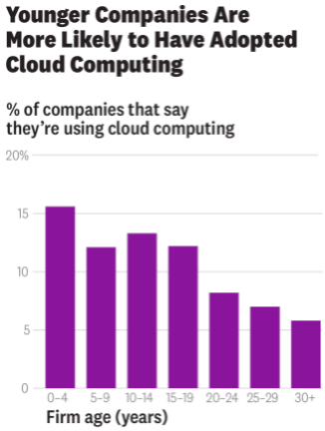
Research: Cloud Computing Is Helping Smaller, Newer Firms Compete
KenSci is a small Seattle-based healthcare analytics company, which uses machine learning techniques to analyze hundreds of variables about patients’ conditions to provide real-time predictions
Pivothead is a firm with 25 employees producing wearable technologies to help the blind and visually impaired
These anecdotes suggest that cloud computing has “democratized computing” by bringing it to the masses of firms.
“In this paper we use the records from more than 150,000 U.S. firms with information on their adoption of cloud computing.” (as on 2016)
Less than 0.5% of firms had adopted it in 2010, whereas 7% had by 2016, which is an annualized growth rate of almost 50%.
Firms with fewer than 25 employees have adoption rates of 10% to 15% on average
Although we don’t have data on how cloud computing affects firm performance, it’s not hard to imagine that lowering computing costs would substantially improve younger and smaller companies’ chances
2020+ question has changed - “Why do we need cloud?” to “Why we don’t need cloud?”
Notes:
Harvard Business Review - “Research: Cloud Computing Is Helping Smaller, Newer Firms Compete” https://hbr.org/2018/08/research-cloud-computing-is-helping-smaller-newer-firms-compete
You know cloud is not just a big boys game! The corporations with deep pockets! Not at all! What you and I have as individuals is the SAME as that of GE, Unilever, you name it!
Remember on thing though - is cloud the differentiator? NO, it provides the tools which can be used to create that “differentiator” quickly, and to fail fast so that you can pivot quickly !
Notes:
Benefits across industries or organization types (startup or traditional)
Key Takeaways:
Low cost of entry due to usage based pricing
startups mostly leveraging to become profitable, but also legacy/traditional to reduce operating costs and become more nimble
Agility, being immediately able to create applications and become productive (day 1)
here again, startups can quickly launch services and compete, but also legacy/traditional enterprises must become more nimble to compete with startups!
being able to build an app in a few hours to days (depending) or launch a product in even 20 days (depending)
References:
Monzo (UK bank), finacial services
8 engineers manage infrastructure for 4+ million customers
real-time statements instead of typical 48 hours or more
also migrated to multi-account setup in less than a day
Robinhood (US financial services)
2 DevOps engineers

Slide 17

The Everywhere Enterprise
From an IT planner perspective, the primary difference between cloud and data center infrastructures revolves around how you deliver a given workload to your business. A simplified view is that data centers own the physical infrastructure and deliver business value via that infrastructure.
In some cases, cloud computing could be an ideal solution; In other cases, on-premises computing may be the best solution
Gartner clients consistently tell us that the real benefits of cloud computing are enterprise agility — or developing and deploying workloads quickly
Gartner predicts that by 2025, 85% of infrastructure strategies will integrate on-premises, colocation, cloud and edge delivery options, compared with 20% in 2020.
IT leaders today are dealing with competing objectives: to keep the lights on — running mission-critical applications while protecting the business from outages — and to enable the business to react to market changes quickly and adopt new technologies or services when they need them (not necessarily when IT is ready or has the cash to spend on them)
Notes:
Gartner - “The everywhere enterprise” https://www.gartner.com/en/conferences/hub/cloud-conferences/insights/swg-the-everywhere-enterprise-a-gartner-qa-with-david-cappuccio
Q: Have you noticed a common theme in all these case studies - “Doing something FAST, be agile & not fragile :)”
Another important point - Historically enterprises that were restricted by the complexity of data center ops worldwide have broken free! Indeed it is now a level playing field.
Notes:
cloud and DC difference is about delivery, the how (including financing going from CapEx to OpEx)
enterprises are moving to a hybrid approach, where it makes sense
having deployment options (cloud or DC, edge/pop, regions) is "everywhere enterprise"
** Key takeaways:**
multiple options for enterprises such as regional expansions, and growth, DC or cloud
cloud enabled scale and focus on value add activities
cloud also has its own challenges and cautions!
the usual: security, latency, networking, configurations
people, processes and procedures are the most common challenges. Need to think different and make some changes!
References:
HBO Max global rollout across 30 markets using event-driven architecture
services 70+ million global customers
Comcast uses hybrid environment to deploy Xfinity X1 features several times a week instead of once every 12-18 months (from previous architecture)

Slide 18

Q&A

Slide 19
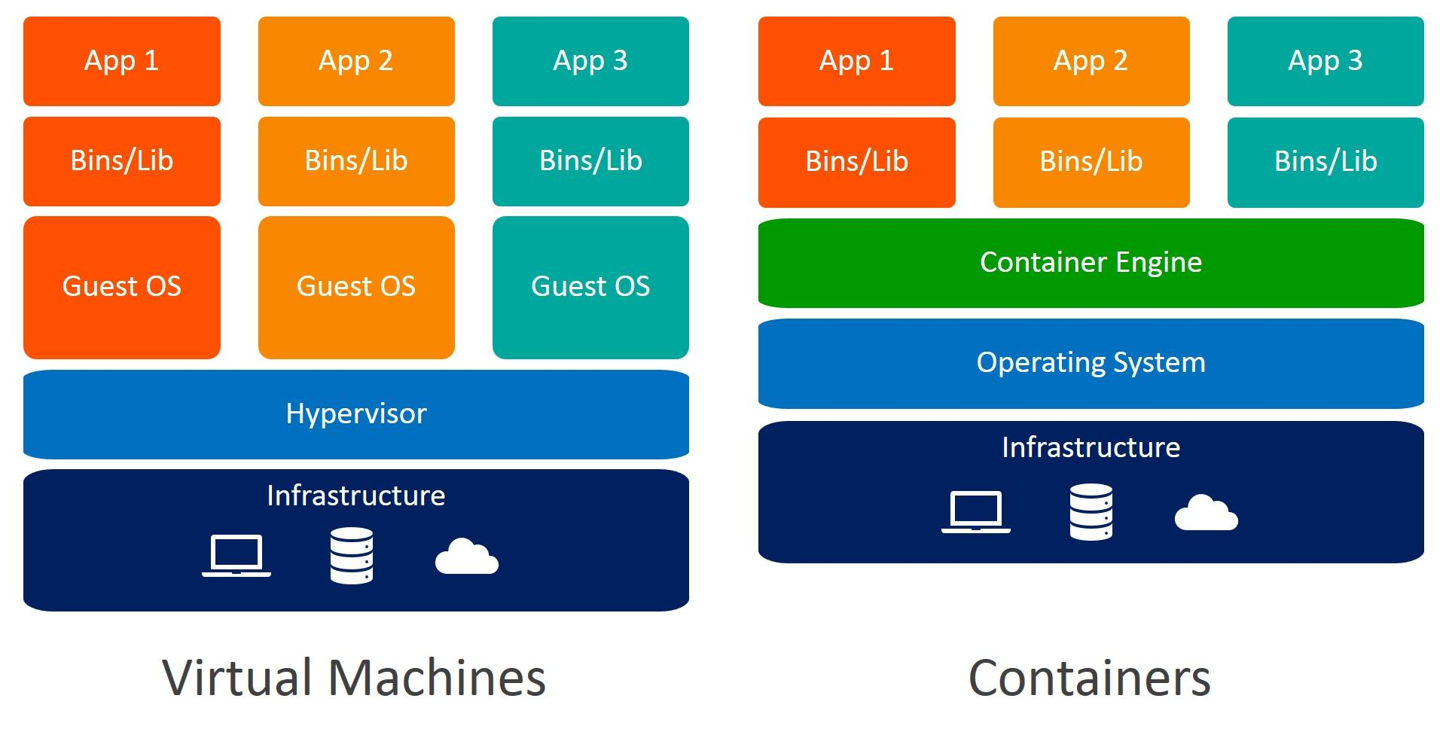
VMs and Containers
Notes:
References:
https://www.weave.works/blog/a-practical-guide-to-choosing-between-docker-containers-and-vms

Slide 20
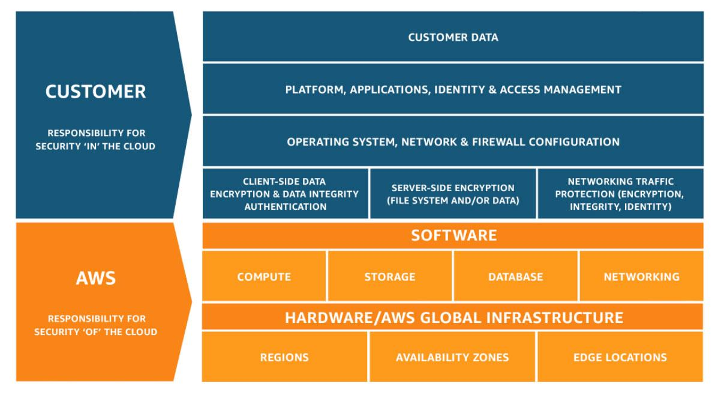
Shared Responsibility Model
Notes:
References:
https://aws.amazon.com/compliance/shared-responsibility-model/

Slide 21
Annexures

Slide 22
How Cloud Computing Is Changing Management
Theories and practices of management often spring from the opportunities created by new technologies. Interchangeable parts spurred ideas about structuring assembly lines and logistics.
The complex calculations of the field known as Operations Research were enabled by mainframe computing.
Client-server technology begat enterprise resource planning systems, and the consequent system-wide visibility that was required for what we call business process management (BPM).
That makes it imperative to start thinking about how management will be changed by the most impactful information technology of our time: cloud computing.
History suggests that the main way information technology changes management is through changes in how information is gathered
eg BPM reflected the interactions of different stakeholders, from product creation through supply chain to final assembly
Notes:
Harvard Business Review - “How Cloud Computing Is Changing Management” https://hbr.org/2018/02/how-cloud-computing-is-changing-management
The likely outcomes of the move to cloud include changing how products are designed; where we can experience closer collaboration between IT and other business units, including sales, finance and forecasting; and more customer interaction, even to a point of jointly developing products with their consumers. In particular, new ways of writing and deploying software will encourage new types of faster-acting organizational designs.
And this is a big one - historically IT has been looked at as a cost center (INTERNAL: describe what a cost center is), now there is a distinct shift where IT is generating business again by providing the tools that is allowing the business to grow and innovate at an unprecidented velocity! Revenue transfer to cloud teams/business unit is a reality.
The shift to “cloud native” organizations - “Cloud native” software approaches stresses ease of use and low-impact alteration of components of any given software application. Massive applications are subdivided into a series of “microservices” that can be tweaked with little effect on a running piece of software.
I have to say this - “IT seems to be not just supporting the business but is helping defining it as well”! Well this is good for us!
Notes:
Shift to "product" centric thinking which combines business units (and customers!) to jointly develop customer services, and plan for the entire product lifecycle and ongoing financing
a "project" based thinking approach uses defined timeperiod for launches, and features, defined or separate teams (""throw-over the wall" to operations), and struggles with IT financing
Agile, or incremental approach to services and updates (low-impact and shortened feedback loop approach to testing)
Cloud first and cloud native thinking
Microservices (one example) for reduced blast radius, and incremental changes
Shorter feedback loop
Key Takeaways:
Focus on product and service, not just single aspect or business unit
IT as value enabler, not cost center
Data driven approach to features and changes
Smaller, more rapid incremental changes
Shifting to ""cloud native", which is using cloud services first (reduce and eliminate non-differentiated activites allowing focus on core business).
References:
3M Health and Information Systems (healthcare) went all in on AWS.
not an IT company, allowed focus of R&D on healthcare analytics
apps are glue between patients, healthcare providers, and payers
benefits?
reduced provisioning time from 10+ weeks to minutes allowing focus on other areas
allow massive scale to support spike in customer demands for large data processing requests
faster innovation, with deployments down to weekly instead of 6 weeks

Slide 23
Set Up Your Organization for cloud
A cloud center of excellence is the best-practice approach to drive cloud-enabled transformation.
How do we develop and enforce organization-wide cloud computing policies in a way that allows us to be flexible, without exposing us to unacceptable levels of organizational risk?
How do we guide our internal users in selecting the right cloud providers to find the best fit and manage vendor-related risk?
How do we manage and mitigate security and regulatory compliance risks while ensuring confidentiality, integrity and availability?
How do we govern our costs and forecast our future costs?
How do we get “smarter about cloud” and make our organization aware of best practices, and keep up with the rate of change introduced by cloud providers?
How can we drive cloud-enabled transformation across the business and help our stakeholders think through the business possibilities enabled by cloud?
CCOE has three core pillars
Governance: Create policies in collaboration with a cross-functional team and select governance tools to provide financial and risk management.
Brokerage: Assist users in selecting cloud providers, architect the cloud solution(s) and collaborate with the sourcing team for contract negotiation and vendor management.
Community: Raise the level of cloud knowledge in the organization and capture and disseminate best practices through a knowledge base, source code repository, training events, outreach throughout the organization, and more.
Notes:
Gartner - “Setup your organization for cloud adoption success” https://www.gartner.com/en/conferences/hub/cloud-conferences/insights/how-to-build-a-cloud-center-of-excellence
“Enterprise architecture” was and “is” all about business and less about tech. Do you think there is a stark similarity of the enterprise architecture charter with CCOE?
It is also about “Citizen driven development”, give the power at the hands of the grass root foot soldiers, you know like you and me, the people who deliver stuff for our customers. We know what it takes, we know what the problems and how to tackle them. All this knowledge was bottled up, now with democratized tech, we can be product creators! Creators of reusable assets, define best practices, define automation, limitless possibilities! Isn’t it?
Notes:
need right skills and organizational structure
Will not be as successful (successful) if conforming to old norms, practices, and organization structures
Key takeways:
Adopt Cloud Center of Excellence (CCoE) to drive practices, provide guidance and oversight and drive innovation
build up knowledge communities and develop skills
lunch and learn, developer forums, etc.
Develop policies, patterns and blueprints, but let teams innovate for their particular use case

Slide 24

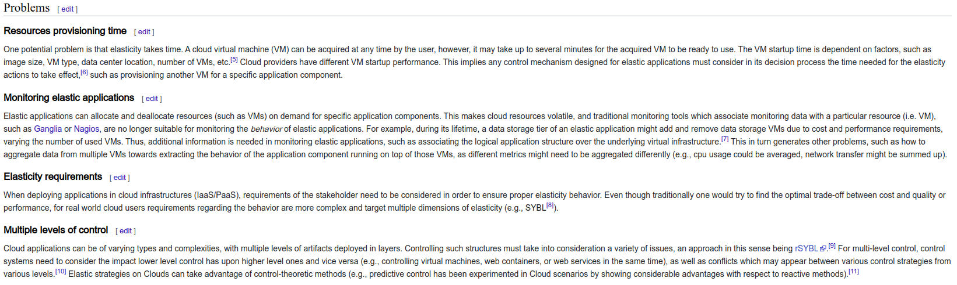
Questions to ponder about
Problems with elasticity [https://en.wikipedia.org/wiki/Elasticity_(cloud_computing)]

Slide 25
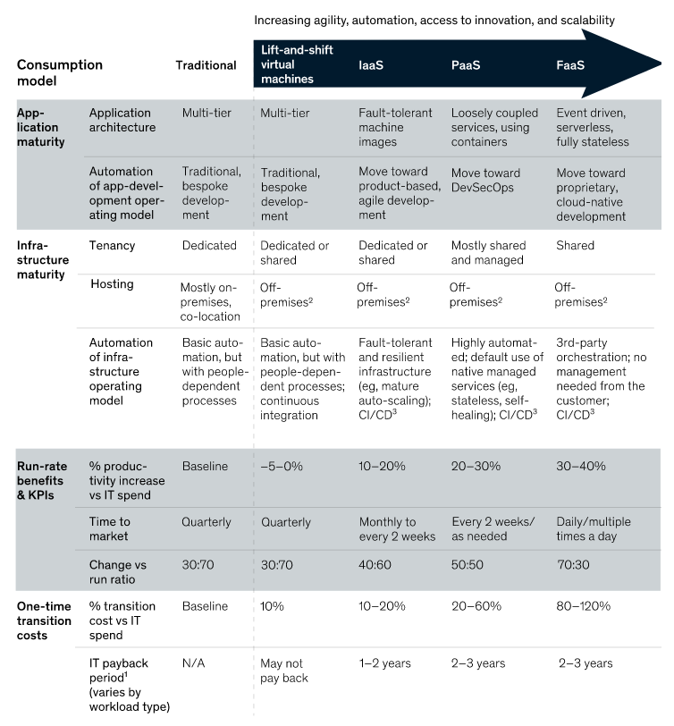
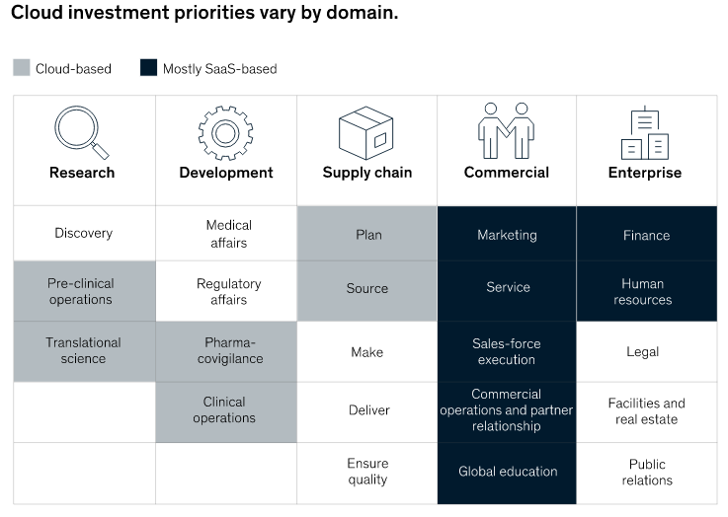
Capturing the value of the cloud
McKinsey - “Capturing the value of the cloud” from the cloud consumer’s perspetive
https://www.mckinsey.com/business-functions/mckinsey-digital/our-insights/how-cios-and-ctos-can-accelerate-digital-transformations-through-cloud-platforms
Notes:
Reference - https://www.mckinsey.com/business-functions/mckinsey-digital/our-insights/capturing-value-in-the-cloud

Slide 26
Capturing the value of the cloud
It has been more than a decade since the first corporate experiments with external cloud platforms, and the verdict is long in on their business value. Companies that adopt the cloud well bring new capabilities to market more quickly, innovate more easily, and scale more efficiently—while also reducing technology risk.
Unfortunately, the verdict is still out on what constitutes a successful cloud implementation to actually capture that value.
Defining the cloud opportunity too narrowly with siloed business initiatives, such as next-generation application hosting or data platforms, almost guarantees failure
Companies that reap value from cloud platforms treat their adoption as a business-technology transformation
Twenty years ago a single small application might run on a $25,000 server. Today, a similar-size application might run on a $5,000 server shared with ten other applications.
Contd ...
Notes:
Reference - https://www.mckinsey.com/business-functions/mckinsey-digital/our-insights/how-cios-and-ctos-can-accelerate-digital-transformations-through-cloud-platforms

Slide 27
Capturing the value of the cloud
These realities have led an overwhelming majority of large institutions to experience one or more of the following failure modes:
Pilot stall: Companies have succeeded in implementing a few greenfield applications on public-cloud platforms, but the value derived from these programs has been limited. This makes further progress impossible because tech leaders cannot make a convincing business case to extend the use of the cloud platform into the heart of IT’s technology environment.
Cloud gridlock: Cloud initiatives become jammed up in long queues because IT cannot build out the automation or reference architectures required to use public-cloud-platform services in a secure, resilient, and compliant fashion.
No value from “lift and shift”: The migration of significant portions of the technology environment—largely by replacing on-premises virtual machines with off-premises ones without taking advantage of cloud-optimization levers—has failed to significantly reduce costs or increase flexibility. Support for cloud initiatives subsequently collapses.
Cloud chaos: Tech leadership does not have an aligned vision and does not provide the required guidance or management oversight, leaving developers largely to their own devices in configuring cloud services. This leads to very divergent approaches and tooling with significant security, resiliency, and compliance risks.
Alright, what about technical challanges ...
Notes:
Reference - https://www.mckinsey.com/business-functions/mckinsey-digital/our-insights/how-cios-and-ctos-can-accelerate-digital-transformations-through-cloud-platforms

Slide 28
Capturing the value of the cloud
Outdated technology environments make change expensive.
Rigid and brittle infrastructures choke on the data required for sophisticated analytics.
Decisions about cloud architecture and sourcing carry significant risk and cost implications—to the tune of hundreds of millions of dollars for large companies.
Success requires CIOs and tech leaders to do three things.
Focus cloud investments in business domains where cloud platforms can enable increased revenues and improved margins
Select a technology, sourcing, and migration model that aligns with economic and risk constraints
Change operating models to capture cloud value
Notes:
Reference - https://www.mckinsey.com/business-functions/mckinsey-digital/our-insights/how-cios-and-ctos-can-accelerate-digital-transformations-through-cloud-platforms

Slide 29
Thank you
Happy Learning!

