Slide 1
PGPCC - Mentor session
AWS Load Balancing, IAM

Slide 2
Recap – Load Balancing, IAM
Load Balancing principles
Types of load balancers
AWS Pricing calculator
Identity & Access Management (IAM)
Notes:
Load Balancer Principles
Distribute incoming user traffic or client connections to a group of target servers
Support traffic distribution algorithms
Support registration of target servers
Be scalable
Capabilities such as canary and blue-green deployments are facilitated by load balancers, by moving traffic incrementally from one target group to another.
Types of load balancers
Classic Load Balancer (CLB) – Not of interest as deprecated, but the original ELB supporting both TCP/TCPS, HTTP/HTTPS. Has some performance concerns with quickly scaling.
Network Load Balancer (NLB) – Provides highest throughput with basic functionality. Supports TCP/TCPS, UDP.
Application Load Balancer (ALB) – For application workloads (HTTP/HTTPS) providing advanced functionality such as path-based routing, headers, etc.
Gateway Load Balancer (GWLB / GLB) – For bump-in-the-wire appliances, such as firewalls. Communication or routing is via route table update.
Load Balancer comparison: <https://aws.amazon.com/elasticloadbalancing/features/>

Slide 3
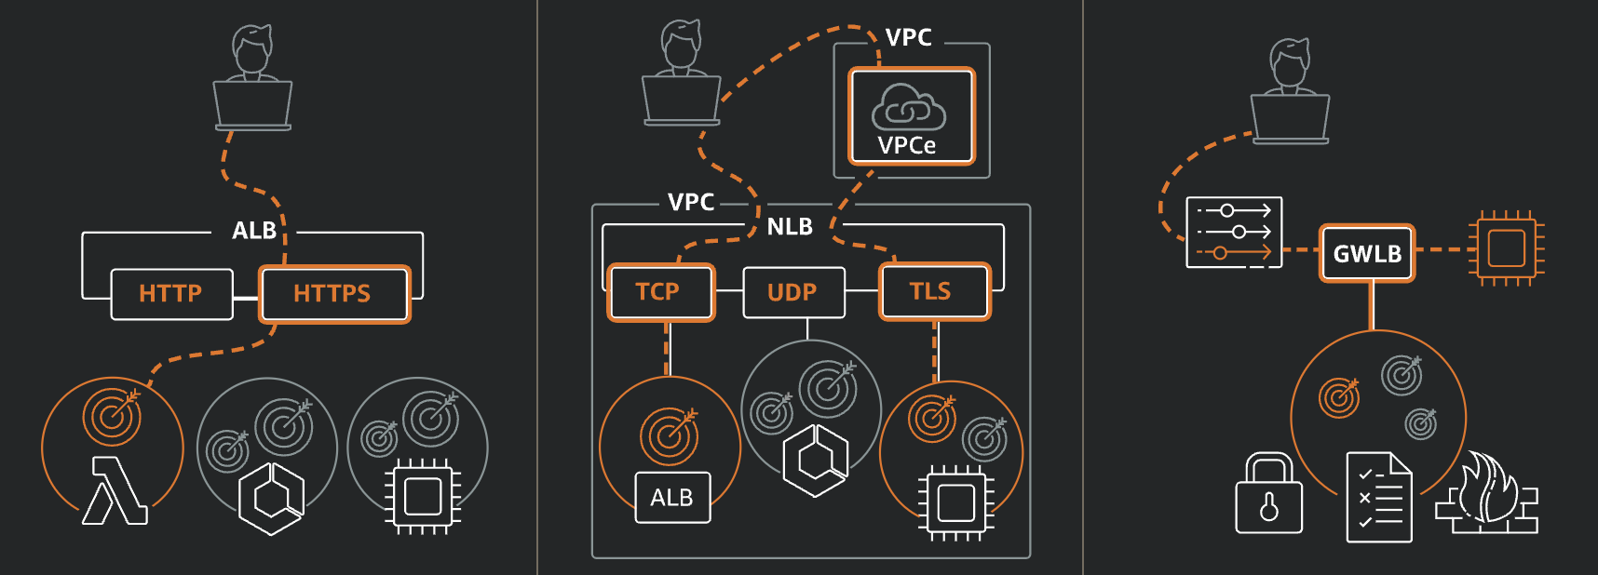
Load Balancer Options

Slide 4
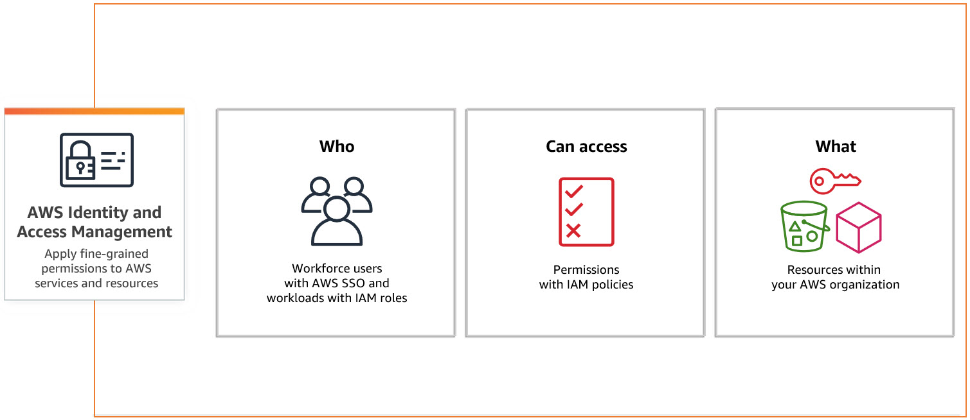
IAM
Notes:
IAM:
Facilitates secure management to AWS services
Administers permissions that dictate users access to specific AWS resources
Oversees both authentication (user sign-in) and authorization (permissions granted) to resource usage
Sample IAM Policy:
{
"Version": "2012-10-17",
"Statement": [ {
"Effect": "Allow",
"Action": [
"iam:GenerateCredentialReport",
"iam:Get*",
"iam:List*"
],
"Resource": "*"
} ]
}

Slide 5
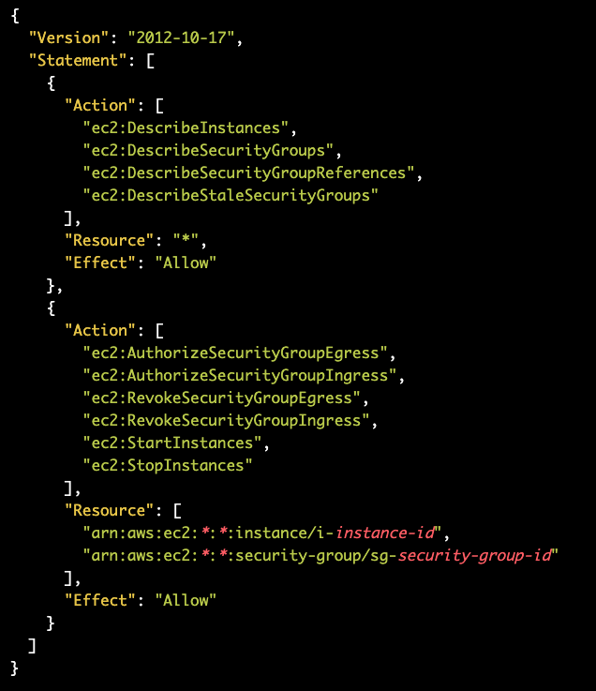
IAM Policy

Slide 6
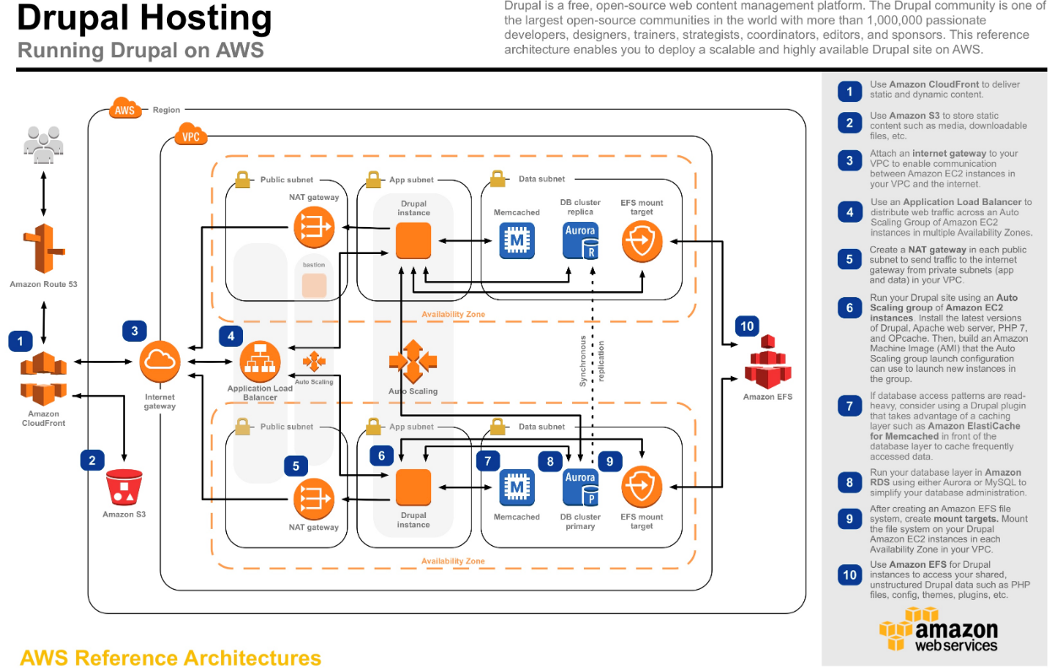
Questions to ponder about
What could be the disadvantages if the load balancer was not part of the architecture?
Do you think it makes sense to use the NLB instead of ALB?
It is suggested that Drupal be installed on EC2, why not use PaaS?
Notes:
Examine the architecture keeping in mind the topics of the current week and think about the questions.
Drupal on EC2 vs PaaS
Drupal on EC2 providers greater flexibility and customization, at the cost of additional maintenance overhead, slower time to market, and less focus on undifferentiated tasks.
Drupal as PaaS
For a PaaS, the hosting provider will not only take care of all the physical infrastructure (as for an IaaS) but also of all the management and availability of this infrastructure. So, you only must focus on the Drupal application and data; the platform manages everything else. Further Benefits.
Lower infrastructure management costs
Since PaaS providers have substantial economies of scale and the best experts in the market, it would be challenging for you to set up and manage an in-house team at a lower cost for the same quality.
Faster time to market
With a flexible and scalable infrastructure, you no longer must wait months for your in-house team to implement a new infrastructure-related element, such as a new search service (eg. Solr) or performance service (Memcache server or a new Load Balancer). Instead, it is a matter of a few hours to install and configure them appropriately for your PaaS provider. This will allow you to have a shorter time-to-market and, therefore, adapt as quickly as possible to the digital needs of your target segments.
Focus on the Drupal application and data
With a PaaS, the only technical responsibility you have left is to develop and maintain your Drupal application. These are development and evolution tasks that you can delegate quite easily to an internal team of Drupal developers or your digital agency.
Reference: <https://aws.amazon.com/efs/resources/aws-refarch-drupal/>

Slide 7
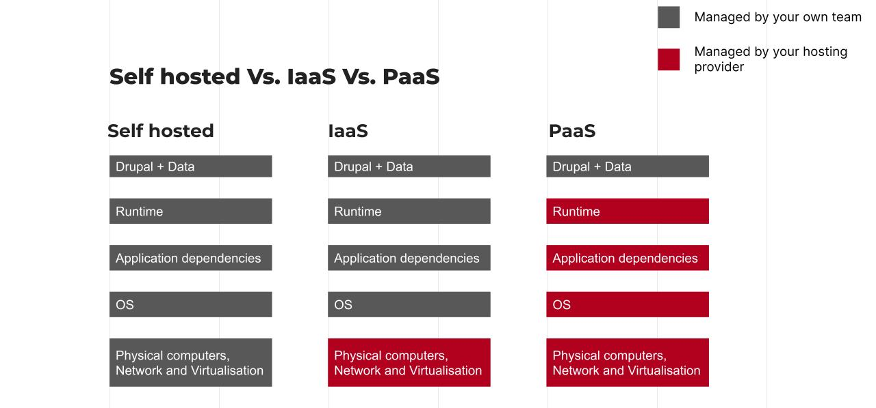

Slide 8
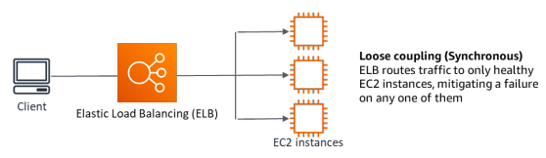
Well architected framework - Reliability Pillar
Implement loosely coupled dependencies: Dependencies such as queuing systems, streaming systems, workflows, and load balancers are loosely coupled. Loose coupling helps isolate behavior of a component from other components that depend on it, increasing resiliency and agility.
“Observe your infrastructure” – Access Logs can be enabled for Amazon Network Load Balancers, and Application Load Balancers.
Little’s Law helps calculate how many instances of compute (EC2 instances) that you need.
L = λW
L = number of instances (or mean concurrency in the system)
λ = mean rate at which requests arrive (req/sec)
W = mean time that each request spends in the system (sec)
For example, at 100 rps, if each request takes 0.5 seconds to process, you will need 50 instances to keep up with demand.
Notes:
Λ * W = L
100 rps * 0.5 sec = 50 instances
Reference: <https://docs.aws.amazon.com/wellarchitected/latest/reliability-pillar/wellarchitected-reliability-pillar.pdf#reliability>

Slide 9
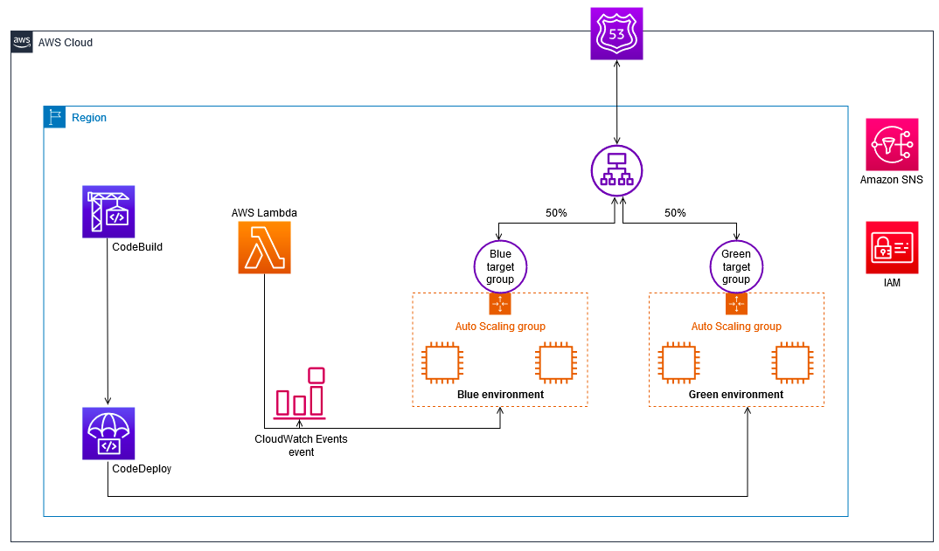
Case: Canary-based deployment using the blue/green strategy
The purpose of a canary deployment is to reduce the risk of deploying a new version that impacts the workload.
The method covered by this pattern incrementally deploys the new version, making it visible to new users in a slow fashion.
As you gain confidence in the deployment, you can deploy it to replace the current version in its entirety.
A launch template specifies instance configuration information. Included are the ID of the Amazon Machine Image (AMI), the instance type, a key pair, security groups, and the other parameters that you use to launch EC2 instances.
Notes:
Focus on ASG and LT only.
Reference (dead link): <https://docs.aws.amazon.com/prescriptive-guidance/latest/patterns/perform-a-canary-based-deployment-using-the-blue-green-strategy-and-aws-lambda.html>

Slide 10
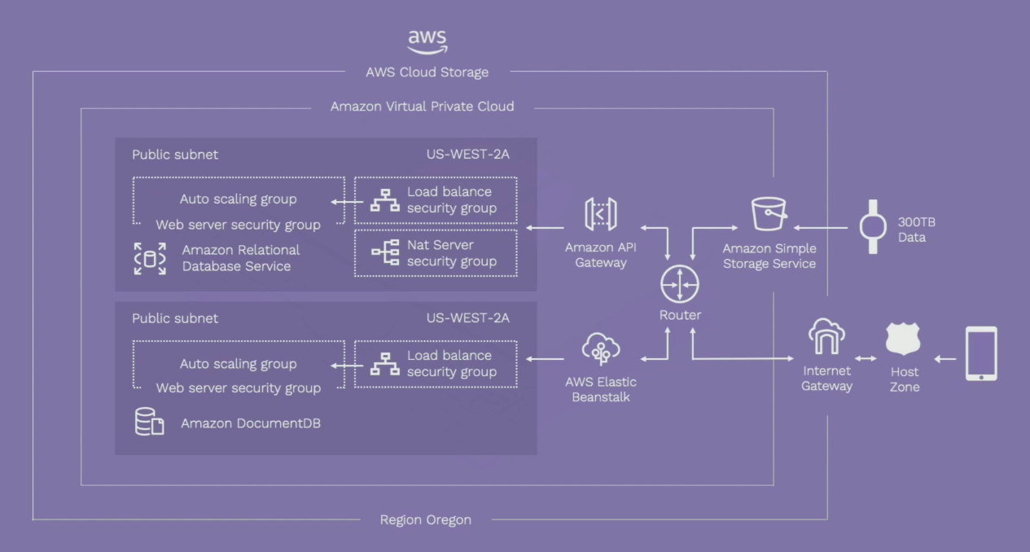
Case: IoT, ASG and other services
Ava Science Inc. - Healthcare provider for women
Notes:
Dr Vogels spoke about Ava in his keynote during re:Invent 2020 (see <https://aws.amazon.com/solutions/case-studies/ava-women-reinvent/>)
Millions of data points are collected and processed to provide personalized health information.

Slide 11
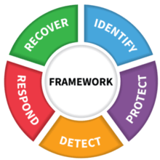
NIST Cybersecurity framework - “Protect!”
The Protect Function outlines appropriate safeguards to ensure delivery of critical infrastructure services. The Protect Function supports the ability to limit or contain the impact of a potential cybersecurity event.
Examples of outcome Categories within this Function include:
Protections for Identity Management and Access Control within the organization including physical and remote access
Empowering staff within the organization through Awareness and Training including role based and privileged user training
Establishing Data Security protection consistent with the organization’s risk strategy to protect the confidentiality, integrity, and availability of information
Implementing Information Protection Processes and Procedures to maintain and manage the protections of information systems and assets
Protecting organizational resources through Maintenance, including remote maintenance, activities
Managing Protective Technology to ensure the security and resilience of systems and assists are consistent with organizational policies, procedures, and agreements
IAM service in AWS helps in creating users, groups, roles & policies
Notes:
Reference https://www.nist.gov/cyberframework/online-learning/five-functions

Slide 12
What else?
Anything else you need to ask
Any use cases that you would like to talk about

Slide 13
Thank you
Happy Learning!

