Slide 1
PGPCC - Mentor session
Flow and Structure for “Cloud with AWS”
Course 2 Week 2
Command Line Interface (CLI) demonstration

Slide 2
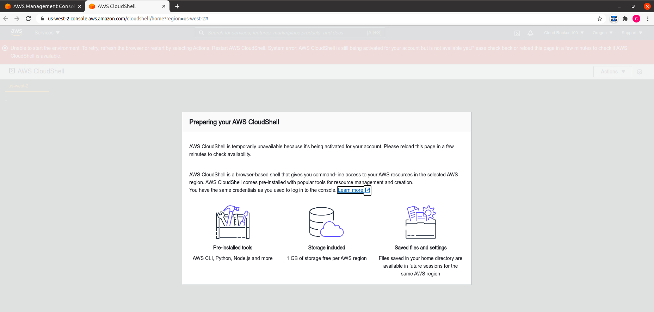
Discussion - AWS cloud shell
AWS CloudShell is a browser-based shell that makes it easy to securely manage, explore, and interact with your AWS resources. CloudShell is pre-authenticated with your console credentials. Common development and operations tools are pre-installed, so no local installation or configuration is required.
With CloudShell, you can quickly run scripts with the AWS Command Line Interface (AWS CLI), experiment with AWS service APIs using the AWS SDKs, or use a range of other tools to be productive. You can use CloudShell right from your browser and at no additional cost.
Notes:
https://aws.amazon.com/cloudshell/

Slide 3
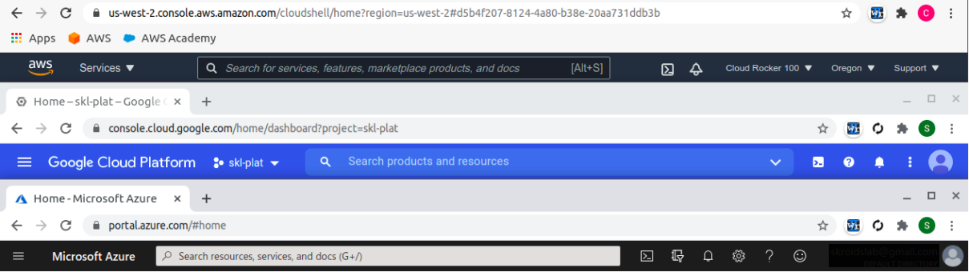
Discussion - Cloud shell from the top 3 cloud providers!
The focus of our demonstration today!
Cloud shell feature is available in AWS, Azure and GCP. Some capabilities may differ.

Slide 4
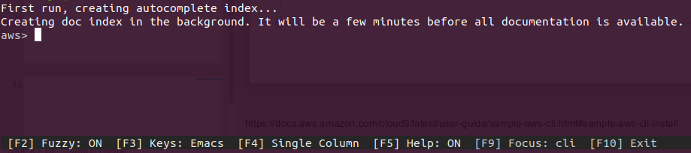
Discussion - AWS shell
AWS Shell can be installed on your local laptop, below is the screenshot of a laptop running Ubuntu
Windows and Mac are supported too
$ sudo pip install aws-shell
$ aws-shell
Notes:
https://docs.aws.amazon.com/cloud9/latest/user-guide/sample-aws-cli.html#sample-aws-cli-install

Slide 5
Demo objective
In this demo we will explore a very powerful way in which cloud resources can be managed using the command line interface aka CLI
This is the building block for
Cloud operations
Infrastructure as Code (IaC)
CLI is needed for 3rd party operations tool like Terraform
This exercises focuses on the operations part of DevOps (Development & Operations)
Operations is considered as the “long tail” of DevOps

Slide 6
CLI command and response structures
The AWS CLI uses a multipart structure on the command line that must be specified in this order:
The base call to the aws program.
The top-level command, which typically corresponds to an AWS service supported by the AWS CLI.
The subcommand that specifies which operation to perform.
General AWS CLI options or parameters required by the operation. You can specify these in any order as long as they follow the first three parts. If an exclusive parameter is specified multiple times, only the last value applies.
$ aws <command> <subcommand> [options and parameters]
Some AWS services have wait commands available. Any command that uses aws wait usually waits until a command is complete before it moves on to the next step.
$ aws <command> wait <subcommand> [options and parameters]
Output from the command
json
yaml (with streaming which allows for faster handling of large data types)
text
table

Slide 7
The goal is to launch an EC2 instance from the command line
Step 1 - Open/Initialize the cloud shell
Test a few commands to understand what comes preinstalled
Step 2 - Create security groups
a) Open the SSH port 22 from specific IP (that of the cloud shell)
b) HTTP port 80 from anywhere (because the instance will have a web application)
Step 3 - Create a key pair (PEM file)
Name - cloudkey.pem
Step 4 - Create an EC2 instance via CLI and verify in the web management console
Region should be N Virginia
Amazon linux AMI
Use the already created SGs and PEM
Use all other defaults
Step 5 - Setup the instance
SSH to the instance & install the sample application
Step 6 - “Always clean up” the resources (cloud is pay as you go!)

Slide 8
Step 1
Ensure the region is N Virginia
Open the cloud shell (you can dismiss the message popup)
Try the following commands
A note for the devops engineers - The python library boto3 is also preinstalled! Boto3 will be discussed with specific examples later (out of scope as of now).
Command | Observation
aws | Gives usage information indicating the CLI is already installed
python3 -V | Python version 3 is installed as well
aws ec2 describe-instances | aws cli command describing instances, empty response is fine, we do not have any instances as of now
sudo yum update | This shell is based on Amazon linux (centos family)
pip3 install aws-shell | Install the AWS shell for interactive command line assistance and execution environment
aws-shell | Run the shell and observe it initialize during the first run Type ec2 and observe the assistant kicks in and valid options are displayed F10 to exit the shell

Slide 9
Step 2a
In order to create a security group we need to know the VPC
aws ec2 describe-vpcs
aws --output text ec2 describe-vpcs --query 'Vpcs[*].VpcId'
myvpcid=$(aws --output text ec2 describe-vpcs --query 'Vpcs[*].VpcId')
echo $myvpcid
Create the SSH SG
aws ec2 create-security-group --group-name openssh --description "Open port 22" --vpc-id $myvpcid
aws --output text ec2 describe-security-groups --group-names openssh --query 'SecurityGroups[*].GroupId'
openssh=$(aws --output text ec2 describe-security-groups --group-names openssh --query 'SecurityGroups[*].GroupId')
echo $openssh
#Open the management console and navigate to “EC2”->“Security Groups” and verify
Assign an ingress rule
#Check the IP of the shell environment
selfipaddr=$(curl https://checkip.amazonaws.com)
echo $selfipaddr
aws ec2 authorize-security-group-ingress --group-id $openssh --protocol tcp --port 22 --cidr $selfipaddr/32
#Go back to the management console and see the “Inbound rules” tab to verify

Slide 10
Step 2b
Create the HTTP SG
aws ec2 create-security-group --group-name openhttp --description "Open port 80" --vpc-id $myvpcid
openhttp=$(aws --output text ec2 describe-security-groups --group-names openhttp --query 'SecurityGroups[*].GroupId')
echo $openhttp
#Open the management console and navigate to “EC2”->“Security Groups” and verify
Assign an ingress rule
aws ec2 authorize-security-group-ingress --group-id $openhttp --protocol tcp --port 80 --cidr 0.0.0.0/0
#Go back to the management console and see the “Inbound rules” tab to verify

Slide 11
Step 3
Create the PEM file
aws ec2 create-key-pair --key-name cloudkey --query 'KeyMaterial' --output text > cloudkey.pem
#Open the EC2 management console, under Key Pairs (left navigation) verify the keypair
List the directory, view the contents of the PEM file & change the permissions
ls -al
cat cloudkey.pem
chmod 400 cloudkey.pem

Slide 12
Step 4
Visit the EC2 management console and grab the AMI id
Amazon linux AMI in N Virginia should be ami-033b95fb8079dc481
Understand the selection of the instance type and the general process of using the management console to launch an instance
Use the following command to launch the EC2 instance
aws ec2 run-instances --image-id ami-033b95fb8079dc481 --count 1 --instance-type t2.micro --key-name cloudkey --security-group-ids $openssh $openhttp
#Type q to exit the large json output display
#Visit the management console and observe the instance is getting created
#Ensure the security groups are attached (Security tab)
This is nothing but “IaC” - Infrastructure as Code!

Slide 13
Step 5
To SSH we need to get the public IP (or DNS) of the EC2 instance
aws --output text ec2 describe-instances --query 'Reservations[*].Instances[*].[PublicIpAddress]'
ec2ip=$(aws --output text ec2 describe-instances --query 'Reservations[*].Instances[*].[PublicIpAddress]')
echo $ec2ip
SSH to the instance from the cloud shell
ssh -i cloudkey.pem ec2-user@$ec2ip
#Type yes when prompted and observe the prompt in the terminal, it is now that of the ec2 instance
Setup the instance with the sample application
sudo su
APP_NAME=LiftShift-Application
yum update -y && yum -y install python3-pip zip
wget https://d6opu47qoi4ee.cloudfront.net/loadbalancer/simuapp-v1.zip
unzip simuapp-v1.zip
sed -i "s=MOD_APPLICATION_NAME=$APP_NAME=g" templates/index.html
pip3 install -r requirements.txt
nohup python3 simu_app.py >> application.log 2>&1 &
Get the public IP of the EC2 instance and hit it in a new browser tab
curl https://checkip.amazonaws.com
#Type exit twice in the EC2 instance shell to come back to the cloud shell environment

Slide 14
Step 6
Terminate the EC2 instance
aws --output text ec2 describe-instances --query 'Reservations[*].Instances[*].[InstanceId]'
ec2id=$(aws --output text ec2 describe-instances --query 'Reservations[*].Instances[*].[InstanceId]')
echo $ec2id
aws ec2 terminate-instances --instance-ids $ec2id
#Verify in the management console the instance is shutting down and then terminated
Delete the security groups
aws ec2 delete-security-group --group-id $openssh
aws ec2 delete-security-group --group-id $openhttp
#Verify in the management console the security groups are deleted
Delete the keypair (PEM file)
aws ec2 delete-key-pair --key-name cloudkey
#Verify in the management console the keypair is deleted
Delete the keypair from the cloud shell environment as well
rm -rf *.pem
Type exit in the cloud shell and close the browser tab to conclude the demonstration

Slide 15
Thank you
Happy Learning!

