Slide 1

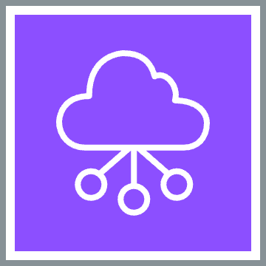


Networking and DevOps
Carrington Wong
LinkedIn: https://linkedin.com/in/cgswong
X: @cgswong

Slide 2

Contents
Infrastructure as Code
AWS CloudFormation
Terraform
Domains, Service Discovery and hostname resolution with AWS Route 53
Monitoring & Observability with Amazon CloudWatch
Containers & Docker
Open Discussion (Q&A)

Slide 3
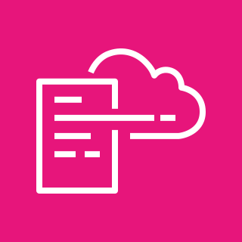

Infrastructure as Code: AWS CloudFormation
AWS CloudFormation service enables the definition, creating and management of AWS infrastructure as code using templates
AWS infrastructure and resources defined declaratively in JSON or YAML
Stacks are the collection of related resources managed as a unit
Templates serve as blueprints for creating and configuring resources
Parameters allow for customization and flexibility
Outputs provide information from a stack and can be used by other stacks or users

Slide 4
Infrastructure as Code: AWS CloudFormation
Change Sets enable the preview of changes prior to application
Rollback safely reverts failed stack updates
Nested Stacks break-down complex templates into smaller, more manageable components or stacks, promoting reuse and easier maintenance
Drift detection identifies discrepancies between expected (template code) and actual configurations
Cloud Development Kit (CDK) provides a software development framework for defining infrastructure as code that is provisioned through AWS CloudFormation
Notes:
CDK:
Define your cloud infrastructure using general-purpose programming languages. Languages: TypeScript, JavaScript, Python, Java, C#/.Net, and Go
Get started developing your application quickly with constructs

Slide 5
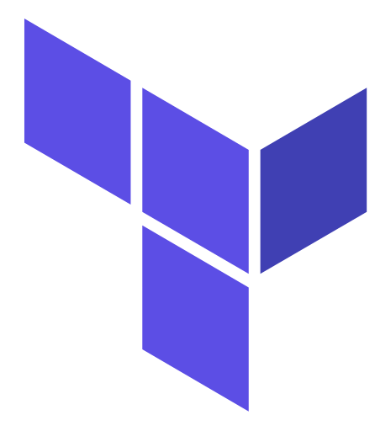
Infrastructure as Code: Terraform
Define and provision infrastructure, including AWS, using a declarative configuration language, HashiCorp Configuration Language or HCL
Providers enable interaction with services, enabling multi-infrastructure provisioning
State file is used to track the current state of infrastructure, helping Terraform understand what changes are needed to achieve desired (coded) state
A `terraform plan` generates an execution plan of what changes will be made to achieve desired state
A `terraform apply` applies the changes to the infrastructure
Modules are reusable configurations used to create a set of resources, promoting code reusability and maintainability

Slide 6
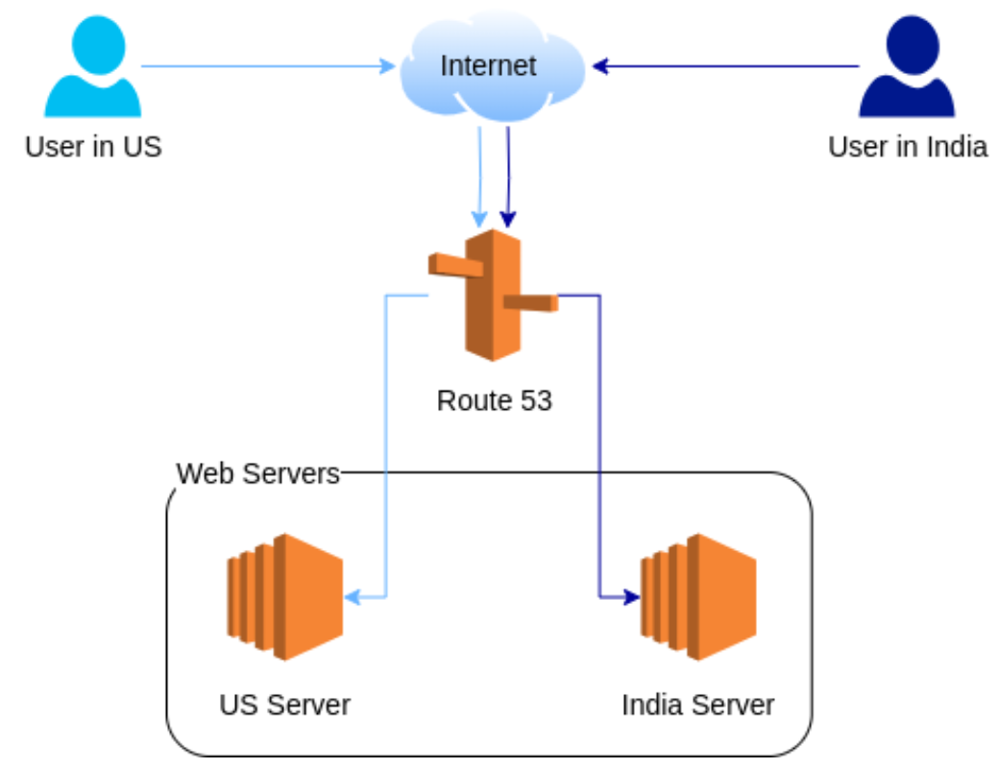
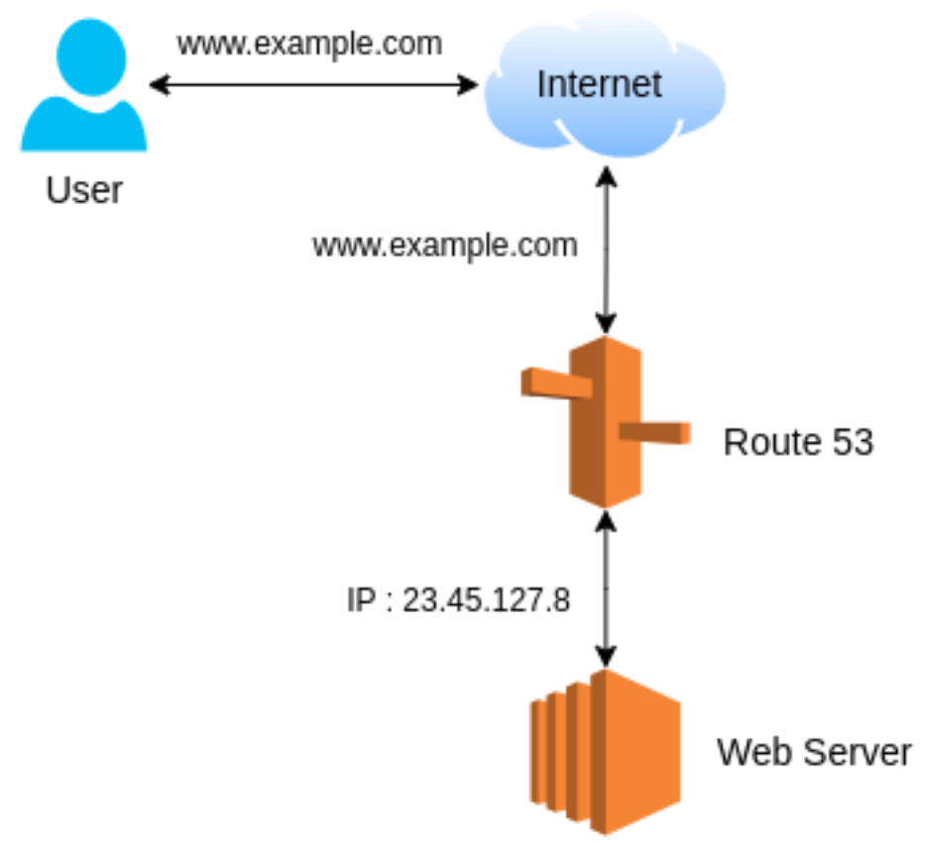
Domains, Service Discovery and hostname resolution with AWS Route 53
Routes traffic efficiently and ensures domain names (e.g., www.amazon.com) lead to correct resources
Domain Registration registers domain names directly or transfer
DNS translates user-friendly domain names into IP addresses
Routing Policies offer options for traffic direction or control
Health Checks monitor resource health, routing traffic away from unhealthy resources
Service Discovery provides discovery of application services, in Amazon ECS

Slide 7
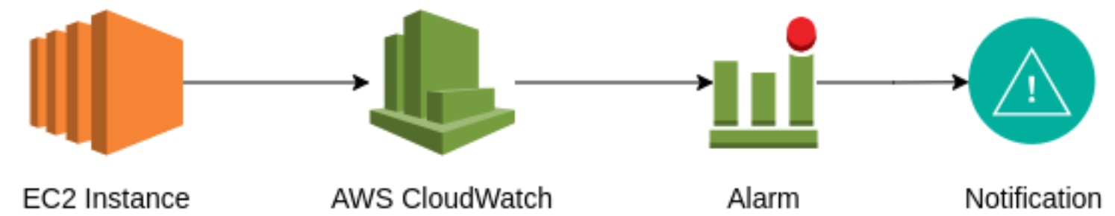
Monitoring & Observability using Amazon CloudWatch
Metrics collect and store metrics (data points) related to resource performance
Alarms create notifications based off metrics, including triggering of automated actions
Dashboards allow custom views or visualization of metrics and alarms
Logs enable capture and storage of log data, improving troubleshooting and historical data analysis
Events help in responding to changes in AWS, enabling event-based workflows and automations

Slide 8
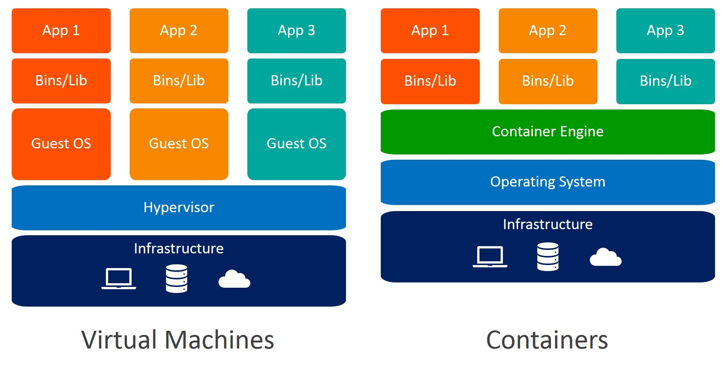
VMs and Containers
Notes:
References:
https://www.weave.works/blog/a-practical-guide-to-choosing-between-docker-containers-and-vms

Slide 9
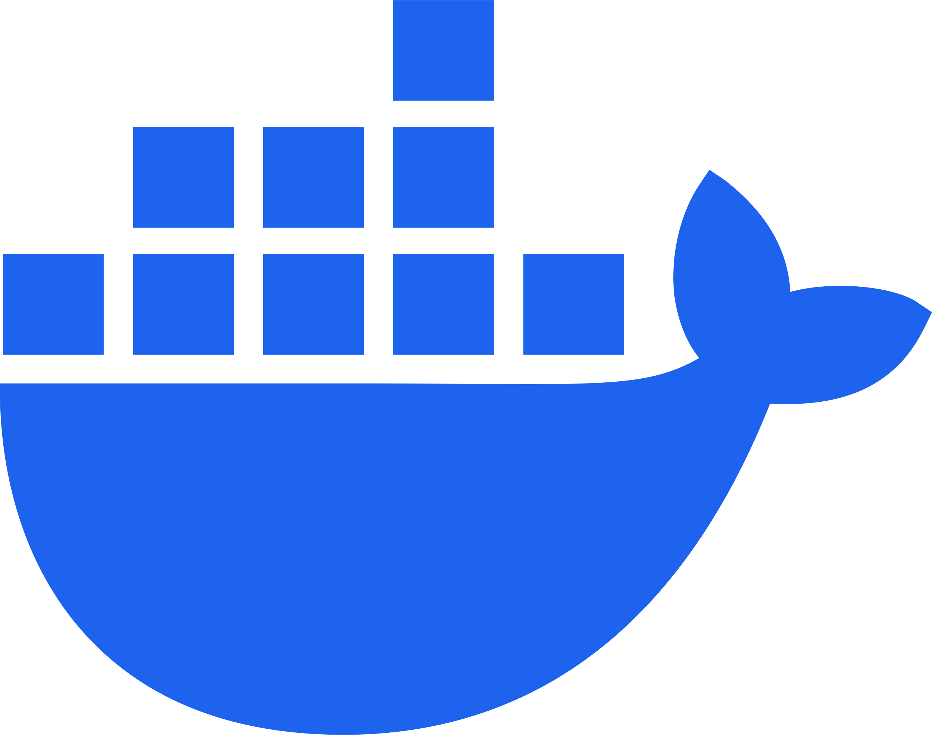
Containers & Docker
Docker deployment runs application inside self-contained package called “container”, enabling application portability
Containers are isolated, lightweight, and portable units that package applications and their dependencies
Docker image serve as template for creating containers, encapsulating the application code, runtime, libraries, and configuration settings
Docker Compose is helper tool that simplifies running multiple containers together, as a stack.

Slide 10
Open Discussion
Q&A

