Slide 1
PGPCC - Mentor
session
Flow and Structure for MS3
Course 2 Week 2
“ASG, LT, AMI, CLI”

Slide 2
Agenda
Total Duration - 120 mins
Recap (50 mins)
Cost Optimization Pillar (5 mins)
Chaos Engineering (5 mins)
General Q & A (45 mins)

Slide 3
AWS Week 2 – Autoscaling, AMI, AWS CLI
Auto Scaling
AMI
AWS CLI

Slide 4
Auto Scaling
Automatic scaling and management using:
• Groups – grouping of EC2 instances, or application services
• Launch Templates (instances) – Instance details (what size, volumes, VPCs, etc.)
• Scaling Options – rules to scale
Free service!

Slide 5
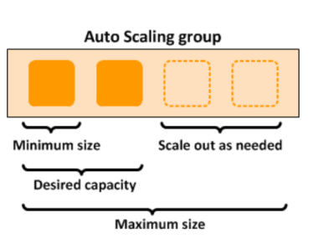
Auto Scaling Groups
➢ An Auto Scaling group is a collection of Amazon EC2 instances that are treated
as a logical unit
➢ To scale the Auto Scaling group, you
can either make manual adjustments
to the desired capacity, or let Amazon
EC2 Auto Scaling automatically add
and remove capacity to meet changes
in demand.
➢ Amazon EC2 Auto Scaling lets you
provision and balance capacity across
Availability Zones to optimize
availability
➢ It also provides lifecycle hooks,
instance health checks, and
scheduled scaling to automate
capacity management

Slide 6
Health checks in reference to EC2
The following are checked to determine the EC2 status:
stopping
stopped
terminating
terminated

Slide 7
Using Launch Templates to launch ASG
Launch EC2 instances from Launch Templates
Create Auto Scaling Group (ASG) from Launch Templates
Create Spot Fleet
Check details and different options available
Check Spot blocks
Launch Configuration (prior mechanism) is deprecated!

Slide 8
Some Launch Templates details
Name, AMI, Instance Type
Optional info – Spot instance, IAM Instance profile, Monitoring, EBS Optimized instance
Advanced details - Kernel ID, RAM Disk ID, Metadata accessible, Metadata Version, Metadata response hop, Userdata, IP Address type (public or not)
Storage Volumes
SG – Rules
Key pair login

Slide 9
Extra Details on Launch Template
▪ Multiple versions of a template
Version controlled differences
Create a base template, and consumers modify as needed
▪ Advanced Amazon EC2 configuration – Tenancy, Capacity Reservation, Elastic GPU, Credit specification, Placement Group, Nitro enclave (execution environment)

Slide 10
Now let us talk about scaling options
If there are no other scaling conditions attached to the Auto Scaling group, the group maintains this number of running instances even if an instance becomes unhealthy
Health checks terminate and launch new instances
When you have a budgetary constraint or aware of fixed capacity need, can set maximum size
Manual Scaling
You specify ONLY the change in the maximum, minimum, or desired capacity of your Auto Scaling Group.
Scheduled Scaling
Scale based on a schedule (function of date, and time)
Use for known usage pattern
Notes:
Scheduled scaling can be used in combination for certain use cases, such in combination with regular dynamic scaling, to cover marketing events

Slide 11
Dynamic Scaling
Define the parameters for scaling, such as CPU.
Auto Scale Group is notified by CloudWatch Metrics

Slide 12
Predictive scaling – Only for EC2 Auto Scaling Group
Amazon EC2 Auto Scaling in combination with AWS Auto Scaling to scale resources across multiple services. AWS Auto Scaling can help you maintain optimal availability and performance by combining predictive scaling and dynamic scaling (proactive and reactive approaches, respectively) to scale your Amazon EC2 capacity faster.
What does it all mean?
Load forecasting – Analyze 14 days of history and forecasts for next two days
Scheduled scaling actions - proactively add and remove resource capacity to reflect the load forecast.
It updates the resource's minimum capacity with the value specified by the scheduled scaling action
Maximum capacity behavior - Beyond maximum capacity when forecast is higher than maximum…Cool!

Slide 13
Autoscaling can be used for other services as well...
• Amazon EC2 Spot Fleet requests: Launch or terminate instances from a Spot Fleet request, or automatically replace instances that get interrupted for price or capacity reasons.
• Amazon ECS: Adjust the ECS service desired count up or down in response to load variations.
• Amazon DynamoDB: Enable a DynamoDB table or a global secondary index to increase or decrease its provisioned read and write capacity to handle increases in traffic without throttling.
• Amazon Aurora: Dynamically adjust the number of Aurora read replicas provisioned for an Aurora DB cluster to handle changes in active connections or workload.
Notes:
Application Autoscaling

Slide 14
AMI - Amazon Machine Image
Snapshots – They are stored in S3.
Create AMI – You can create an AMI with No reboot option
AMI is region centric
AMI can be copied to a different region
You cannot delete a snapshot related to AMI – try it. Snapshots can be public as well.
Volume is in same AZ as EC2 . Volume exist on EBS
Snapshots are incremental
Encryption – root volume can be encrypted

Slide 15
Well architected framework - “Cost Optimization” Pillar
Automation: Auto Scaling, which ensures elasticity at minimal effort, and increases staff productivity by eliminating manual capacity planning work.
Decommission resources: Use automation to reduce or remove the associated costs of the decommissioning process. Designing your workload to perform automated decommissioning will reduce the overall workload costs during its lifetime. You can use AWS Auto Scaling to perform the decommissioning process.
Cost: Spot is also integrated into multiple AWS services, such as EC2 Auto Scaling groups (ASGs)
Dynamic Supply: Leverage the elasticity of the cloud to supply resources to meet changing demand. Take advantage of APIs or service features to programmatically vary the amount of cloud resources in your architecture dynamically
Scheduling: Auto Scaling can implement manual, scheduled or demand based scaling, you can also use metrics and alarms from Amazon CloudWatch to trigger scaling events for your workload.
Notes:
• “Well architected framework” document “Manage demand and supply resources” section • https://docs.aws.amazon.com/wellarchitected/latest/framework/wellarchitected-framework.pdf

Slide 16
Chaos Engineering
• AWS Fault Injection Simulator is a fully managed chaos engineering service that makes it easier for teams to discover an application’s weaknesses at scale in order to improve performance, observability, and resiliency.
• Chaos engineering is the process of stressing an application in testing or production environments by creating disruptive events, such as server outages or API throttling, observing how the system responds, and implementing improvements.
• Chaos engineering helps teams create the real-world conditions needed to uncover the hidden issues, monitoring blind spots, and performance bottlenecks that are difficult to find in distributed systems. Teams need to stitch together a patchwork of tools and keep an experiment from impacting users.
• Fault Injection Simulator simplifies the process of setting up and running controlled chaos engineering experiments across a range of AWS services so teams can build confidence in their application behavior.
• With Fault Injection Simulator, teams can quickly set up experiments using pre-built templates that generate the desired disruptions, such as server latency or database error.
• Fault Injection Simulator provides the controls and guardrails that teams need to run experiments in production, such as automatically rolling back or stopping the experiment if specific conditions are met.
• With a few clicks in the console, teams can run complex scenarios with common distributed system failures happening in parallel or building sequentially over time, enabling them to create the real world conditions necessary to find hidden weaknesses.

Slide 17
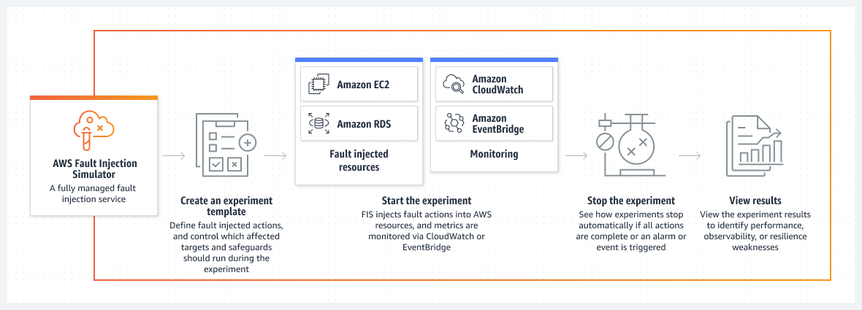
How Chaos Engineering works

