Slide 1
PGPCC - Mentor session
AWS Compute

Slide 2
Recap – Compute
Degree of abstraction
Global infrastructure
AWS IaaS EC2 core features
The 7 step workflow
Notes:
Note to the mentor - you can use screenshots from the recorded videos and add more slides.
Degree of abstraction is how cloud abstracts the very detailed configuration and underlying hardware. There are 3 core components, compute (EC2), storage (EBS, etc.), networking (VPC), and scaling (ASG).
Global infrastructure is the AWS global network of regions and Azs.
AWS IasS EC2 core features are launching in specific AZ within a region, it is a VM running an OS with your app, connects to a virtual network via virtual interface, has storage for holding app and data. It is the foundation of many AWS services.
Tags – What are tags (meta-data)? Usages (billing, automation, identification)
Instance type – multiple types for different use cases
AMI
Storage
Network
Security
7-step workflow is how to launch an EC2 instance. Not industry standard per say, but taken from typical EC2 wizard.
Name and tag
AMI selection
Instance type
Key pair
Network settings
Storage configuration
Advanced Details

Slide 3
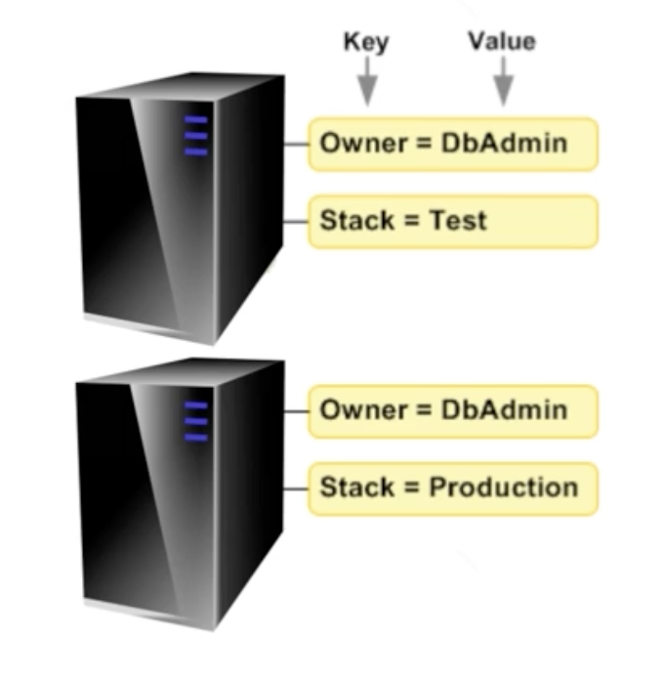
Core Features - Tags
Metadata or label associated with resources, EC2 here
Helps in identification or grouping
The “Name” tag is a special label

Slide 4
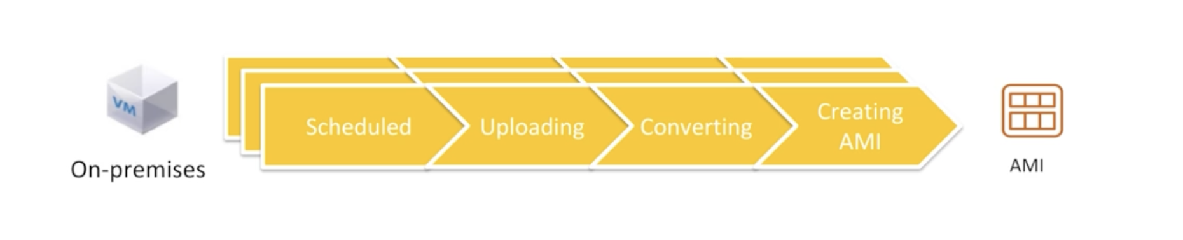
Core Features - AMI
Out-of-the-box operating system (OS)
Can include OS + application, AWS, 3rd party, or customers
Eliminate operation overhead, easier data center migrations
Notes:
Tools are provided to seamlessly create image

Slide 5
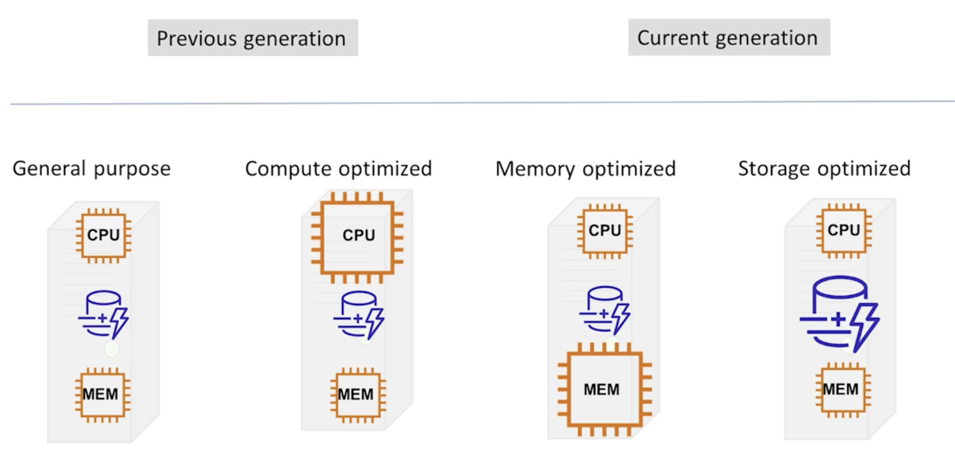
Core Features – Instance Type
Notes:
Multiple types of instances for different use cases. Shown are the general categories, but there other, more special purpose types not shown, such as GPU types which fall within the compute optimized category.

Slide 6
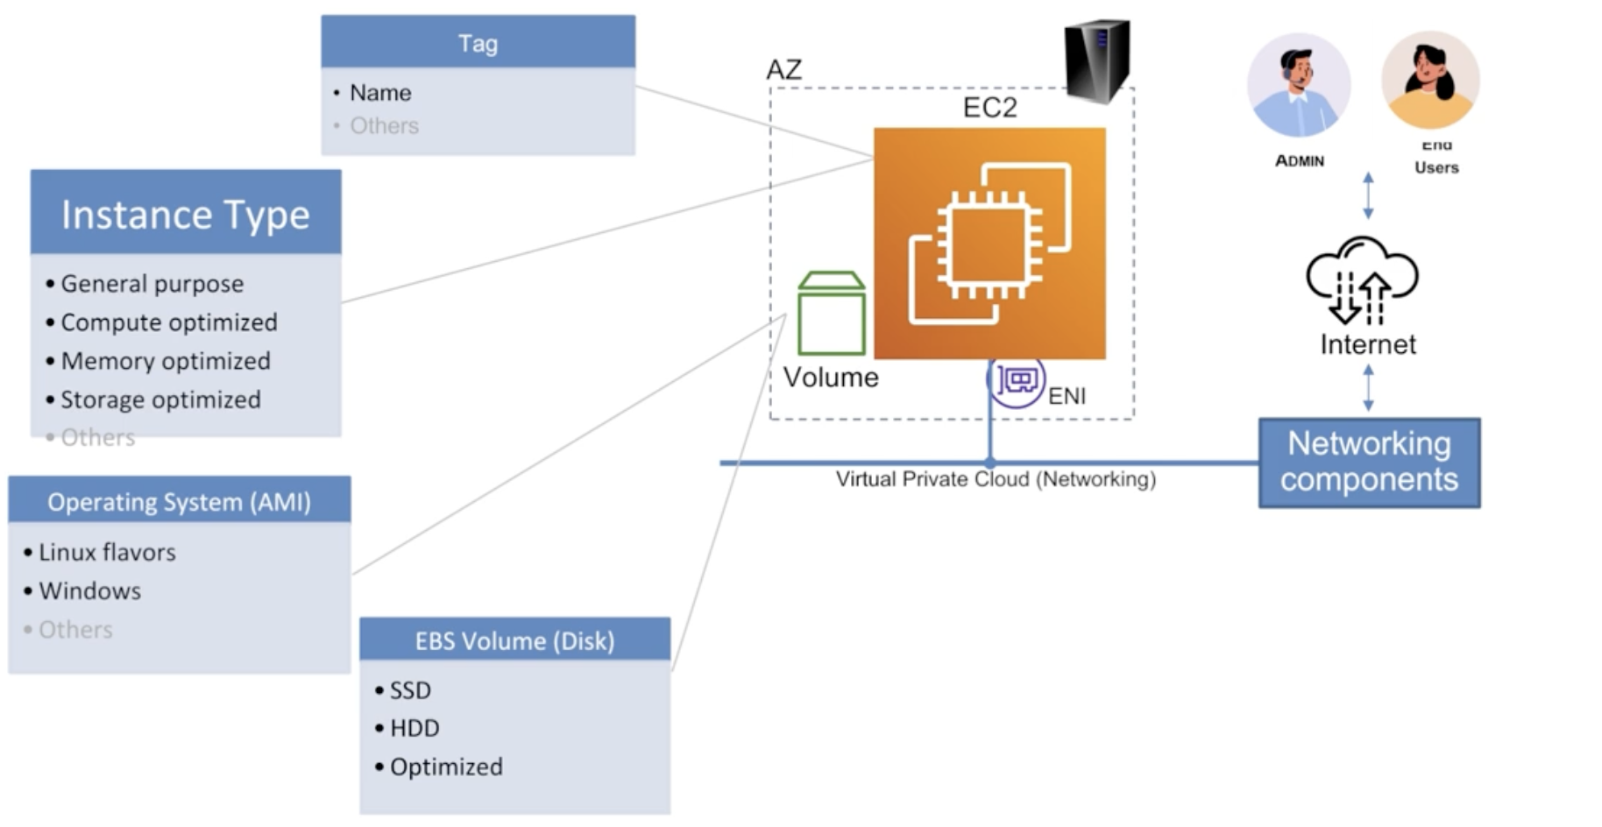
Core Features – Storage (EBS)& Networking
Notes:
- EBS is storage primarily used, but there are others
- Networking is a virtual private cloud (VPC)
- Subnet is AZ location
- Can have multiple (elastic) networking interfaces or ENI, for different use cases (isolated networks)
- Each ENI will be associated with a security group or “firewall”

Slide 7
Core Features - Security
Security Group
Instance access (SSH access)
IAM
Notes:
- Private Enhanced Mail (PEM)

Slide 8
Case Studies
Edmunds.com Cuts Costs and Boosts Availability by Using AWS Fargate Spot
https://aws.amazon.com/solutions/case-studies/edmunds-fargate-spot
S&P Global Ratings Uses AWS to Speed Application Migration, Drive Innovation
https://aws.amazon.com/solutions/case-studies/s-and-p-global-case-study
TymeBank, South Africa’s first digital bank, migrates its core systems to AWS
https://aws.amazon.com/solutions/case-studies/TymeBank-Case-Study
Mortgage Closings in 15 Minutes with Snapdocs on AWS
https://aws.amazon.com/solutions/case-studies/snapdocs-case-study
Notes:
Note to the mentor - Please analyze these case studies and create your own talking points/slides as you deem fit. Alternatively, please do talk about your own experiences using EC2 in your projects masking specific confidential details.
Edmunds
Already in AWS, but took advantage of additional features to simplify and evole
Such as Spot Instances (access unused capacity with cost savings up to 90%) and Fargate (serverless compute engine for containers)
Spot and Fargate reduces operations overhead, and can improve the developer experience
They saw: 1\ Reduced costs 25-30% vs On-Demand costs 2\ Cut billing by $100K over 8-month period (Spot and Savings Plan) 3\ Run 80% of customer-facing apps on Fargate Spot 4\ Increased availability to 99.999% 5\ Releases 20-30 times daily vs 10-20 6\ Autoscale in seconds vs minutes
Journey is about findings the right tool for the job vs. on-size-fits-all. Started with EC2 of single instance type, then diversified, and went from there.
S&P
On-premise was slow and inflexible. Typically took 1 month for hardware acquisition, and 2 weeks for configurations
Stability was another concern with again data center, and more frequent system outages. Outages can result in SEC fines.
Migration to AWS resulted in: 1\ Avoidance of fines due to outages, uptime was 100% 2\ Improved DR time by 50% 3\ Provisioning in hours vs weeks 4\ Global expansion capabilities in minutes vs. 6-12 months for DC building
Some of the critical systems included Oracle databases (including RAC), which are now run in multiple regions and AZs
TymeBank
South African bank, a digital bank, and first to receive license in over 20 years
100K customers a month since launch!
Migrated 85% of infrastructure to AWS, running mission-critical systems on ECS and EKS (containers platforms).
Was originally on-premise, not ”born in the cloud”. Scaled by moving to AWS (life-and-shift) to support 500K+ customers (reached figure in 5 months), while cutting infrastructure costs in half!
Moved in 6 months about 450 EC2 instances
Shows capability of AWS compute options (EC2, which also runs ECS and EKS) supporting mission-critical, regulated environments
Full savings were not immediate due to life-and-shift, but were achieved over a little more time through optimizations
Mortgage Closings
Uses ML and AI to speed document processing
Can process over 1 million transactions annually. The typical mortgage process takes 60 days and costs some $6,000
ML models are trained on EC2 instances, and deployed using Lambda functions.
Essentially they; 1\ Reduced real estate closings from 1 hour to 15 minutes 2\ Eliminated 75% of errors
Enhanced customer experience and efficiency
Supports compliance requirements in thousands of local jurisdictions
Still preserves contextual information

Slide 9
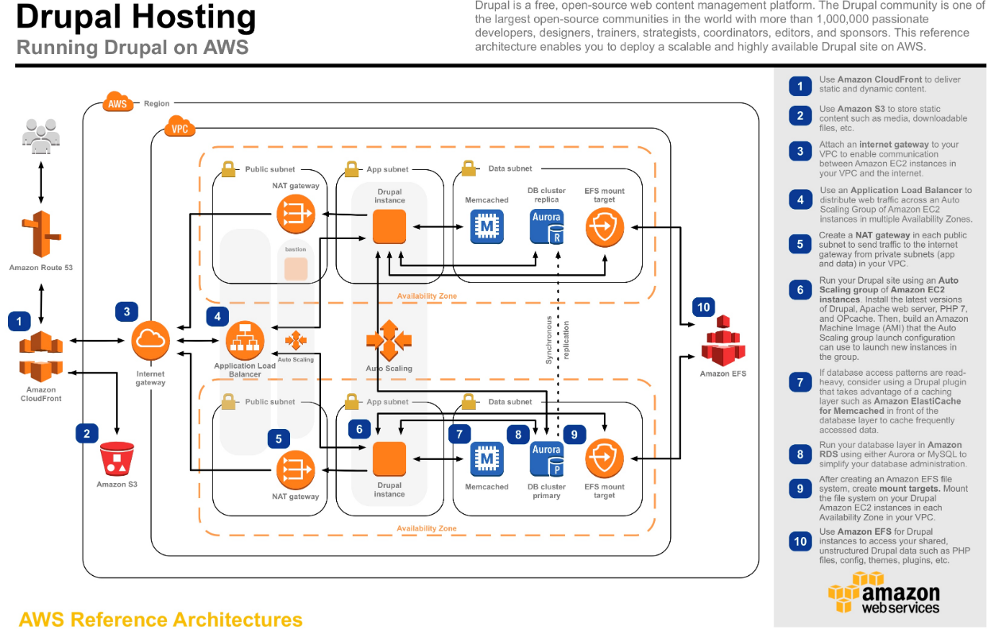
Questions to ponder about
Notes:
Note to the mentor - show the bigger picture and explain how EC2 is helping in the hosting. Do not get into ALB, the same picture will come back in week 2 where you can explain ALB.
Reference https://aws.amazon.com/efs/resources/aws-refarch-drupal/

Slide 10
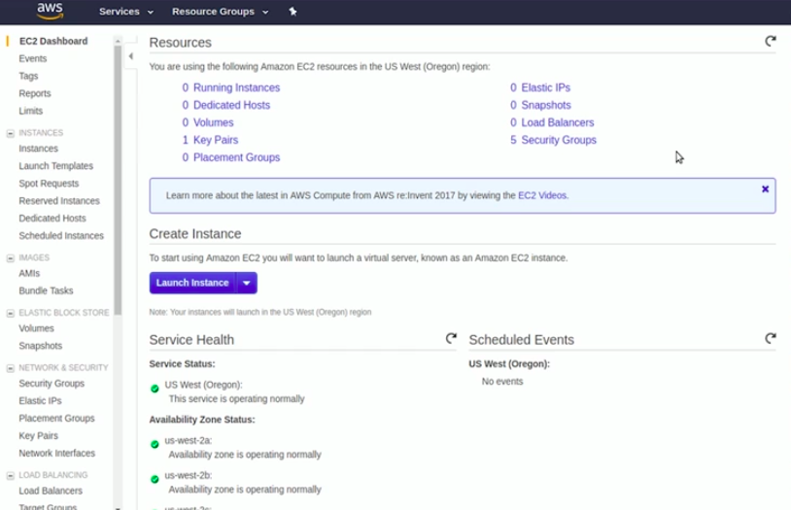
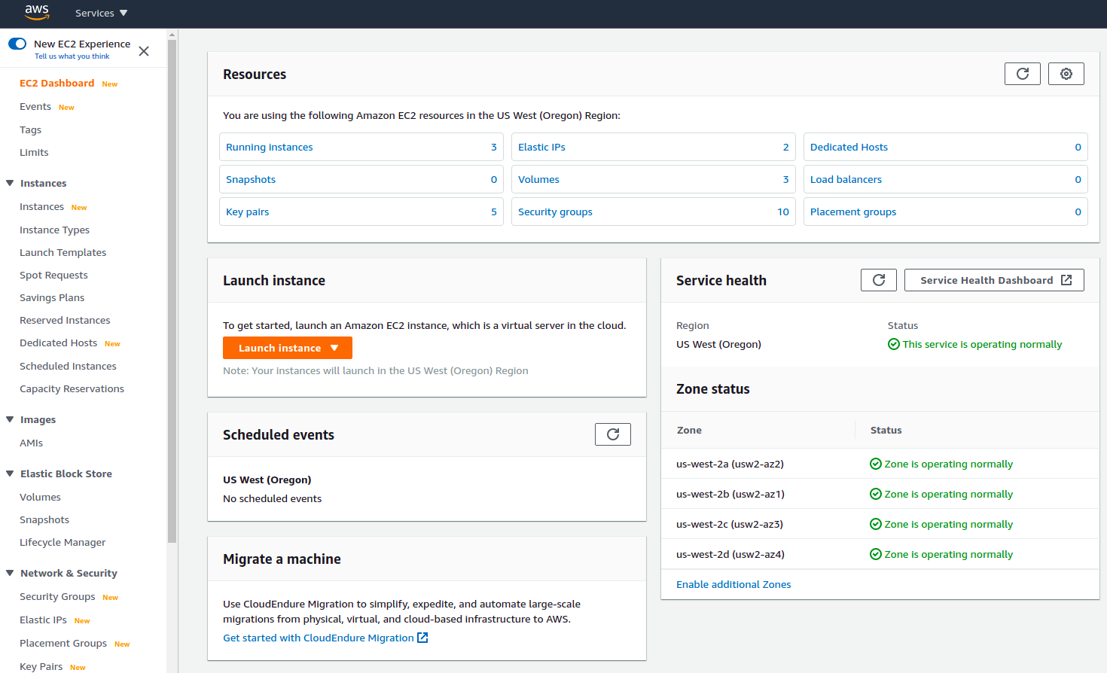
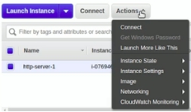
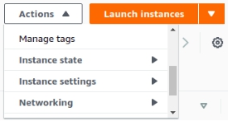
Cloud has different colors but its function remains the same!
Notes:
Note to the mentor - cloud UI can and will change. Core principles will remain the same.

Slide 11
Infrastructure cost reduction
Identify amazon EC2 instances with low-utilization and reduce cost by stopping or rightsizing
Review networking and reduce costs by deleting idle load balancers
Use amazon EC2 spot instances to reduce EC2 costs
Use reserved instances (RI) to reduce costs
Use compute savings plans to reduce EC2 costs
Using budgets, you can set up an alert on forecasted costs too (apart from actual). This gives you the ability to get ahead of the problem and reduce costs proactively.
Notes:
Reference https://aws.amazon.com/blogs/compute/10-things-you-can-do-today-to-reduce-aws-costs/

Slide 12
What else?
Anything else you would like to ask
Any use cases that you would like to talk about

Slide 13
Thank you
Happy Learning!

