Slide 1
Mentor session
Week 3 – AWS Storage

Slide 2

Agenda
Total duration 120 mins
Sustainability (30 mins)
S3 features (30 mins)
AWS Data/Backup services (20 mins)
EBS Decision tree (10 mins)
Q&A from participants (30 mins)

Slide 3
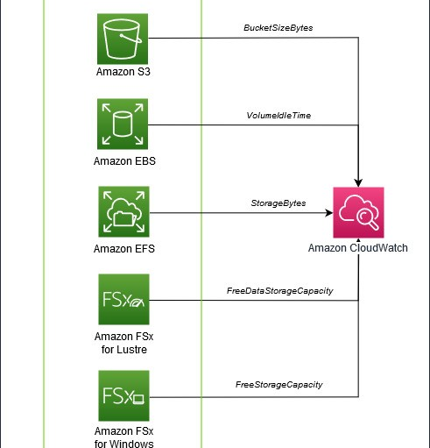
Optimizing your AWS Infrastructure for Sustainability
Managing your data lifecycle and using different storage tiers are key components to optimizing storage for sustainability.
When you consider different storage mechanisms, remember that you’re introducing a trade-off between resource efficiency, access latency, and reliability.
This means you’ll need to select your management pattern accordingly.
We present four concepts to reduce idle resources and maximize utilization for your AWS storage layer
Analyze data access patterns and use storage tiers
Use columnar data formats and compression
Reduce unused storage resources
Deduplicate data
Notes:
Ref-> https://aws.amazon.com/blogs/architecture/optimizing-your-aws-infrastructure-for-sustainability-part-ii-storage/

Slide 4
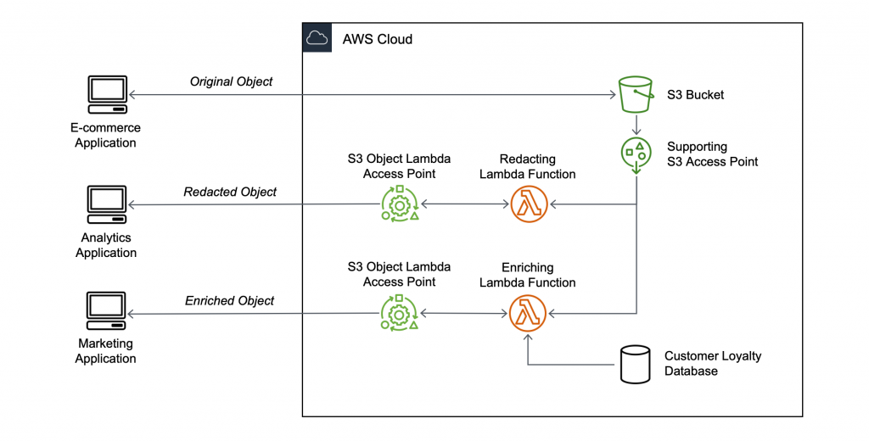
Feature - S3 Object Lambda
When you store data in S3, you can easily share it for use by multiple applications.
However, each application has its own requirements and may need a different view of the data.
For example, a dataset created by an e-commerce application may include personally identifiable information (PII) that is not needed when the same data is processed for analytics and should be redacted.
On the other side, if the same dataset is used for a marketing campaign, you may need to enrich the data with additional details, such as information from the customer loyalty database.
To provide different views of data to multiple applications, there are currently two options.
create, store, and maintain additional derivative copies of the data
build and manage infrastructure as a proxy layer in front of S3 to intercept and process data as it is requested
S3 Object Lambda, a new capability that allows you to add your own code to process data retrieved from S3 before returning it to an application
There are many use cases that can be simplified by this approach, for example:
Redacting personally identifiable information for analytics or non-production environments.
Converting across data formats, such as converting XML to JSON.
Augmenting data with information from other services or databases.
Compressing or decompressing files as they are being downloaded.
Resizing and watermarking images on the fly using caller-specific details, such as the user who requested the object.
Implementing custom authorization rules to access data.
Notes:
Ref-> https://aws.amazon.com/blogs/aws/introducing-amazon-s3-object-lambda-use-your-code-to-process-data-as-it-is-being-retrieved-from-s3/

Slide 5
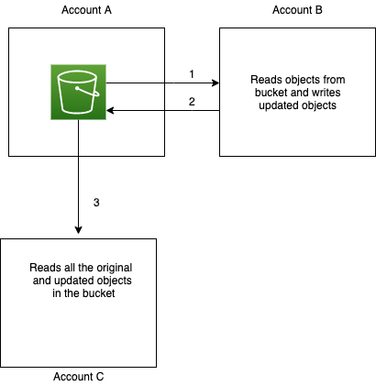
Feature - Enforcing ownership of S3 objects in a multi-account environment
S3 Object Ownership is a feature that offers an effective way to ensure that an S3 bucket owner automatically owns all objects written to a bucket.
Using S3 Object Ownership, you can simplify access control management at scale in multi-account environments, as you can govern access to objects you own through access control mechanisms like bucket policies.
By doing so, you can improve operational efficiency and security by standardizing ownership of and access to objects written to your S3 buckets without manual processes.
Let’s look at some typical scenarios where this is particularly relevant. For example, you might have a data lake workflow where you have an analytics application in account B reading the ‘raw objects’ from an S3 bucket in account A, and writing ‘processed objects’ to the same bucket in account A. In this example, the ‘raw objects’ in the bucket would be owned by account A, and the ‘processed objects’ would be owned by account B. Your workflow may now require another application in account C to read ‘processed objects’ in the account A bucket.
Notes:
Ref -> https://aws.amazon.com/blogs/storage/enforcing-ownership-of-amazon-s3-objects-in-a-multi-account-environment/

Slide 6
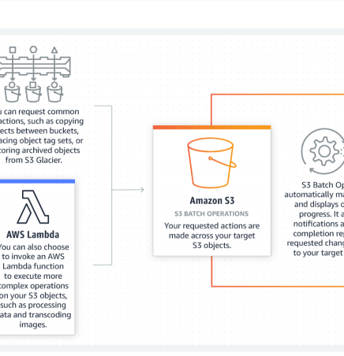
Feature - Data management at scale using Amazon S3 Batch Operations
S3 Batch Operations can perform a single operation on lists of S3 objects that you specify. A single job can perform a specified operation on billions of objects containing exabytes of data.
S3 tracks progress, sends notifications, and stores a detailed completion report of all actions, providing a fully managed, auditable, and serverless experience.
With S3 Batch Operations, you can perform storage management tasks, such as
copying objects between buckets
replacing object tag sets
modifying access controls
restoring archived objects from S3 Glacier or S3 Glacier Deep Archive
S3 Batch Operations gives you the ability to invoke AWS Lambda functions to perform custom actions on objects.
Notes:
Ref -> https://aws.amazon.com/blogs/storage/data-management-at-scale-using-amazon-s3-batch-operations/

Slide 7
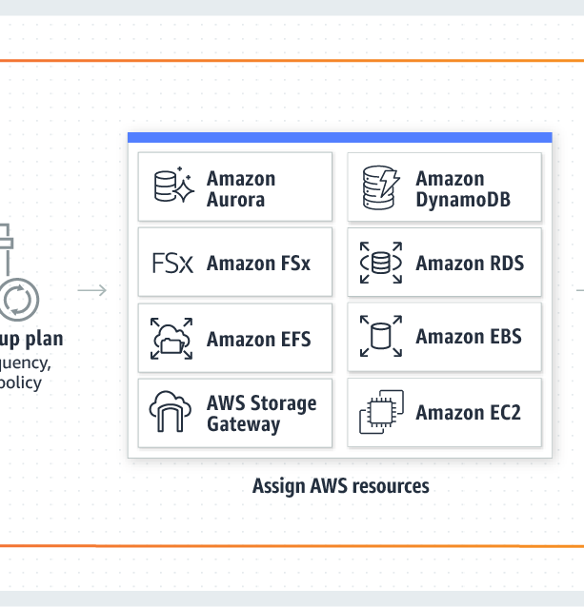
“AWS Backup”
Enables you to centralize and automate data protection across AWS services.
Offers a cost-effective, fully managed, policy-based service that further simplifies data protection at scale.
Helps you support your regulatory compliance or business policies for data protection.
Notes:
Ref -> https://aws.amazon.com/backup/

Slide 8
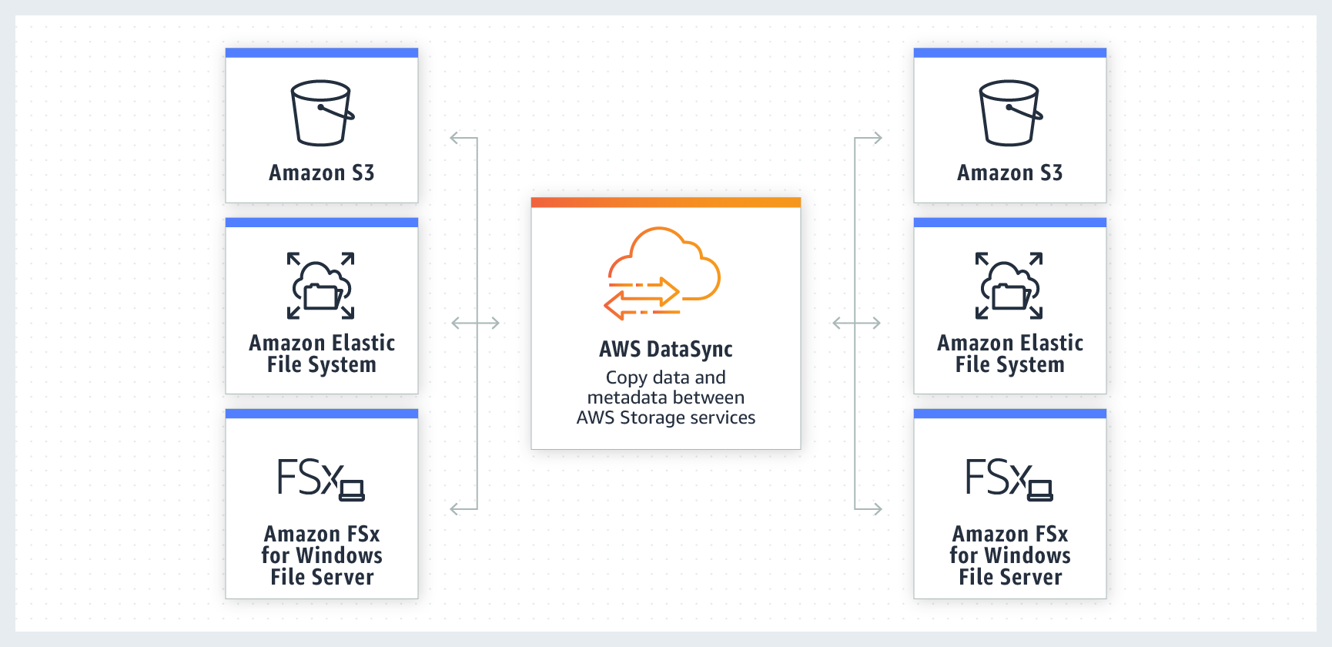
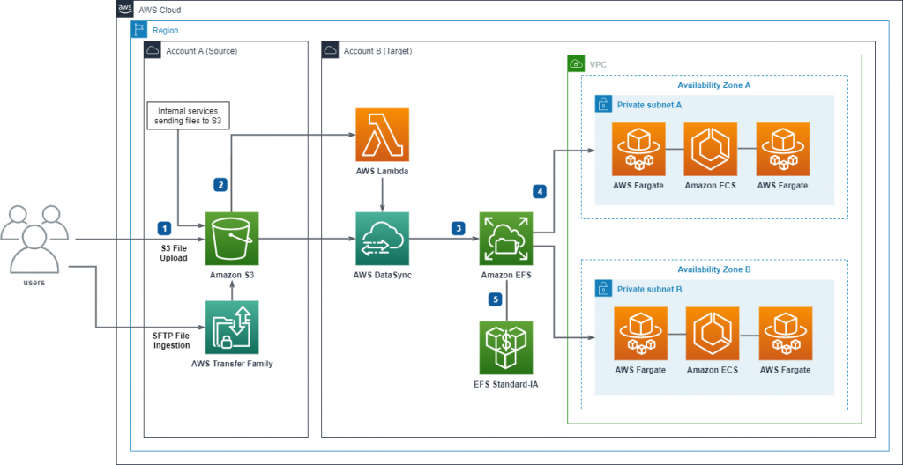
“AWS DataSync”
AWS DataSync is an online data transfer service that simplifies, automates, and accelerates moving data between on-premises storage systems and AWS Storage services, as well as between AWS Storage services.
You can use DataSync to migrate active datasets to AWS, archive data to free up on-premises storage capacity, replicate data to AWS for business continuity, or transfer data to the cloud for analysis and processing.
Users upload files to Amazon S3 via S3 upload or via AWS Transfer Family using SFTP or AWS internal services send files to S3.
Amazon S3 file upload event triggers AWS Lambda to start DataSync task.
Defined DataSync task copies file from S3 to EFS.
Notes:
Ref -> https://aws.amazon.com/datasync
https://aws.amazon.com/blogs/storage/event-driven-data-transfer-to-container-shared-storage-on-aws/

Slide 9
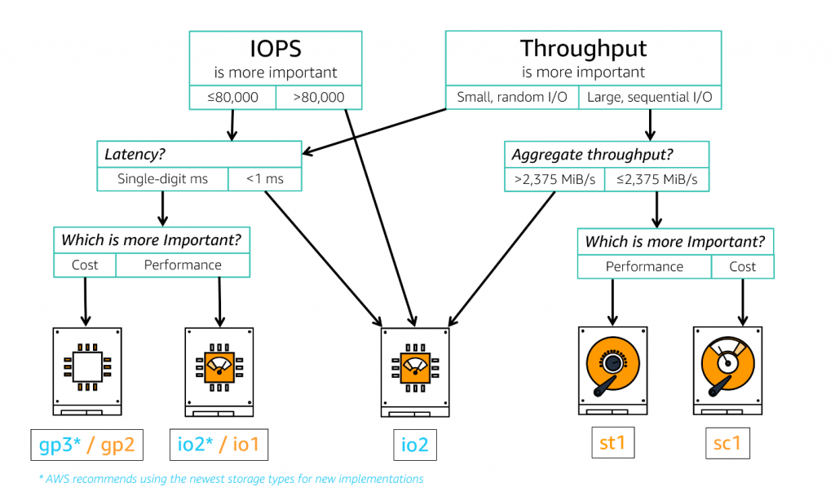
General-purpose Amazon EBS storage decision tree
UseCase: Storage for I/O-intensive SQL Server using Amazon EBS io2 Block Express
We compare how the new EBS storage type compares against existing storage options from the performance point of view.
Refer to the reference link for analyzing the complete use case
Notes:
Ref -> https://aws.amazon.com/blogs/storage/storage-for-i-o-intensive-sql-server-using-amazon-ebs-io2-block-express/

Slide 10
Deciding which storage service
Characteristic | Instance Store | Elastic Block Store (EBS) | Amazon S3 | EFS | FSx
Latency | Lowest (best performance) | Low (sub to single digit ms) | Medium (double - triple-digit ms) | Low (600 µs – double-digit ms) | Low (< 0.5 ms – 1 ms)
Deployment option | Instance-dependent | AZ (single) | Region | AZ (single, multiple) | AZ (single, multiple)
Multiple clients | No | Partial* (via EBS Multi-Attach) | Yes* (multiple REST clients) | Yes | Yes
Lifespan/Ephemeral | EC2 dependent | Separate* (EC2 with “terminate with instance”) | Separate | Separate | Separate
Volume Limit | Instance type | 64 TB | virtually unlimited | virtually unlimited | 64 TB – virtually unlimited
Security Controls | EC2 | IAM Policy | Bucket Policy Bucket ACLs IAM Policy Access Points | Security Group Network ACLs IAM Policy | Security Group Network ACLs IAM Policy
Availability | Instance-dependent | 99.8% - 99.9%* (type dependent) | 99.5% – 99.99% (type dependent) | 99.99% | 99.5% - 99.99% (type dependent)
Durability | Instance-dependent | 99.8% - 99.999%* (type dependent) | 99.999999999% | 99.999999999% | -
Storage Tiering | No | No | Yes (Lifecycle Policy) | Yes | Yes* (ONTAP only)
Types | Single | Multiple | Multiple | Single* (two modes) | Multiple
Pricing | Size/Allocated | Size/Allocated | Usage | Usage* (additional features extra) | Usage* (additional features extra)

Slide 11
Additional Links
Choosing the right storage for your high-performance workloads: https://d1.awsstatic.com/events/reinvent/2019/Choosing_the_right_storage_for_your_high-performance_workloads_STG347.pdf
Comparing your on-premises storage patterns with AWS Storage services: https://aws.amazon.com/blogs/storage/comparing-your-on-premises-storage-patterns-with-aws-storage-services/

Slide 12

Thank you
Happy Learning!

