Slide 1
PGPCC - Mentor session
Flow and Structure for “Managed Services on AWS”
Course 3 Week 4
DynamoDB on EC2 demonstration

Slide 2
Do’s and Don’ts
Do watch the instructional video content to understand the core principles. Please do not attempt to do the hands-on simultaneously.
Please use the “Try-It-Out” Labs, projects and do-it-yourself exercises for self practice
Do note the cloud service screens do change from time to time, but the core concepts rarely do, if at all.
Practice labs and DIY exercises are not compatible with the AWS Academy account.
Please use your personal cloud account for practice labs and DIY exercises.
Practice exercises/DIYs need to be completed in go. Do not spread it out over long hours or days.
Always cleanup immediately after your practice is completed. Failure to do this will result in charges getting applied to your account.

Slide 3
DynamoDB Workbook Demonstration

Slide 4
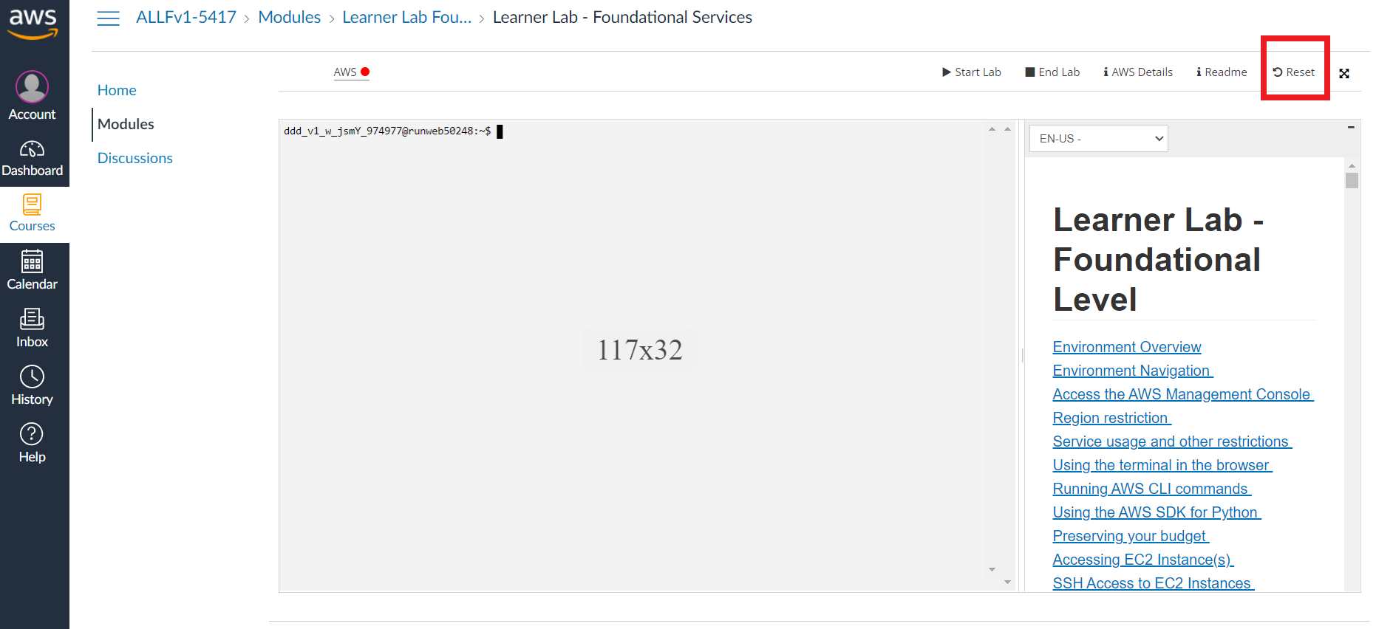
Do not forget to reset your lab

Slide 5
Q&A
Let’s demystify!
Notes:
Based on questions submitted by the specific batch
To be structured as a discussion
Mentor can share personal project experiences if needed
If applicable mentor can share any relevant cloud provider documentation link for further reading by the learners

Slide 6
Thank you
Happy Learning!
Notes:
The attached DynamoDB workbook exercise should be performed here.

