Slide 1


Race-Related Discrimination and the Behavioral Drive for Muscularity in Asian/Asian American Men
Claire Guidinger, M.A., M.S. & Yijun Cheng, M.A.
Department of Counseling Psychology
Prevention Science Institute
University of Oregon
Notes:
Introduce selves
Claire talks

Slide 2

R Journey
Notes:
We started the journey: piecwise understanding of R
Yijun add journey
Why we chose this research question

Slide 3

R Journey
Challenges
New challenge each week!
Nitpicky details of R
Time-consuming de-bugging
You think you got it...but you don’t got it
Notes:
Feels like it makes sense during class, then when we get to class, very hard

Slide 4

R Journey
Successes
setwd()
Setting up workflow
Basics of R, making plots and tables, how to collaborate with others
Data cleaning
Learning fundamentals of R (e.g., how to create an R Project and Markdown)
The importance of open science framework
How to access open resources

Slide 5
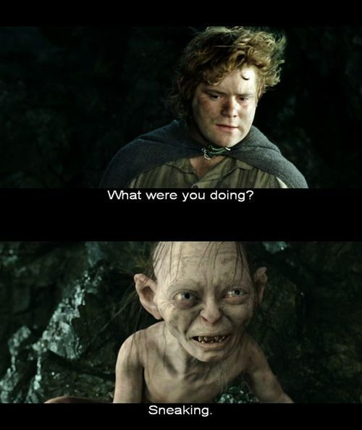
Challenges we are Still Facing
Knitting the document to pdf (under APA format)
APA-Formatting of regression tables
Ensuring formatting is consistent (tables, figures, text)

Slide 6
Outline
Introduction
Hypotheses
Methods
Results
Discussion

Slide 7
Introduction
Historically, men have been understudied and underrepresented in disordered eating research
Data suggest that Asian and Asian American men report among the highest rates of disordered eating across genders and racial/ethnic groups
Braun et al., 1999; Lavender et al., 2017; Braun et al., 1999; Strother et al., 2012

Slide 8
Introduction
Asian/Asian American men may be particularly susceptible to reporting disordered eating behaviors aimed at increasing their muscularity (e.g., steroid use & excessive/compulsive exercise)
Asian/Asian American men often rate their bodies as smaller and less attractive than the ideal physique
Also rated by potential romantic partners as smaller, less masculine, and more feminine than their non-Asian peers
Barnett et al., 2002; Kelly et al., 2015; Strother et al., 2012; Wilkins et al., 2011

Slide 9
Introduction
Evidently, these harmful stereotypes have a profound effect on Asian/Asian American’s body image and associated disordered eating behaviors
May render Asian/Asian American men especially susceptible to engaging in muscularity-enhancing behaviors aimed at achieving the lean and muscular, Western male body ideal
Kelly et al., 20118; Nadal et al., 2014; Wilkins et al., 2011

Slide 10
Introduction
Race-related discrimination, both in the forms of overt racism and microaggressions, may be particularly relevant to the behavioral drive for muscularity in Asian/Asian American men
It is theorized that when Asian/Asian American men experience race-related discrimination, their Asian identity becomes particularly salient, therefore perpetuating internalized feelings of perceived inadequacy with regards to embodying the mesomorphic, Western male body ideal
Kelly et al., 20118; Nadal et al., 2014

Slide 11
Study Aims
There is a robust body of literature linking experiences with race-related discrimination to negative mental health outcomes, including anxiety, depression, and binge eating in Asian/Asian American men
No known studies to date have examined the link between race-related discrimination and the behavioral drive for muscularity (e.g., body building, excessive exercise, and metabolic steroid use) in Asian/Asian American men

Slide 12
Hypotheses
Hypothesis 1: Experiences with overt racism will be significantly and positively associated with the behavioral drive for muscularity in young, Asian/Asian American men.
Hypothesis 2: Experiences with microaggressions will be significantly and positively associated with the behavioral drive for muscularity in young, Asian/Asian American men.

Slide 13
Methods
Study approved by the University of Oregon IRB
Data collected January-February 2017
Participants recruited via Qualtrics Panels
Completed an online Qualtrics survey
All study responses were anonymous and considered invalid if less than 80% of questions were answered (Dong & Peng, 2013), the survey was completed in < 2 minutes (n = 9), or if participants failed to answer “yes” to an embedded validity item (n = 52)
Notes:
This study was approved by the Institutional Review Board at the University of Oregon
Data were collected between January-February of 2017
Participants were recruited via qualtrics panels, which partners with various social media outlets to recruit a diverse and nationally representative pool of survey respondents
Participants completed an online survey consisting of demographic questions and validated measures aimed to assess our hypotheses

Slide 14
Participant Criteria
Inclusion Criteria:
Between 18-30 years of age
Identify as male
Identify as Asian or Asian American
Understand English
Live in the U.S.
Notes:
In order to be eligible for the current study, participants had to be between the ages of 18-30, self-identify as male, identify as Asian or Asian American, understand English, and currently reside in the United States

Slide 15
Measures
Construct | Measure
Demographic Information | Participants self-reported their height (ft and in) and weight (lbs.), from which BMI was calculated; age; race/ethnicity; annual income; highest level of education; presence of a psychiatric diagnosis
Experiences with Racism | 13-item Asian American Racism-Related Stress Inventory (Miller et al., 2012): Overt racism (e.g., “You see a TV commercial in which an Asian character speaks bad English and acts subservient to non-Asian characters”) and Microaggressions (e.g., “Someone asks you if you can teach him or her karate”)
Behavioral Drive for Muscularity | 15-Item Behavioral Drive for Muscularity Scale (DMS; McCreary & Sasse, 2000) used to assess the behavioral drive for muscularity (e.g., “I think that my weight training schedule interferes with other aspects of my life”)
Notes:
We used empirically validated measures to assess our study variables

Slide 16
Results
RStudio Statistical Software was used for all analyses.
Data were first screened for normality, goodness of fit, and missingness using the “Performace” and ”ggResidual” packages
Data fulfilled all model assumptions and missing data were minimal (<2%) so listwise deletion was employed
All analyses adjusted for BMI, annual income, highest level of education, and presence of a psychiatric diagnosis given their associations with disordered eating symptoms, including the behavioral drive for muscularity (McLean et al., 2014; Striegel, Bedrosian, Wang, & Schwartz, 2011)

Slide 17
Participants
Sample: 266 Asian/Asian American men
Age range: 18-30 years
M age = 24.4 ± 3.6 years
M BMI = 24.2 ± 5.6 kg/m²
Notes:
The current study consisted of 266 Asian/Asian American men
The mean age was 24.4
The mean BMI was 24.2

Slide 18
 | Full Sample (N = 266)
Geographic Region Urban Suburban Rural Other | 44.0% 42.9% 7.1% 6.0%
Education ≤High school Some college ≥4-year college degree | 21.4% 26.3% 52.3%
Employment Status Disability Unemployed Employed part-time Employed full-time | 3.8% 27.5% 24.9% 43.8%
Annual income <$19,000 $20,000-29,000 $30,000-39,999 $40,000+ | 25.5% 13.9% 6.4% 54.2%
Presence of a Psychiatric Diagnosis No Yes | 80.5% 19.5%
Demographics

Slide 19
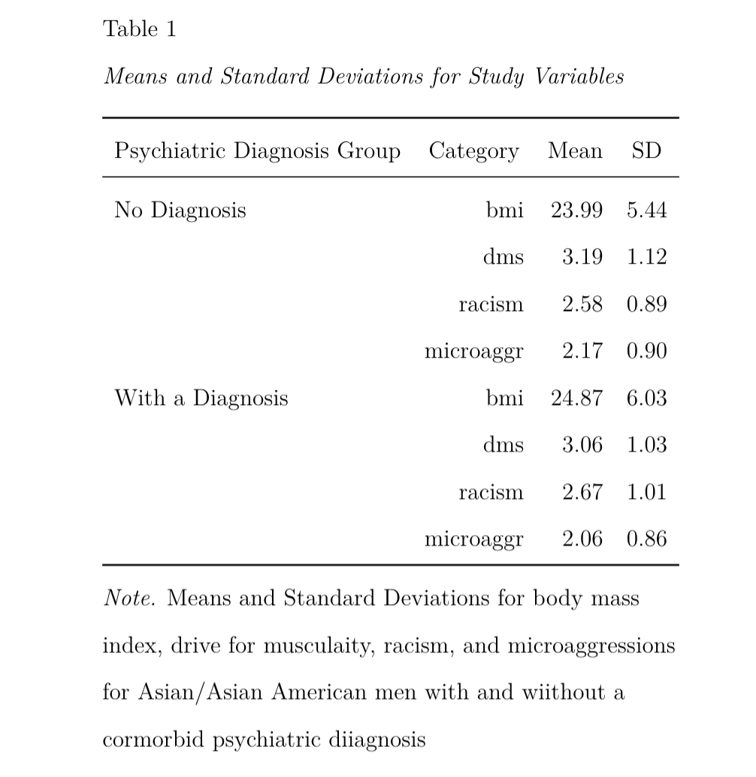
Mean and Standard Deviation for Study Variables

Slide 20
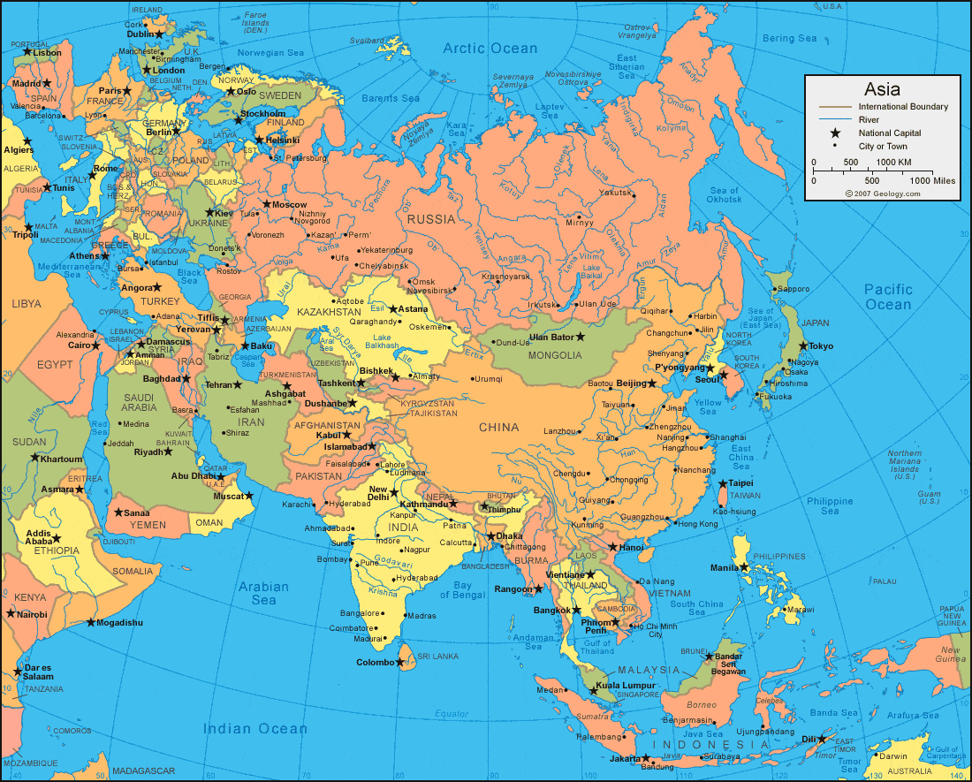
Participants
22.2% Chinese (n = 59)
15.4% Indian (n = 41)
12.4% Filipino (n = 33)
9.4% Vietnamese (n = 25)
9.0% American Indian (n = 24)
7.9% Korean (n = 21)
6.0% Japanese (n = 16)
2.6% Middle Eastern (n = 7)
2.3% Hmong (n = 6)
1.9% Pacific Islander (n = 5)
1.5% Native Hawaiian (n = 4)
9.4% other Asian ethnic group (n = 25)
Notes:
As you can see, we had a very ethnically diverse sample, with the largest ethnic subgroups being Chinese, Indian, and Filipino men

Slide 21
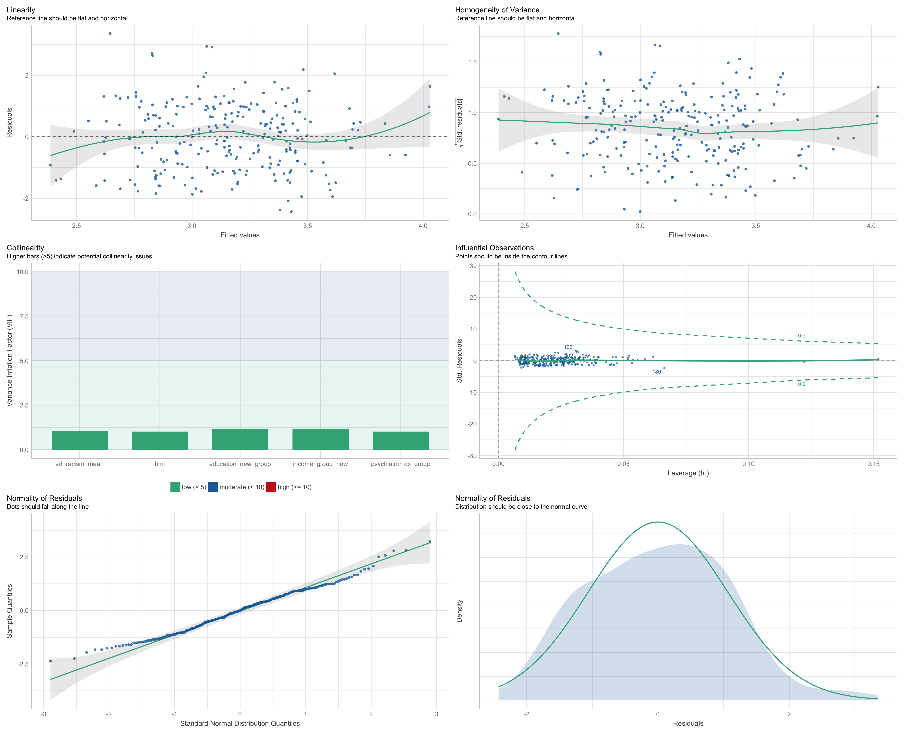
Model Assumptions

Slide 22

Regression Results
Overt Racism
Behavioral Drive for Muscularity
F(5, 250) = 4.06, p < .01, R² = 0.08
Microaggressions
Behavioral Drive for Muscularity
F(5, 250) = 6.48, p < .001, R² = 0.12
Notes:
Follow-up analyses showed that Filial piety was significantly and inversely associated with LOC eating frequency
Conformity to collectivist norms was significantly and positively associated with LOC eating frequency
Humility was not associated with LOC eating frequency

Slide 23
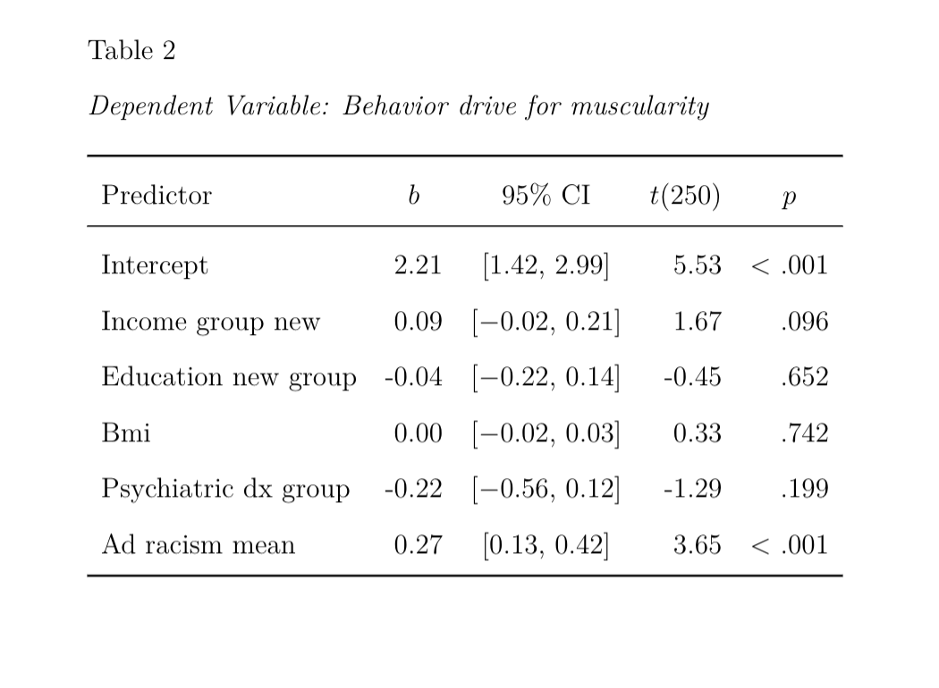
Regression Table

Slide 24
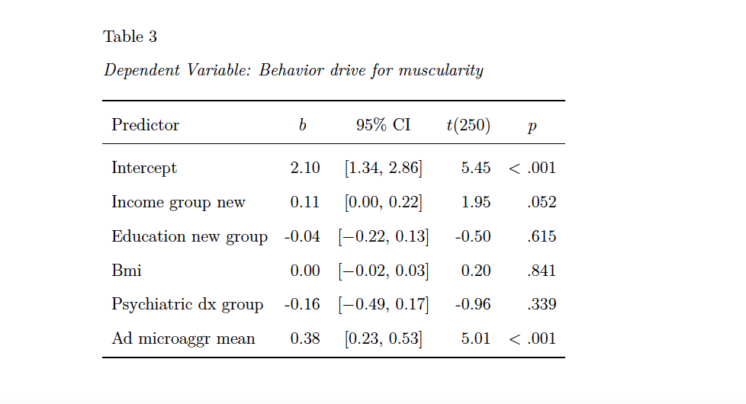
Regression Table

Slide 25
Discussion
First known study to explore the factor structure of the Asian Values Scale-Revised and if distinct dimensions of Asian values were differentially associated with disordered eating and body image concerns
Asian Values Scale-Revised loaded onto three separate factors:
Filial piety
Conformity to collectivist norms
Humility
Diener et al., 2003; Kim et al., 2002; Wong et al., 2012
Notes:
This was the first known study to explore the factor structure of the AVS-R scale, and if these distinct dimensions were differentially associated with emotion dysregulation and eating disorder symptoms. As hypothesized, the AVS-R loaded onto three separate factors representing (a) filial piety, (b) conformity to collectivist norms, and (c) humility.
It was important to examine this scale for separate factors because several studies have identified both positive and negative outcomes with regard to adherence to these values and because prior research has identified Asian/Asian American men as a high risk population for developing avoidant coping mechanisms, such as loss of control eating, and high body dissatisfaction
Because of these inconsistencies in the literature, it was unclear which mechanisms of Asian values were serving as risk versus protective factors.

Slide 26
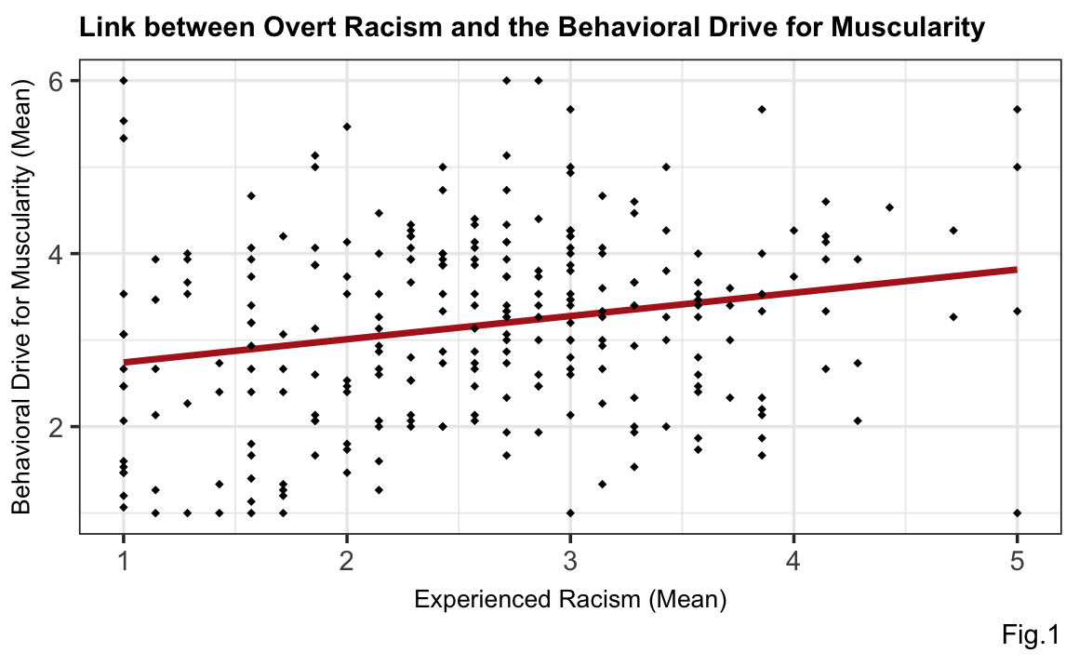
Regression results

Slide 27
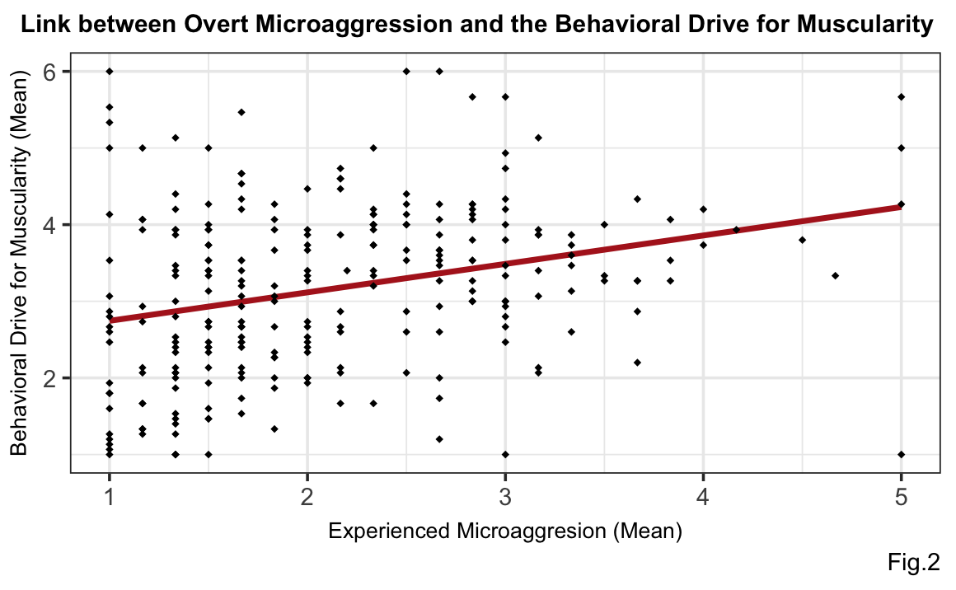
Regression results

Slide 28
Discussion
First known study to examine the link between Asian/Asian American men’s experiences with race-related discrimination and the behavioral drive for muscularity
As hypothesized, both experiences with overt racism (e.g., “You see a TV commercial in which an Asian character speaks bad English and acts subservient to non-Asian characters”) and microaggressions (e.g., “Someone asks you if you can teach him or her karate”) were significantly and positively associated with the behavioral drive for muscularity (e.g., engaging in behaviors aimed at increasing muscle mass)

Slide 29
Discussion
The current study sheds further light on the harmful effects of racism on Asian/Asian American men’s mental health, including body image and muscularity-enhancing behaviors
Data support the notion that experiences with racism may prompt Asian/Asian American men to engage in behaviors aimed at achieving the mesomorphic male body ideal
Asian/Asian American men may be going to extreme lengths to achieve the ideal Western male body physique (e.g., excessive and compulsive muscularity-enhancing behaviors)

Slide 30
Study Strengths and Limitations
Large, ethnically diverse, nationally representative sample of Asian/Asian American men
Underpowered to examine intra-ethnic differences
Cross-sectional data: findings are correlational
Experimental and prospective studies are needed to further validate the current findings

Slide 31
Implications and Future Directions
The current study adds to a small, but growing body of research implicating experiences with race-related discrimination as a significant contributor to health disparities among racial/ethnic minority men living in the United States
These data may help to inform clinical programming and preventative interventions aimed at addressing the harmful effects of race-related discrimination on men’s body image and disordered eating behaviors
Current study may also help to inform the development and implementation of interventions aimed at helping Asian/Asian American men adopt healthy coping strategies in response to discriminatory experiences
Notes:
Although prospective and mechanistic studies are needed, these findings indicate that experiences with race-related discrimination negatively impact Asian/Asian American men’s body image

Slide 32
Next R Hurdle
Higher-level stats with R
Ethnic/racial variations of findings
Writing in everything in R as efficiently as working in word, excel, SPSS, manually, etc.
Data visualization:
Moderation findings
Mediation findings
Aesthetically pleasing, APA-format graphs and figures

Slide 33
References
Barnett, H. L., Keel, P. K., & Conoscenti, L. M. (2002). Body Type Preferences in Asian and Caucasian College Students. Sex Roles, 12.
Braun, D. L., Sunday, S. R., Huang, A., & Halmi, K. A. (1999). More males seek treatment for eating disorders. The International Journal of Eating Disorders, 25(4), 415–424.
Buhi, E. R., Goodson, P., & Neilands, T. B. (2008). Out of sight, not out of mind: Strategies for handling missing data. American Journal of Health Behavior; Star City, 32(1), 83–92. https://search.proquest.com/docview/211806047/abstract/F7977D68F2D04E4APQ/1
Dong, Y., & Peng, C.-Y. J. (2013). Principled missing data methods for researchers. SpringerPlus, 2(1). https://doi.org/10.1186/2193-1801-2-222
Edwards, C., Tod, D., Molnar, G., & Markland, D. (2016). Perceived social pressures and the internalization of the mesomorphic ideal: The role of drive for muscularity and autonomy in physically active men. Body Image, 16, 63–69. https://doi.org/10.1016/j.bodyim.2015.11.003
Kelly, N. R., Cotter, E. W., Tanofsky-Kraff, M., & Mazzeo, S. E. (2015). Racial variations in binge eating, body image concerns, and compulsive exercise among men. Psychology of Men & Masculinity, 16(3), 326–336. https://doi.org/10.1037/a0037585

Slide 34
Barnett, H. L., Keel, P. K., & Conoscenti, L. M. (2002). Body Type Preferences in Asian and Caucasian College Students. Sex Roles, 12.
Braun, D. L., Sunday, S. R., Huang, A., & Halmi, K. A. (1999). More males seek treatment for eating disorders. The International Journal of Eating Disorders, 25(4), 415–424.
Buhi, E. R., Goodson, P., & Neilands, T. B. (2008). Out of sight, not out of mind: Strategies for handling missing data. American Journal of Health Behavior; Star City, 32(1), 83–92. https://search.proquest.com/docview/211806047/abstract/F7977D68F2D04E4APQ/1
Dong, Y., & Peng, C.-Y. J. (2013). Principled missing data methods for researchers. SpringerPlus, 2(1). https://doi.org/10.1186/2193-1801-2-222
Edwards, C., Tod, D., Molnar, G., & Markland, D. (2016). Perceived social pressures and the internalization of the mesomorphic ideal: The role of drive for muscularity and autonomy in physically active men. Body Image, 16, 63–69. https://doi.org/10.1016/j.bodyim.2015.11.003
Kelly, N. R., Cotter, E. W., Tanofsky-Kraff, M., & Mazzeo, S. E. (2015). Racial variations in binge eating, body image concerns, and compulsive exercise among men. Psychology of Men & Masculinity, 16(3), 326–336. https://doi.org/10.1037/a0037585
Kelly, N. R., Smith, T. M., Hall, G. C. N., Guidinger, C., Williamson, G., Budd, E. L., & Giuliani, N. R. (2018). Perceptions of general and postpresidential election discrimination are associated with loss of control eating among racially/ethnically diverse young men. International Journal of Eating Disorders, 51(1), 28–38. https://doi.org/10.1002/eat.22803
Lavender, J. M., Brown, T. A., & Murray, S. B. (2017). Men, Muscles, and Eating Disorders: An Overview of Traditional and Muscularity-Oriented Disordered Eating. Current Psychiatry Reports, 19(6). https://doi.org/10.1007/s11920-017-0787-5
Lewinsohn, P. M., Seeley, J. R., Moerk, K. C., & Striegel-Moore, R. H. (2002). Gender differences in eating disorder symptoms in young adults. The International Journal of Eating Disorders, 32(4), 426–440. https://doi.org/10.1002/eat.10103
Miller, M. J., Kim, J., Chen, G. A., & Alvarez, A. N. (2012). Exploratory and confirmatory factor analyses of the Asian American Racism-Related Stress Inventory. Assessment, 19(1), 53–64. https://doi.org/10.1177/1073191110392497
Nadal, K. L., Griffin, K. E., Wong, Y., Hamit, S., & Rasmus, M. (2014). The impact of racial microaggressions on mental health: Counseling implications for clients of color. Journal of Counseling & Development, 92(1), 57–66. https://doi.org/10.1002/j.1556-6676.2014.00130.x
Spann, N., & Pritchard, M. (2008). Disordered eating in men: A look at perceived stress and excessive exercise. Eating and Weight Disorders, 13(2), e25-27.
Strother, E., Lemberg, R., Stanford, S. C., & Turberville, D. (2012). Eating Disorders in Men: Underdiagnosed, Undertreated, and Misunderstood. Eating Disorders, 20(5), 346–355. https://doi.org/10.1080/10640266.2012.715512

Slide 35

Thank you! Questions?

