Slide 1
Battle-of-Neighbourhoods
Analysing the Neighbourhoods in Delhi

Slide 2



Bakground
Opening and running a business in Food industry is difficult, as there are a lot of challenges one will face, when opening such establishment. For example, there is an issue of where to operate from as the location is really an important factor. There have been a lot of cases where establishments have failed just because their location was not appropriate. But this problem could be solved using data.

Slide 3
Problem Statement and Description
In the Union Territory of New Delhi, there are a lot of places for the residents to go out and eat, and there are people who would like to take the opportunity of serving such people by opening his/her own restaurant.
Food business always thrives on the quality of the food served, variety of the dishes and area in which it is operating. But, in large cities like New Delhi, it could be difficult to decide where should one open his new restaurant
So, to find appropriate answers to the problem we must-
Classify different areas in different Clusters
Decide appropriate location regarding where to open a restaurant

Slide 4
Data Requirements
The data requirements of the problem are fulfilled using:
Wikipedia
Foursquare
Geolocator
Important links:
https://simple.wikipedia.org/wiki/List_of_districts_in_Delhi
https://en.wikipedia.org/wiki/Neighbourhoods_of_Delhi

Slide 5
Data Gathering and Transformation
Plotting markers of the locations on Map to visualize the areas.
Using coordinates in Foursquare API to make several calls and gather data of different places in each neighbourhood for classification of them in clusters.
After classifying, they will be marked on map in different colours for visualizing different clusters in the city.

Slide 6
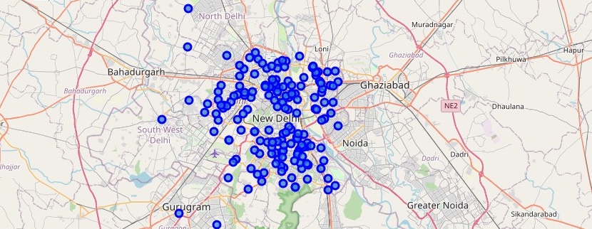
Neighbourhoods in Delhi marked using Folium
z

Slide 7
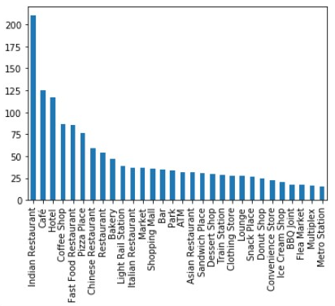
Top Venue Categories in Delhi
z

Slide 8
Description of data collected
Total of 2080 locations were found in their database located in Delhi.
Those 2080 locations were divided into 218 different categories, of those top 30 categories with respect to the number of venues in each category, is represented as a bar graph plotted in previous slide.
The first 9 venue categories are related to food, of which the most venues were Indian Restaurants, followed by Café and then Hotel.
Most common category is related to food and is quite popular.

Slide 9
Methodology
The data collection, transformation, and analysis, all was done in the Jupyter Notebook using python. Sources of data were different for different data. Mainly there were 3 sources:
Wikipedia
Geolocator
Foursquare
After collecting and transforming data into meaningful dataset, an algorithm called as K-Means-Clustering was applied to the collected data.

Slide 10
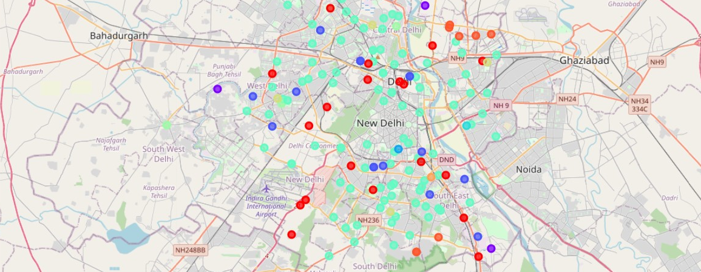
The map of Delhi showing neighbourhoods divided into 10 clusters
z

Slide 11
Results
z

Slide 12
Number of Neighbourhoods in each cluster
z

Slide 13
With these findings, we can surely say that :
Most common type cluster is 5, which has Fast Food Restaurants
Clusters- 1,2,3,8,7 commonly have French Restaurants
Clusters-3,6 commonly have Indian Restaurants

Slide 14
Discussion
Now that we have findings backed by data, one can easily plan with these findings, about whether he will go into areas where that venue common and will have to compete with them in order to survive in the market. Also, he can go into areas where that category of venue is not there at present and could possibly attract people by introducing something new in their neighbourhood. It is completely dependent on the person on how he would use these findings

Slide 15
Conclusion
These findings from the analysis could be very useful for someone looking to get into food business and would help him a lot to understand the characteristics of the neighbourhoods in Delhi, and Delhi as whole. He would be able to get a fair idea of what kind of challenges and opportunities each neighbourhood offers. This would help him in planning about those in advance and would be very beneficial in the initial stages of business.

