Slide 1
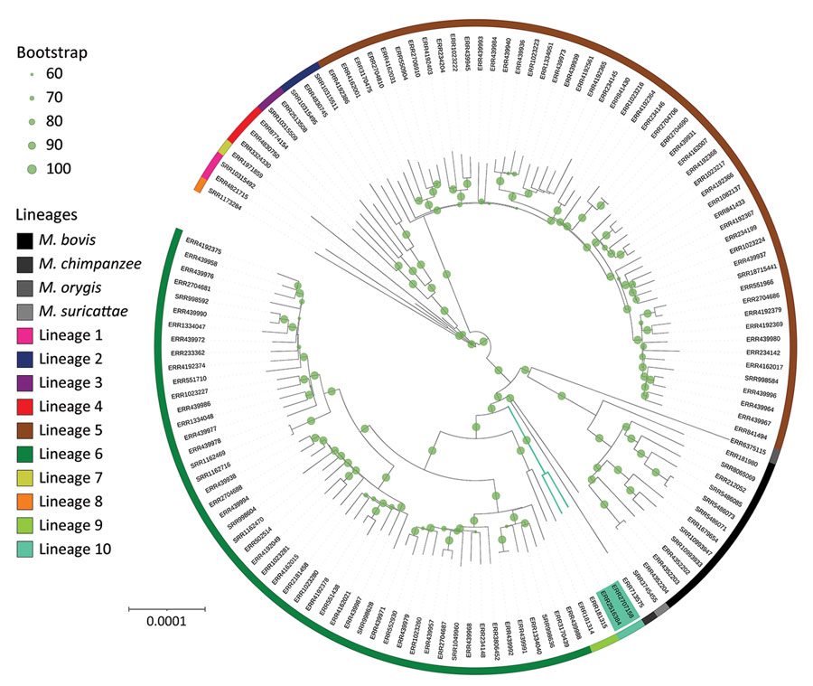
Figure
Figure. Global Mycobacterium phylogeny including newly identified M. africanum L10 (proposed) strains (green shading). We selected M. africanum samples for harboring RD9 deletion, having documented country of origin (for the purpose of additional analyses; Appendix 2, Figure 2), and refined our selection to retain a sole representative of each sublineage for each country. This sample represents representing the genetic and geographic diversity of M. africanum in Africa. Specifically for this phylogenetic reconstruction, single-nucleotide polymorphisms were identified in comparison with an M. tuberculosis ancestor (11) and reincorporated into the whole genome to avoid biases in the molecular model or need for Lewis correction. Phylogeny was rooted with M. canettii, subsequently removed for better visualization. Bootstrap support was computed using 100 replicates and shown when ≥0.6. Circles confirm the large support of almost all branches, especially of L10 and its sister branches. L10 branching point lies between L9 and the La_A1 lineage grouping chimpanzee and Dassie bacillus. Scale bar indicates nucleotide substitutions per site.
Guyeux C, Senelle G, Le Meur A, Supply P, Gaudin C, Phelan JE, et al. Newly Identified Mycobacterium africanum Lineage 10, Central Africa. Emerg Infect Dis. 2024;30(3):560-563. https://doi.org/10.3201/eid3003.231466

