Slide 1
广泰永立 风扇噪声分析
Siemens
T CED INW-CN&DCO-CN
Yang Shaopeng, Liu Ning, Yu He
2024-04-03

Slide 2
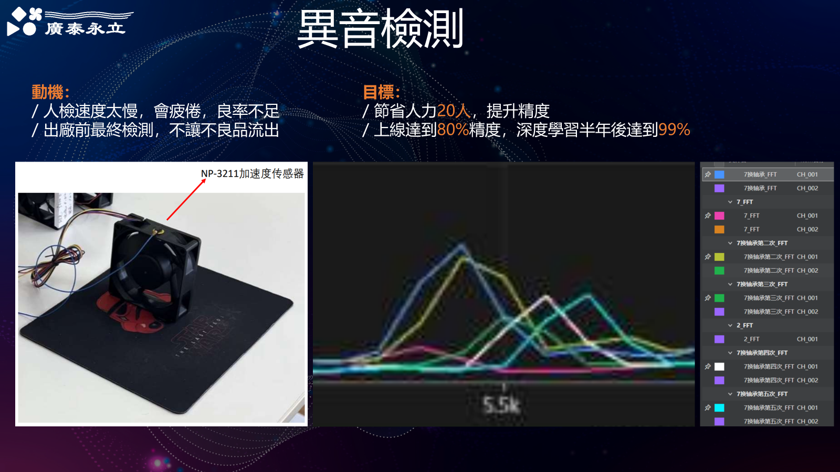
Problem definition
Abnormal noise generated during fan production.
Manual field detection based on human ear for quality judgement.
Automatic testing and objective judgement for quality is highly needed.

Slide 3
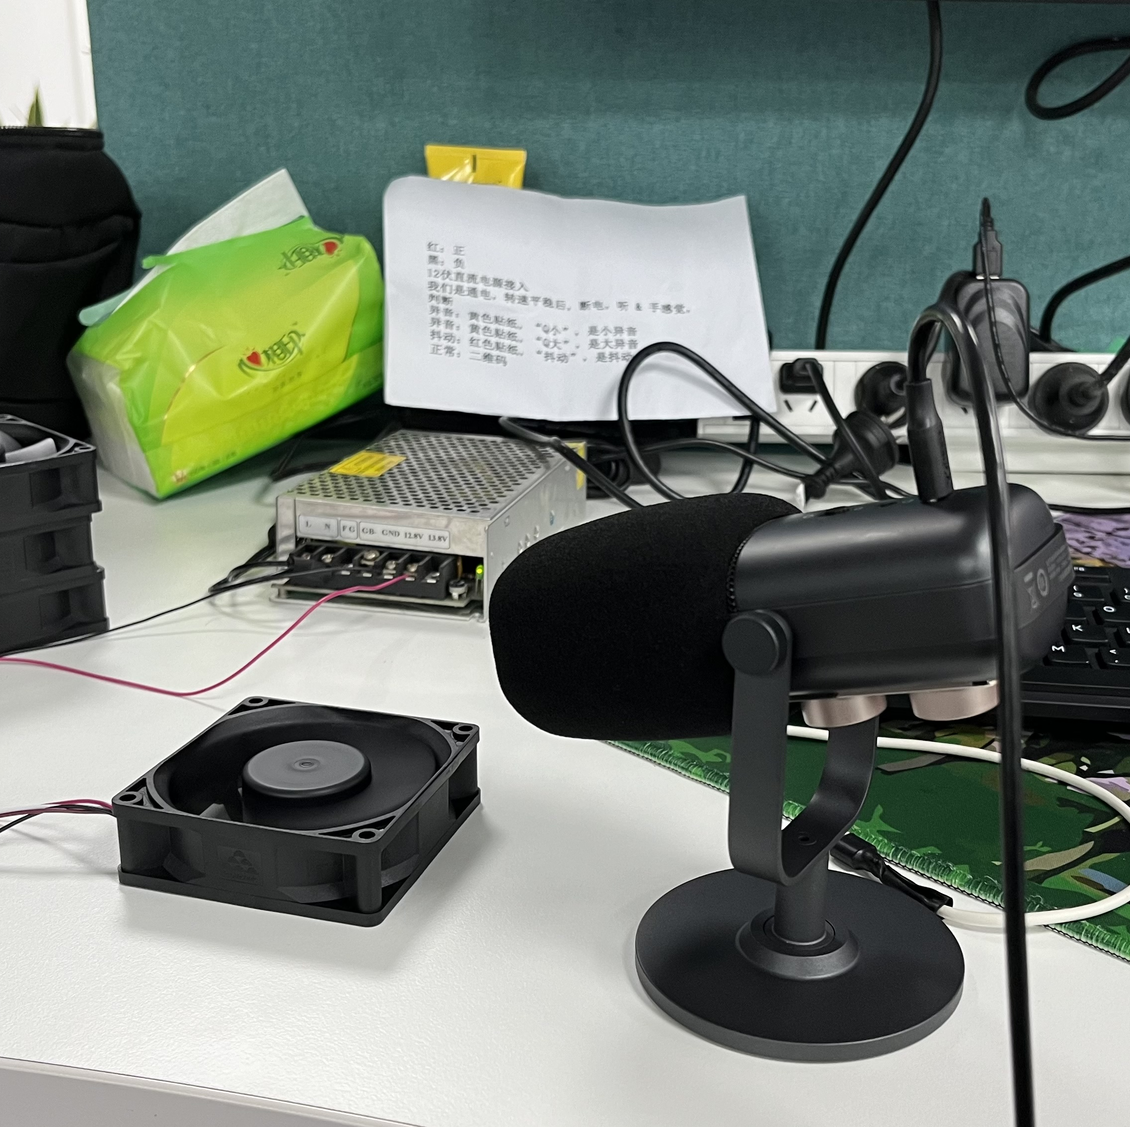

Test setup
Hi-Res microphone with heart shape radio collection.
Stable power supply.
Separated space to prevent interference.
Fixed distance between fan and microphone.
10cm

Slide 4
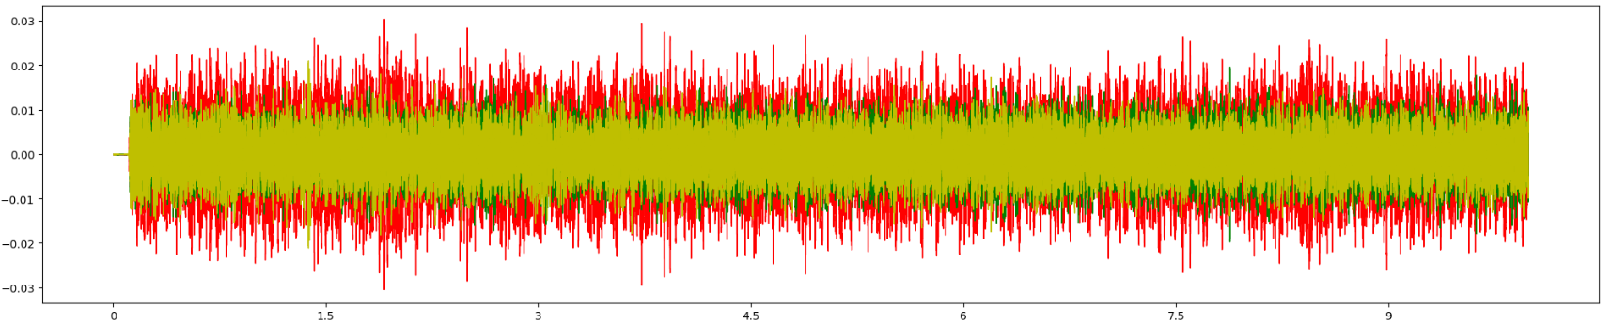
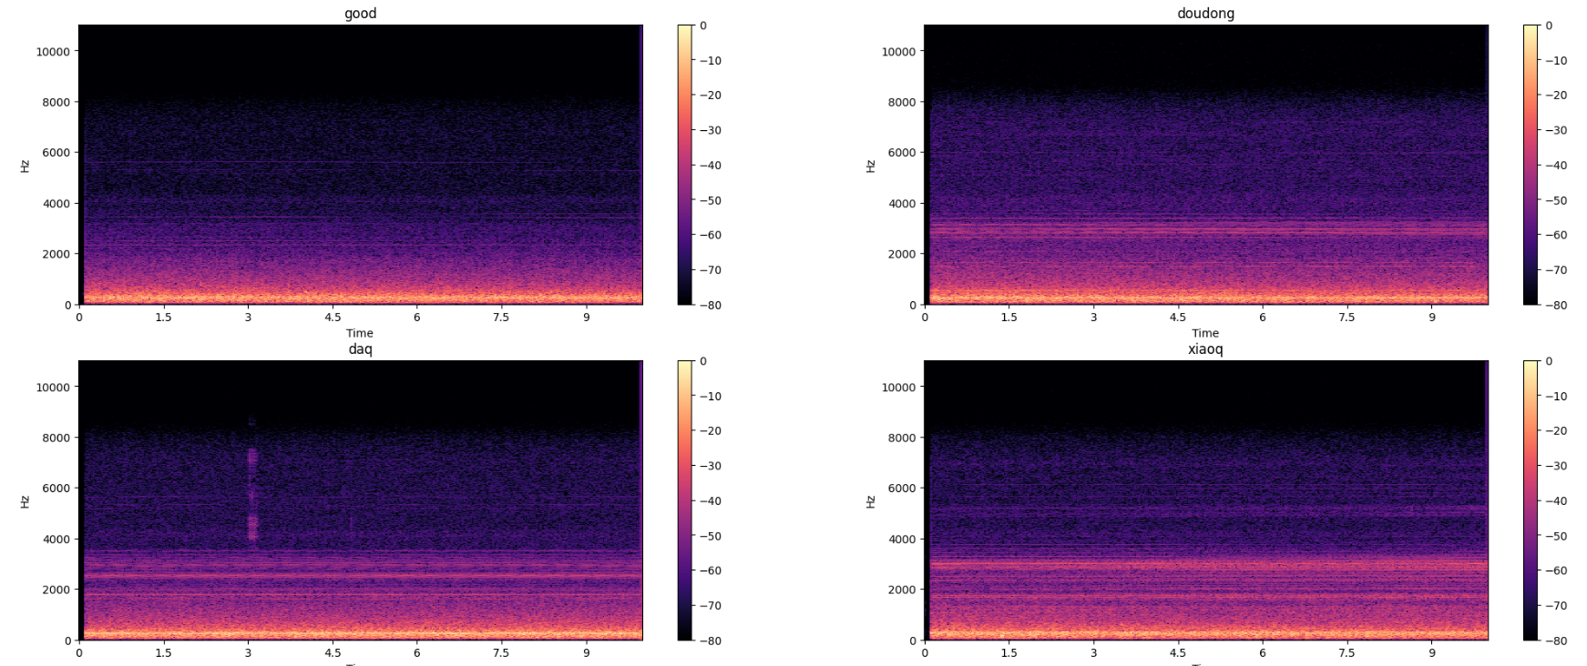
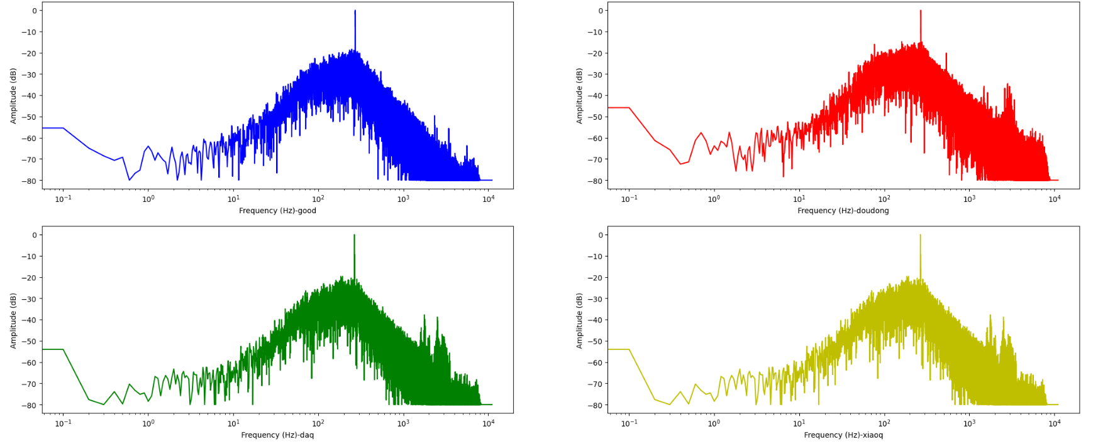
Basic fan samples analysis
Samples: Good-1, daq-1, xiaoq-1, doudong-1
Wave chart
Spectrogram
FFT chart

Slide 5
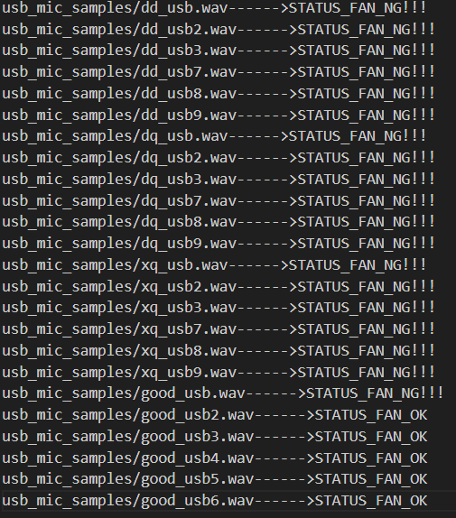

Algorithm evaluation
Input: 10s* 6 * 4types
Output: Good or NG
Result:
Successfully classified for quality judgement.

Slide 6
Liu, Ning
liuning@siemens.com
Senior Key Expert
T CED DCO-CN
Beijing, China
Yu, He
he.yu@siemens.com
Senior Expert Engineer
T CED INW-CN
Wuxi, China
Yang Shaopeng
shaopeng.yang@siemens.com
Expert Engineer
T CED INW-CN
Wuxi, China

