Slide 1
Current data analysis, forecast and proposal
西门子无锡创新中心

Slide 2
Analysis and Forecast
Basic analysis
Statistical analysis and forecast
Forecast using deep learning(LSTM)

Slide 3
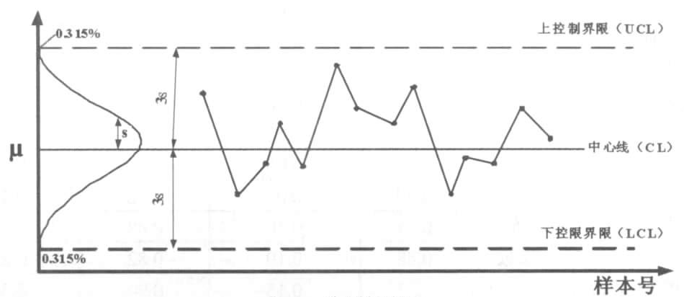
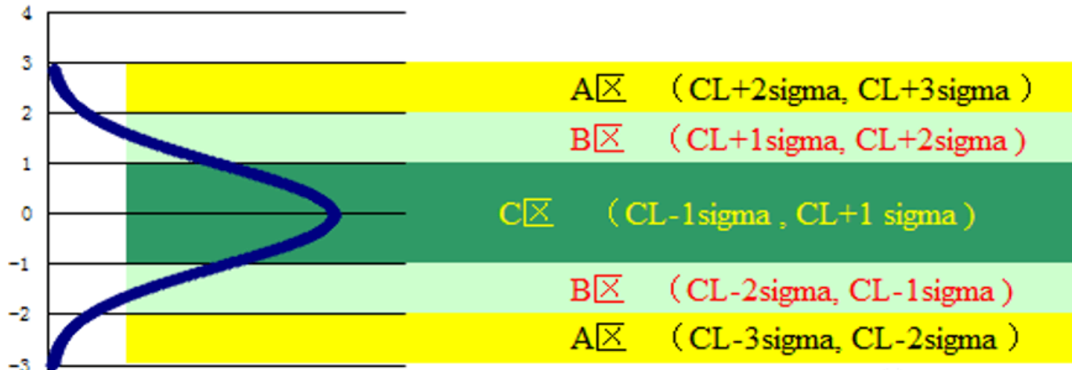
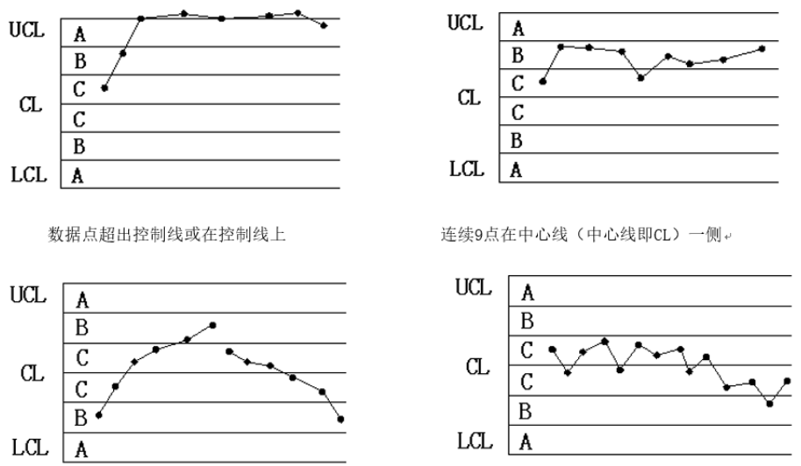
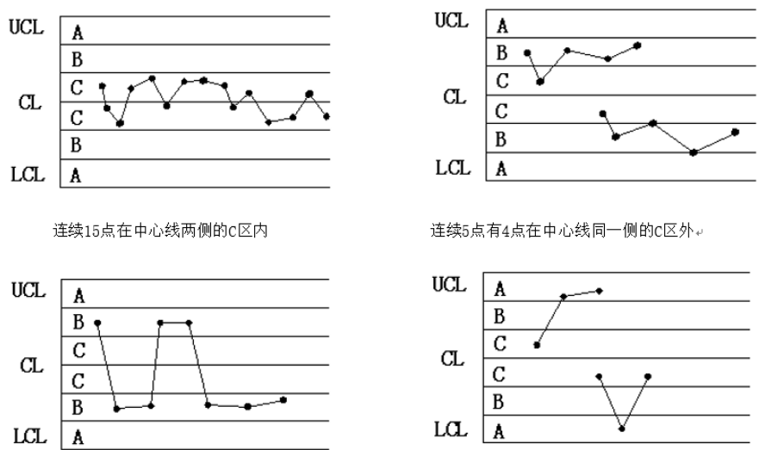
Proposal
Target:
To predict potential failure or defect of the motor before it really crashed.
Proposal:
Mark ultra high peaks as abnormal point.
Monitor abnormal point occurrence with SPC(Statistical Process Control,统计过程控制或统计制程控制) and statistics. Each point in SPC chart meaning the maximum of each work cycle. If ultra high peaks occur continuously and exceed a certain count(meaning a trend if generated), we consider an urgent maintenance is needed.
For ultra high peak labeling and recognition, we can use 3-sigma or other auto labeling method based on different statistics.

Slide 4
谢 谢！

