Slide 1
Multiple DAGs Learning with Non-negative Matrix Factorization
Yun Zhou
National University of Defense Technology
AMBN-2017, Kyoto, Japan
20/09/2017

Slide 2
Overview
Classic Machine Learning (ML) paradigm: isolated single-task learning
Given a dataset, run an ML algo. to build a model
e.g., SVM, CRF, Neural Nets, Bayesian networks, ….
Without considering previously learned knowledge
Weaknesses of “isolated learning”
Knowledge learned is not retained or accumulated
Needs a large number of training examples
Suitable for well-defined & narrow tasks.
Zhou et al. Multiple DAGs Learning with NMF 20/09/2017 01/20

Slide 3
Overview
Human retain knowledge learned in one task and use it in another task to learn more knowledge
Learn simultaneously from different similar tasks
Shared knowledge among different tasks enables us to learn these tasks with little data or effort.
Multi-Task Learning:
Related tasks can be learned jointly
Some kinds of commonality can be used across tasks
Inductive Transfer Learning
Focus on optimizing a target task
Tasks are learned simultaneously
Multi-Task Learning
Zhou et al. Multiple DAGs Learning with NMF 20/09/2017 02/20
Notes:
Humans never learn in isolation

Slide 4
Overview
Bayesian network have been well studied in the past two decades.
Structure learning still is challenging:
Score-based algorithm
Constraint-based algorithm
There are shared parts between different BNs.
Zhou et al. Multiple DAGs Learning with NMF 20/09/2017 03/20

Slide 5
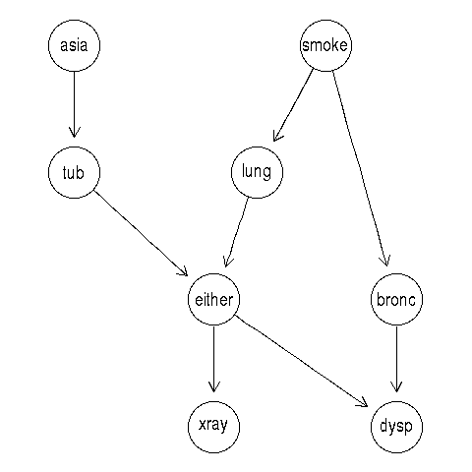
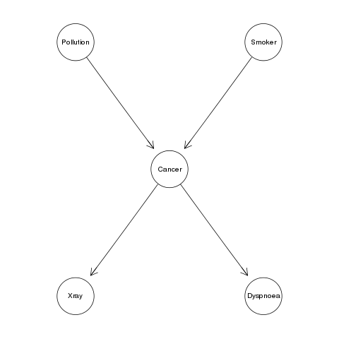
Overview
Asia and Cancer networks adopted from the bnlearn repository.
Zhou et al. Multiple DAGs Learning with NMF 20/09/2017 04/20

Slide 6
Overview
We focus on the multi-task setting of score-based algorithms for BN structure learning.
Zhou et al. Multiple DAGs Learning with NMF 20/09/2017 05/20

Slide 7
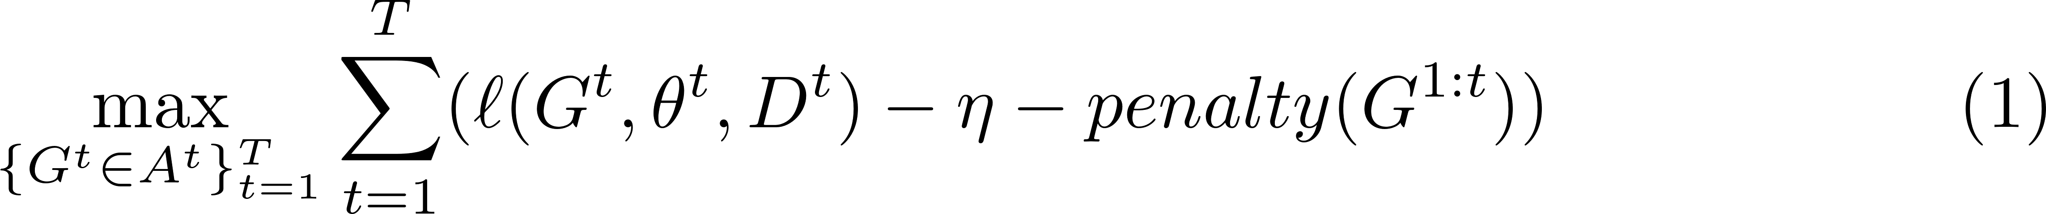
Related Works
Task-Relatedness Aware Multi-task (TRAM) learning [Oyen and Lane, 2012]:
Data fitness
Regularization on model complexity
Structure differences among tasks
Zhou et al. Multiple DAGs Learning with NMF 20/09/2017 06/20

Slide 8
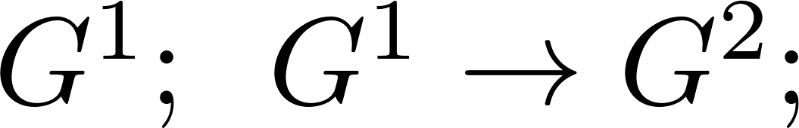
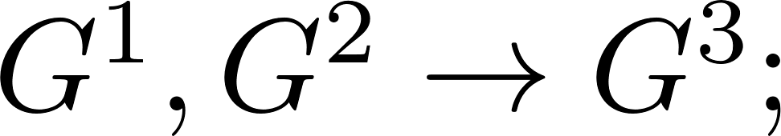
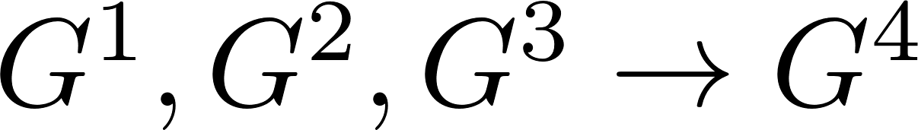
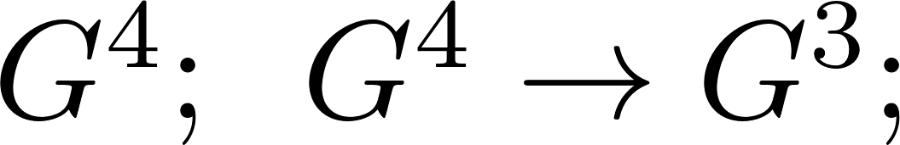
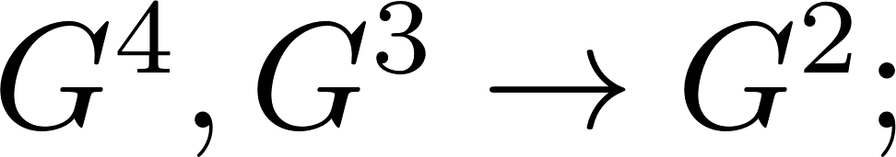
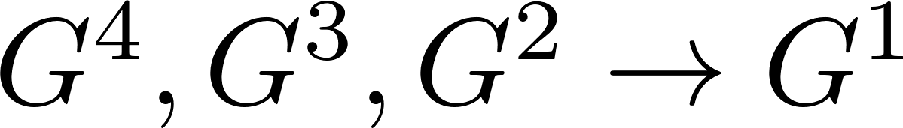
Limitations of TRAM
Different task learning orders will produce different learning results:
Task order 1, 2, 3, 4:
Task order 4, 3, 2, 1:
Task relatedness needs to be tuned with specific domain knowledge.
Zhou et al. Multiple DAGs Learning with NMF 20/09/2017 07/20

Slide 9
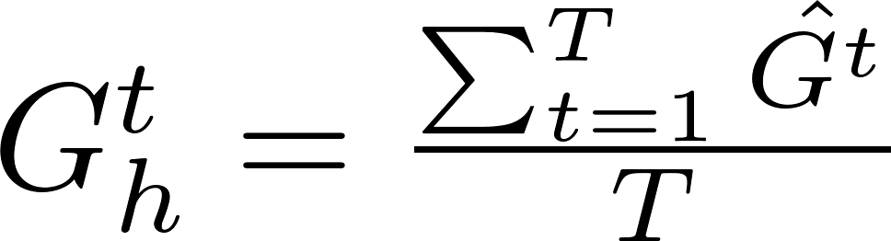

Learning a set of DAGs with a single hidden factor (MSL-SHF)
M step:
E step:
The is the shared hidden structure over the entire tasks.
Zhou et al. Multiple DAGs Learning with NMF 20/09/2017 08/20

Slide 10
Learning a set of DAGs with a single hidden factor (MSL-SHF)
The black DAG is the shared hidden structure over the entire tasks.
Zhou et al. Multiple DAGs Learning with NMF 20/09/2017 09/20

Slide 11
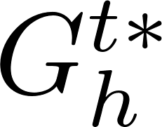

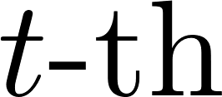
Learning a set of DAGs with multiple hidden factor (MSL-MHF) [Oates et al., 2016]
M step:
E step:
The is the closest hidden structure to selected in task.
Zhou et al. Multiple DAGs Learning with NMF 20/09/2017 10/20

Slide 12
Learning a set of DAGs with parts-based factors
In real world BNs construction, people usually combine some expert knowledge to handcraft the DAG:
BN idioms [Neil et al., 2000]
BN fragments [Laskey et al., 2008]
Zhou et al. Multiple DAGs Learning with NMF 20/09/2017 11/20

Slide 13
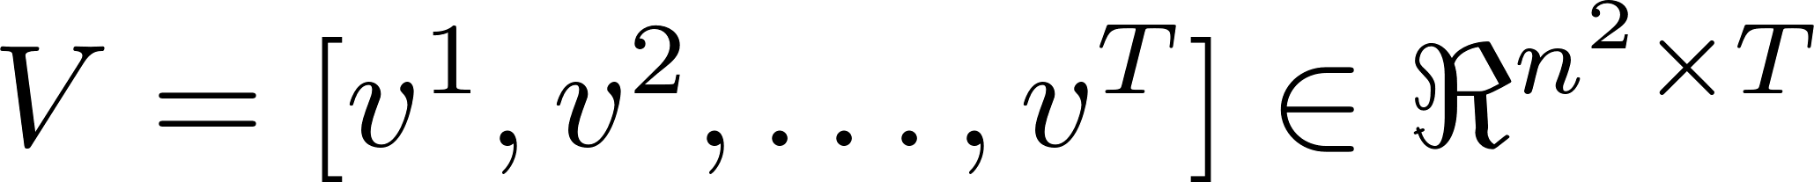

Learning a set of DAGs with parts-based factors
A set of estimated
A matrix
NMF aims to
;
.
Zhou et al. Multiple DAGs Learning with NMF 20/09/2017 12/20

Slide 14
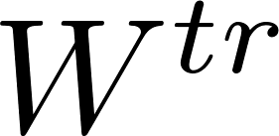

Learning a set of DAGs with parts-based factors
Thus, the entire multi-task estimation problem (MSL-NMF) is defined as:
The is the transpose of the matrix .
Reconstructed hidden strucure
decoder
encoder
Zhou et al. Multiple DAGs Learning with NMF 20/09/2017 13/20

Slide 15
Experiments
Synthetic data from Asia network:
Randomly insert or delete one edge of the ground truth to make T new BNs;
Forward sampling 200, 350 and 500 samples for 20 and 50 tasks.
Real-world landmine problem:
Classifying the existence of landmines with synthetic-aperture radar data;
29 landmine fields correspond to 29 tasks, each has 400-600 data samples.
Zhou et al. Multiple DAGs Learning with NMF 20/09/2017 14/20

Slide 16
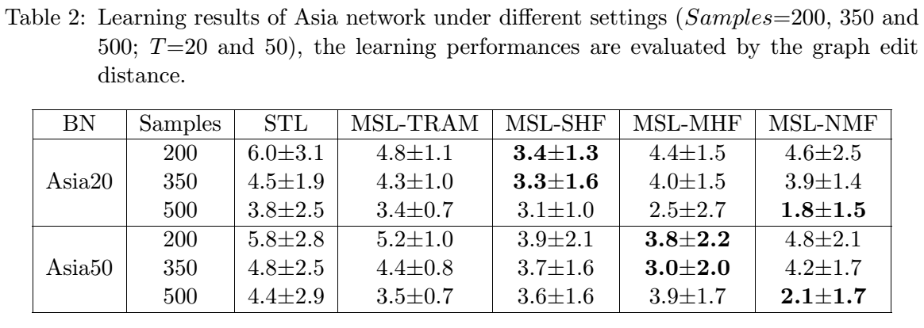
Asia network
The number of hidden factor is set as 2 (K=2);
The relatedness parameter in MSL-TRAM is set as 0.5.
Zhou et al. Multiple DAGs Learning with NMF 20/09/2017 15/20

Slide 17
Landmine problem
9 features are discretized into two values by a standard K-means algorithm.
Learned DAG contains 10 nodes, where the node 10 is the landmine class node.
Binary node that 1 for landmine and 0 for clutter.
Half of each dataset for training and half for testing (calculating AUC values).
Zhou et al. Multiple DAGs Learning with NMF 20/09/2017 16/20

Slide 18
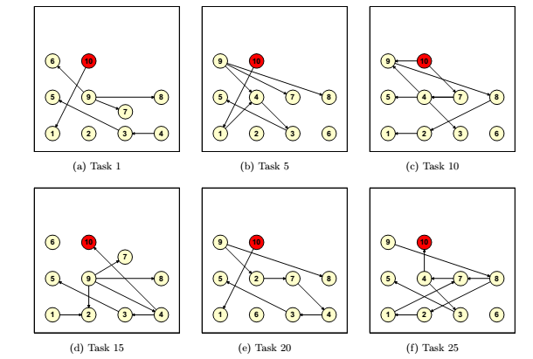
Landmine problem
Zhou et al. Multiple DAGs Learning with NMF 20/09/2017 17/20

Slide 19
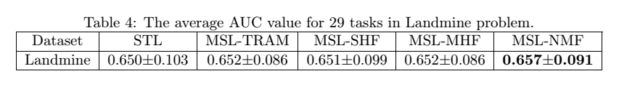
Landmine problem
Small improvements observed.
Zhou et al. Multiple DAGs Learning with NMF 20/09/2017 18/20

Slide 20
Conclusions
Findings
There exists commodities between different Bayesian networks.
Multi-task learning achieves the better result than learning individually when multiple similar tasks are provided.
This is the first try to learn multiple DAGs with parts-based factors.
Limitations
Improvements are not huge.
More experiments are needed to verify the proposed method.
Zhou et al. Multiple DAGs Learning with NMF 20/09/2017 19/20

Slide 21
Future works
Consider the shared parameters in the learning;
Extend this method to solve BN transfer learning problem.
BN repository
(well learnt BNs)
transfer
update
New learning task
Zhou et al. Multiple DAGs Learning with NMF 20/09/2017 20/20

Slide 22
Thank you!
zhouyun@nudt.edu.cn

