Slide 1





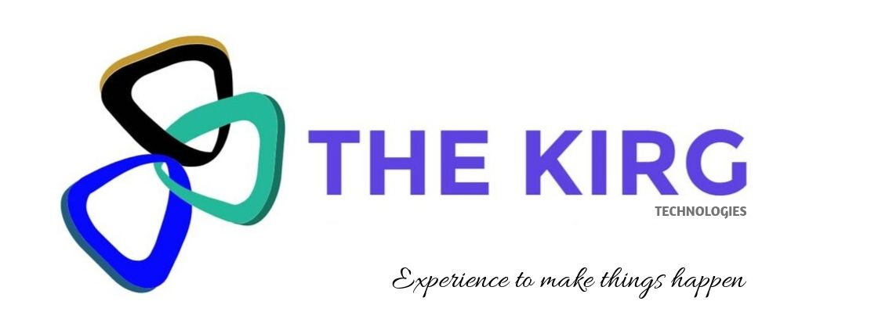
Vi Con
A go to app for your everyday need , call or message students & clients with a tap
Developed by The Kirg Technologies

Slide 2









ABSTRACT
This project of The Kirg Technologies is intended at creating a platform for ease of contacting students/clients uniquely identified by their respective designations and unique ID without disturbing the contact book, which will benefit organisations that deal with large databases with large population.

Slide 3
PROBLEM STATEMENT
These days , time has become an important factor for Day to Day routine, especially in institutes and commercial sectors where limited time is allocated for an enormous work.
Regarding Information passing or client/student unavailability, it is essential to call/message them which has become strenuous in current day scenario.
Usage of phone-books and records is consuming a lot of time, and takes a lot of effort in retrieving the previous logs and contact details of the client .

Slide 4
SOLUTION
Application that is unlike any other data base oriented contact platform like e-mail and other phone-books, our Application (Vi – Con) provides a proper and organized interface for one to grant and revoke permission of access to contact details of a group of people categorized under an umbrella and shall further allow ease of contacting thus identified people through various features like call/message option ,direct access to phone numbers indexed with unique identification keys without strenuous manual efforts and also keep a track of limited previous logs.

Slide 5


PROTOTYPE
So let us now have a look at how exactly our application prototype which will represent the main idea of the application.

Slide 6
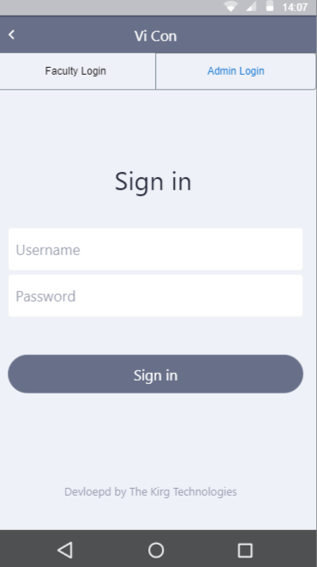
1. Sign up page
We have 2 types of logins, User and Admin login. Each of them will have their own username and password as well as corresponding access permissions for a particular group of members.
Admin user has certain levelled permissions since he/she will be having the access to all databases and would be allocating certain databases to certain users only as per need.
Place your screenshot here

Slide 7
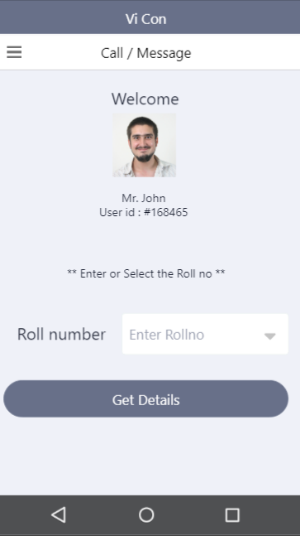
2. Search Page
On successful login, the user is now directed to the main functionality of the application in which he/she can now use the application to search the details about the desired client using an Unique key.

Slide 8
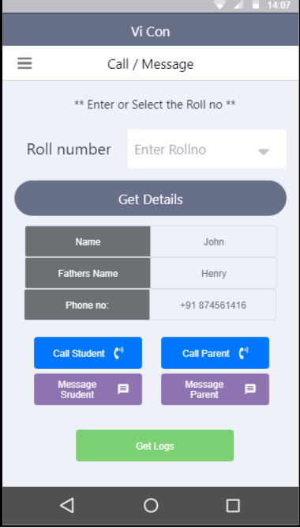
3. Client details
On successful search completion , the corresponding client details will be displayed, which include Name, Phone no, Parental details, etc.
Along with these , certain options like call/ message to desired numbers will also be available . If necessary we can obtain the previous call logs of the client along with any particular remarks attached to that previous log.
Place your screenshot here

Slide 9
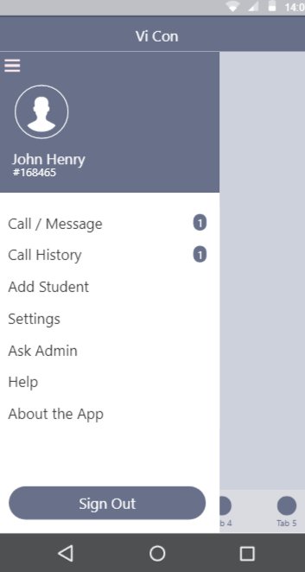
4.Dashboard
The user will be able to customize and monitor their dashboard which includes options like call history, call / message, add student etc . This is will ensure ease and effective access. Also directly raising a query when a problem occurs is made feasible with the Ask Admin option on our application.

Slide 10
Advantages
Time saving and an efficient interface for the administration.
Easy retrieval of information such as call logs and student / client database.
Easy way for splitting up work by the admin
The database such as the phone numbers do not sync with the users contact book and hence there is no hassle to his/her personal life.
Scope of Improvement
Call recording in next versions
of Application.
Remarks can be added to a particular call.
Marking of Attendance can be made possible in the application making it a possibility for lectures / managers to save time rather than doing the same paperwork.

Slide 11

Thank you!
Any questions?
You can reach us at:
kirgtechnologies@gmail.com

