Slide 1
Can We Predict Every Pass?
Building an Expected Pass Model for Football
– Seminar: Sports Analytics
- Team:
Aashish Nair (7086324)
Ankit Khatiwada (7089529)
Moaaz Sajjad Warraich (7089952)

Slide 2
Table of Contents
Introduction
Literature Review
Methodologies
Limitations
Future Scope
References

Slide 3
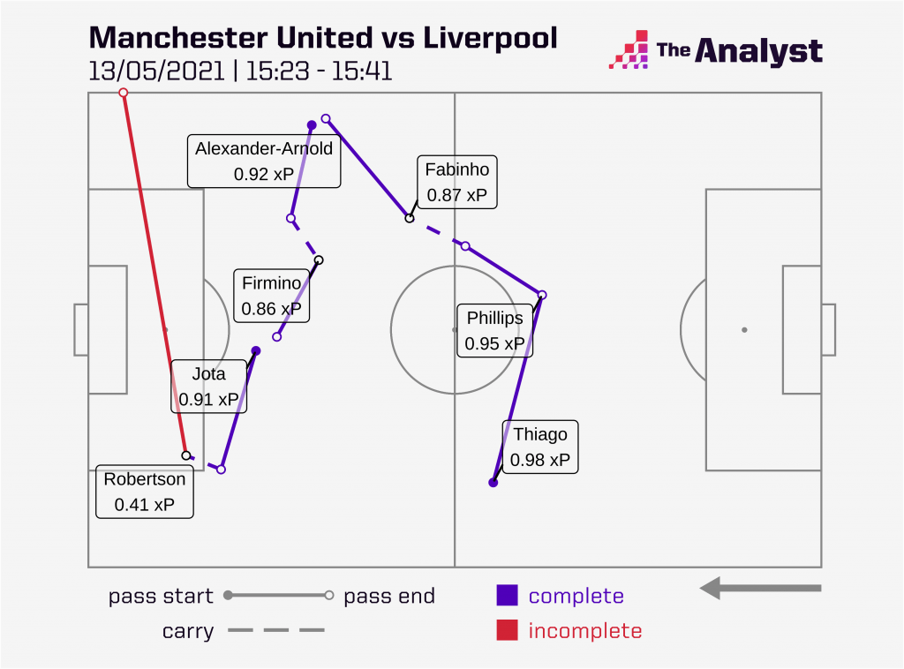
What is Expected Pass?
Just as expected goals (xG) predicts the likelihood of a shot being scored, xP framework models the probability of a pass being completed by taking information about the pass and the current possession.
xPass is essentially a metric for pass difficulty, basically predicting whether a pass would be given the context of the game.
Applications:
  Separating Decision Quality from Execution Quality
  Evaluating Passing Skill
  Scouting
  Tactical Analysis
Credit : The Analyst

Slide 4
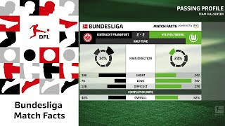
Video Clip Showing xP in Bundesliga
Credit:
DFL Youtube Channel

Slide 5
Literature Review
Paper | Topic | Main idea
Szczepański & McHale, 2016 | Beyond completion rate | Raw pass completion is limited because it ignores pass difficulty. Motivates evaluating passes relative to expected difficulty.
Arbués-Sangüesa et al., 2020 | Body orientation & pass feasibility | Shows that player orientation and opponent positioning affect whether a pass is feasible. Useful as a limitation/future feature.
Anzer & Bauer, 2022 | Expected Pass / xPass | Core reference. Models pass difficulty as the probability of successful pass completion using spatio-temporal context.
Robberechts et al., 2023 | Creativity / Un-xPass | Extends pass evaluation by considering whether passes are both useful and atypical. Relevant for risk-reward or creative passing analysis.
Rahimian et al., 2024 | Temporal graph networks | Predicts pass receiver and pass outcome using sequential/graph-based representations. Relevant for future sequential extensions.
Takamido et al., 2025 | PassAI / explainability | Uses explainable machine learning and multimodal match data to classify pass success or failure. Relevant for model interpretability.
Notes:
Szczepański & McHale: this paper is the reason completion rate alone isn't good enough, it ignores difficulty entirely.
Anzer & Bauer: "this is the paper we're directly building on, it solves that problem using tracking data."

Slide 6
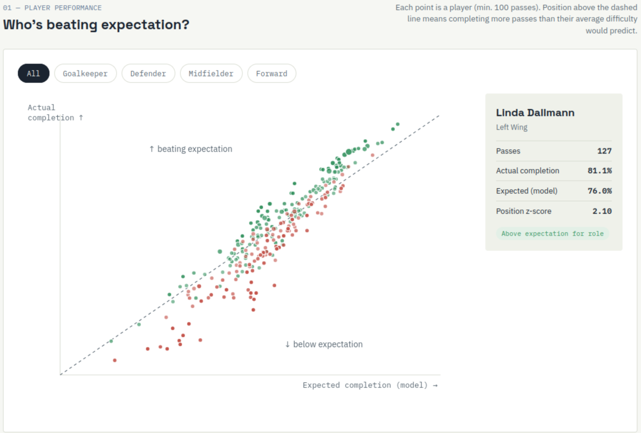
Methodologies I
Data and Target (112,744 passes)
  Statsbomb open event data
  Women Bundesliga Data 2023/24 (132 matches)
Feature Engineering
  Anzer & Bauer (2022) xPass set
  Features:
    start/end position, pass length and angle
    distance to goal, pressure, possession phase
  Gap: ½ features not constructible
Notes:
No big enough sample for tracking data. Skill corner has for about 10 matches

Slide 7
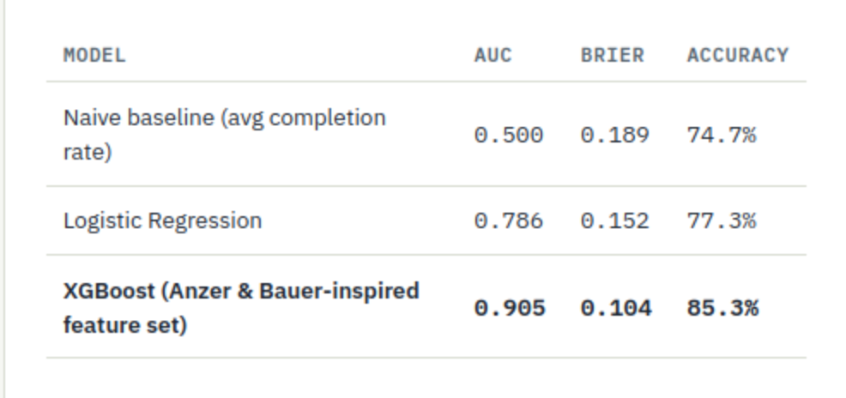
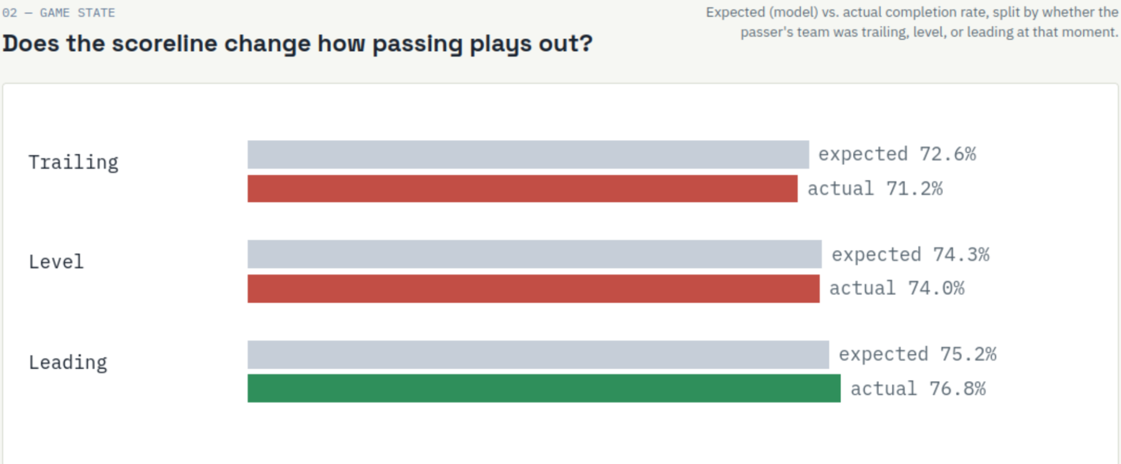
Methodologies II
Model Validation:
  Naive baseline -> Logistic-Regression -> XGBoost
  Train-Test Split: Match level
  Metrics used:
    AUC
    Brier Score
Position Normalized Comparison
z = |gap - μ_{position} | / σ_{position}
gap= actual completion rate-model expected rate

Slide 8
Limitations
• StatsBomb Open Data may create sample bias/incomplete data.
• Opponent positioning is not yet modeled.
• Receiver availability and body orientation are not included.
• Sequential context before the pass is ignored.

Slide 9
Future Scope
Research Gap:
  Existing xPass models largely ignore game context (scoreline, match time, game state).
  Passes are typically treated as independent events, ignoring possession history and sequence dynamics.
Proposed Framework:
Enhanced xPass = Baseline Features + Game State Features + Sequential Features
Game State Features: Score difference, Match minute, game status (winning, losing or draw) etc.
Expected Models: XGBoost (feature based approach), LSTM / Sequence Models (temporal approach)

Slide 10
References
Takamido, R., Ota, J., & Nakamoto, H. (2025). PassAI: An explainable machine learning framework for predicting soccer pass outcomes using multimodal match data. IEEE Access.
Rahimian, P., Kim, H., Schmid, M., & Toka, L. (2024). Pass Receiver and Outcome Prediction in Soccer Using Temporal Graph Networks. In U. Brefeld, J.Davis, J. Van Haaren, & A. Zimmermann (Eds.), Machine Learning and Data Mining for Sports Analytics.
Arbués-Sangüesa, A., Martín, A., Fernández, J., Ballester, C., & Haro, G. (2020). Using player’s body-orientation to model pass feasibility in soccer. Proceedings of the IEEE/CVF Conference on Computer Vision and Pattern Recognition Workshops.
Anzer, G., & Bauer, P. (2022). Expected passes: Determining the difficulty of a pass in football (soccer) using spatio-temporal data. Data Mining and Knowledge Discovery.
Szczepański, Ł., & McHale, I. (2016). Beyond completion rate: Evaluating the passing ability of footballers. Journal of the Royal Statistical Society Series A: Statistics in Society.
R, R., Harell, A., & S, P. (2022). Pass evaluation in women's Olympic ice hockey. Proceedings of the 5th International ACM Workshop on Multimedia Content Analysis in Sports.
Radke, D., Radke, D., Brecht, T., & Pawelczyk, A. (2021). Passing and pressure metrics in ice hockey. Artificial Intelligence for Sports Analytics (AISA) Workshop.
Arbués-Sangüesa, A., Martín, A., Fernández, J., Ballester, C., & Haro, G. (2020). Using player's body-orientation to model pass feasibility in soccer. Proceedings of the IEEE/CVF Conference on Computer Vision and Pattern Recognition (CVPR) Workshops.

Slide 11
Thank you!
Q&A

