Slide 1
Introduction to Python
Project 1- Printing a house

Slide 2
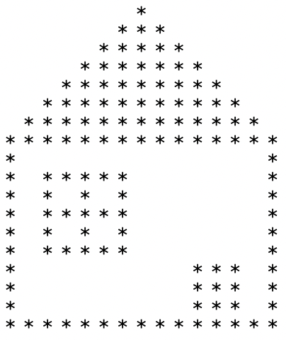
< Project Output >
Print the house in the terminal:

Slide 3
< Analysis >
# of * (roof) : 1 , 3, 5, 7 ... 15
# of * (window): 4 x (3 x 3)
# of * (door): 3 x 3
rules of space: one space + one *
# of space (roof): 14, 12 , 0 ...

Slide 4
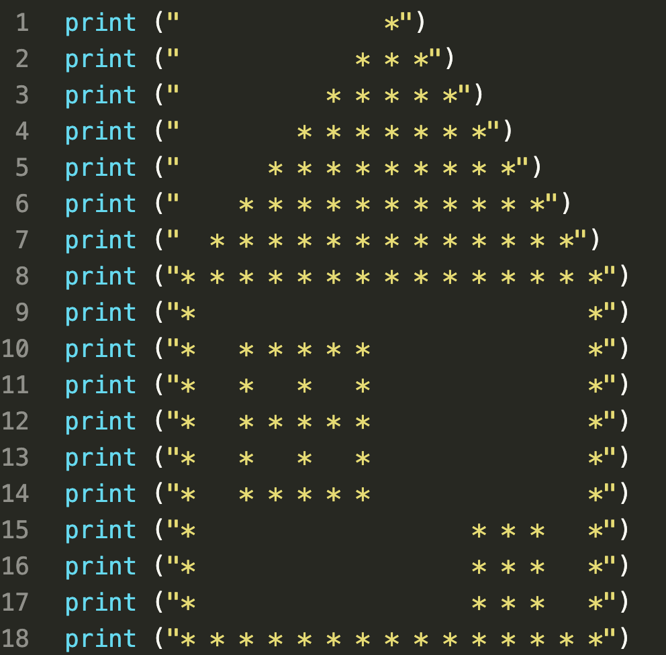
< Solution 1 >

Slide 5
< Solution 2 >
1. Print the roof
2. Print two *
3. Print the window
4. Print the door
5. Finish the house

Slide 6
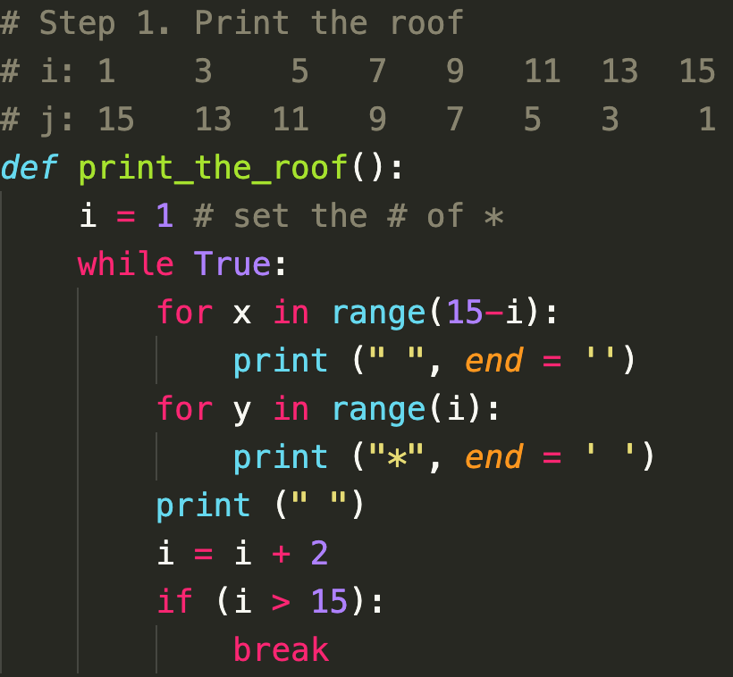
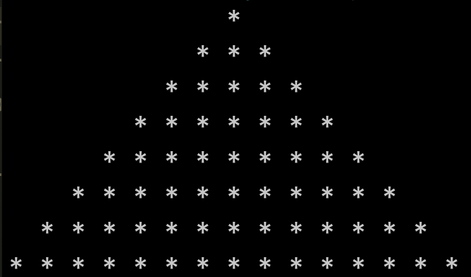
< 1. Print the roof >

Slide 7
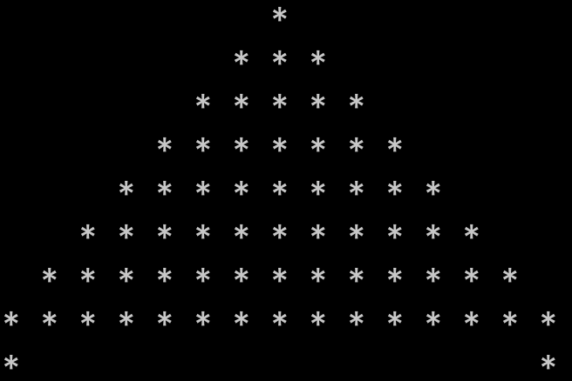
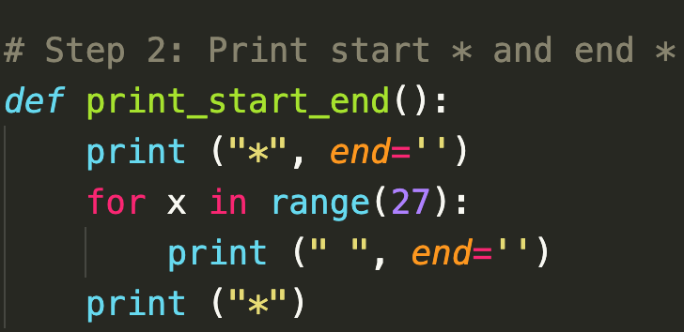
< 2. Print start * and end * >

Slide 8
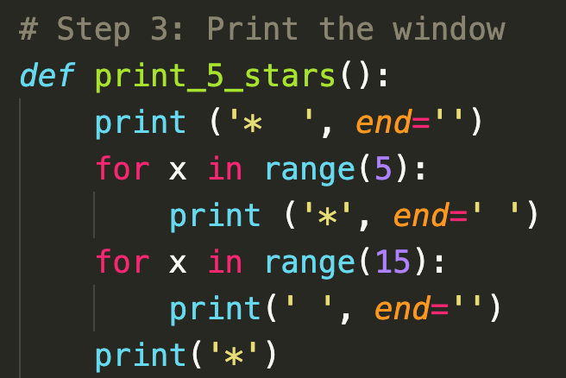
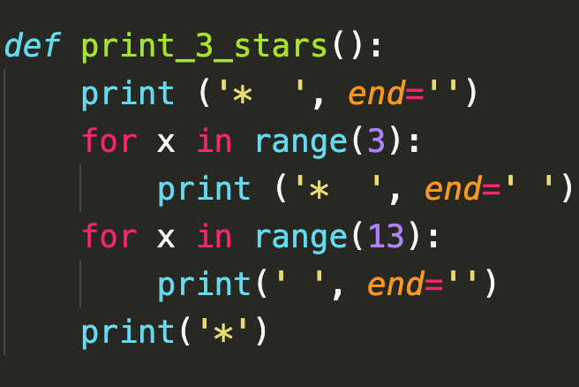
< 3. Print the window - Print 5 * & 3 *>

Slide 9
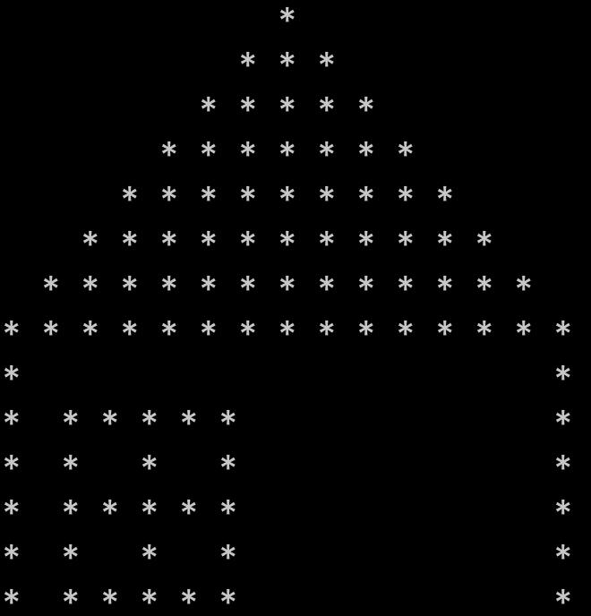
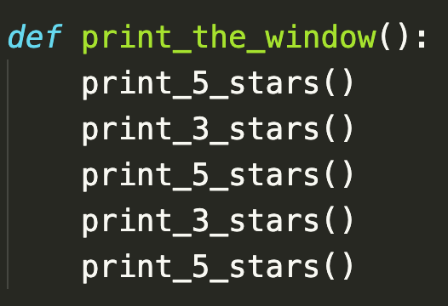
< 3. Print the window >

Slide 10
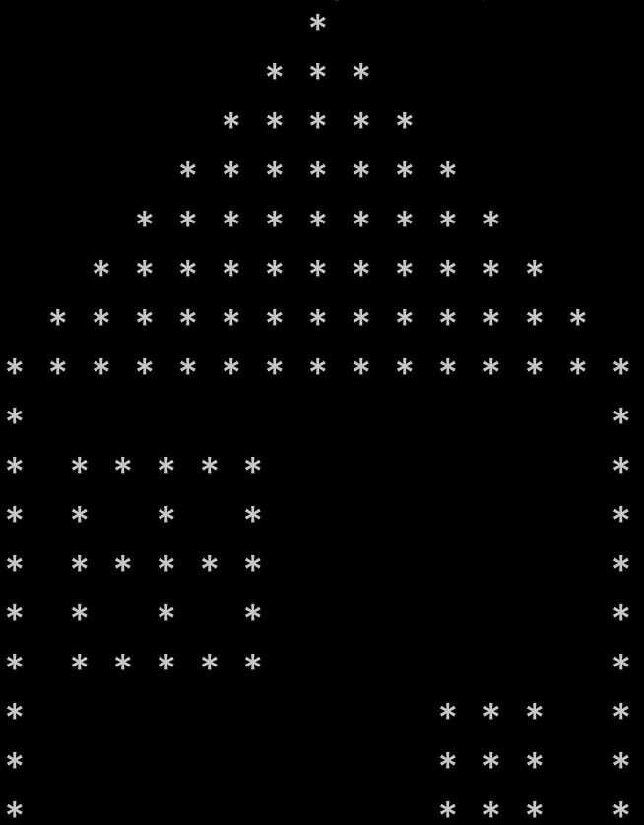
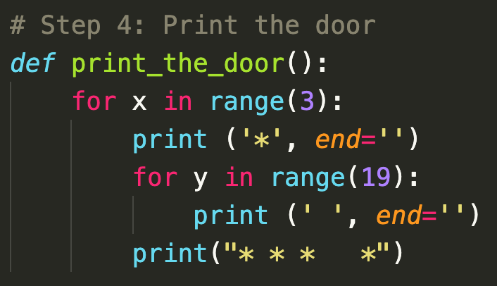
< 4. Print the door >

Slide 11
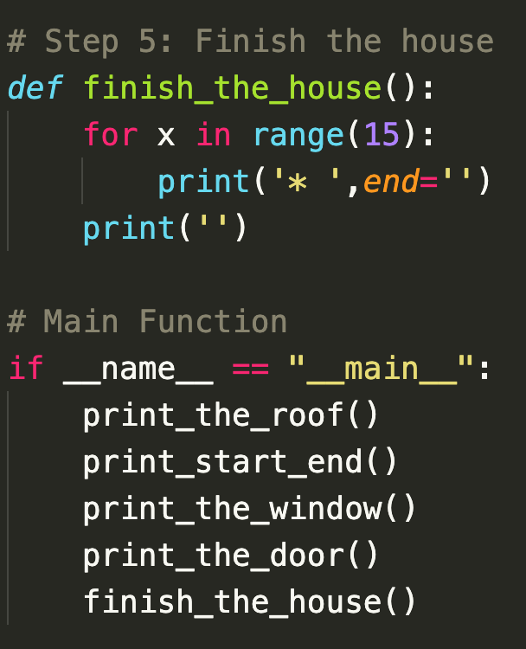
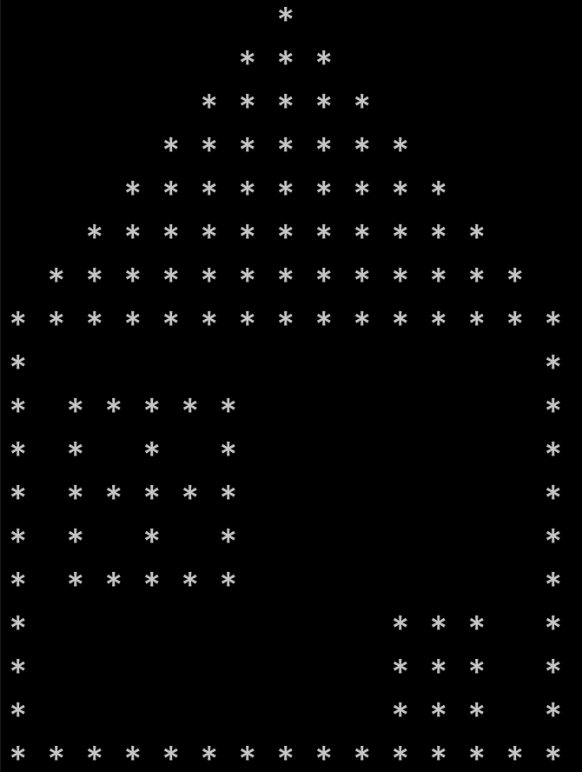
< 5. Finish the house >

