Slide 1
Introduction to Python
Section 1 - Start

Slide 2
< What is Python? >
Python is a popular programming language. It was created by Guido van Rossum, and released in 1991.
It is used for:
- web development (server-side) [flask, django]
- software development
- mathematics
- system scripting
- ...

Slide 3
< What can Python do? >
- Python can be used on a server to create web applications.
- Python can be used alongside software to create workflows.
- Python can connect to database systems. It can also read and modify files.
- Python can be used to handle big data and perform complex mathematics.
- Python can be used for rapid prototyping, or for production-ready software development.

Slide 4
< Python Install >
Python Online Editor: https://wood.codemao.cn
For Windows:
To check if you have python installed on a Windows PC, search in the start bar for Python or run the following on the Command Line C:\Users\Your Name>python --version
(Tip: you can use win + r to open runner and then type cmd )

Slide 5
< Python Install >
Python Online Editor: https://wood.codemao.cn
For Mac:
To check if you have python installed on a Linux or Mac, then on linux open the command line or on Mac open the Terminal and type: python --version
(Tip: you can use command + space to spotlight search and then type "terminal" to open it )

Slide 6
< Python Install >
If you find that you do not have python installed on your computer, then you can download it for free from the following website: https://www.python.org
[ Link ] - Official document:
https://docs.python.org/3/tutorial/

Slide 7
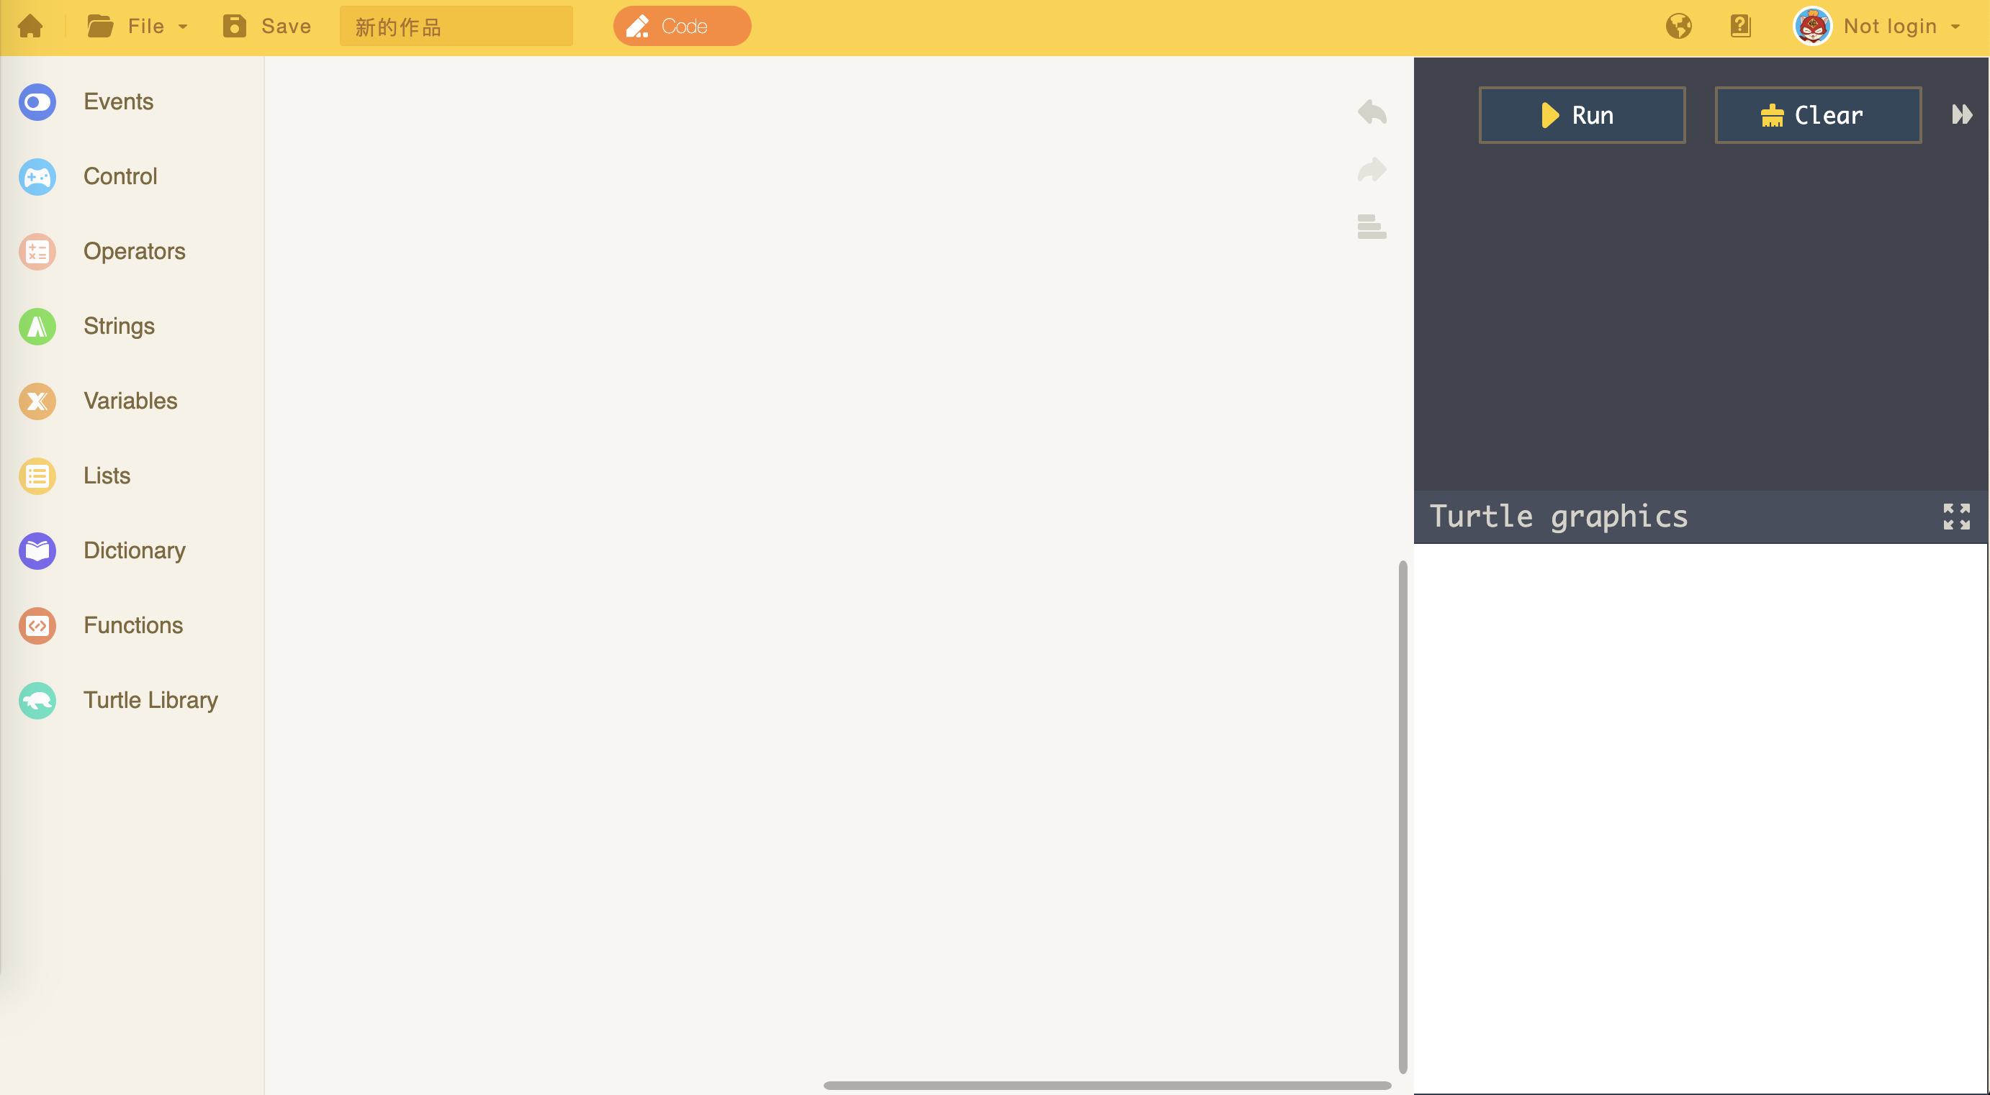
< Introduction to wood >
Python Online Editor: https://wood.codemao.cn

Slide 8
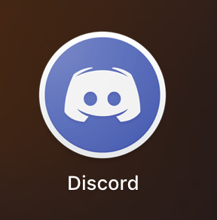
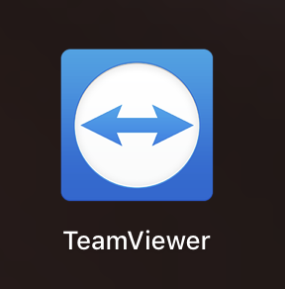
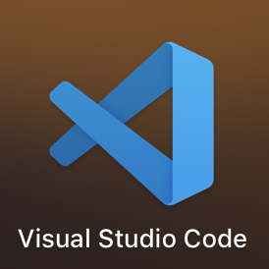
< Install Discord >
Link: https://discordapp.com/
< Install TeamViewer >
Link: https://www.teamviewer.com/
< Install Visual Studio Code >
Link: https://code.visualstudio.com/

