Slide 1
Introduction to Python
Section 2 - Events

Slide 2
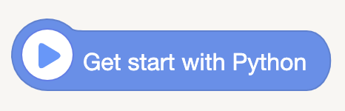

< Let's go into our Python World ! >
Blocks:
Note:
- This block means 'the beginning of our program'. It has no pratical meaning.
- In Python, it is only a comment and will not run.
Code:

Slide 3
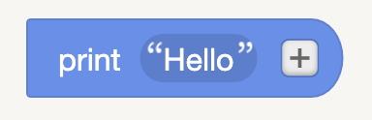

< Print >
Blocks:
Note:
- [ print() ] can print specific contents in our terminal area. Contents can be strings or any other different types of data.
- Be careful, the contents we want to print must be wrapped by two brackets.
Code:

Slide 4
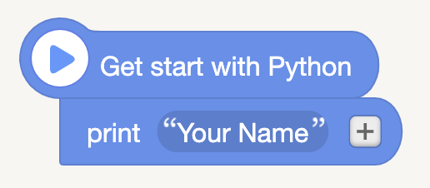

< Print >
Let try to print you name in the terminal :

Slide 5
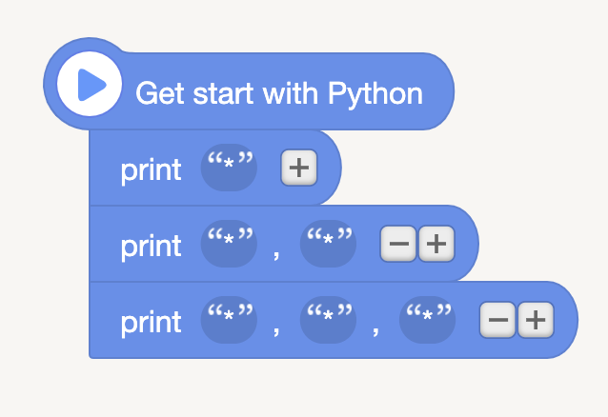
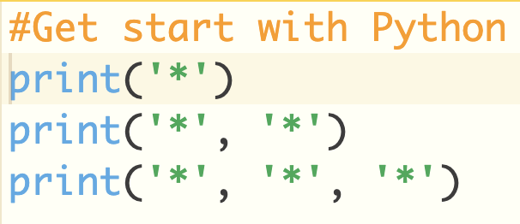
< Print >
Let try:

Slide 6
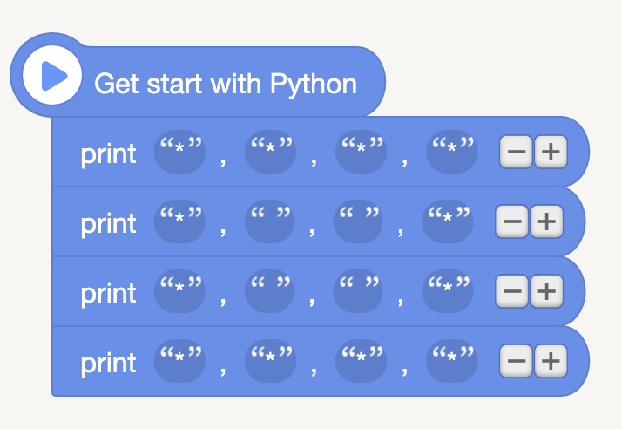
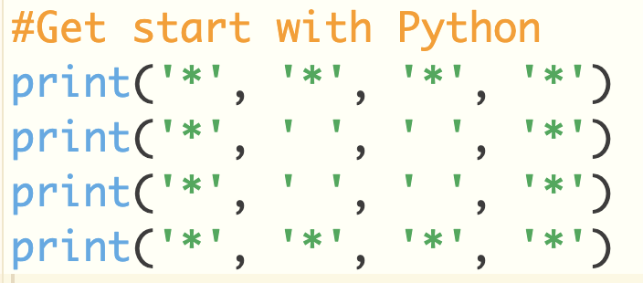
< Print >
Let try:

Slide 7
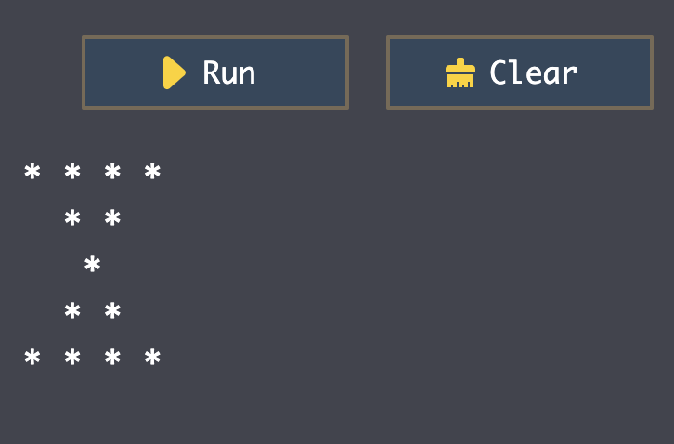
< Print >
Exercise:

Slide 8
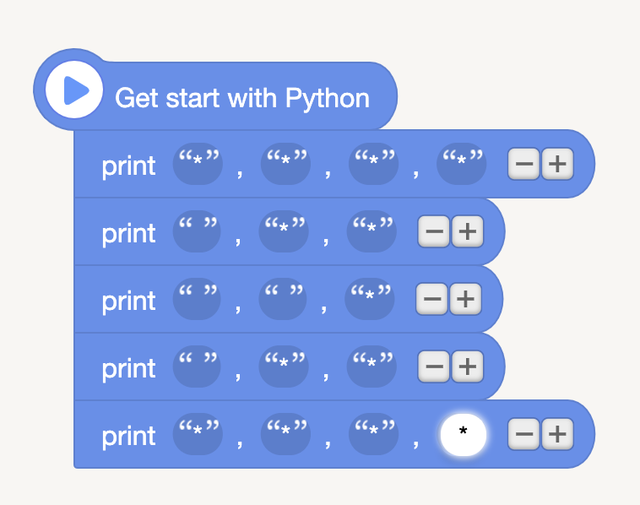
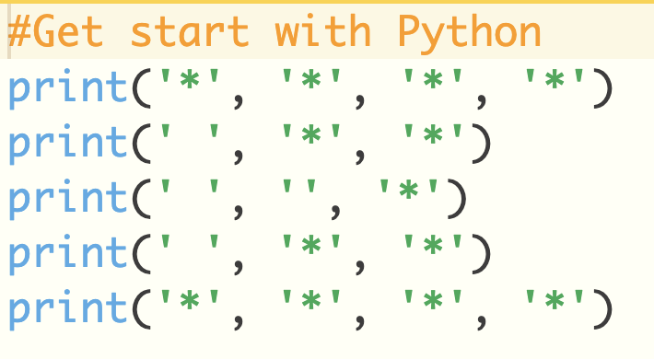
< Print >
Solution:

Slide 9
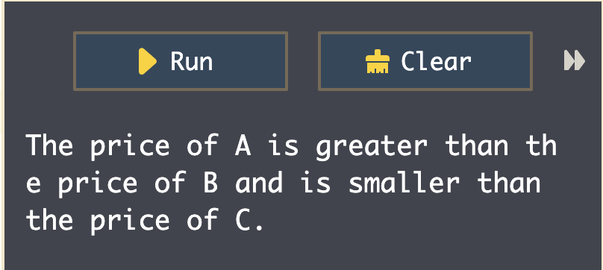
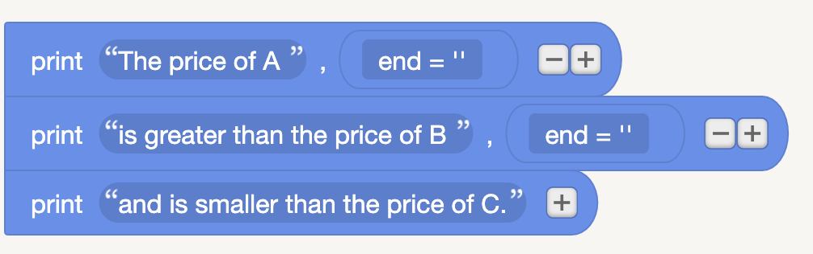
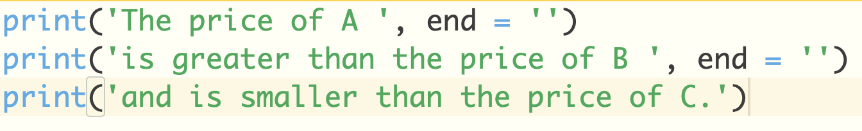
< Print without a new line >

Slide 10
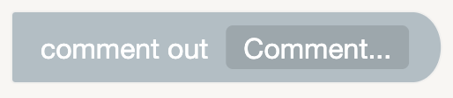

< Comments >
Blocks:
Note:
- In Python, one line comment begins with number sign #
- The comment out code will not be
executed by the computer.
- The purpose of comments is to remind us of some important notes when coding and is easy for others to read our code.
Code:

Slide 11
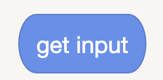

< Get Input >
Note:
- [get input] can obtain the input data by users.
- When the code execuated, cursor flashing and waiting for our input.
- Press [Enter] means we have finished the input.
Blocks:
Code:

Slide 12
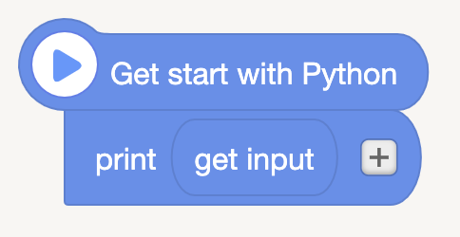
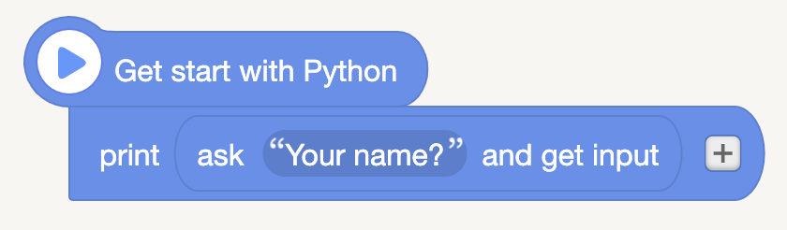
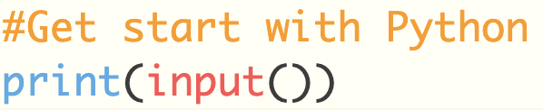
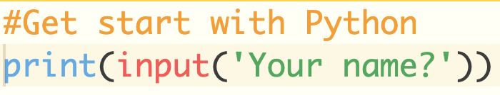
< Get Input >
Let try:

Slide 13
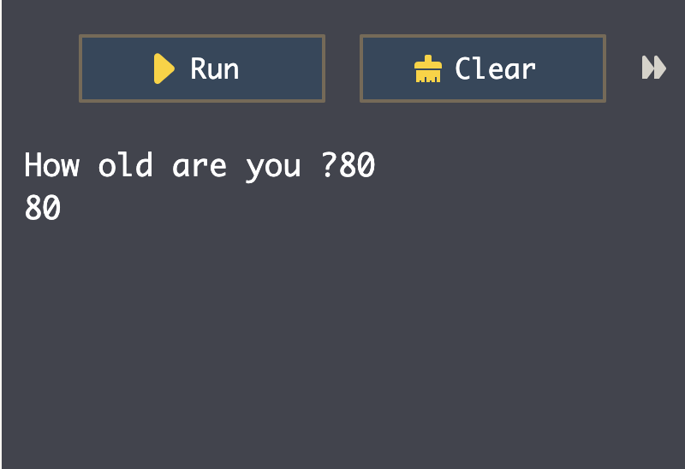
< Get Input >
Exercise:

Slide 14
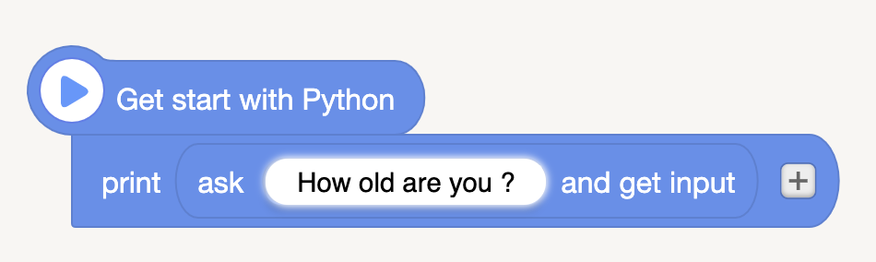
< Get Input >
Solution:

Slide 15

< # Enter your code here and execute >
Solution:
Note:
- You can put any other code here in the furture in order to realize different functions.

