Slide 1
Introduction to Python
Section 3 - Control

Slide 2
< Advantages of computers >
Loops can let the computer repeat some specific operations, which is one of buge advantages of computers - fast computing.
In python, we have these loops:
- For
- while
- do ... while ...
......

Slide 3
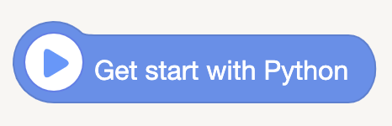

< Let's go into our Python World ! >
Blocks:
- This block means 'the beginning of our program'. It has no pratical meaning.
- In Python, it is only a comment and will not run.
Code:

Slide 4
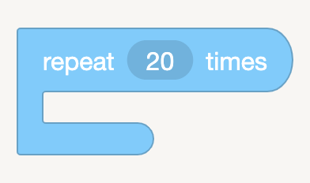
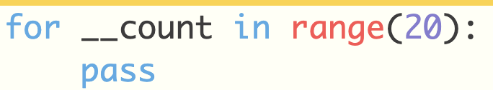
< repeat ( ) times >
- [ repeat ] is an open mouth block, we can add other blocks into it.
- The number above means the repeating time
- In code, the repeating contents should have 4 space indent or using tab to indent
- pass is one line without any meaning in order to oppupy the position instead of
Blocks:
Code:

Slide 5
< repeat ( ) times >
Code:
Note:
- In python code, the repeating contents should have 4 spaces indent or using tab to indent ! (python syntax)
- pass is one line code without any meaning. It is used to make the for loop completed.
- If we don't have pass here, the code is not completed and will throw an error.

Slide 6
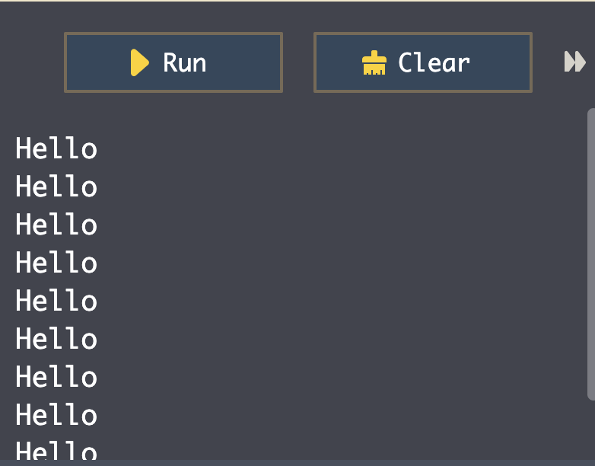
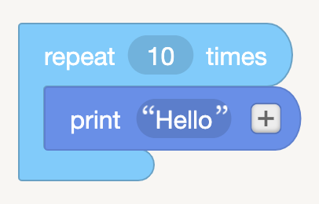
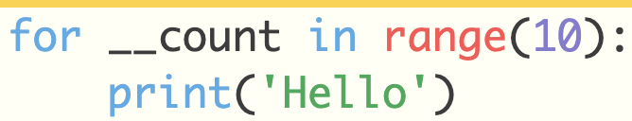
< for >
Let's try:
Blocks:
Code:

Slide 7
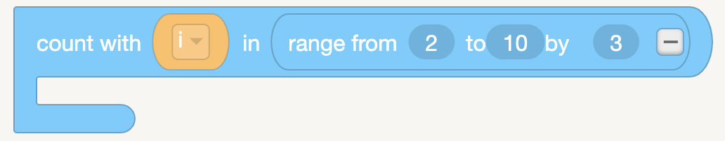
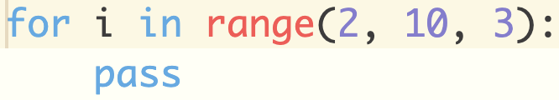
< range >
Blocks:
3 formats of range:
- range(10)
0, 1, 2, 3, 4, 5, 6, 7, 8, 9
- range(3, 8)
3, 4, 5, 6, 7
- range (2, 10, 3)
2, 5, 8
Code:

Slide 8
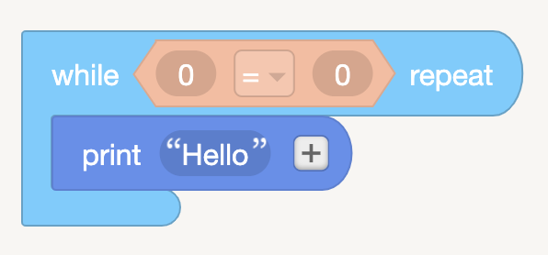
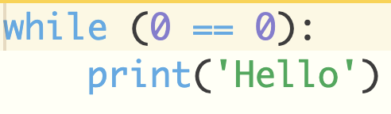
< while >
Blocks:
- It executes the inner contents while meeting the specific conditions.
- It checks the conditions everytime before executing the contents.
- Be careful for indent and :
Code:

Slide 9
< while >
BE CAREFUL !
- If the condition is always true in while loop, it will cause crash in our browers or computers.

Slide 10
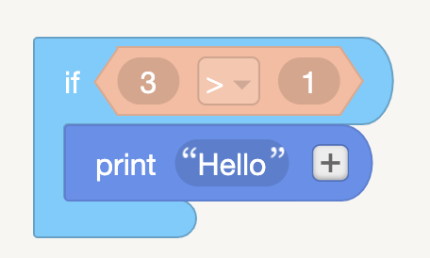
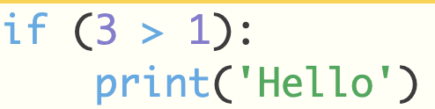
< if >
Blocks:
- If it meets the condition, execute the code inner the block, else it does not meet the condition, then ignore contents.
- If there are more than one condition, we use if ... else if ... else if ... else ...
Code:

Slide 11
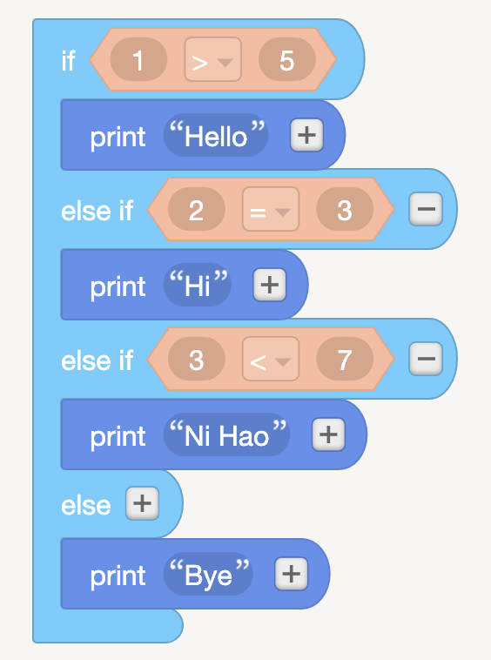
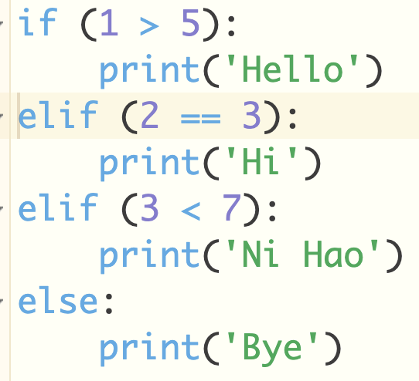
< if ... else .. >

Slide 12
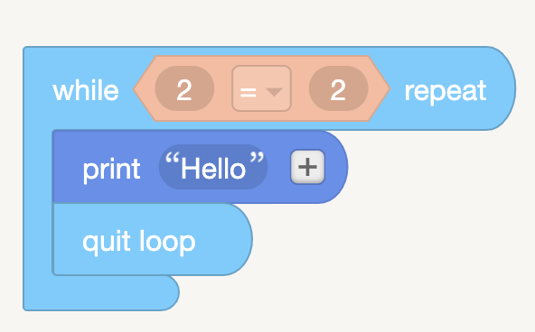
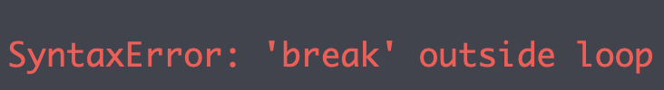
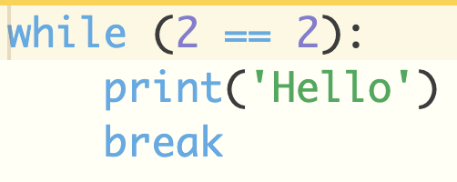
< break >
Blocks:
- break can only be used in loop
- when the system runs 'break', it will stop right now and exit the loop.
Code:

Slide 13

< Time library >
- Python has lots of built-in libraries which can make our programming more powerful. In code, before using them, we should import these libraries.
- In blocks, the editor has already imported these libraries.

Slide 14
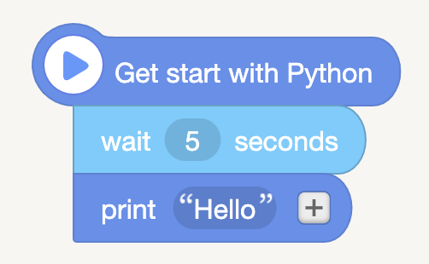
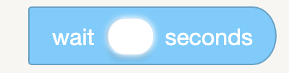
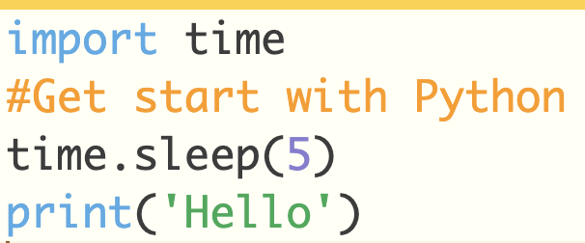
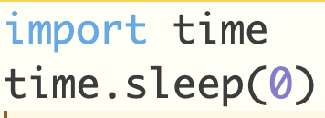
< Time library - wait >
Let's try:
Blocks:
Code:

Slide 15
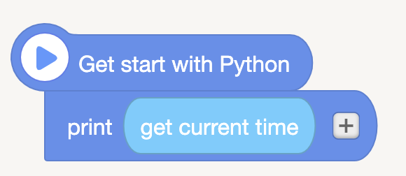
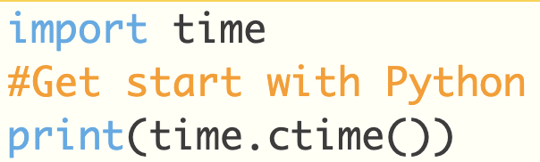
< Time library - get current time >
Blocks:
Code:

