Slide 1
Introduction to Python
Section 4 - Operator & String & List

Slide 2
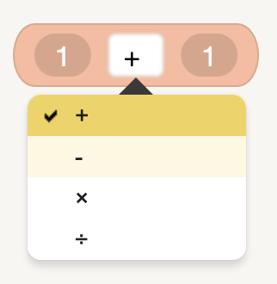
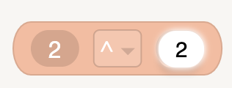
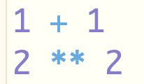
< Math Operators >
- We can add numbers together.
- We also can add strings, lists ... together.
- When adding two strings, the result doest not contain space.

Slide 3
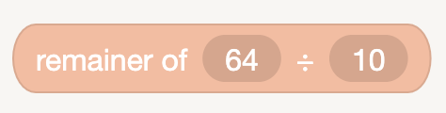

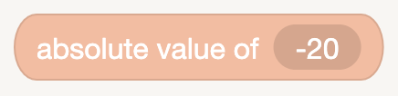

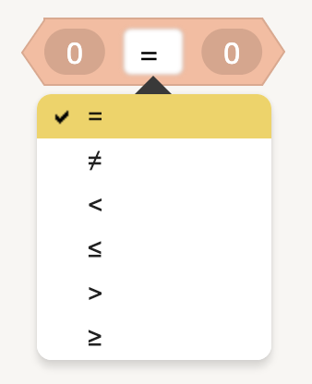

< Other Operators >
- Remainer
- Absolute value
- Comparision Expression

Slide 4
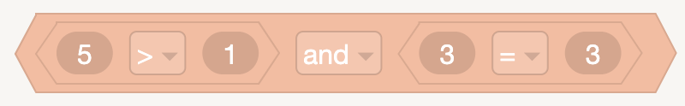

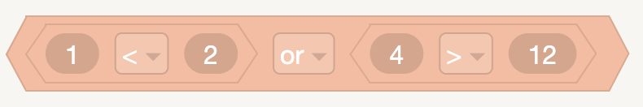

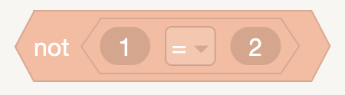

< Logic Operators >
- AND
- OR
- NOT

Slide 5
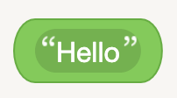

< String >
- String is one of data types consisted of numbers, characters, signs and so on. It is represented by ' ' or “ ”

Slide 6
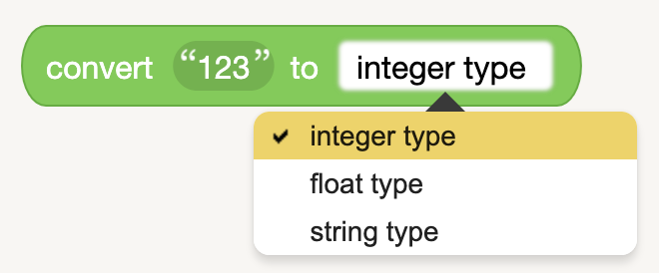

< Types Conversion >
- change different data types

Slide 7
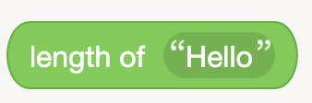

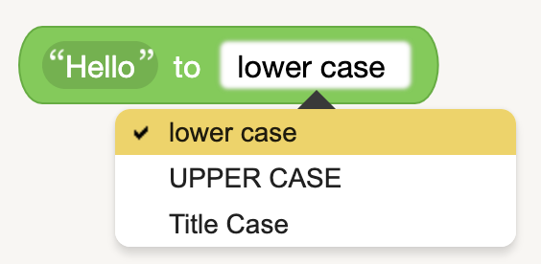
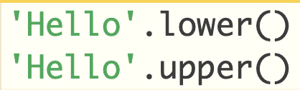
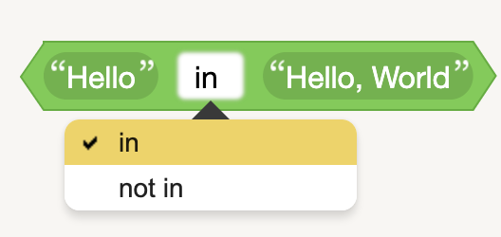

< String properties >
- length of string
- lower or upper
- in or not in

Slide 8


< List >
- List is one of common data types in programming.
- It incldues lots of items which can be any data types.
- There are many methods to create a list, one of simple methods is to wrap elements by square brackets

Slide 9
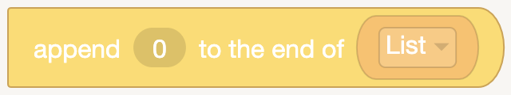

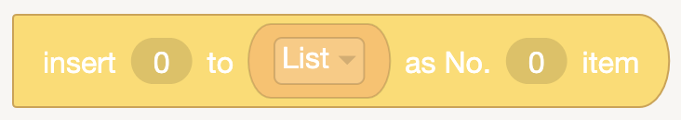

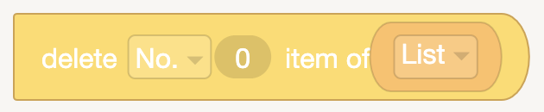

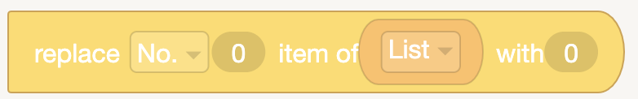

< List - Operations>
- append
- insert
- delete
- replace

Slide 10
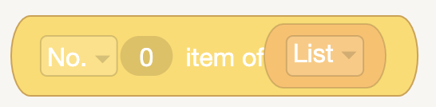

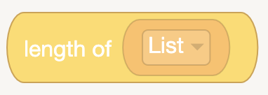

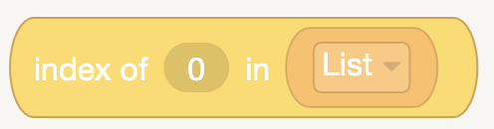

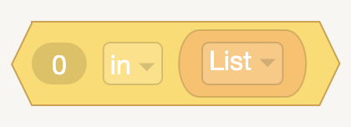

< List - Operations>
- No. item
- insert
- length
- index
- in

