Slide 1
Introduction to Python
Section 5 - Variable & Function

Slide 2
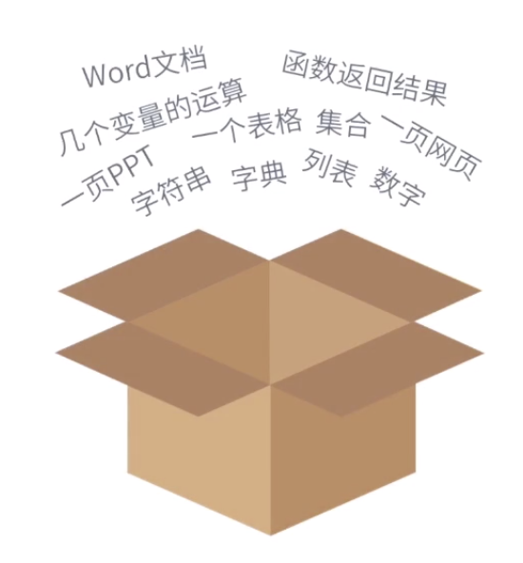
< Variable >
Variable is a box.
The box contains our data.
We use = to put stuff in to the box.
Example: x = 4 ( x is the box , 4 is the value)
Example: yyy = [3 , 4, 5, 6, 7]
( yyy is the box, list [3, 4, 5, 6, 7] is the value )

Slide 3
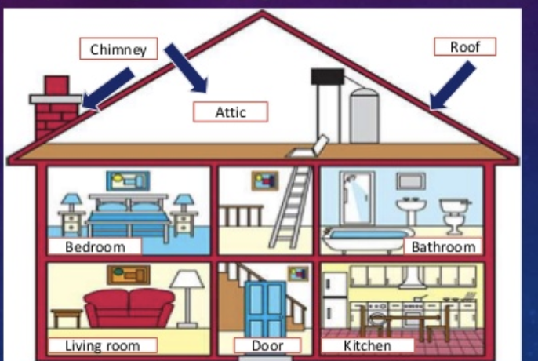
< Function >
The program is a house.
Rooms are different fuctions.
A house is consisted of different functions like different rooms consisted of the whole house.

Slide 4
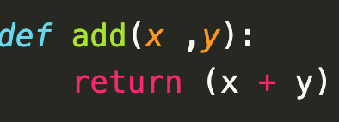
< Function >
execute a function: enter a room
def: definition tells computer it is a function
add: the name of function
(x ,y) : values in the function (objects in the room)
return: obtain a value when leave the room (do somethoing)

Slide 5
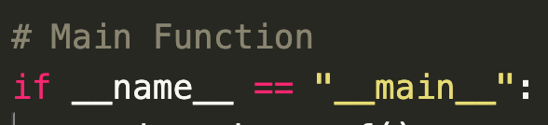
< Function >
Main function:
A program can have lots of functions, it is where the whole program starts

