Slide 1
MovieLens - Movie Recommendation System
HDFS · Apache Spark · Spark MLlib ALS
Problem Statement
Given a large collection of historical movie ratings, learn from the known (user, movie, rating) records and recommend, for a chosen user, a short ranked list of unrated movies predicted to be rated highly.
Process about 25 million ratings from HDFS with Spark
Predict unseen ratings and measure error on held-out data
Exclude movies the user has already rated; show titles and genres
Present the data and model behaviour through visualizations

Slide 2
Architecture
Five stages; stages communicate through HDFS
MovieLens 25M
HDFS
Apache Spark
Spark MLlib ALS
Outputs
ratings.csv
movies.csv
→
hdfs://localhost:9000
/bigdata_project
→
PySpark
local[2]
→
rank 10 · 10 iter
regParam 0.1
→
RMSE / MAE
Top-N recs · charts
Scope
Data and model hand-off
Runs in Spark local mode on a single WSL2 machine with HDFS as the storage layer. No multi-node cluster and no web front-end; recommendations are produced by a script and saved to HDFS as CSV.
Input: ratings.csv (646.8 MB) and movies.csv (2.9 MB) in HDFS.
The trained ALS model is saved to and loaded from HDFS; recommendations are written to /bigdata_project/output/.

Slide 3
Workflow
One PySpark script per stage
Load data
Read ratings & movies from HDFS; count records; show samples
Train ALS
80:20 split (seed 42); fit ALS on training part; save model to HDFS
Evaluate
Recreate split; predict on test set; drop rows without prediction; RMSE and MAE
Recommend
Top-N candidates (N + 20); remove already-rated movies; join titles; save CSV
Visualize
Rating distribution; top-10 most-rated; actual vs predicted (no training)
ALS settings: rank 10 · maxIter 10 · regParam 0.1 · 20 user / 20 item blocks · nonnegative · coldStartStrategy = drop

Slide 4
Tools Used
As shown in the project screenshots and scripts
Data
Storage
Processing
MovieLens 25M
HDFS
Apache Spark 4.2.0
25,000,095 ratings, 162,541 users; movies.csv has 62,423 titles
fs.defaultFS = hdfs://localhost:9000
PySpark, Scala 2.13.18, master local[2]
Machine learning
Runtime
Charts
Spark MLlib
Ubuntu on WSL2
matplotlib
ALS and RegressionEvaluator (RMSE, MAE)
OpenJDK 17.0.20.1
WSL limits: 5 GB RAM, 2 GB swap, 4 processors
PNG output via the Agg backend

Slide 5
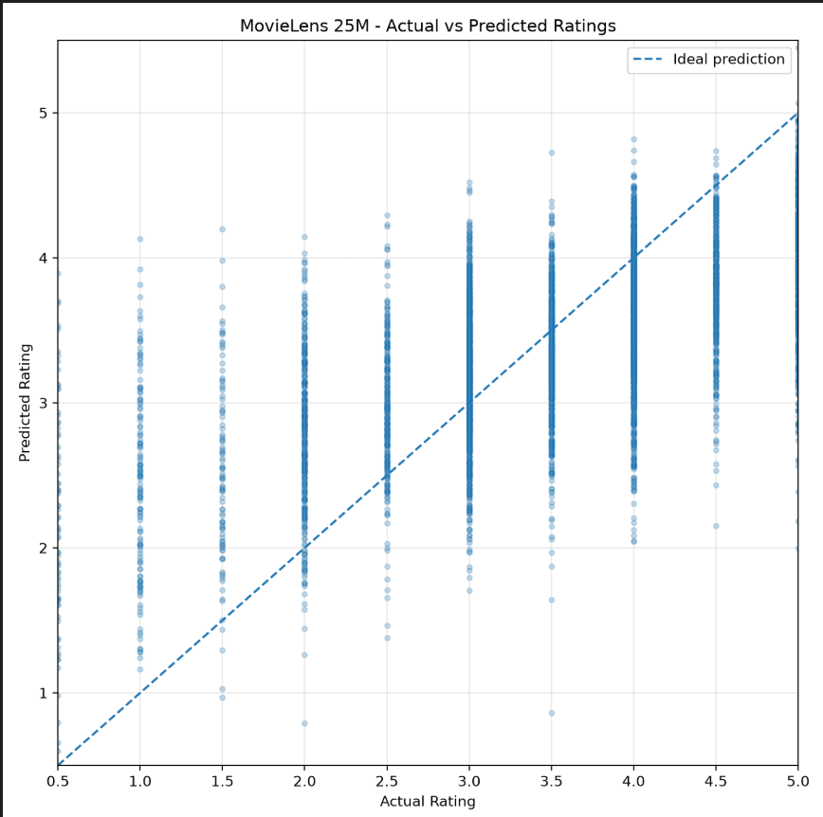
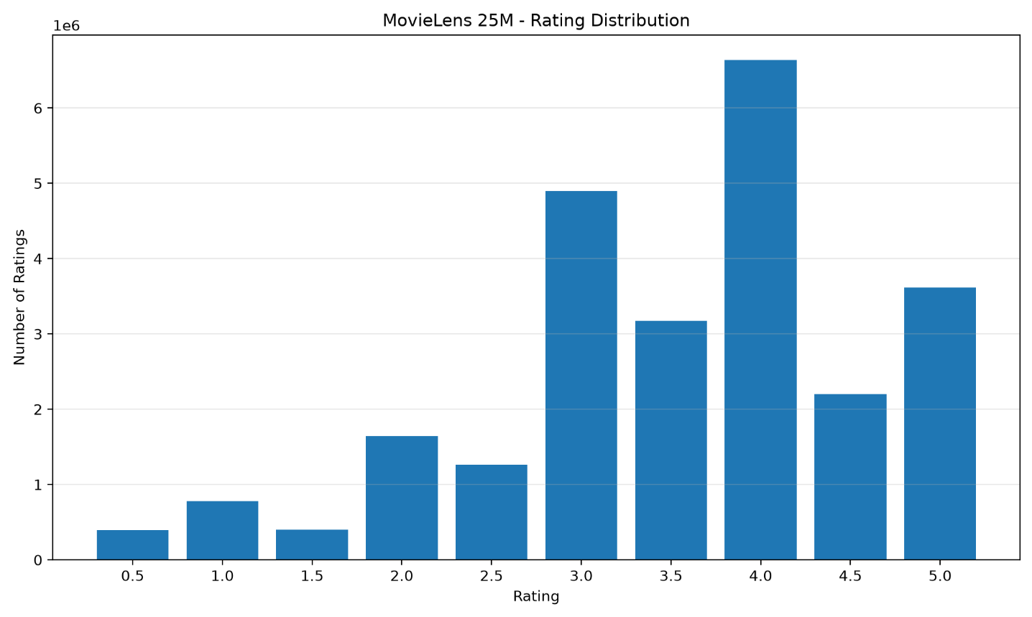
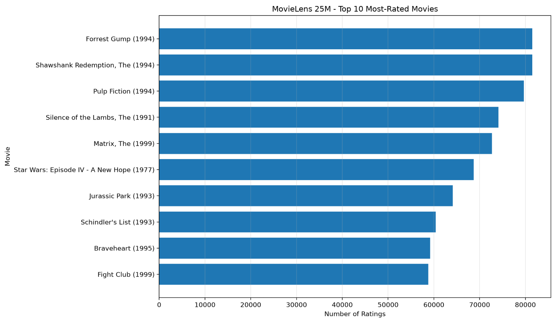
Visualizations
Generated by 13_visualize_25m_results.py
Rating distribution
Top 10 most-rated movies
Actual vs predicted ratings
4.0 is the most frequent rating (about 6.6 M); 3.0 and 5.0 follow. Values are read from the chart.
Forrest Gump and The Shawshank Redemption lead with roughly 81,000 ratings each. Counts show frequency, not quality.
Sample of 5,000 test predictions. Predictions are pulled toward the middle of the scale.

Slide 6
Conclusions
0.8141
0.6327
4,998,109
5,000,974
RMSE
MAE
valid predictions
test records
Full pipeline built: HDFS → Spark → MLlib ALS → evaluation, recommendations, charts
Average prediction error is about 0.63 rating points (MAE); only 2,865 test rows (about 0.06%) had no prediction
Top-10 lists generated for users 10 and 100 with already-rated movies removed; some predicted scores exceed 5.0, so they act as ranking scores
Limits: one ALS configuration, one 80:20 split, no ranking metric, single-machine local mode
Future work: parameter tuning, baseline comparison, ranking metrics, multi-node run

