Slide 1
Tech setup
The pipeline behind the demo: Salesforce data to an event log
Luke Audie · October 2026
Notes:
Companion to the main deck for a technical audience: how the data gets out of Salesforce and where to see it running.

Slide 2
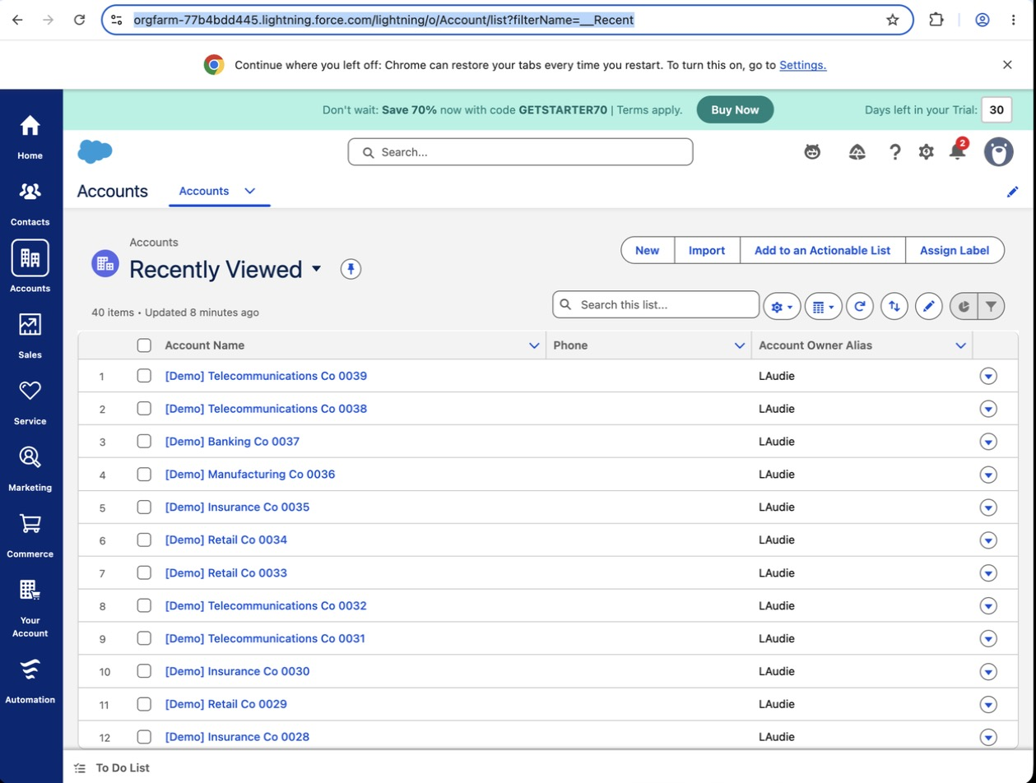
From a Salesforce org to an event log
pipeline/extract.py · stage history
SOQL via the CLI session
Trial org = the client's CRM
3
1
SELECT OpportunityId, StageName, CreatedDate,
CreatedById, CreatedBy.Name
FROM OpportunityHistory
ORDER BY OpportunityId, CreatedDate
4
Objects → events
2
seed.py: 40 [Demo] records
Salesforce object | Becomes in the event log
Opportunity | Case: Id, Amount, IsWon, region
OpportunityHistory | Stage events: StageName, CreatedDate
Task (WhatId) | Activities: Subject, created → completed
Lead (ConvertedOpportunityId) | Lead Created event
Salesforce trial org: seed.py loaded 40 [Demo] accounts and opportunities to simulate a client's CRM.
extract.py: four SOQL queries over the REST API, signed by the Salesforce CLI session. Output: CSV and XES.
Notes:
Left: the trial org standing in for a client's CRM, seeded by seed.py so there's real OpportunityHistory to read. Right: the stage-history query and how each object maps to events; Opportunity Id is the case. Known limits: Task created → completed can include queueing time; open tasks have no completion time and show as zero duration; history can't be backdated in a trial org, so the 10-month dataset is simulated in the same shape. The export produces CSV and XES; an import into a process mining tool is the next step to verify. Production work would add incremental refresh, stable event IDs and reconciliation.

Slide 3
Prototype today, production next
What the prototype proves
Known limits
Production path
SOQL over REST, signed by the CLI session; no stored credentials
Opportunity as the case; Tasks join on WhatId, Leads on ConvertedOpportunityId
History rows collapse to real stage changes; paginated queries
CSV and XES export with start and complete events
Task created → completed can include queueing time
Open tasks have no completion time yet
Trial orgs can't backdate history, so the analysis uses simulated data
Import into a process mining tool still to verify
Bulk API 2.0 with incremental refresh on SystemModstamp
Stable event IDs and deterministic ordering for timestamp ties
Approval history from ProcessInstance and its steps
Reconciliation and data-quality checks against source counts
The plumbing is proven. What's left is event semantics and data quality, not connectivity.
Notes:
The prototype proves the extraction and event-log design end to end on a real org. The limits are about event semantics and data, not plumbing. Production work is incremental refresh at volume, stable identifiers, approval history from the approval objects, and reconciliation so Finance can trust the numbers.

Slide 4
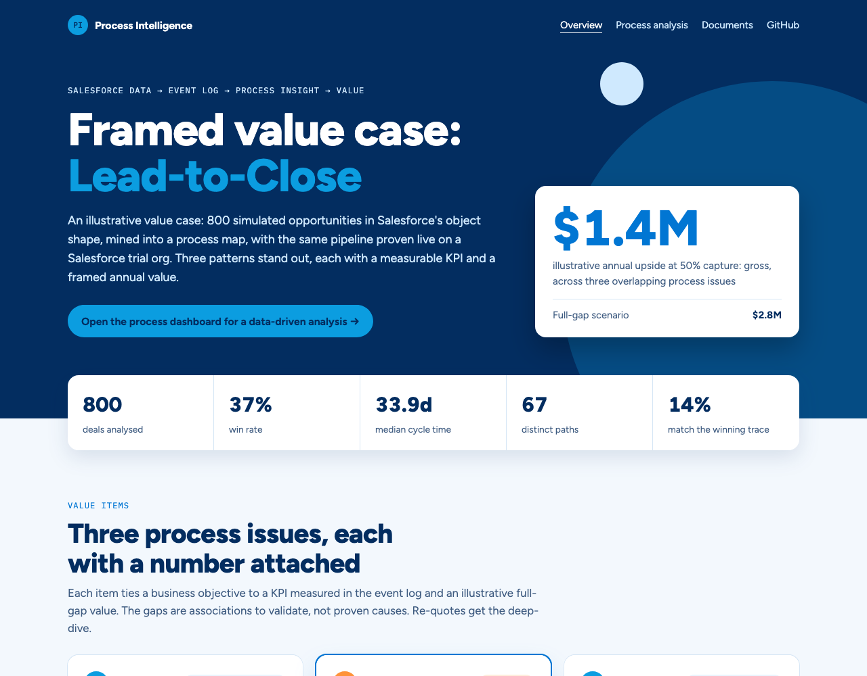
Hosted demo, live extraction proof and source code
→
Overview: value items and business case
salesforce-process-intelligence.vercel.app
→
Process analysis
salesforce-process-intelligence.vercel.app/dashboard.html
→
Business case (re-quotes)
salesforce-process-intelligence.vercel.app/#business-case
→
Data assets and downloads
salesforce-process-intelligence.vercel.app/#live-run
→
Source code and event logs
github.com/ch-lukas/salesforce-process-intelligence
Notes:
All of this is hosted. The overview carries the value items and business case; Data assets has the live run and every event log; the repo has the pipeline, the seeding script and the README with the setup gotchas from a new trial org.

