Slide 1
From Salesforce data to a framed value case
Lead-to-close process intelligence: a working demo build
Luke Audie · October 2026
Notes:
I wanted to show how I'd open with a Salesforce-heavy prospect: start from their own CRM data, find where the process leaks, and turn it into a number the CRO cares about.

Slide 2
The answer first: three process fixes worth $1.4M a year
$1.4M
Accelerate revenue
EMEA discount approvals take 7.0 days vs 1.2 in the fastest region.
Annual revenue upside if half of the gap is closed on three issues found in the CRM data. Full gap: $2.8M.
Improve win rate
19% of negotiated deals loop back for a re-quote; they win 31% vs 49%.
Sized from 800 opportunities over 10.4 months.
Sales productivity
12% of deals skip Qualification and win 18% vs 39%.
800
37%
33.9d
67
14%
deals analysed
win rate
median cycle time
distinct paths
follow the happy path
Notes:
Lead with the number, then the three findings. Everything after this slide is how I got there and how you would check it.

Slide 3
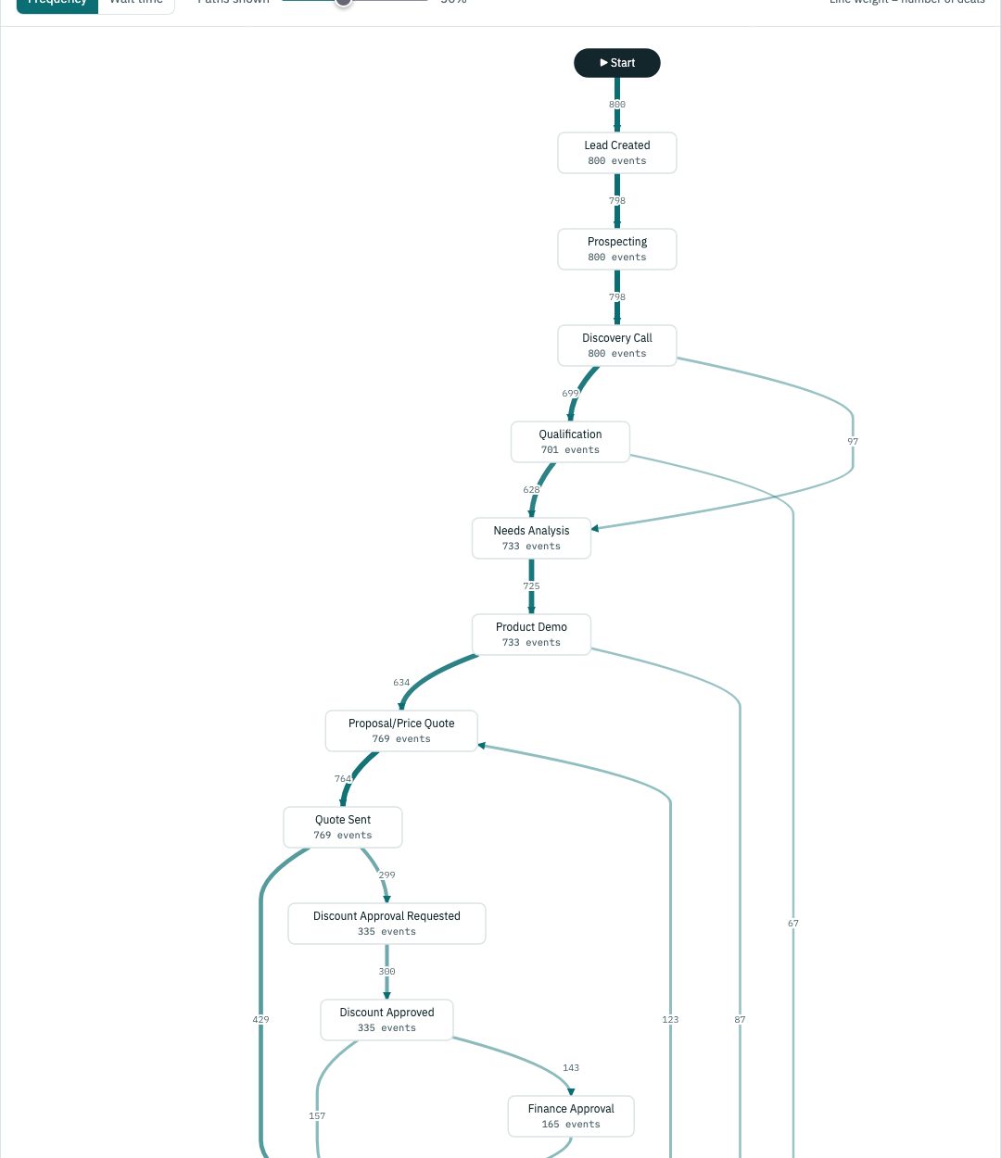
Discover: the process as it actually runs
14%
of deals follow the designed happy path
67
distinct paths across 800 deals
7.0 days
median EMEA approval wait, the slowest hand-off
Approval steps and re-quote loops show up as detours from the designed path.
Notes:
This is the directly-follows map from the hosted dashboard. Fourteen percent conformance is the hook: the CRM shows the stage, process mining shows the path.

Slide 4
Diagnose: three deviations explain most of the lost value
EMEA's single approver adds about 6 days per discounted deal.
19% of negotiated deals are re-quoted, and they win 18 points less often.
12% of deals skip Qualification and win less than half as often.
Notes:
Orange marks the problem cohort in each chart. Win-rate gaps compare like with like, for example only deals that reached Negotiation for re-quotes.

Slide 5
Value case: reduce re-quotes in quote-to-close
Time frame: 2025-10 to 2026-09 · New business · Deals that reached Negotiation · Owner: VP Revenue Operations
Challenge
Root cause (to capture)
Solution with Apromore
750 negotiated deals a year; 19% loop back for a re-quote
Re-quoted deals win 31% vs 49%
EMEA approvals take 7.0 days vs 1.2
Reason codes: quote expired, discount, scope, pricing error
Hotspots by approver queue, region and rep
Confirm: slow approval → expired quote → re-quote
Performance views show where quotes wait and loop
Conformance checking flags skipped steps
Simulate a delegated EMEA approval threshold first
Negotiated deals / yr
Re-quotes per deal
Win-rate gap
Average won deal
Improvement
≈ $669k
revenue upside p.a.
750
×
0.19
×
17.5 pts
×
$53k
×
50%
=
Assumptions: annualised from 10 months of history; win-rate gap compares only deals that reached Negotiation; cycle-time gains not counted; half of the gap closed.
Notes:
This follows my value framing format: challenge, root cause, solution, then a multiplicative value chain. The customer owns the improvement assumption; we own the evidence. Root cause is labelled 'to capture' because it needs reason codes the CRM doesn't hold yet.

Slide 6
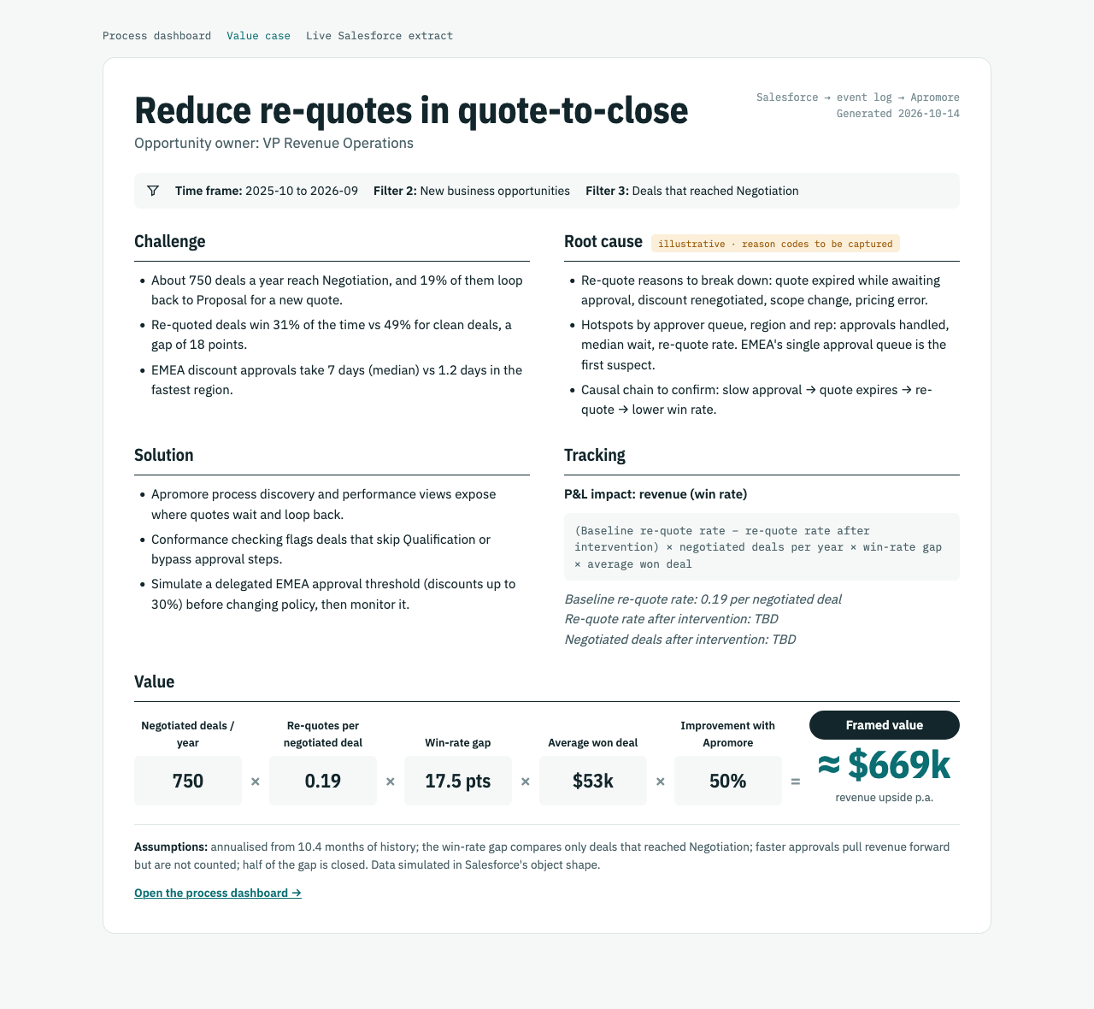
Everything is live and open to inspect
Process dashboard
→
salesforce-process-intelligence.vercel.app
Value case one-pager
→
salesforce-process-intelligence.vercel.app/value-case.html
Live Salesforce extract
→
salesforce-process-intelligence.vercel.app/live.html
Source code and event logs
→
github.com/ch-lukas/salesforce-process-intelligence
Notes:
All of this is hosted. The repo has the pipeline, the seeding script and the README with the setup gotchas I hit on a new trial org.

Slide 7
Turning the finding into a decision
Validate
Act
Monitor
Run the same extract on the production org and confirm approval waits and re-quote rates with RevOps.
Pilot a delegated approval threshold for EMEA discounts up to 30% and make Qualification a required gate.
Schedule the extract into Apromore, track the KPIs against target and report value realised quarterly.
salesforce-process-intelligence.vercel.app · Luke Audie
Notes:
Close on the decision: validate on production data, pilot one policy change, then monitor value realised in Apromore.

Slide 8
Tech setup
How the data gets from a Salesforce org into an Apromore-ready event log
Notes:
For the technical audience: the pipeline, the data model, and what it took to run it against a brand-new trial org.

Slide 9
From Salesforce to Process Intelligence in four steps
1
2
3
4
Extract
Correlate
Load
Mine and size
SOQL over REST
One case per deal
Event log
Map and value
Lead, Opportunity, OpportunityHistory and Task, signed by the Salesforce CLI session. No stored credentials.
Case ID = Opportunity Id. Tasks join on WhatId, Leads on ConvertedOpportunityId.
CSV and IEEE XES with activity, timestamps, resource and case attributes, ready for Apromore.
Directly-follows graph, variant analysis, cohort win rates and a driver-based value model.
Live run on a Salesforce trial org: 40 opportunities · 351 events · 2 objects joined · CSV + XES for Apromore
Notes:
Opportunity is the case. Trial orgs can't backdate history, so the 10-month dataset is simulated in the exact Salesforce shape; the extractor runs unchanged against the live org, as the band at the bottom shows.

Slide 10
Data model: Salesforce objects to an event log
Event log field | Salesforce source
Case ID | Opportunity.Id
Lead Created | Lead.CreatedDate, joined on Lead.ConvertedOpportunityId
Stage activities | OpportunityHistory.StageName and CreatedDate; repeated rows collapse to real stage changes
Task activities | Task.Subject, CreatedDate → CompletedDateTime, joined on Task.WhatId
Resource | CreatedBy.Name (stage changes), Owner.Name (tasks)
Case attributes | Opportunity.Amount, LeadSource, IsWon; Account.Industry, BillingCountry → region
Output: one row per event
case_id, activity, start_time, end_time, resource, source_object, region, industry, lead_source, amount, outcome
006WV…YAB Qualify
006WV…YAB Discovery Call
006WV…YAB Closed Lost
Written as CSV for Apromore's import and as IEEE XES with start/complete lifecycle events.
Notes:
Opportunity is the case notion. Leads join through the converted opportunity, tasks through WhatId. History tables write a row on any field change, so the transform keeps only real stage transitions.

Slide 11
Running it against a brand-new trial org
Steps
Problems solved along the way
1
Authenticate
New orgs block uninstalled connected apps
sf org login web: the CLI session signs every API call; no stored passwords.
Installed Salesforce CLI under Connected Apps OAuth Usage.
2
Seed
Starter orgs use a shorter sales process
seed.py loads 40 [Demo] deals and walks them through stages via the Composite API.
Stages auto-map to Qualify → Propose → Negotiate.
3
Extract and mine
The CLI redacts access tokens
extract.py → transform.py → mine.py write the event log and insights.
Calls go through sf api request rest instead.
4
Publish
History can't be backdated
build_site.py renders the dashboard and value case; deployed to Vercel.
The 10-month dataset is simulated in the same object shape.
Notes:
These are the things that would trip up a customer's first technical session; each one is solved in the repo and written up in the README.

Slide 12
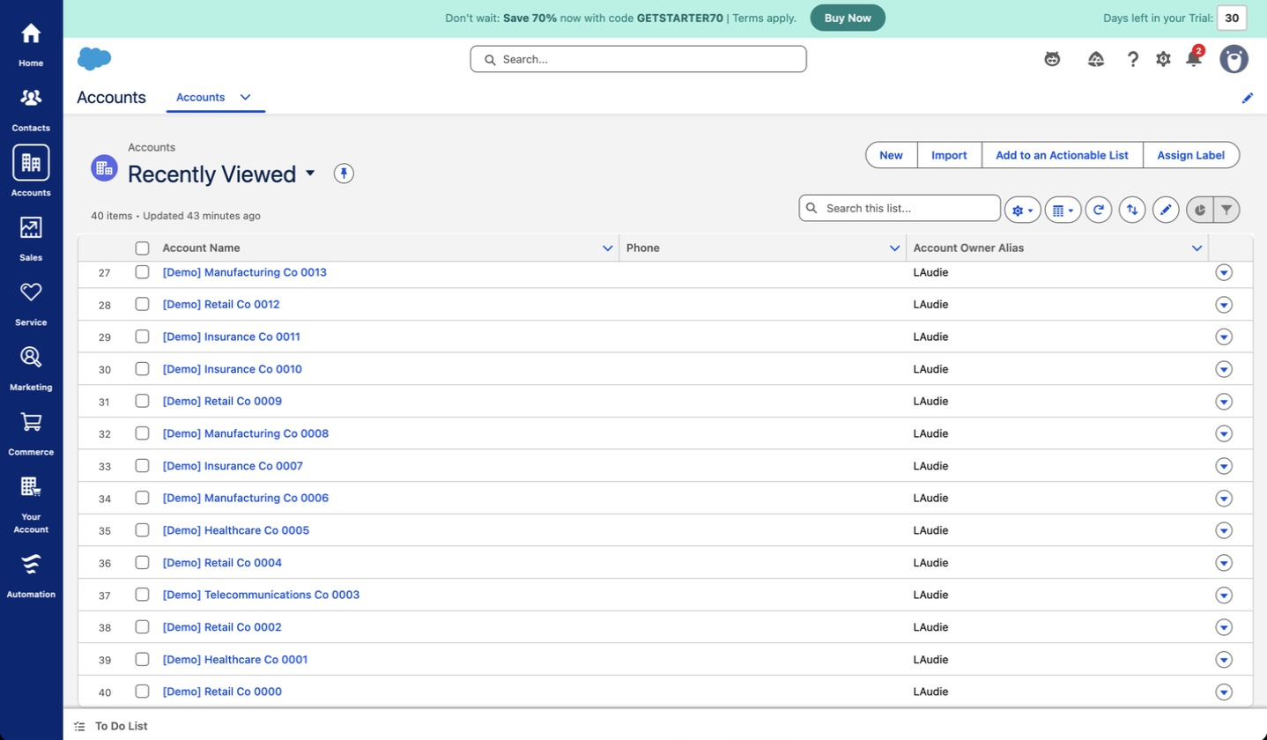
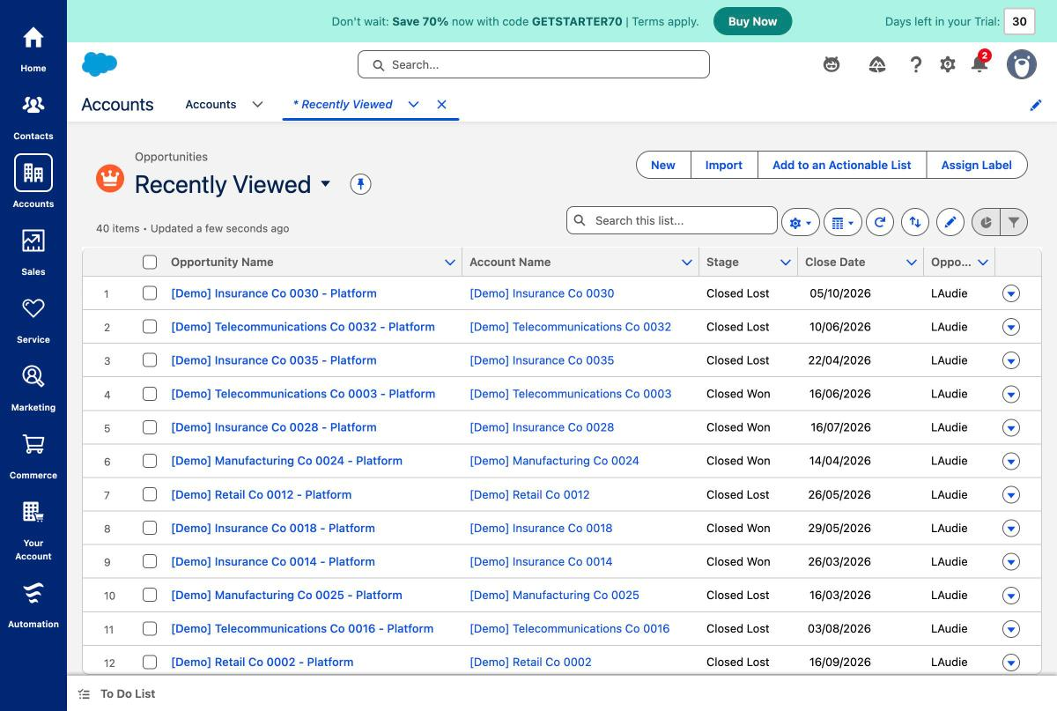
Evidence: the seeded deals live in Salesforce
40 [Demo] accounts created through the Composite API, each with an industry and country.
40 opportunities walked through the org's own sales stages.
Notes:
Screenshots from the trial org. Every record is tagged [Demo] and can be removed with seed.py --cleanup.

Slide 13
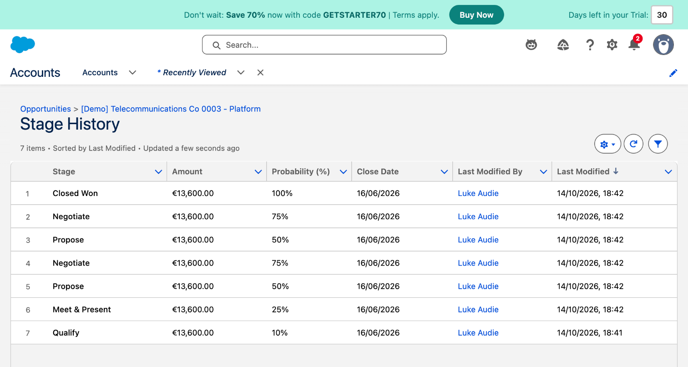
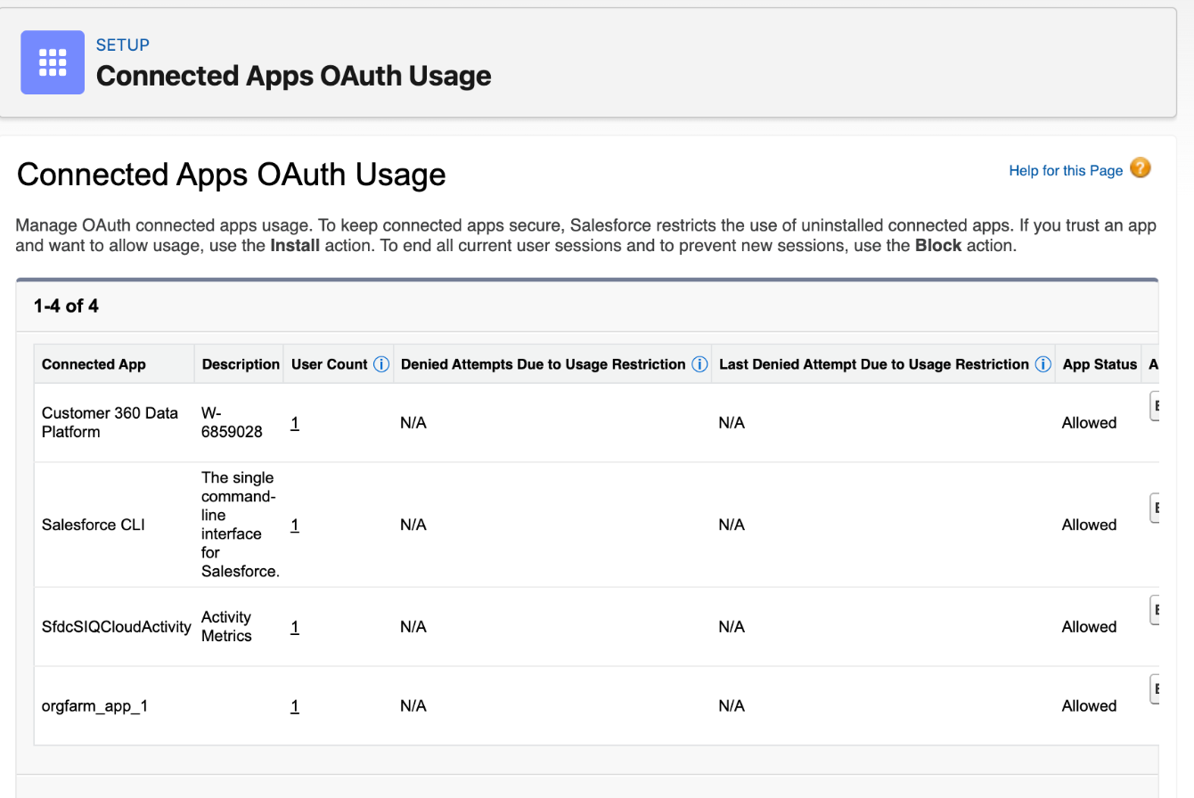
Evidence: what the extract reads
OpportunityHistory for one deal: Propose → Negotiate twice before Closed Won. This is the re-quote loop the dashboard measures.
Setup: Salesforce CLI installed and allowed, which unblocked API access on the new org.
Notes:
The stage history is the raw material for the event log: each row becomes an event. The setup screen is the one-click fix for new orgs that block uninstalled connected apps.

