Slide 1
Sales Data – Power BI
Designed for Business Insights & Decision Support
Presented by: [CH.Manjula]
Date: [25-042025]

Slide 2
Project Objective
To build an interactive dashboard using Power BI
Enable stakeholders to analyze key sales metrics
Visualize trends across time, regions, and products

Slide 3
Dataset Overview
Dataset: sales_data_sample.csv (from Kaggle)
2823 records, 25 columns
Key Fields: SALES, ORDERDATE, PRODUCTLINE, COUNTRY, DEALSIZE

Slide 4
Tools & Techniques
Tool: Power BI Desktop
Created calculated columns & DAX measures
Applied filters, slicers, and drill-downs
Used consistent theme and layout for clarity

Slide 5
Key KPIs Tracked
- 🔢 Total Quantity Sold:
*99.07K*- 💸 Total Sales Revenue:
*10.03M USD*- 📈 Sales Growth Over Time (2003-2005)-
🌍 Sales by Country and Region-
📊 Sales by Product Line & Deal Size

Slide 6
Dashboard OVERVIEW
📈 Line Chart – Sales Over Time
📊 Bar Chart – Sales by Product Line
🌍 Map or Bar – Sales by Country
🍩 Donut Chart – Deal Size Breakdown
🔲 KPI Cards – Sales, Profit, Quantity
🔄 Slicers – Year, ProductLine, Country

Slide 7
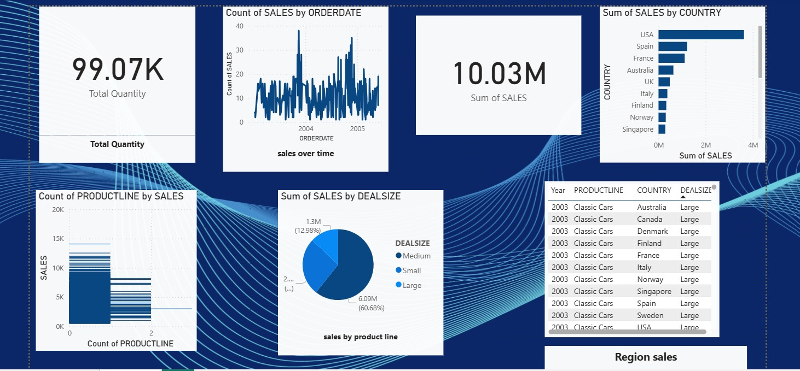
Dashboard:screen shots

Slide 8
Insights Derived
📌 High sales in countries like USA, France, and Germany
📌 Best-selling Product Lines: Classic Cars & Motorcycles
📌 Seasonal peaks observed in Q3
📌 Medium deal sizes yield highest revenue

Slide 9
Conclusion & recommendations
Dashboard provides clear insights for decision-making.- Recommending further:
Integrating live data sources for real-time updates.
Setting up predictive analytics for future sales trends
Deploy dashboard to Power BI Service with auto-refresh.

