Slide 1


Positivity
I am a thoroughly positive person, actively trying to break out of negative thought patterns. I firmly believe that whatever friends or I approach will somehow work out and have a positive ending. I spread this attitude also with people around me, and will also distance myself from overly negative (not realistic) people.

Slide 2
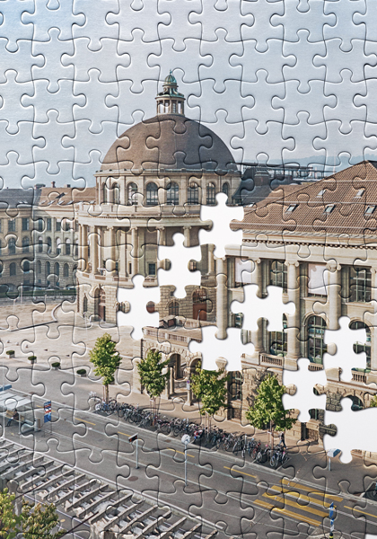
Learning
I have a pronounced love for learning new things. Today, I am the sum of the books I have read, the number of times I have practiced an exercise, and the lines of code I have implemented. For this reason, I strive for learning something new every day while keeping a balance between theoretical knowledge and practical application.

