Slide 1

Under Guidance of Mrs. Vaishali Sonanis Mam
Presented by Chekurthi Rohith

Slide 2
CONTENTS
INTRODUCTION
OVERVIEW
MODULES
DEFECTS
CHALLENGES
EXPERIENCE

Slide 3
Introduction :
Browser Stack is a cloud testing platform that allows developers and testers to test websites and mobile applications across different browsers, operating systems, and real devices.

Slide 4
Overview
What is BStack?
Browser Stack is a cloud-based testing platform that enables developers and testers to test websites and mobile applications on real browsers and devices without maintaining physical infrastructure.
My project is a demo setup using Browser Stack.
It helps users understand how cross-browser and cross-device testing works. Browser Stack provides instant access to thousands of browsers, operating systems, and mobile devices.
It supports both manual and automated testing, with integrations for Selenium, TestNG, JUnit, Appium, and CI/CD tools.

Slide 5
Modules
Module 1 : Login
Checked the functionalities of username and password in the sign in page for login
Module 2 : Add to Cart
Checked the functionality of add to cart button by adding an item to the cart.
Module 3 : Delete
Checked the functionality of delete by deleting an item from the cart.
.
Notes:
Module 1: Signn in page
Checked all the functionalities on Sign in page which included personal info as email
address, password
Module 2: Women page
Checked all the functionalities on Women page which included item details, Quantity, Filters,compare button,Add to cart button,product info,grid,list button
Module 3: Tshirt page
Checked all the functionalities on T-Shirt page which included item details, Quantity, Filters,compare button,Add to cart button,product info,grid,list button
Module 4: All Buttons and Drop Down Arrow :
team checked if all the buttons and drop down arrows of different fields are functioning properly or not

Slide 6
Module 4 : Checkout
Checked the functionality of checkout by buying an item from the cart.
Module 5 : Search Multiple Items
Checked the functionalities of search button by searching multiple items
Module 6 : Shop By Brands
Checked the functionalities of vendors button by selecting different company phones.
Module 7 : Order By
Checked the functionality of order by button by changing lower to higher and vice versa .

Slide 7
Module 8 : Favourites
Checked the functionality of favorites button by adding items to favorite .
Module 9 : Offers
Checked the functionality of offers button.
Module 10 : Privacy policy
Checked the functionality of privacy policy button
Module 11 : Logout
Checked the functionality of logout button

Slide 8
Defects
While running a testcase at certain point some fields are not working as it is expected which is nothing but a defect, so I have created a Defect report on those defects.

Slide 9
Defect identifier :- B_001
Defect summary Expected result is when we click on "Search" Product list shows iPhone or related products, but it is navigating to home page Search engine is not working
Test Id TC_001, TC_002
Ø Test case name Search_Valid, Search_Invalid, BStack-SearchPartialMatch, Search_Blank
Ø Module name Search
Ø Severity High
Ø Priority High
Ø Raised by Rohith
Ø Assigned to developer Team lead
Ø Date of assignment
Ø Status pending
Snap shots
Fixed by Developer

Slide 10
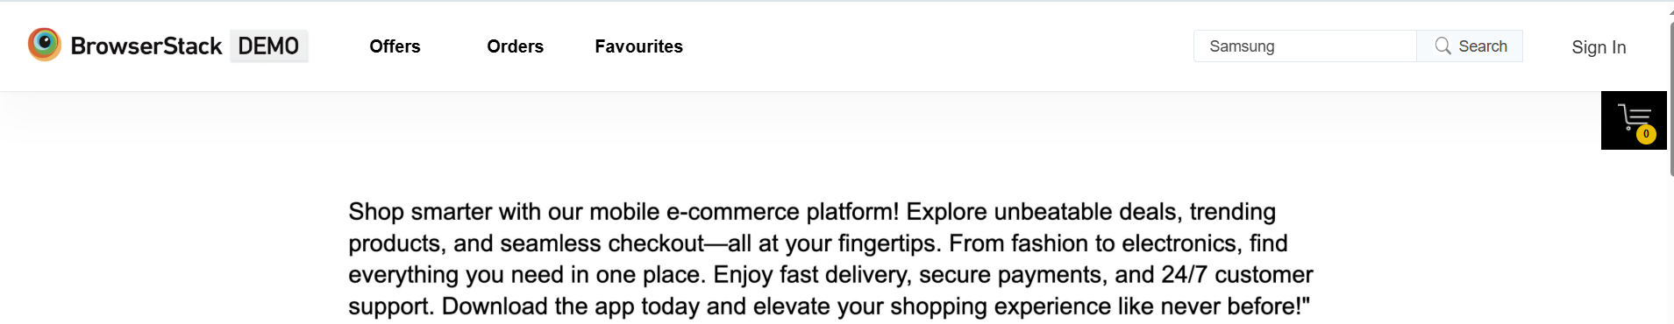
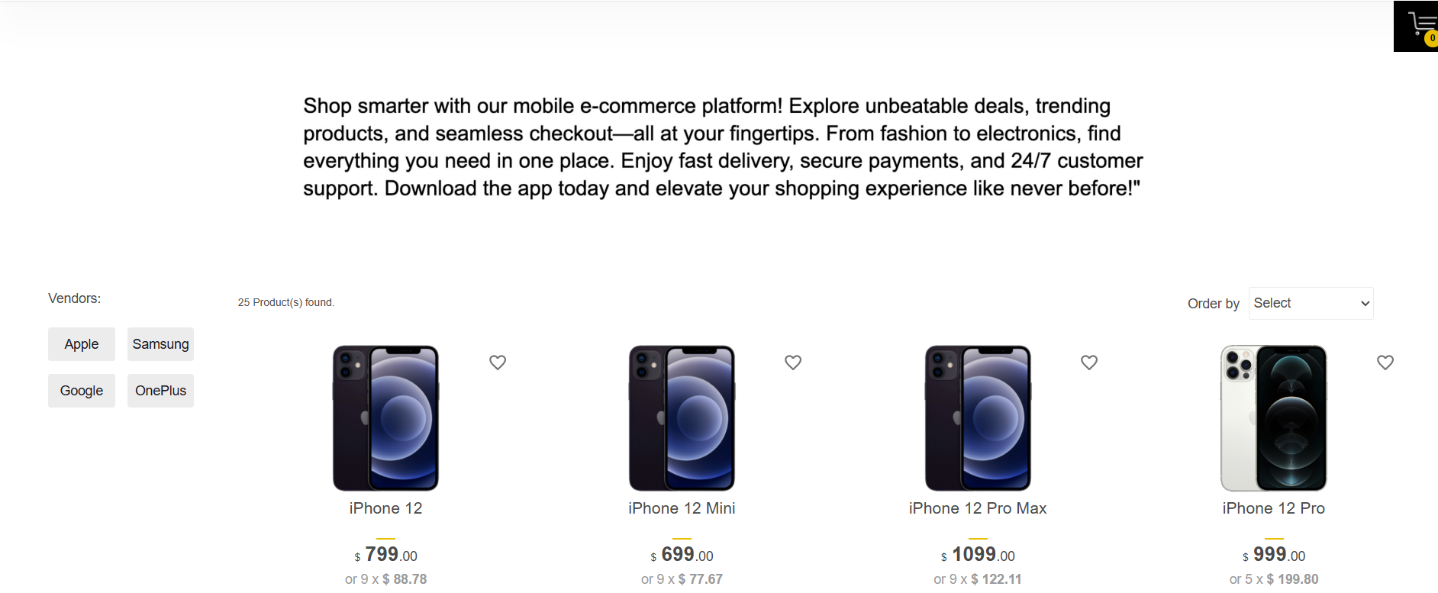

Slide 11
Defect identifier :- B_002
Ø Defect summary Privacy policy read more is not redirecting to the privacy policies page .
Ø Test Id TC_001
Ø Test case name bstack_privacy_policyreadmore
Ø Module name Footer Links
Ø Severity Medium
Ø Priority Medium
Ø Raised by Rohith
Assigned to developer
Date of assignment
Ø Status pending
Ø Fixed by developer

Slide 12
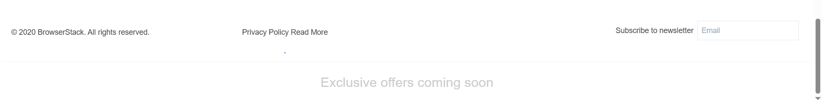
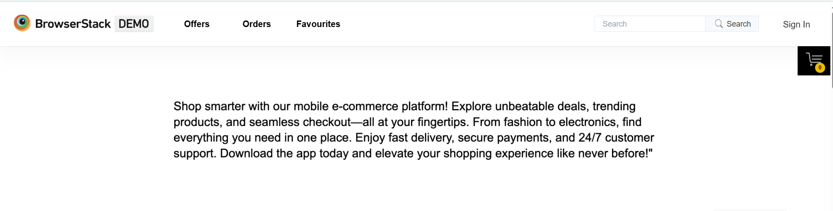

Slide 13
Defect identifier :- B_003
Ø Defect summary Responsiveness across different devices.
Ø Test Id TC_001
Ø Test case name bstack_responsiveness
Ø Module name Responsiveness across different mobiles
Ø Severity Medium
Ø Priority Medium
Ø Raised by Rohith
Assigned to developer
Ø Date of assignment
Ø Status pending
Ø Fixed by developer

Slide 14
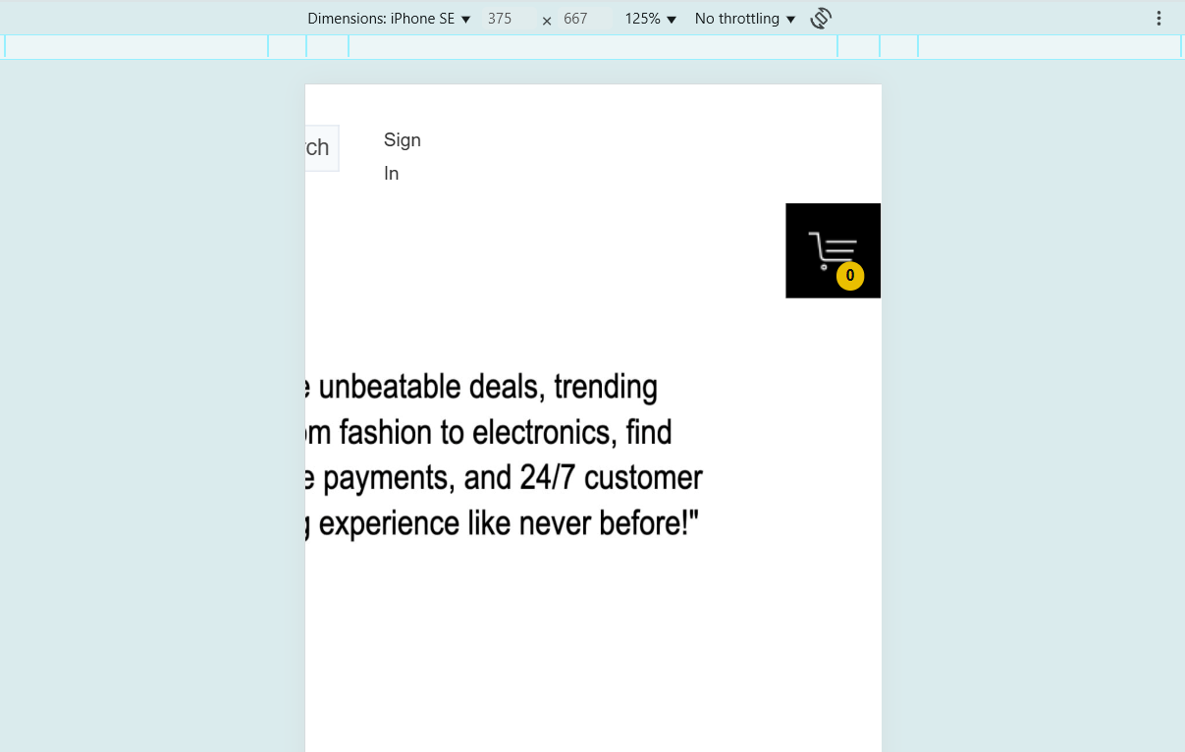

Slide 15
Defect identifier :- B_004
Ø Defect summary Expected result is when we click on product image it need to redirect to
product details but it is not clickable.
Ø Test Id TC_001
Ø Test case name addtocart_items
Ø Module name add to cart
Ø Severity Medium
Ø Priority Medium
Ø Raised by Rohith
Assigned to developer
Ø Date of assignment
Ø Status pending
Ø Fixed by developer

Slide 16
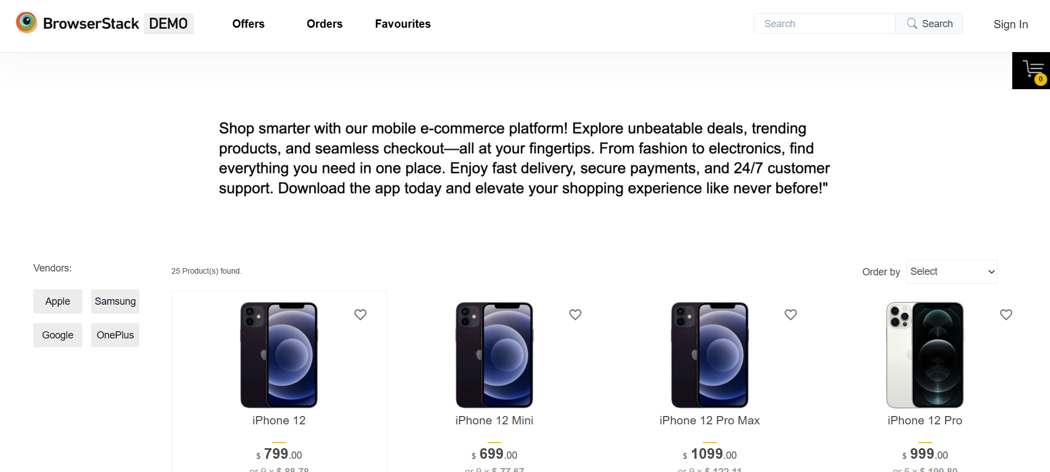

Slide 17
Challenges
Handling the entire scope of testing website like BStack alone was a significant challenge, requiring careful time management.
Login module was bit difficult because of locators
Tests failing inconsistently due to slow internet

Slide 18
Experience
I stopped looking at the website as a user and started looking at it as a tester.
Gained hands-on experience in Selenium WebDriver, TestNG, and Cucumber
GAINED HANDS-ON EXPERIENCE IN E-COMMERCE TESTING BY WORKING ON BStack DEMO Shop
Learned to handle test failures.
This project reinforced the need for meticulous attention to detail.

Slide 19
Thank You
Vaishali Mam For Guiding Us through out the Project.

