Slide 1

Under Guidance of Mrs. Vaishali Sonanis Mam
Presented by Chekurthi Rohith

Slide 2
CONTENTS
INTRODUCTION
OVERVIEW
MODULES
DEFECTS
CHALLENGES
EXPERIENCE

Slide 3
Introduction :
eBay is a multinational e-commerce company that manages a global online marketplace, connecting millions of buyers and sellers in countries around the world.
The platform offers a massive range of new, used, and refurbished products, from everyday items like electronics and fashion to rare collectibles, antiques, and vehicles.

Slide 4
Overview
What is eBay?
eBay is a vast online marketplace known for its auctions and "Buy It Now" shopping.
It allows users to buy and sell a wide variety of new and used goods, from electronics and fashion to collectibles and vehicles.
It helps users understand the buying, selling, and auction features of eBay
This project focuses on testing the eBay website to ensure its functionality , usability and reliability

Slide 5
Modules
Module 1 : User Registration & Sign-In
Checked all functionalities on the Sign-In page, including creating a new account, signing in with email/username, and using social sign-on (Google, Facebook, Apple).
Module 2 : Homepage & Navigation
Tested the functionality of the main search bar, category browsing, daily deals, promotional banners, and navigation links.
Module 3 : Search & Filtering
Checked all functionalities on the search results page, including keyword search, advanced search filters (e.g., price, condition, buying format), and sort options.
Notes:
Module 1: Signn in page
Checked all the functionalities on Sign in page which included personal info as email
address, password
Module 2: Women page
Checked all the functionalities on Women page which included item details, Quantity, Filters,compare button,Add to cart button,product info,grid,list button
Module 3: Tshirt page
Checked all the functionalities on T-Shirt page which included item details, Quantity, Filters,compare button,Add to cart button,product info,grid,list button
Module 4: All Buttons and Drop Down Arrow :
team checked if all the buttons and drop down arrows of different fields are functioning properly or not

Slide 6
Module 4 : Product Details Page
Checked all the functionalities on the Product Details page, which included item images and videos, product descriptions, seller information, shipping details, return policies, "Add to cart," "Buy It Now," and "Add to watchlist" buttons.
Module 5 : Shopping Cart & Checkout
verified that all buttons and processes within the shopping cart and checkout flow are functioning properly. This included updating item quantities, removing items, applying coupons, and proceeding to payment.
Module 6 : Payment Gateway
Checked for the successful processing of payments through various methods like credit/debit cards, PayPal, and other available options. Ensured secure transaction and order confirmation.

Slide 7
Module 7 : My eBay (User Dashboard)
Checked that the "My eBay" dashboard correctly displays user information, purchase history, watched items, saved sellers, and messages
Module 8 : FOOTER AND HEADER
Ensured all links and information in the header and footer are valid and functional. This includes the eBay logo, user account links, notifications, help & contact.

Slide 8
Defects
While running a testcase at certain point some fields are not working as it is expected which is nothing but a defect, so I have created a Defect report on those defects.

Slide 9
Defect identifier :- B_001
Defect summary When navigating to the "Sports" category and selecting the "Water Sport" sub-category, the website incorrectly displays a "0 results found" page
Test Id TC_01
Ø Test case name TC_Category_Select_WaterSport_SubCategory
Ø Module name Category Navigation
Ø Severity Medium
Ø Priority Medium
Ø Raised by Rohith
Ø Assigned to developer Team lead
Ø Date of assignment 18/08/2025
Ø Status pending
Ø Snap shots Attached
Ø Fixed by

Slide 10
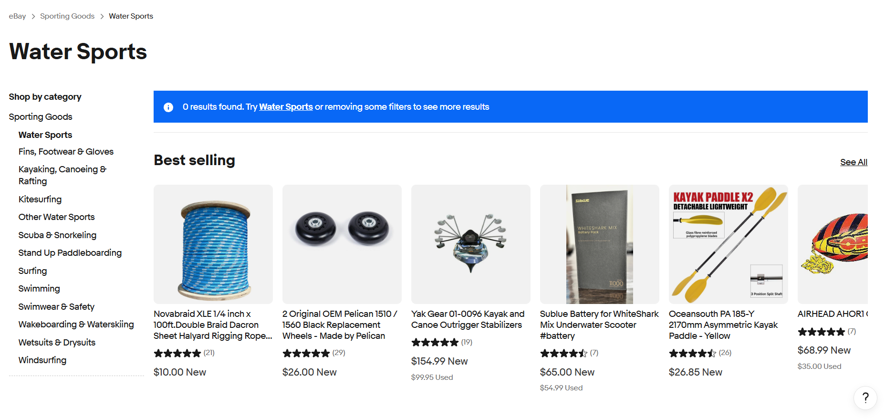

Slide 11
Defect identifier :- B_002
Ø Defect summary After applying the "Sort by: Price + Shipping: lowest first" filter on a search results page, the products are not sorted correctly. Higher-priced items are mixed in with or appear before lower-priced items, ignoring the filter selection.
Ø Test Id TC_02
Ø Test case name TC_Sort_PriceLowestFirst_Verification
Ø Module name Search & Filtering
Ø Severity Medium
Ø Priority Medium
Ø Raised by Rohith
Ø Assigned to developer Team lead
Ø Date of assignment 18/08/2025
Ø Status pending
Ø Snap shots attached
Ø Fixed by developer

Slide 12
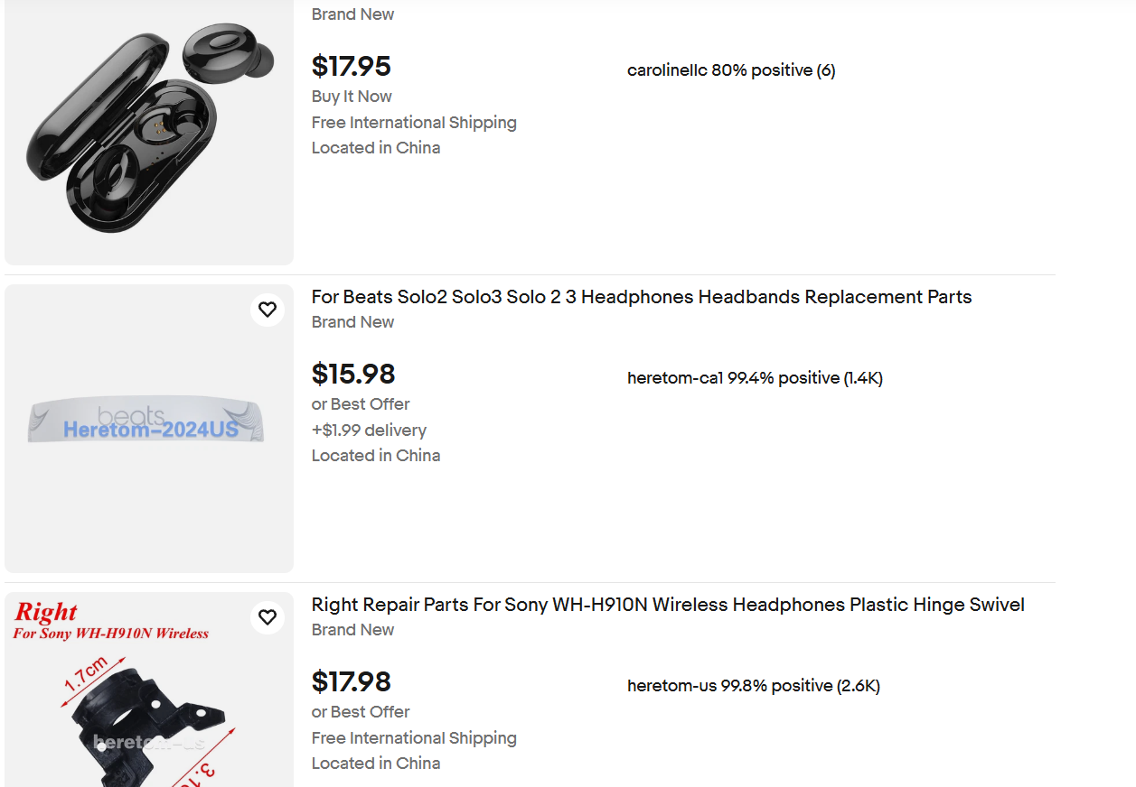

Slide 13
Challenges
Handling the entire scope of testing for a large-scale website like eBay alone was a significant challenge, requiring careful time management.
CAPTCHA or verification steps disrupting the automation process.
Tests failing inconsistently due to delayed page loading

Slide 14
Experience
I stopped looking at the website as a user and started looking at it as a tester.
Testing all modules single-handedly provided a comprehensive, end-to-end understanding of the application's architecture and user flow.
Learned to handle test failures.
This project reinforced the need for meticulous attention to detail.

Slide 15
Thank You
Vaishali Mam For Guiding Us through out the Project.

