Slide 1
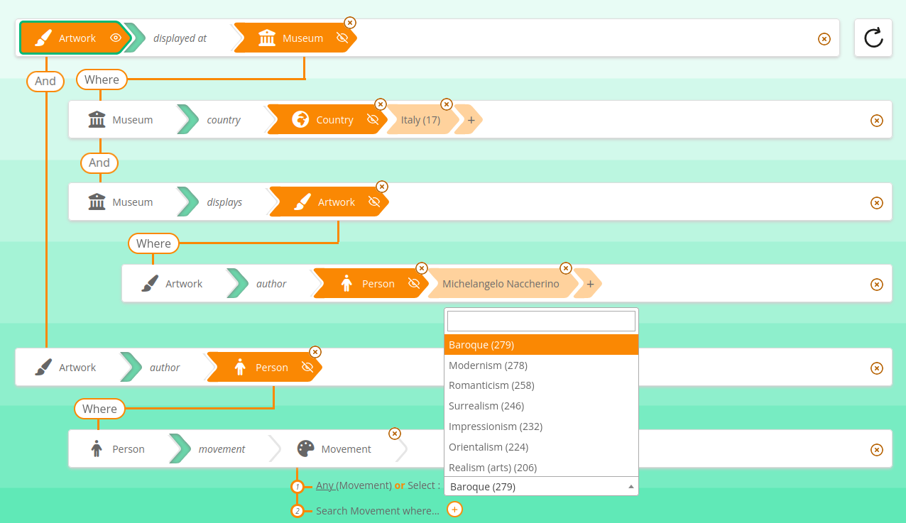

SPARNATURAL

Slide 2
« End-user oriented knowledge graph explorer »
show the graph as a graph, not as tabular datasets or faceted search
Open source LGPL license

Slide 3
2 components : query builder, and result set display
Technically speaking, 2 different modules : Sparnatural is the query builder, Sparnatural-yasgui-plugins contains the result set displays

Slide 4
User features

Slide 5
Traverse the graph
Start from any entry point, traverse any property in the graph, at any level deep
Combine with additional criteria at any level, « à la » faceted search

Slide 6
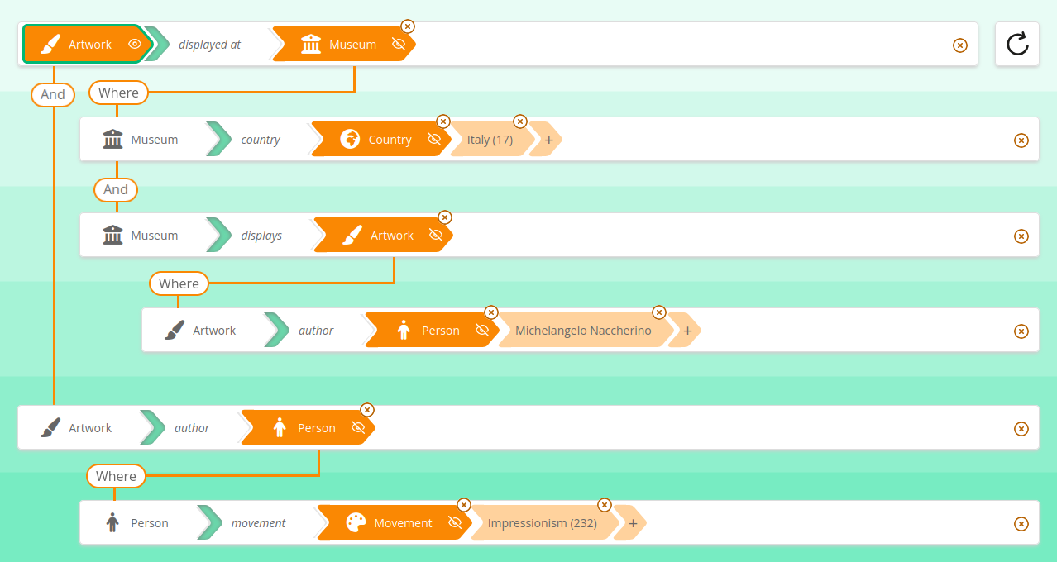

Slide 7
Value selection widgets
Dropdown list (+search inside the list)
Autocomplete search
Tree selector
Date range
Numeric range
Yes/no value
Map selector (GeoSPARQL)
Resource selectors
Literal selectors

Slide 8
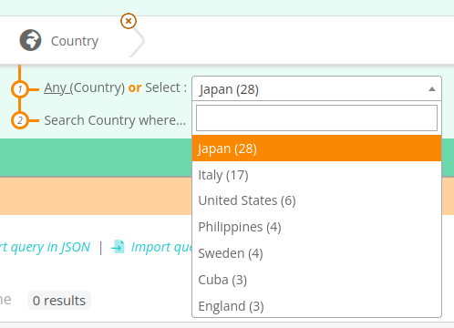
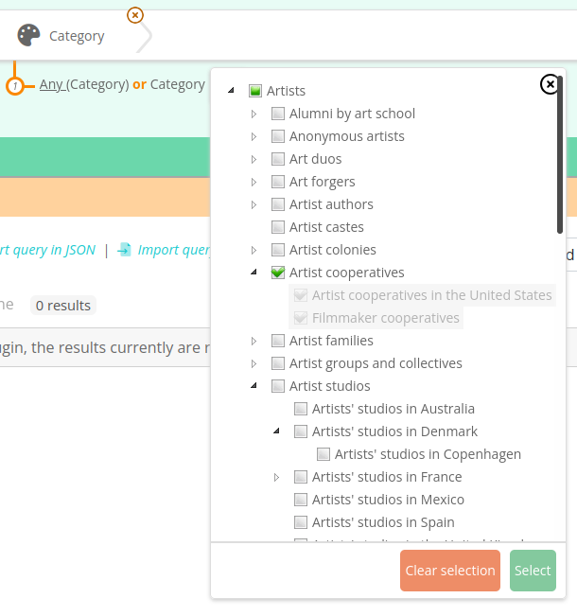
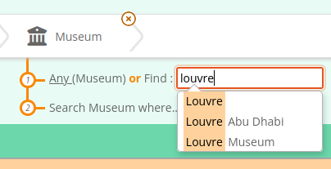

Slide 9
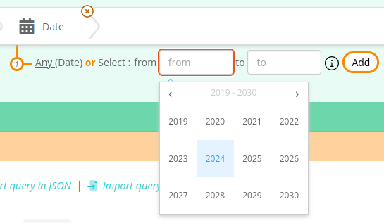
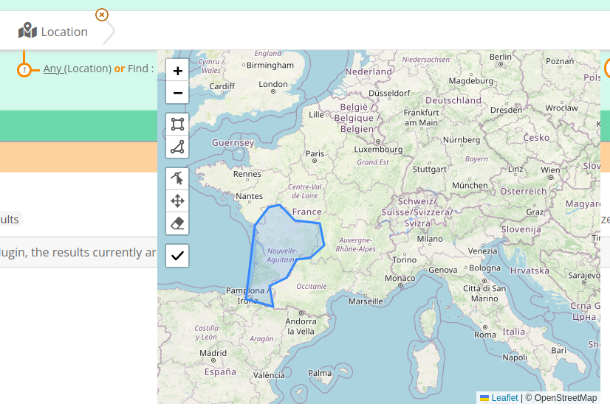
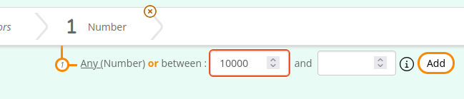

Slide 10
Support for optional conditions
Retrieve a column value if it set, otherwise column will be empty

Slide 11
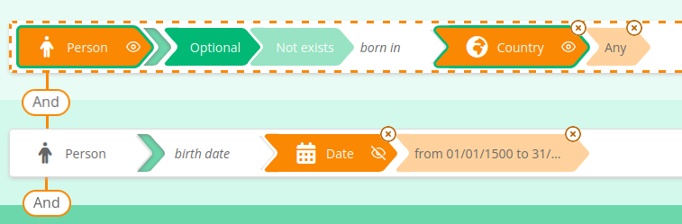

Slide 12
Support for negative conditions
"All documents except reports"

Slide 13
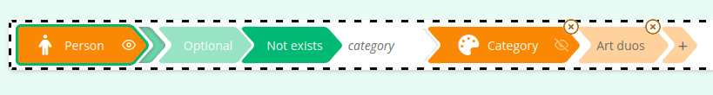

Slide 14
Column ordering, sort result set, rename columns

Slide 15
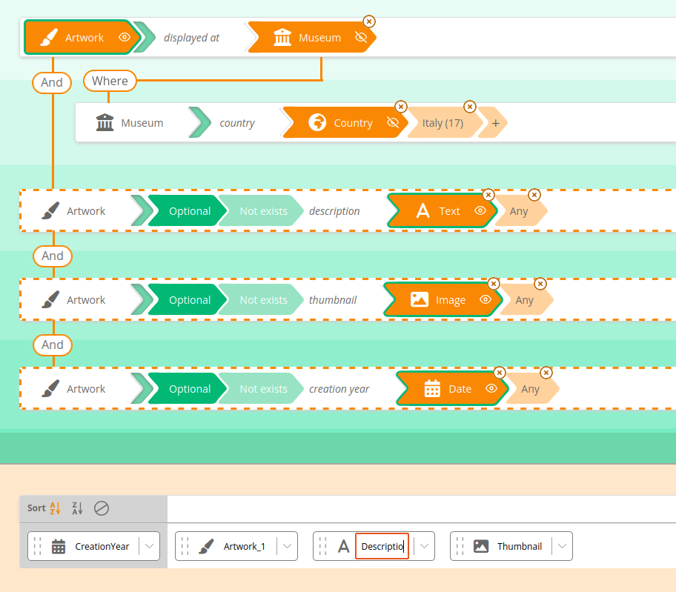

Slide 16
« Count » queries and other aggregates
"How many reports have been tabled in plenary in 2022 ?"

Slide 17
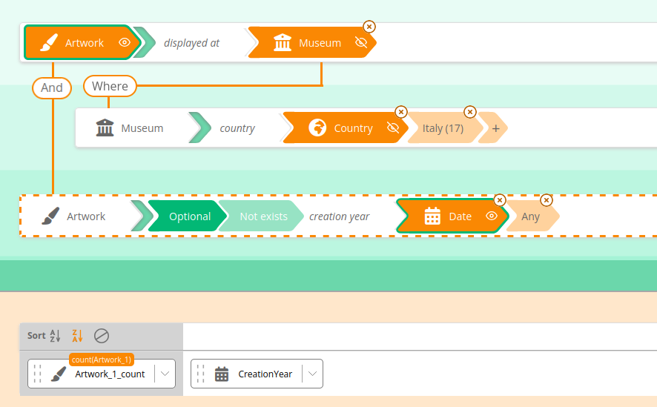

Slide 18
Human-readable labels are fetched automatically

Slide 19
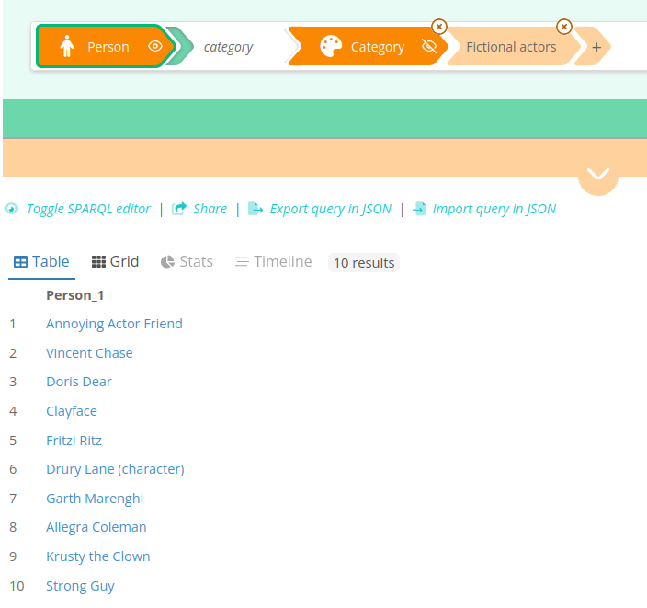

Slide 20
Result-set display plugins
TableX (smart table display)
Grid plugin
Timeline plugin
Stats plugin

Slide 21
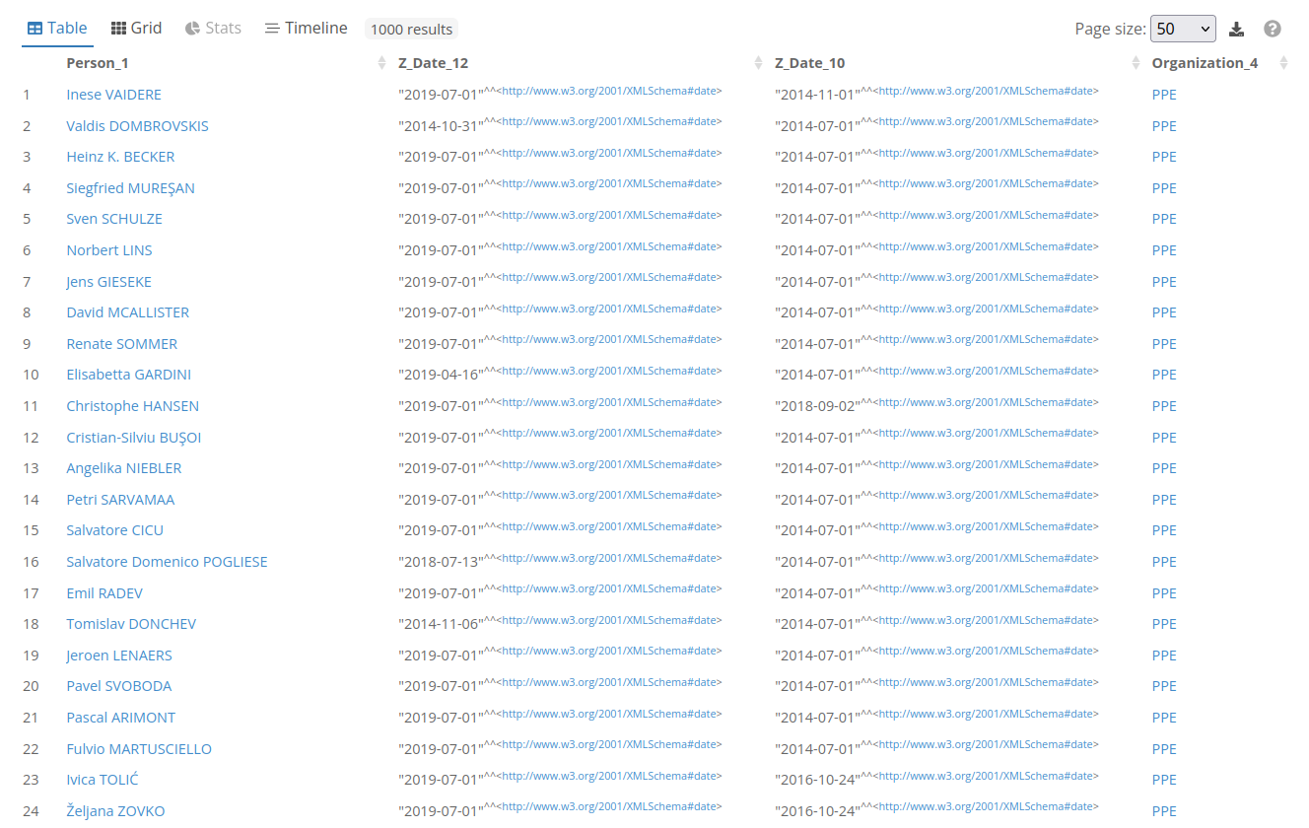

Slide 22
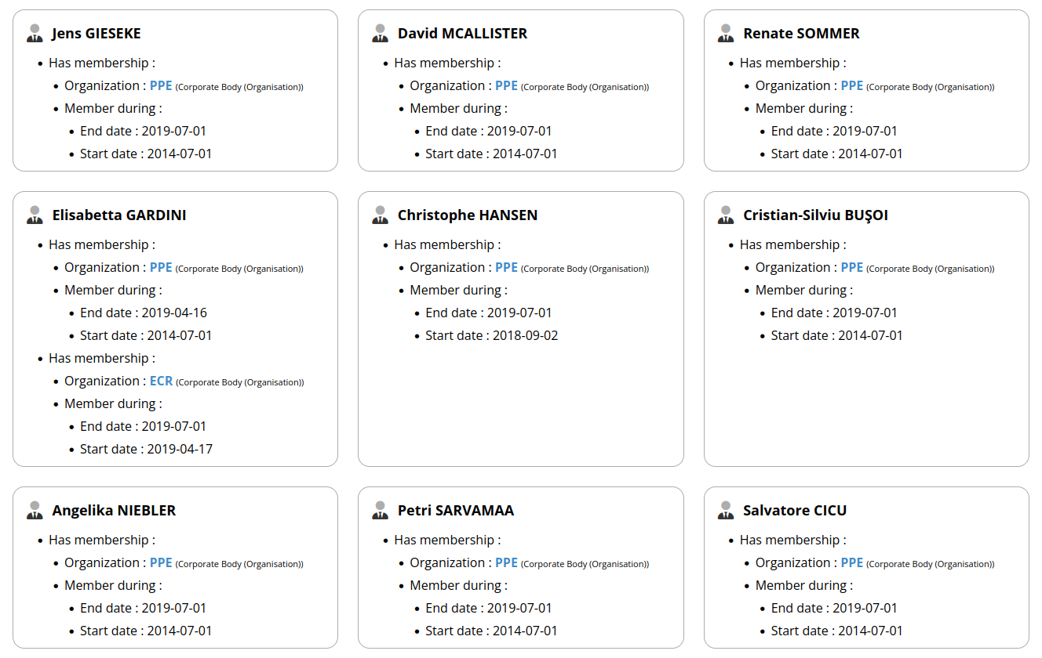

Slide 24
Integration features

Slide 25
Client-side only web component
Only requirement : CORS-enabled SPARQL endpoint. No additionnal middleware.

Slide 26
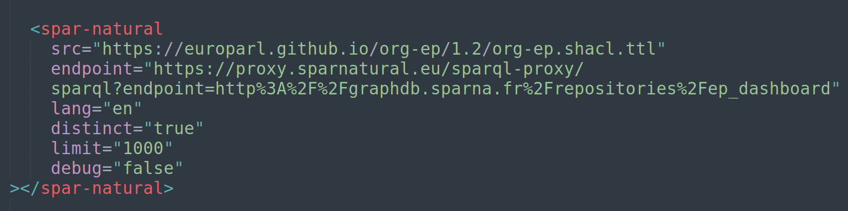

Slide 27
Prepare and load example queries in one click

Slide 28
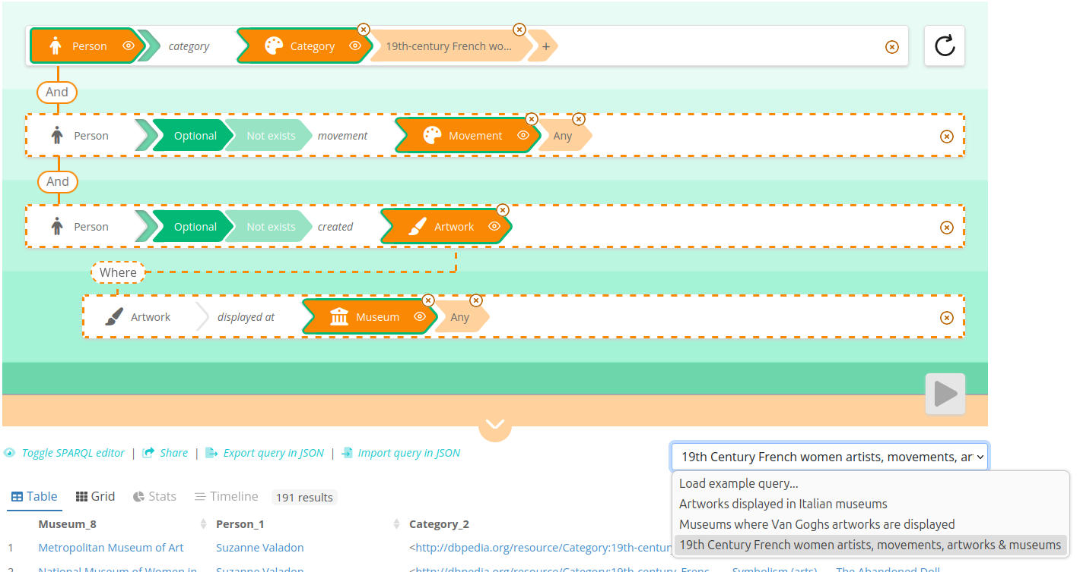

Slide 29
Sparnatural has its own query format (not SPARQL), in JSON
https://docs.sparnatural.eu/Query-JSON-format.html

Slide 30
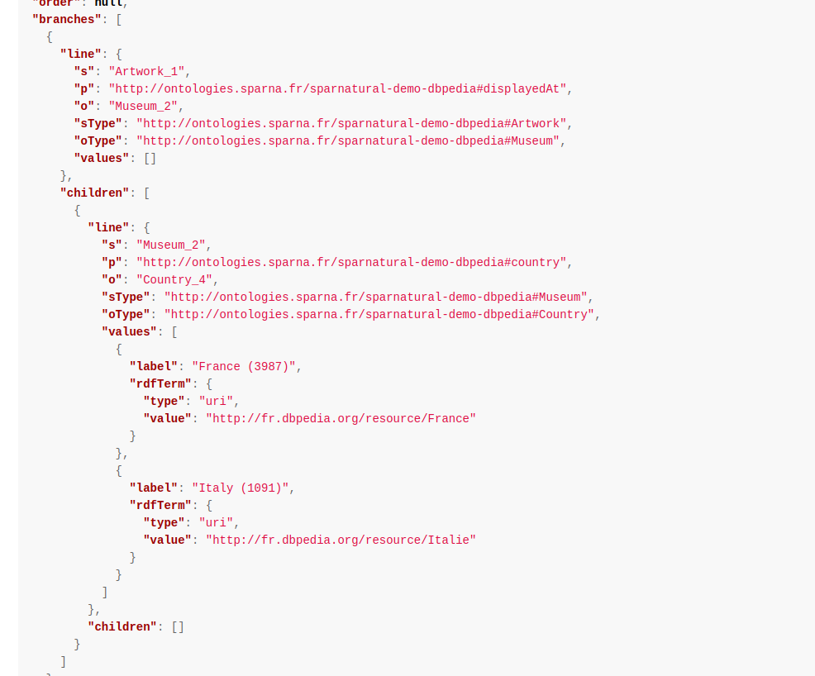

Slide 31
Easy colors customization
Theme CSS

Slide 32
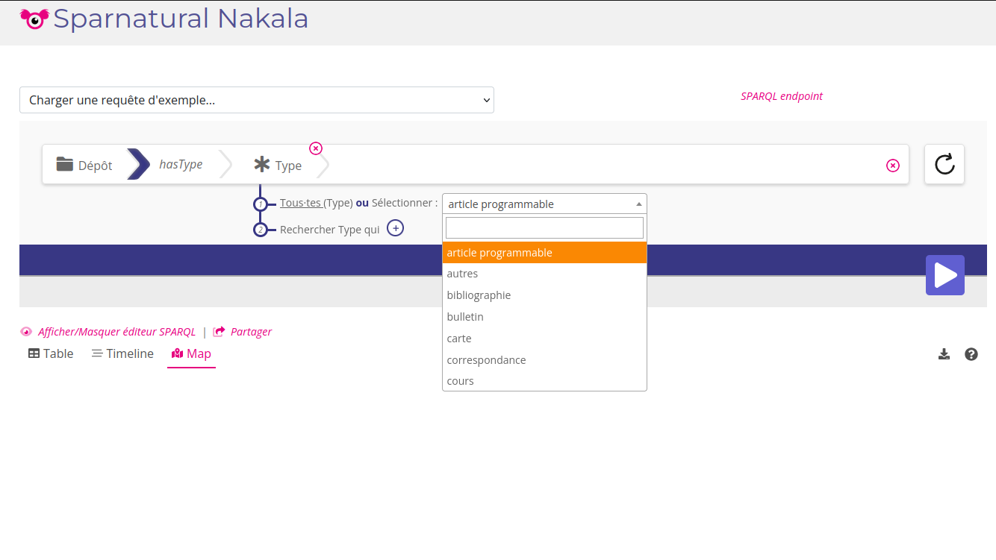

Slide 33
Mutlilingual labels
Define the user UI language, and define the dataset default language.
Labels will be retrieved in the user UI language first, and will default to the dataset default language.

Slide 34
Configuration features

Slide 35
Sparnatural can be configured from SHACL
« Model-driven approach »

Slide 36
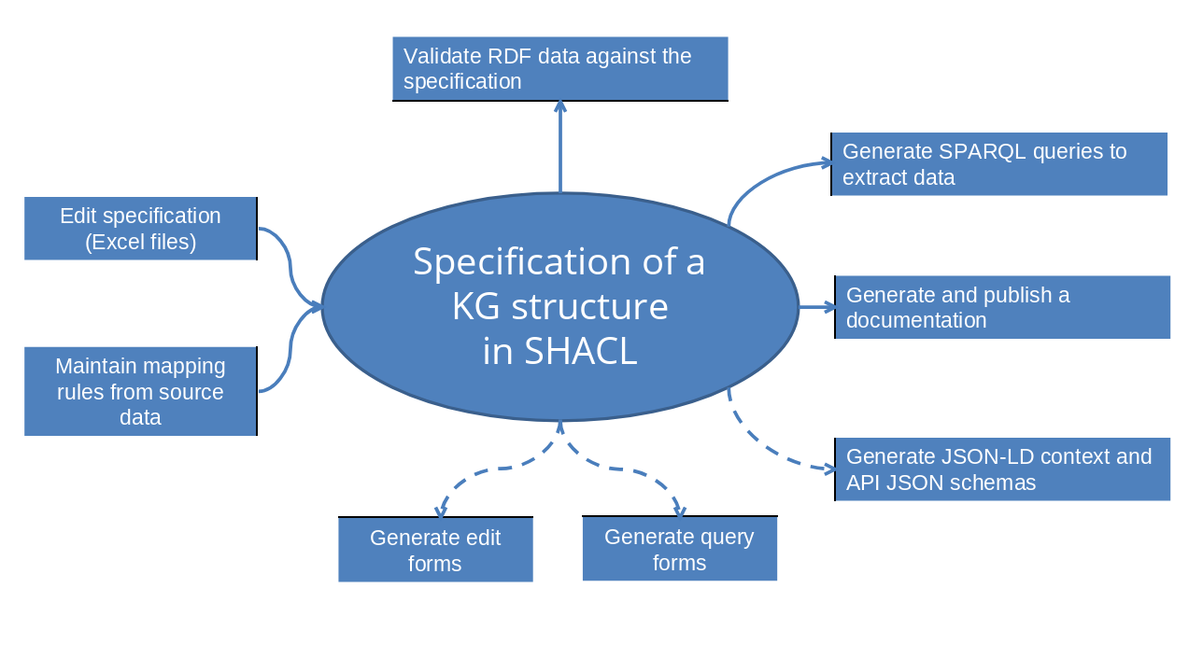

Slide 37
Different configuration strategies
Use the same SHACL spec as the knowledge graph specification
Or write a custom tailored SHACL spec for the UI
hide entities or properties
take shortcuts
etc...
Or use the same SHACL spec as KG specification, + additionnal customisation layer

Slide 38
You can provide different configurations over the same KG
« Beginners » vs. « advanced » users

Slide 39
It is possible to generate a SHACL specification automatically
https://shacl-play.sparna.fr/play/generate

Slide 40
The statistics of the datasets can be leveraged
Show the amount of each entity in the first list
Automatically set widget to dropdown list if there are a few distinct values

Slide 41
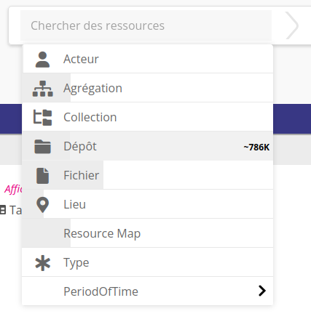

Slide 42
Usages

Slide 43
Front-office query editor, for end-users
Use precise configs with end-user oriented labels and tooltips
Provide sample queries
Demonstrate the structure of the graph

Slide 44
Back-office analysis tool
Quality checks, quick reporting
Detect inconsistencies
Use a precise config matching the graph structure

Slide 45
Dataset production tool
Select a subset of entities from the graph
Select all columns to include in a dataset
Export the columns
Combine with dashboard tool

Slide 46
SPARQL learning tool
Show the generated SPARQL query
Use as SPARQL learning resource

Slide 47
Query examples

Slide 48
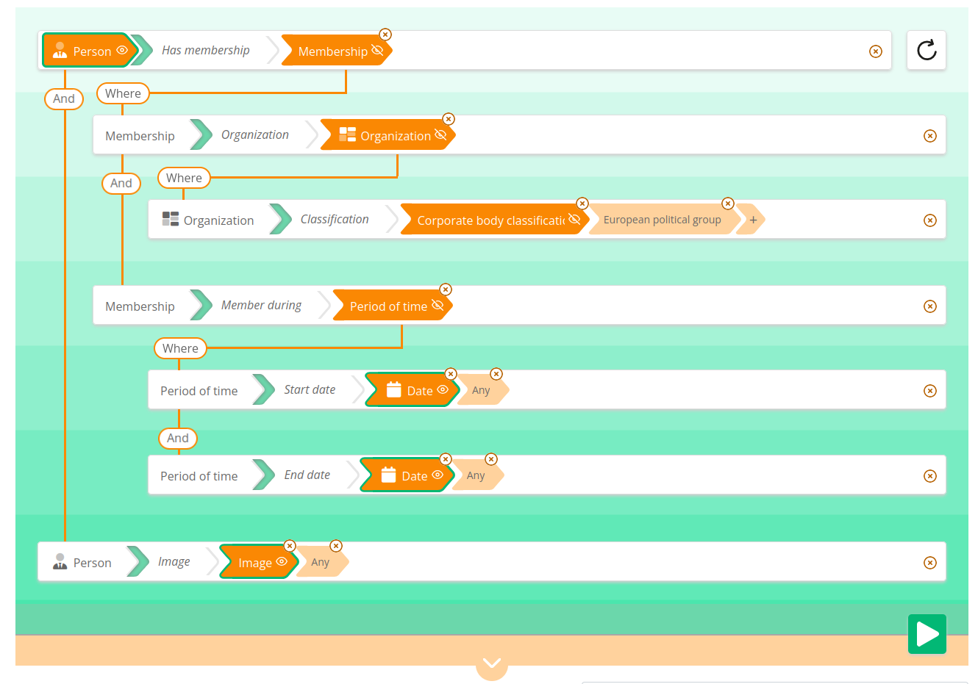
« All chairmans of EU political groups, with their dates of membership and picture »

Slide 49
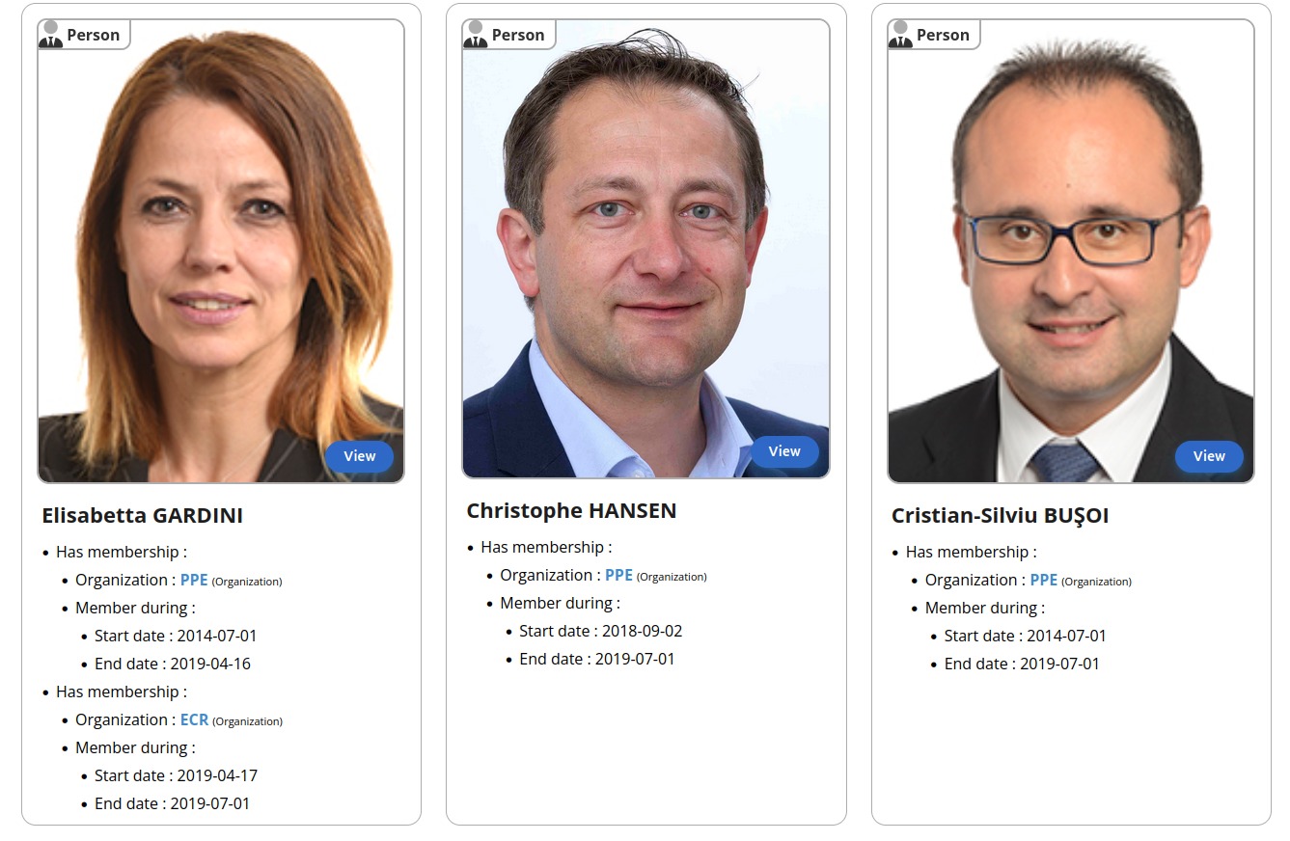
« All chairmans of EU political groups, with their dates of membership and picture »

Slide 50
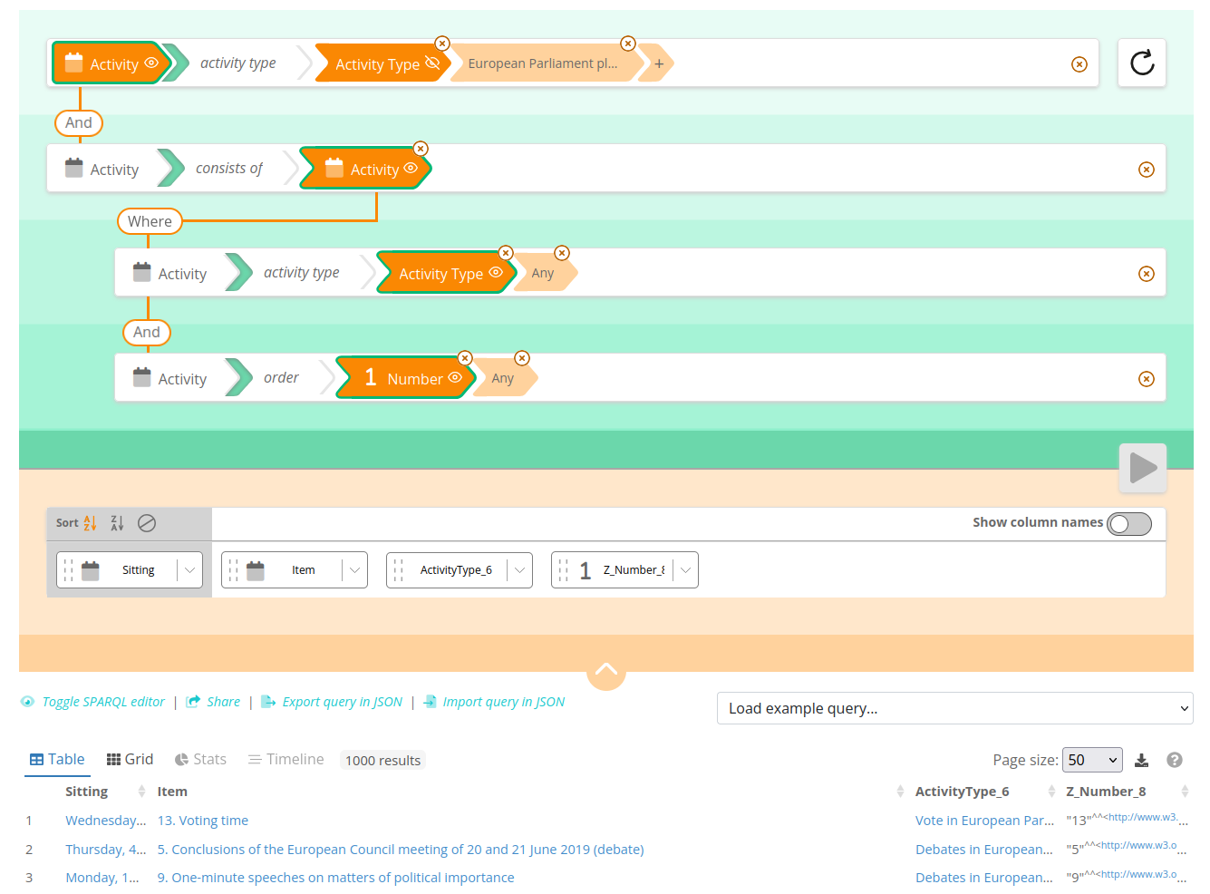
« Votes and Debates per parliamentary sitting »

Slide 51
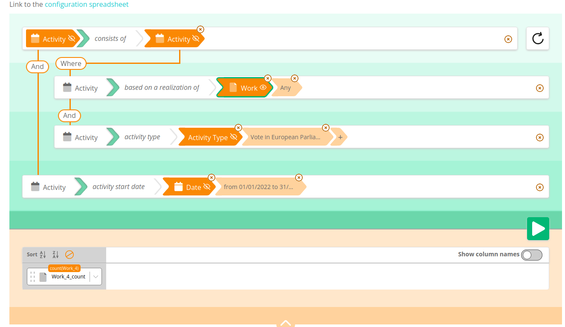
« How many documents were voted during a plenary sitting in 2022 ? » (not sure)

