Slide 1
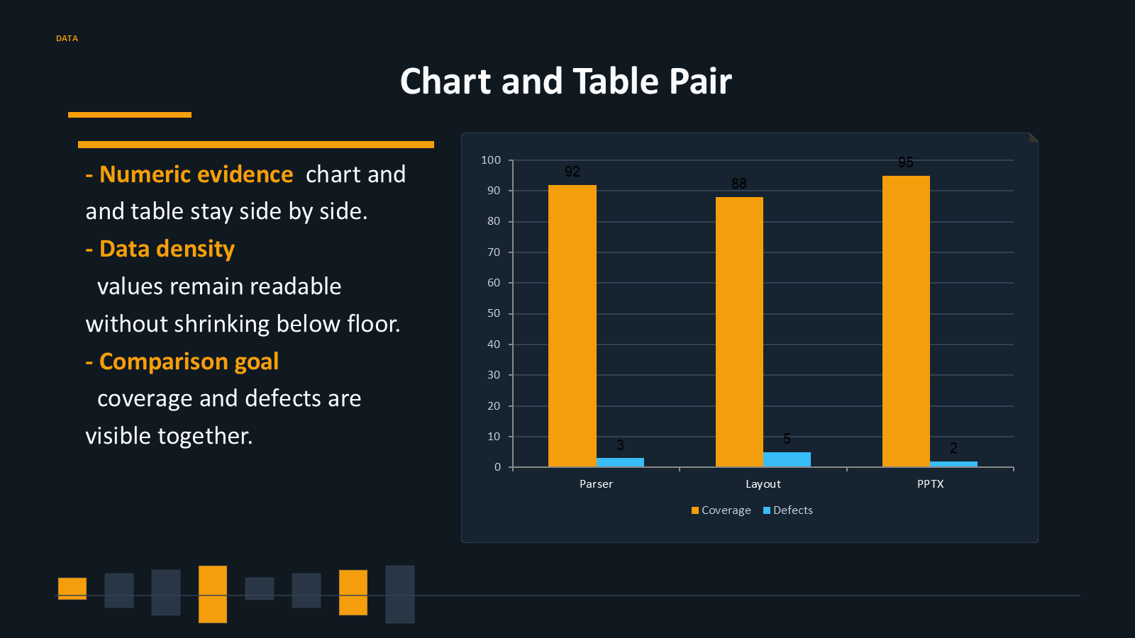

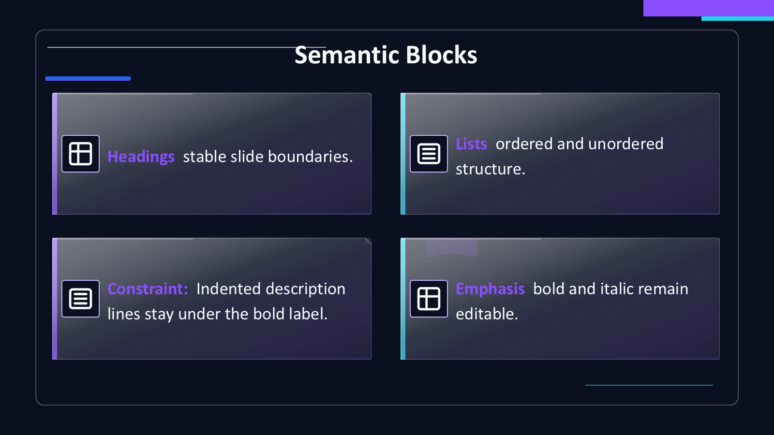
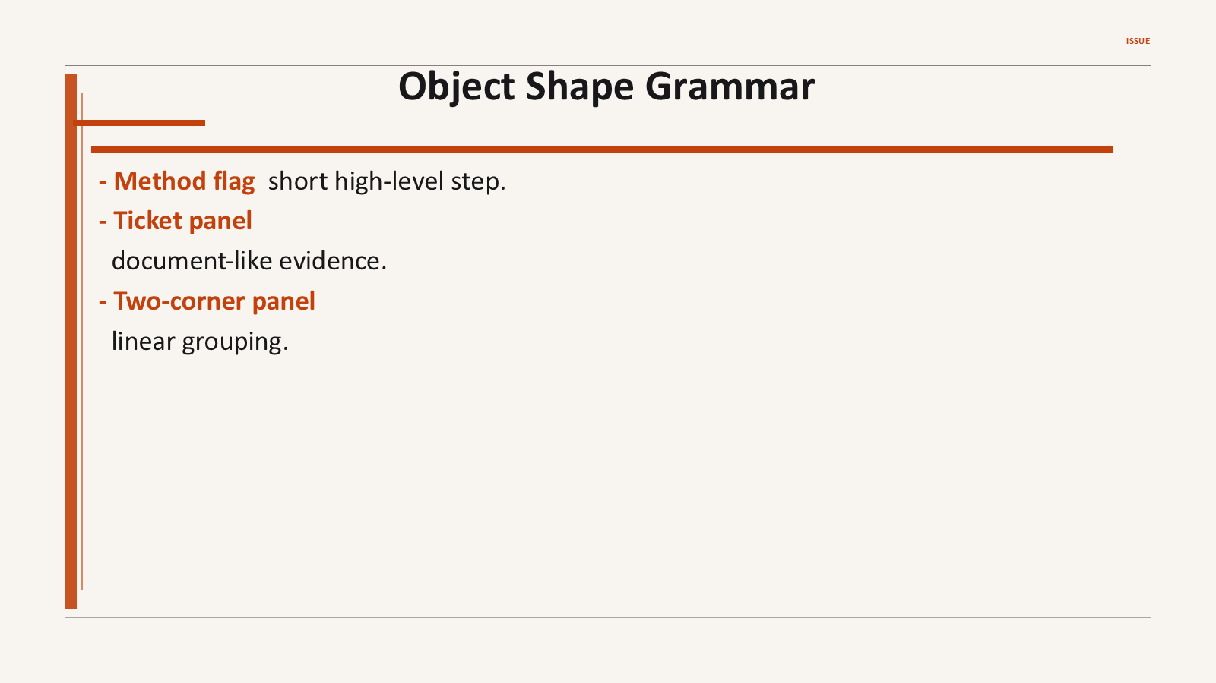
Markdown to editable PowerPoint
What is covered
MDPR uses rule-based layouts, theme colors, proof objects, tables, charts, and visual QA generated from actual PPTX outputs.
Themes
10 styles
Layouts
10 compositions
Objects
10 forms
Exports
190 PPTX PNGs
Deterministic visual rules
Theme colors
SVG-backed surfaces
Native tables + charts
Overflow and scale checks
data
Chart + table: chart and table stay editable, aligned, and theme-bound
Built from real MDPR results
theme-preview PPTX -> PowerPoint PNG -> README teaser

