Slide 1
MDPR Object Catalog

Slide 2
Agenda
Object Family Index
Text Objects
Card Layouts
Comparison Cards
Vertical List Cards
Grid Cards
Pentagon Object Set
Table Object
Native Bar Chart
Chart Beside Prose
Chart Plus Table
Gauge Proof Object
Arc Ring Proof Object
Connected Strip Proof Object
Ranked Bars Proof Object
Metric Dots Proof Object
Pipeline Diagram Object
Quote Callout Object
Code Window Object
Text Icon Aside Object
Image Focus Object
Image Beside Text Object
Decoration Objects
Card Decoration Styles A
Card Decoration Styles B
Card Decoration Styles C

Slide 3
Object Family Index
Family | Usable objects | Rendered as
Text | cover, title, paragraph, list, quote, code | editable PPT text boxes
Cards | single card, comparison, vertical list, 2x2 grid, 3x2 grid, radial pentagon | editable rounded regions
Data | table, native bar chart, chart beside prose, chart plus table | native PPT table/chart plus text
Proof charts | arc ring, gauge, connected strip, ranked bars, metric dots | editable PPT shapes
Media | image focus, image beside text, image stack | PPT image objects
Decoration | backgrounds, surfaces, badges, accent rails, icon markers, proof callouts | editable shapes/icons

Slide 4
Text Objects
Cover/title object large hierarchy entry point.
Paragraph object bounded body text with readable minimum size.
Ordered list object number badges and stable row spacing.
Unordered list object small icon badges when rendered as item cards.

Slide 5
Text Objects (Cont. 2/2)
- Quote object key-message callout surface.
- Code object monospace code window.

Slide 6
Card Layouts
Single-card one emphasized takeaway.
Comparison two balanced regions.
Vertical-list three or more row cards.
Grid 2x2 four peer cards.

Slide 7
Card Layouts (Cont. 2/2)
- Grid 3x2 six compact peer cards.
- Pentagon/radial five related cards around a center rhythm.

Slide 8
Comparison Cards
- Baseline contract Markdown is source.
- Runtime contract MDPR owns deterministic layout.

Slide 9
Vertical List Cards
Parse semantic Markdown.
Split slides and objects.
Select recipe and variant.
Validate overflow and coherence.

Slide 10
Grid Cards
Title/body
Quote/key message
Table focus
Chart proof
Image focus
Code focus

Slide 11
Pentagon Object Set
Feature extraction
Decoration pass
Recipe selection
Region composition
Theme harmony

Slide 12
Table Object
Element | PPTX object | Coherence rule
Header row | Native table text | bold and readable
Numeric cell | Native table text | right aligned
Long label | Native table text | trimmed spacing
Body cell | Native table text | stable minimum font

Slide 13
Native Bar Chart

Slide 14
Chart Beside Prose
- Pattern short interpretation text beside quantitative evidence.
- Owner
MDPR selects body/chart geometry and typography.
- Constraint
text stays compact so the chart keeps visual priority.

Slide 15
Chart Plus Table
Object | Use | Rule
Text | interpretation | left or lower support
Table | precise values | middle aligned cells
Chart | visual proof | theme-bound colors
Image | evidence | aspect ratio preserved

Slide 16
Gauge Proof Object
83%
0
100
Score · Readiness

Slide 17
Arc Ring Proof Object
Validated 72%
Remaining 28%
72%
Coverage

Slide 18
Connected Strip Proof Object
Draft
Render
Validate
20%
68%
92%

Slide 19
Ranked Bars Proof Object
1
Renderer
94%
2
Parser
91%
3
Layout
87%

Slide 20
Metric Dots Proof Object
Draft
Review
Ship
20%
68%
92%

Slide 21
Pipeline Diagram Object
Draft
Parse
Split
1
2
3
Validate
Render
Compose
6
5
4

Slide 22
Quote Callout Object
One graph or diagram block must stay on one slide.
- The callout surface is editable.
- The quote keeps a stronger hierarchy than support text.
- Supporting text remains bounded below the proof point.

Slide 23
Code Window Object
const deck = parseMarkdown(source);const layout = planLayout(deck, config);
await renderPptx({ presentation: deck, layout }, options);

Slide 24
Text Icon Aside Object
Text-only slides may receive one quiet monochrome icon.
The icon is centered in its slot and stays secondary.
It must not fill empty space as a large decorative object.

Slide 25
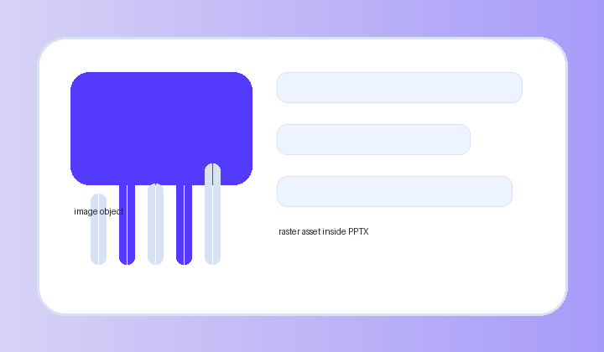
Image Focus Object

Slide 26
Image Beside Text Object
- Image-aware layouts keep body text and image objects in separate regions.
- The renderer must preserve aspect ratio and avoid covering text.
- The catalog keeps the icon/image role restrained rather than filling blank space.

Slide 27
Decoration Objects
Decoration | Purpose | Coherence guard
Preset background | theme identity | low contrast behind content
Region surface | grouping | one radius grammar per slide
Accent rail | reading order | same-role rails share color
Number badge | ordered item marker | centered to item text
Icon badge | unordered item marker | small monochrome marker
Proof callout | validation emphasis | contrast color used sparingly
Theme colors | deck-level palette | accent1-accent6 registered in PPT
Template asset | brand support | decorative only, body recalculated

Slide 28
Card Decoration Styles A
left-accent-rail plain lists with a stable vertical rail.
top-hairline-rule quiet cards with a thin top rule.
number-tab ordered cards with a compact number tab.
corner-chip short high-importance labels.

Slide 29
Card Decoration Styles A (Cont. 2/3)
bracket-callout proof or constraint labels with an indented description.
dot-marker-row plain list rows with a small centered dot.
split-tone-row comparison rows with a restrained label zone.
proof-chip-inline validation metric chip.

Slide 30
Card Decoration Styles A (Cont. 3/3)
thin-outline-card dense cards with only a surface outline.
bottom-meter progress or score cards with data-bound meter.
side-notch important cards with a compact side notch.

Slide 31
Card Decoration Styles B
floating-label-pin image cards with a small readable pin.
caption-underlay image cards with a caption band.
rank-ribbon ranked metric cards.
micro-icon-marker one quiet monotone semantic marker.

Slide 32
Card Decoration Styles B (Cont. 2/3)
- double-rule-header sectioned lists with paired hairlines.
- soft-shadow-lift
one lead card with shallow depth.
- inset-label-bar
category cards with a compact bar.
- vertical-step-rail
long-text sequence cards.

Slide 33
Card Decoration Styles B (Cont. 3/3)
- horizontal-step-rail short-text sequence cards.
- paired-contrast-edge
true before/after or opposing comparison.
- quote-rule-card quotation or takeaway cards.

Slide 34
Card Decoration Styles C
metric-lead-card importance-five numeric lead.
checklist-grid-card many short checklist items.
constraint-stack-card bold label line plus indented description.
label-overline-card category label over title/body.

Slide 35
Card Decoration Styles C (Cont. 2/3)
subtle-band-card medium density support band.
arc-corner-emphasis small arc cue for ratio/progress.
target-ring-badge goal or benchmark badge.
image-sidecar-card small image beside text.

Slide 36
Card Decoration Styles C (Cont. 3/3)
table-summary-card table-adjacent summary.
connector-dot-card flow/dependency anchor.
plain-safe-card high-density text where decoration would hurt readability.

