Slide 1

Notes:
Generated from the same visual page image used for the codex-ppt assembly baseline.

Slide 2
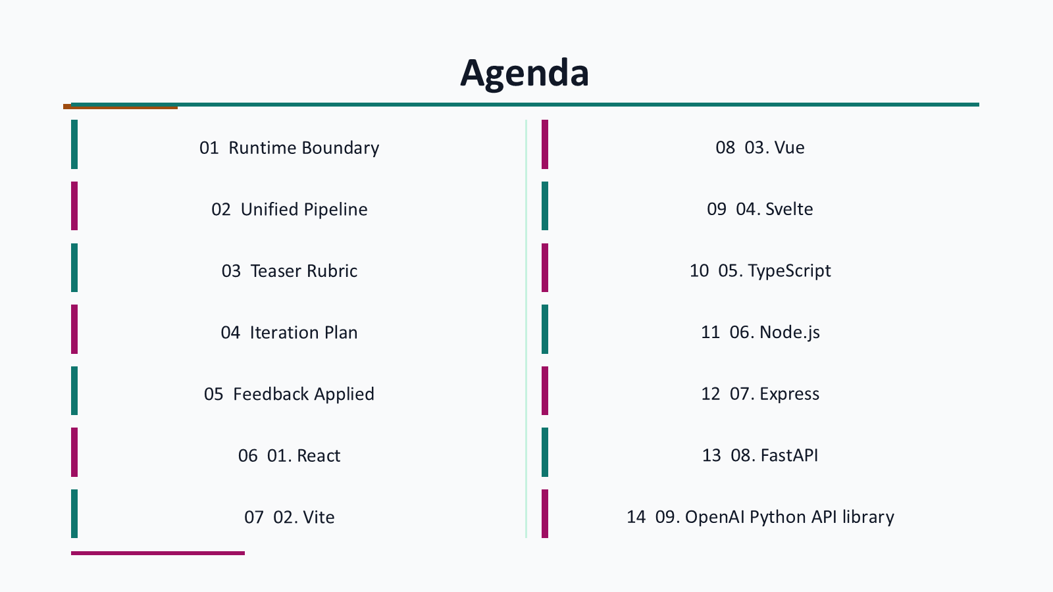
Notes:
Generated from the same visual page image used for the codex-ppt assembly baseline.

Slide 3
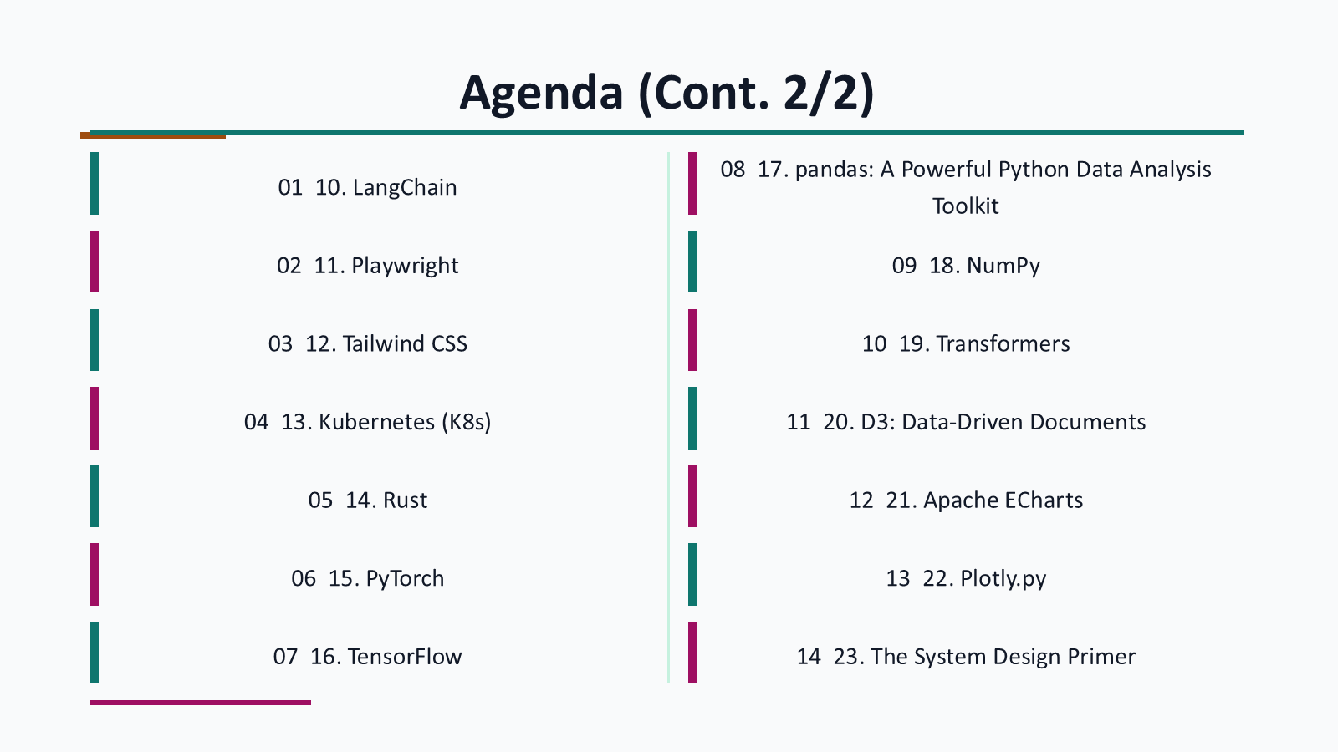
Notes:
Generated from the same visual page image used for the codex-ppt assembly baseline.

Slide 4
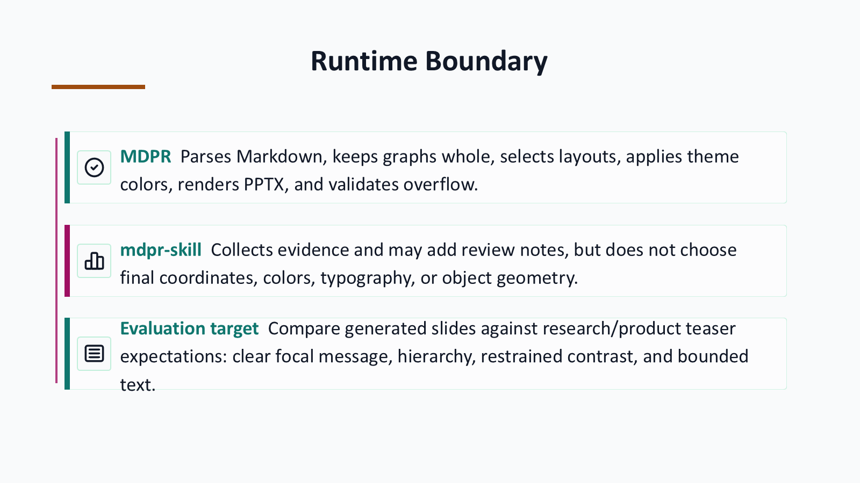
Notes:
Generated from the same visual page image used for the codex-ppt assembly baseline.

Slide 5
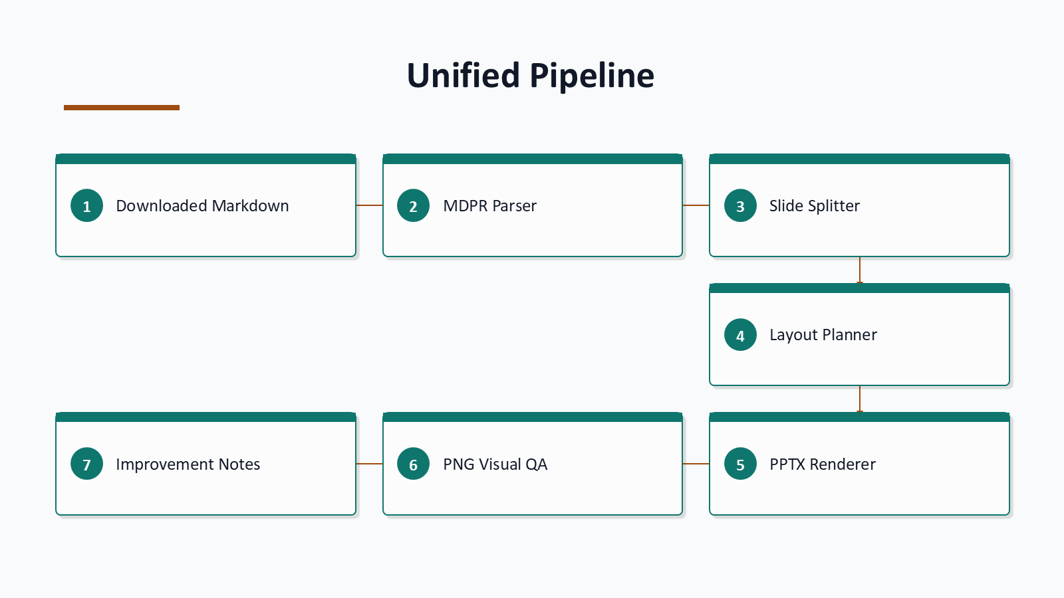
Notes:
Generated from the same visual page image used for the codex-ppt assembly baseline.

Slide 6
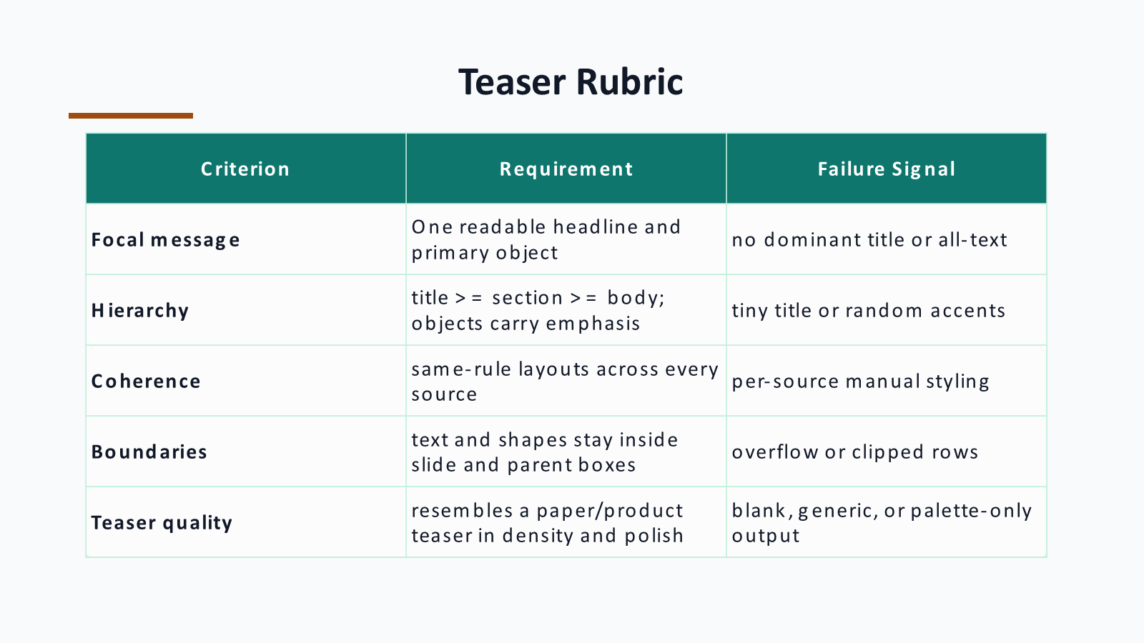
Notes:
Generated from the same visual page image used for the codex-ppt assembly baseline.

Slide 7
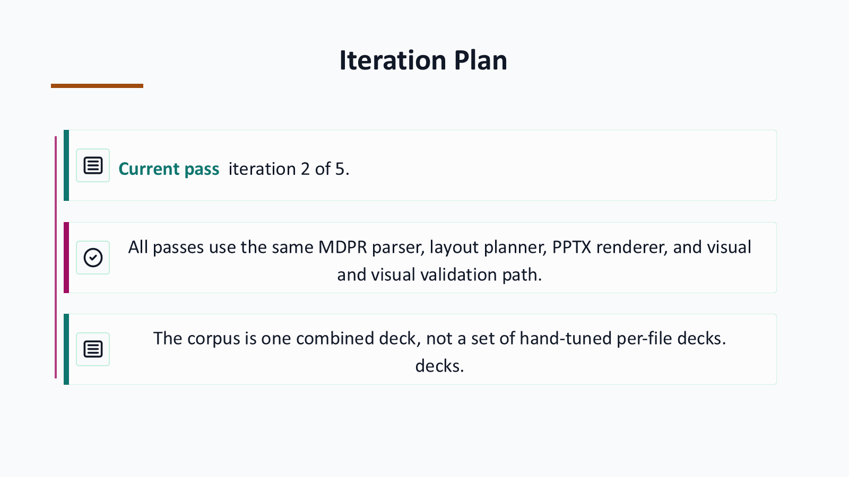
Notes:
Generated from the same visual page image used for the codex-ppt assembly baseline.

Slide 8
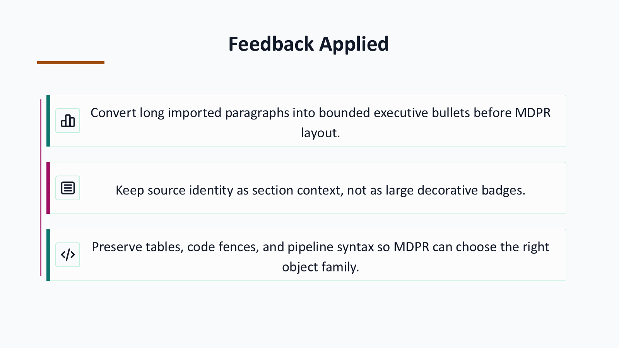
Notes:
Generated from the same visual page image used for the codex-ppt assembly baseline.

Slide 9
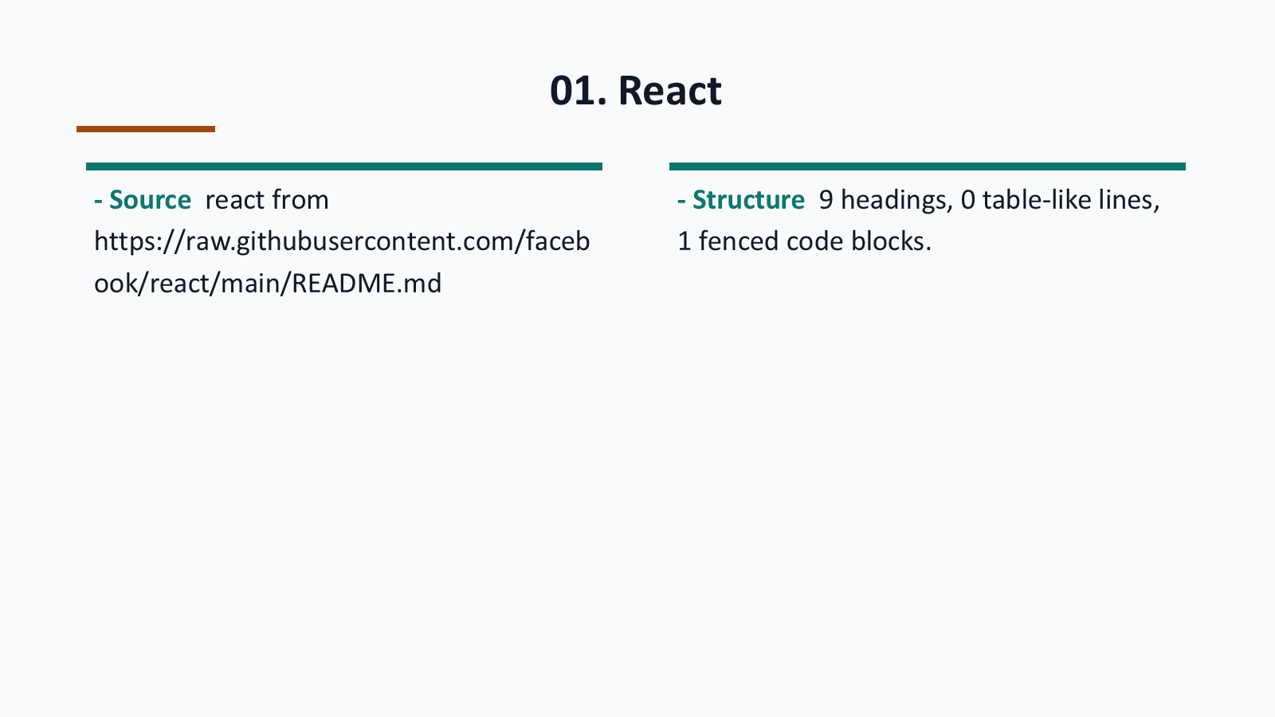
Notes:
Generated from the same visual page image used for the codex-ppt assembly baseline.

Slide 10
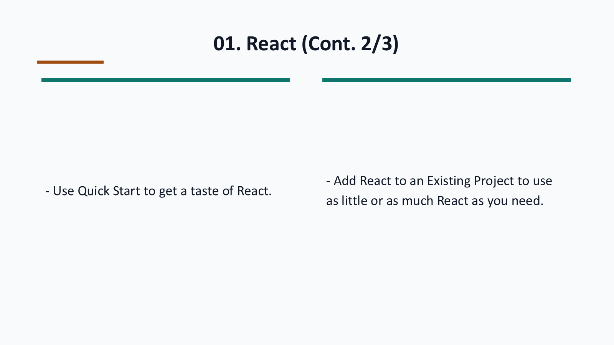
Notes:
Generated from the same visual page image used for the codex-ppt assembly baseline.

Slide 11
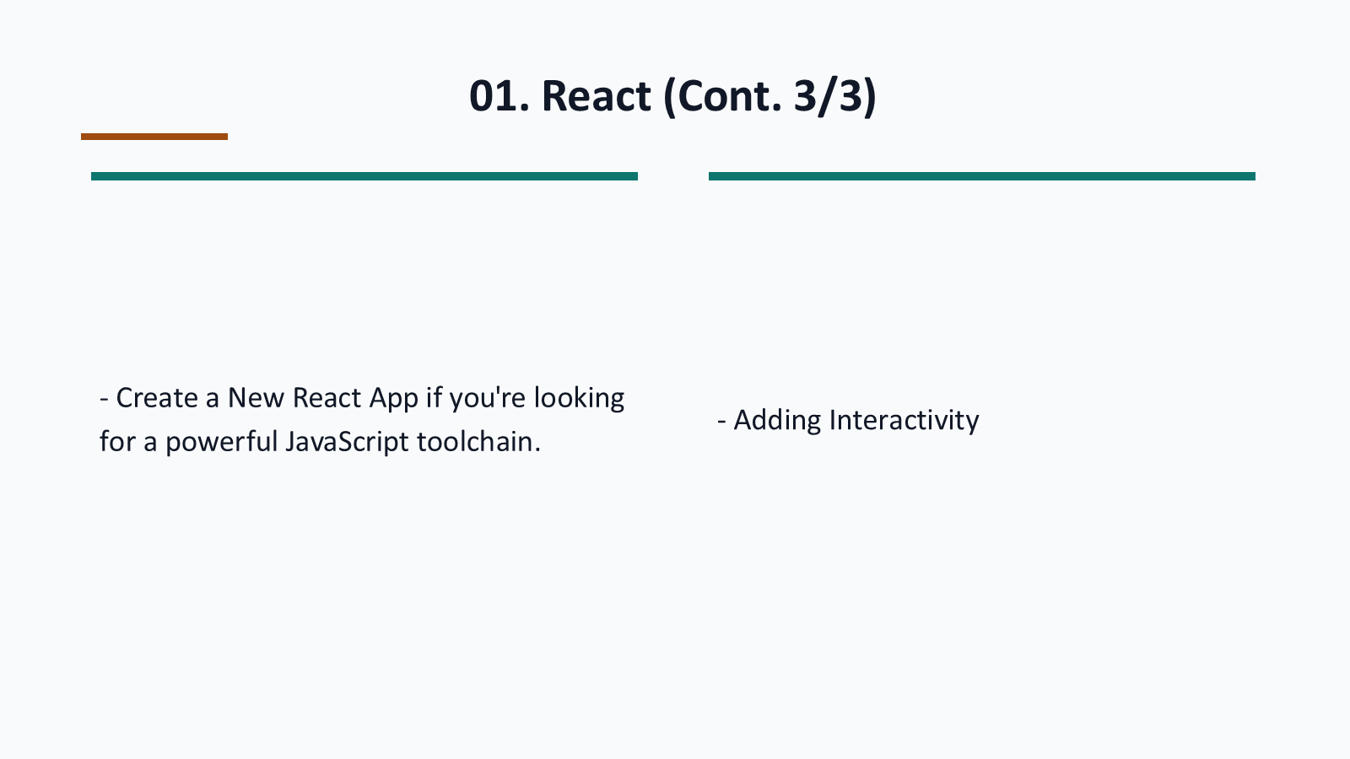
Notes:
Generated from the same visual page image used for the codex-ppt assembly baseline.

Slide 12
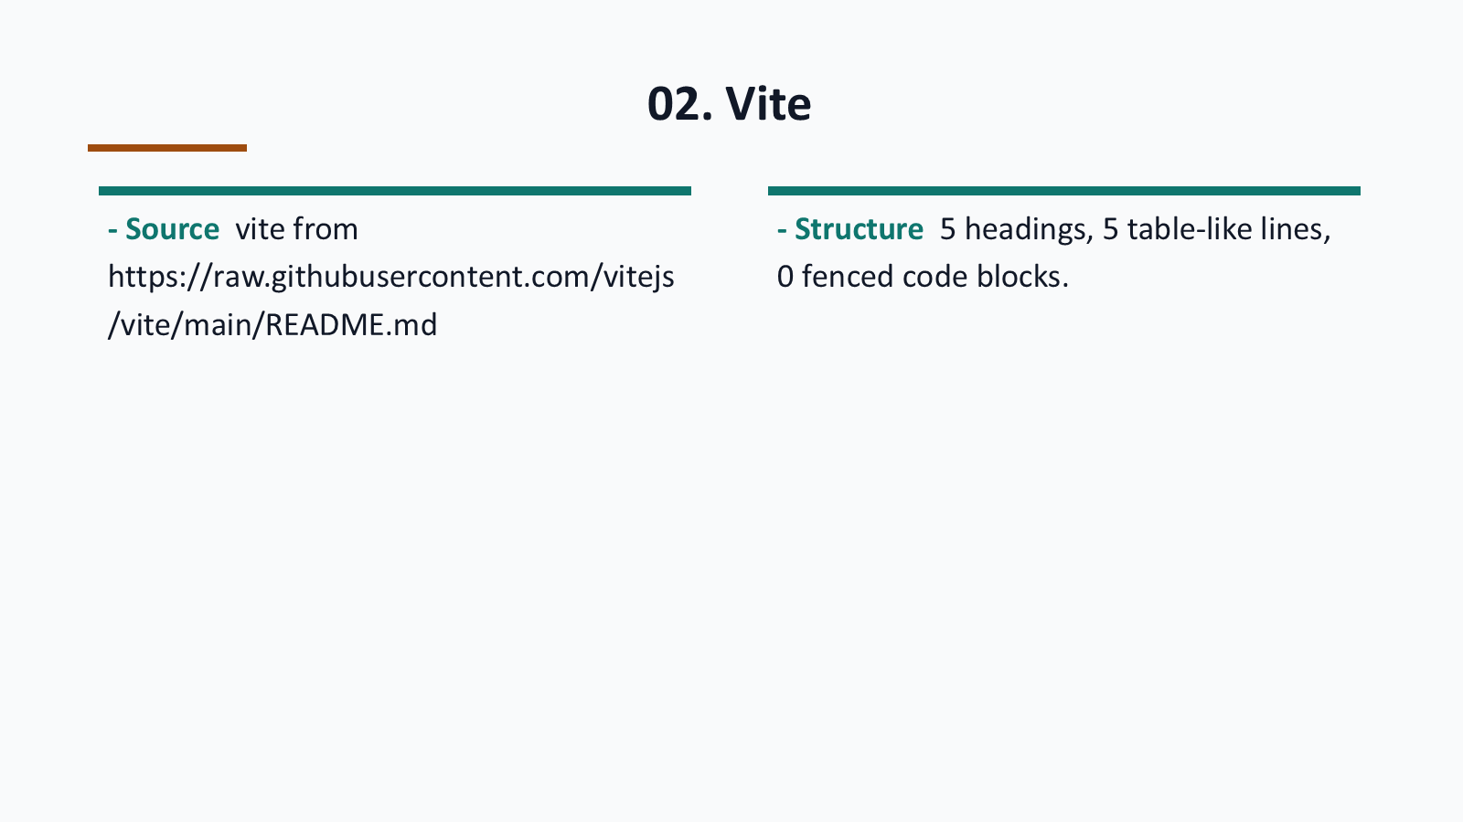
Notes:
Generated from the same visual page image used for the codex-ppt assembly baseline.

Slide 13
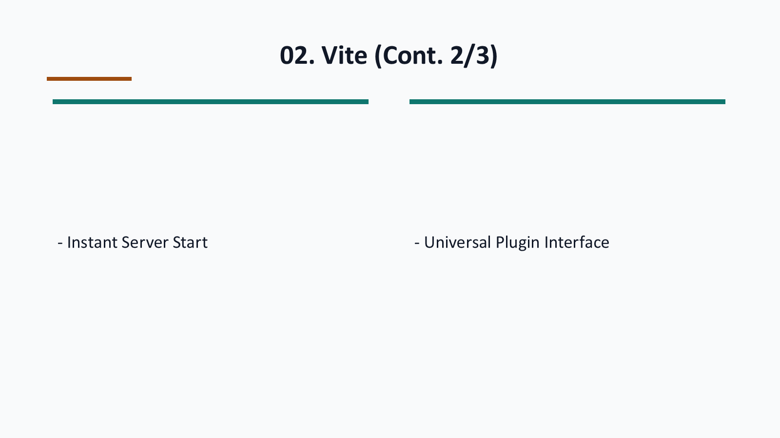
Notes:
Generated from the same visual page image used for the codex-ppt assembly baseline.

Slide 14
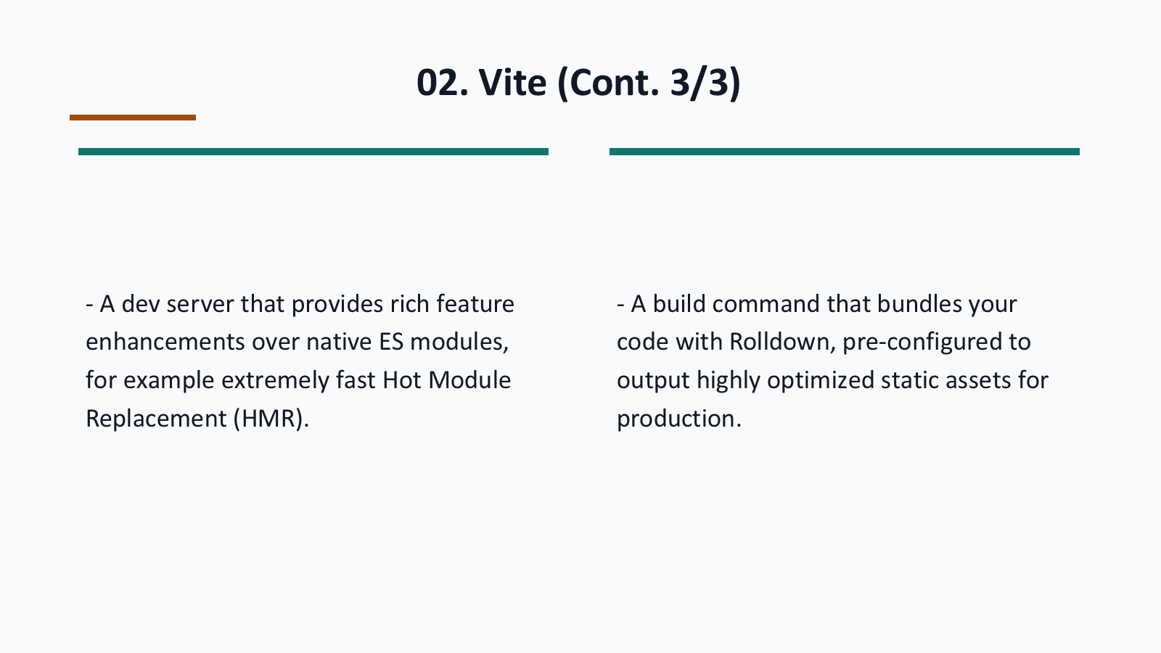
Notes:
Generated from the same visual page image used for the codex-ppt assembly baseline.

Slide 15
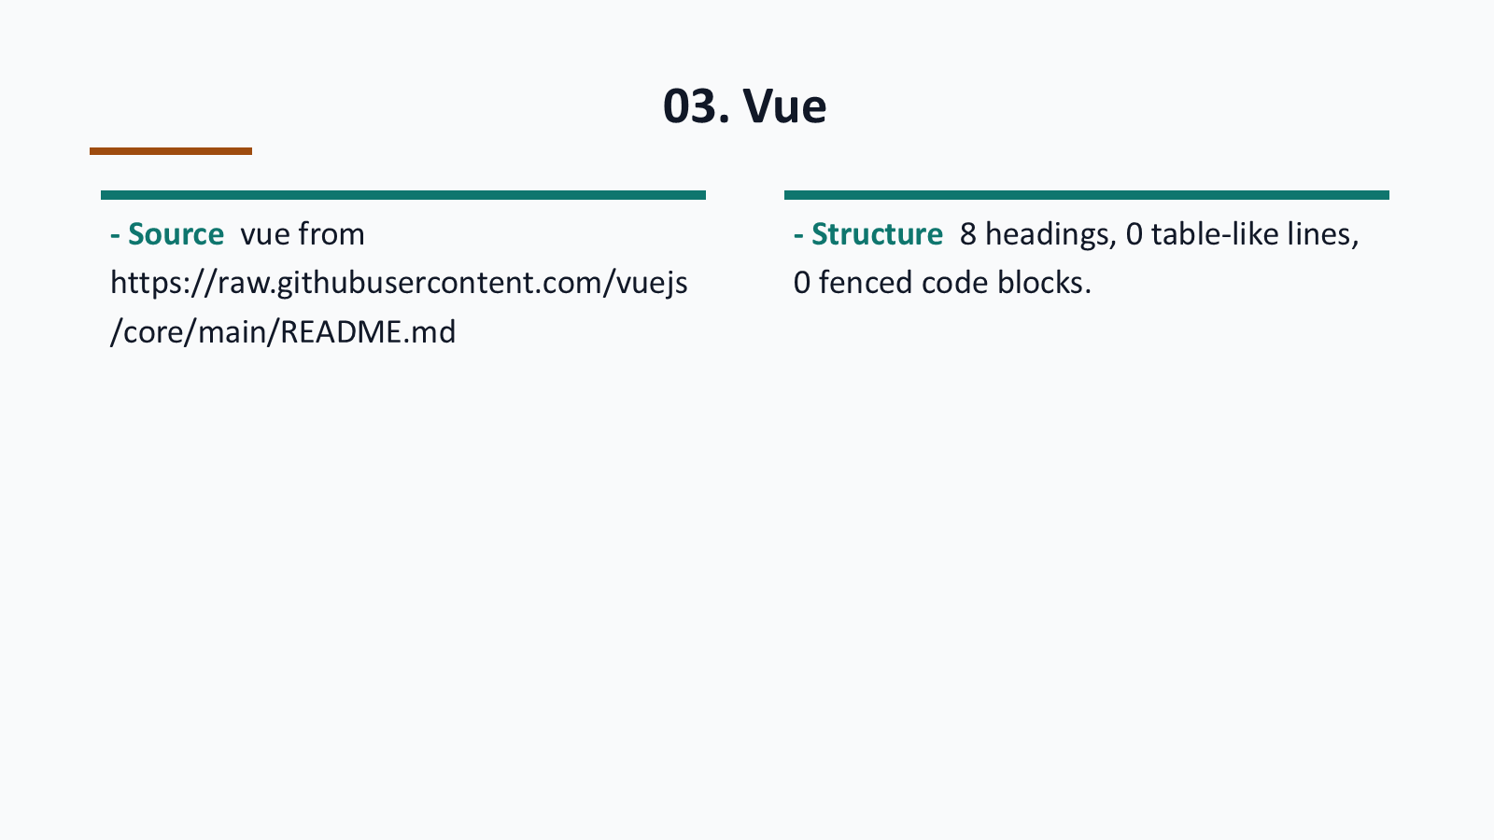
Notes:
Generated from the same visual page image used for the codex-ppt assembly baseline.

Slide 16
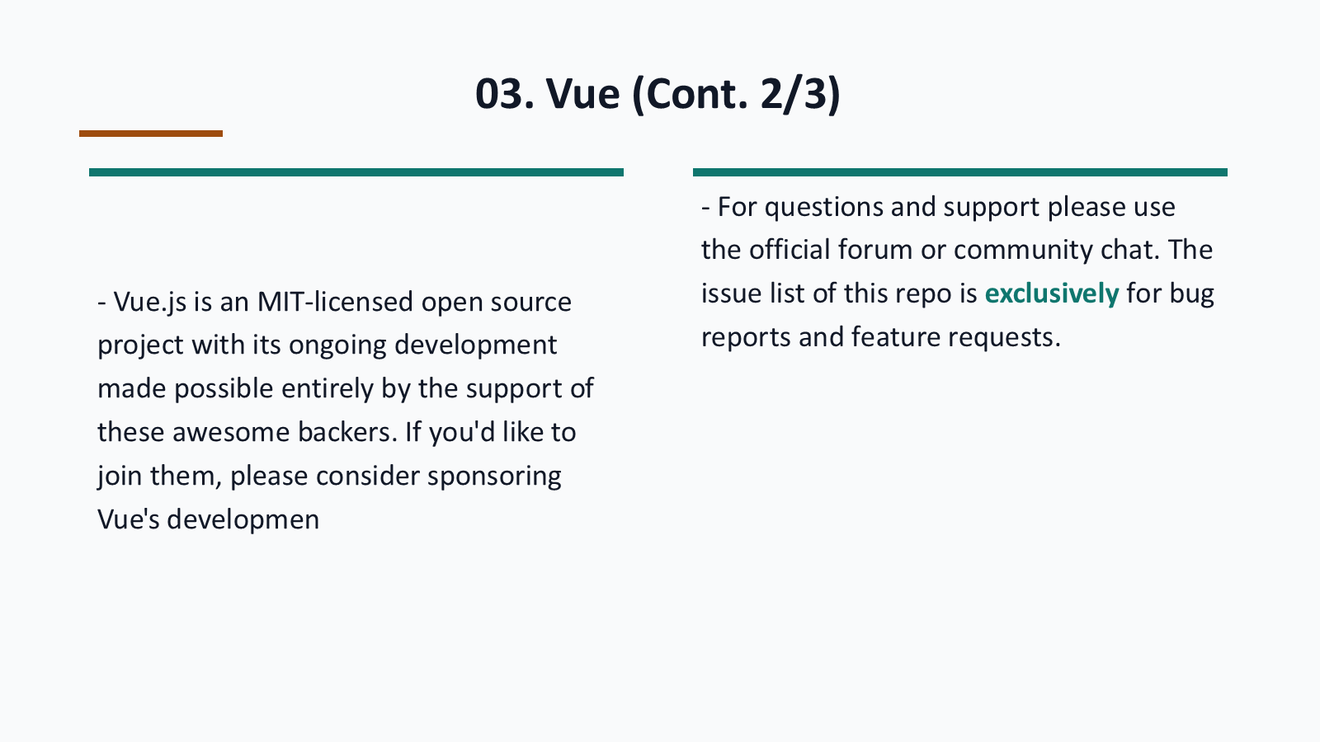
Notes:
Generated from the same visual page image used for the codex-ppt assembly baseline.

Slide 17
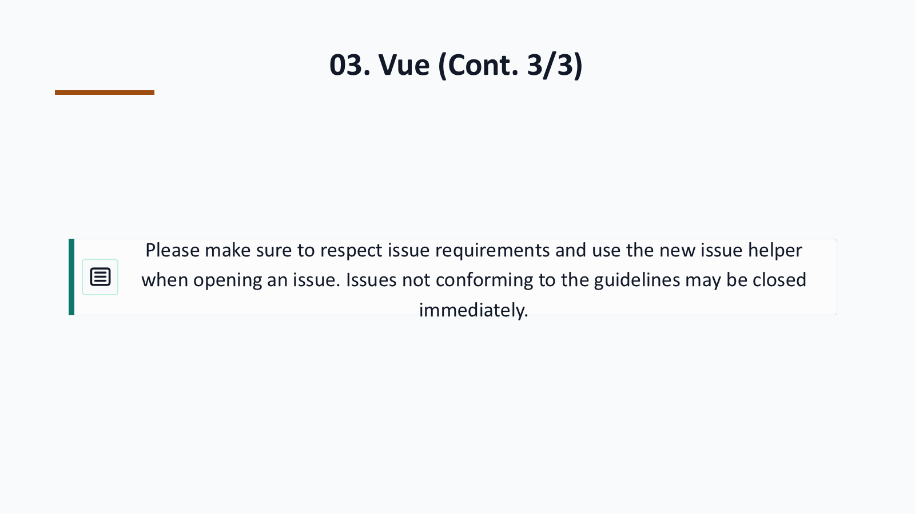
Notes:
Generated from the same visual page image used for the codex-ppt assembly baseline.

Slide 18
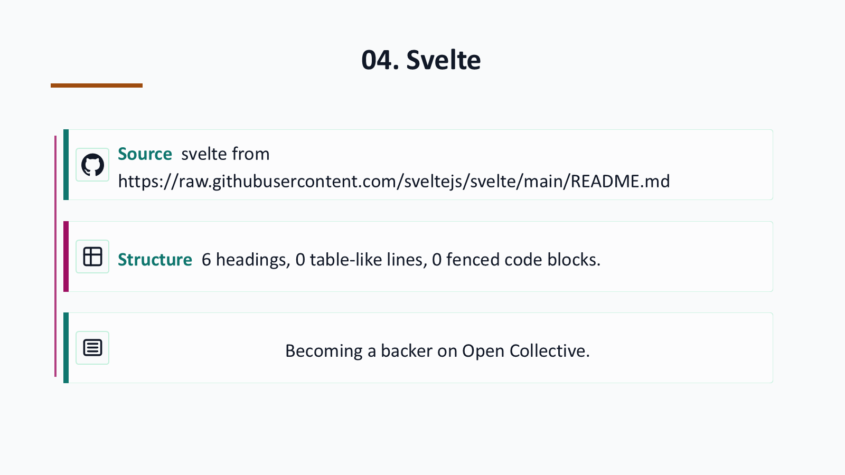
Notes:
Generated from the same visual page image used for the codex-ppt assembly baseline.

Slide 19
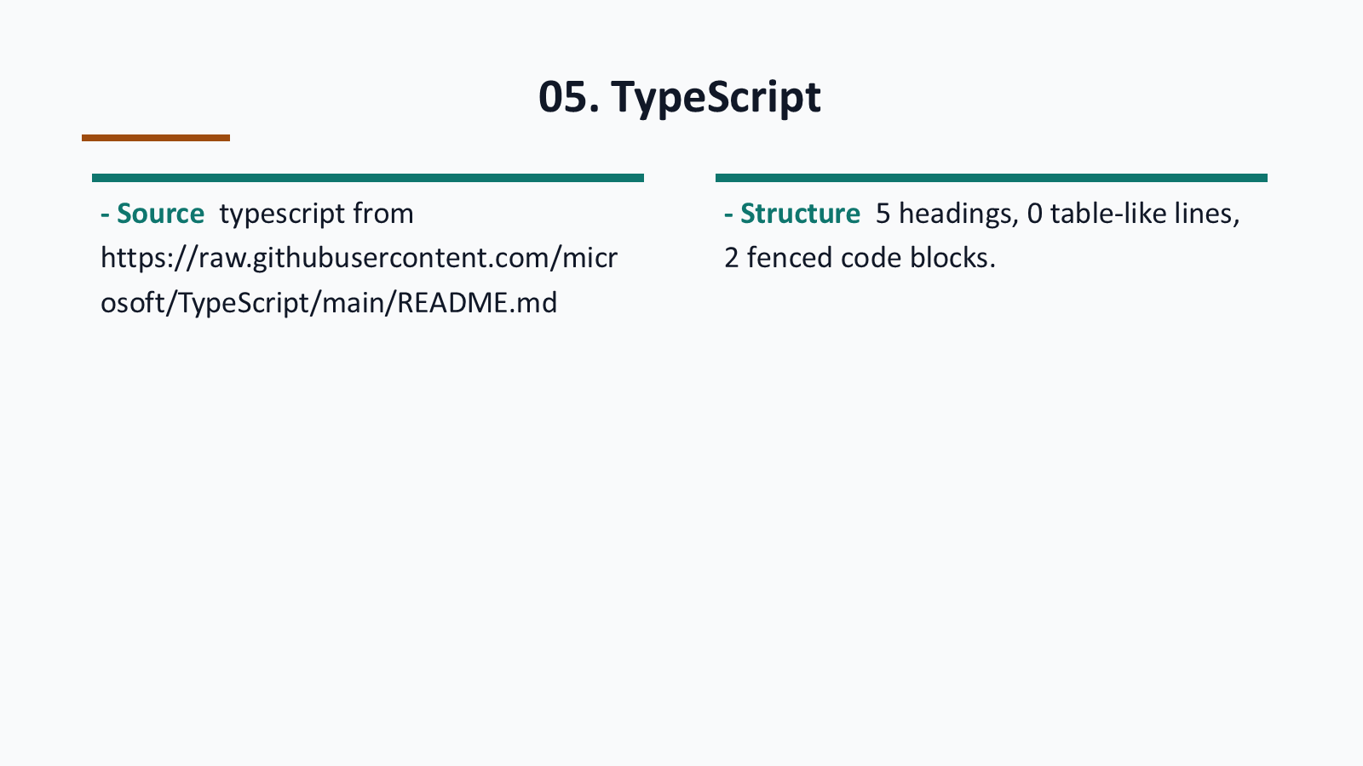
Notes:
Generated from the same visual page image used for the codex-ppt assembly baseline.

Slide 20
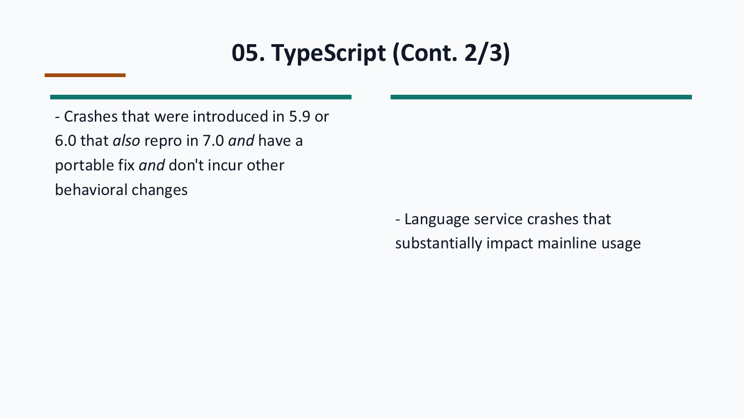
Notes:
Generated from the same visual page image used for the codex-ppt assembly baseline.

Slide 21
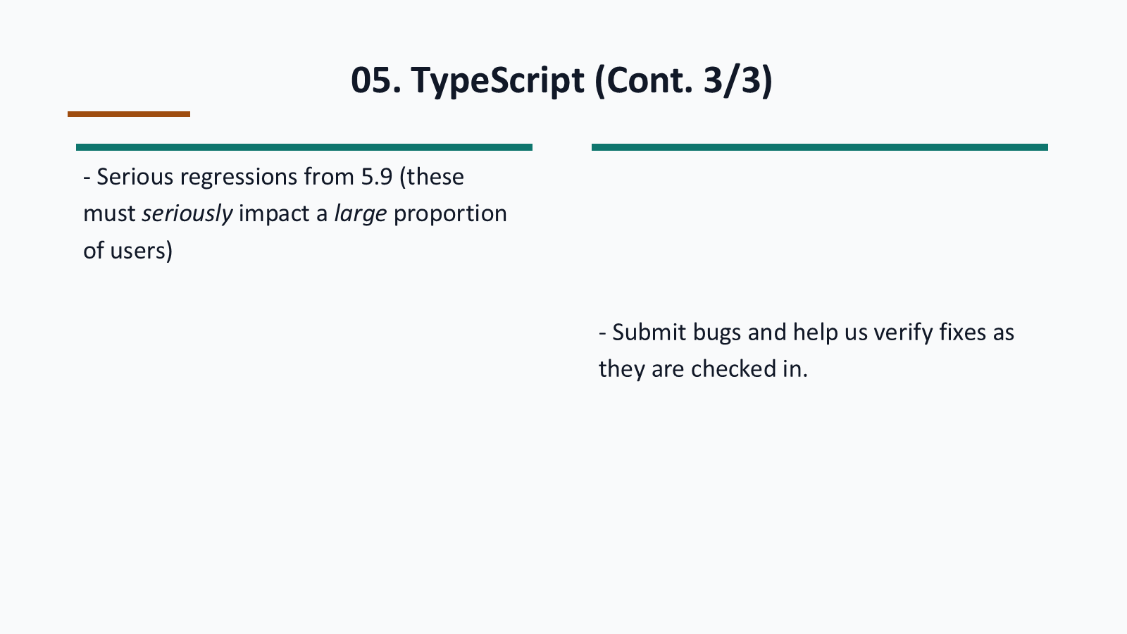
Notes:
Generated from the same visual page image used for the codex-ppt assembly baseline.

Slide 22
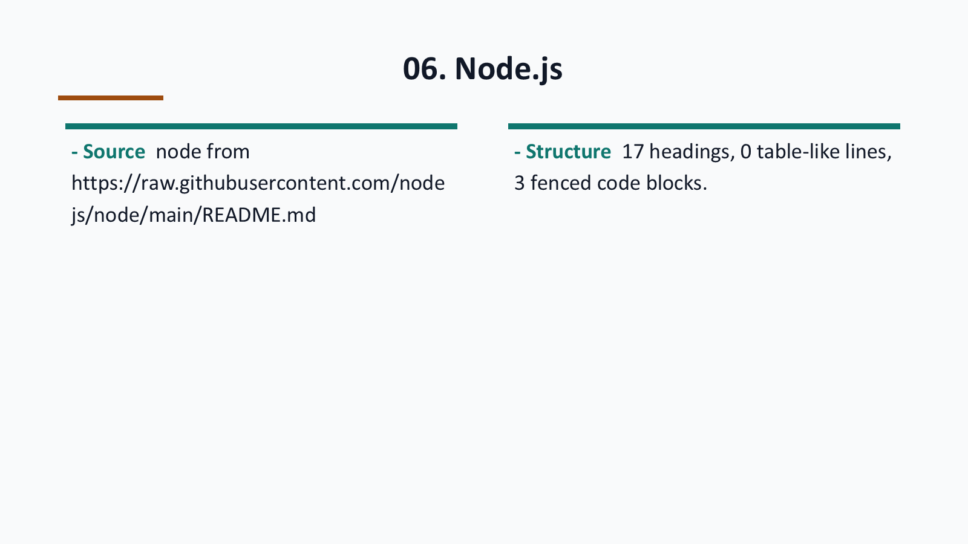
Notes:
Generated from the same visual page image used for the codex-ppt assembly baseline.

Slide 23
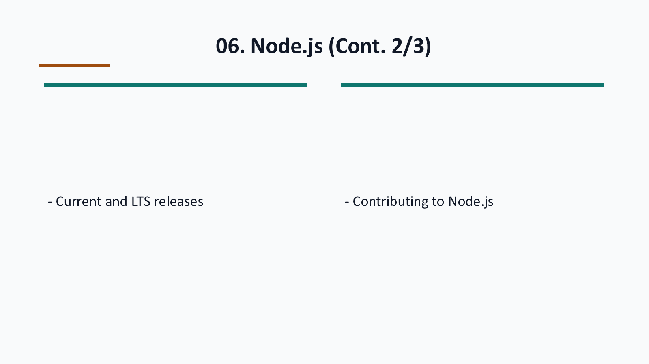
Notes:
Generated from the same visual page image used for the codex-ppt assembly baseline.

Slide 24

Notes:
Generated from the same visual page image used for the codex-ppt assembly baseline.

Slide 25
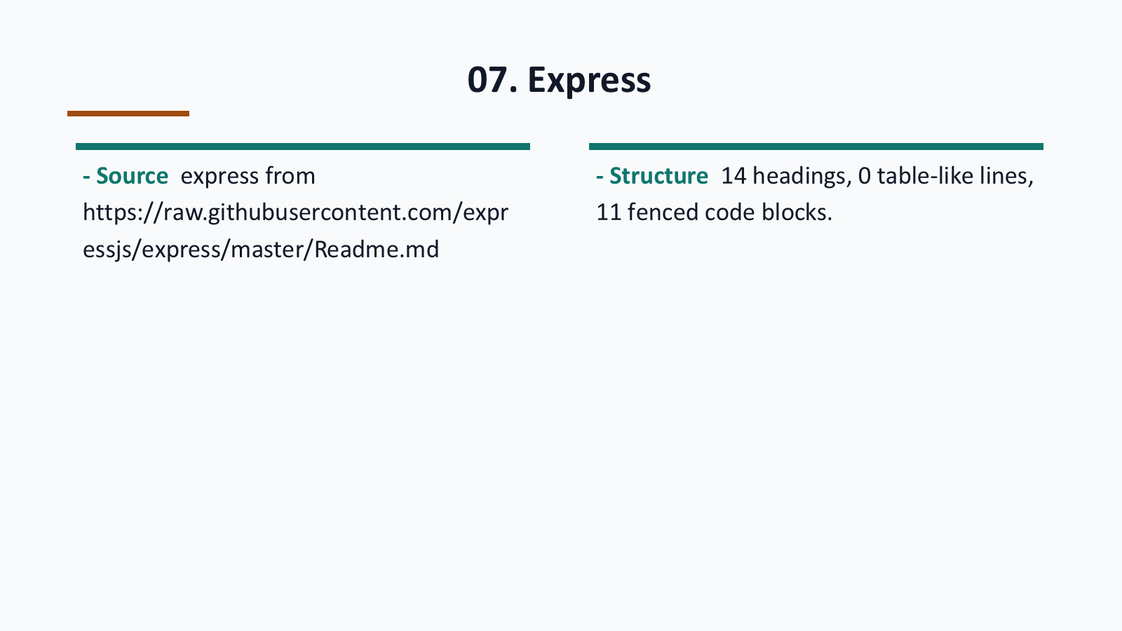
Notes:
Generated from the same visual page image used for the codex-ppt assembly baseline.

Slide 26

Notes:
Generated from the same visual page image used for the codex-ppt assembly baseline.

Slide 27
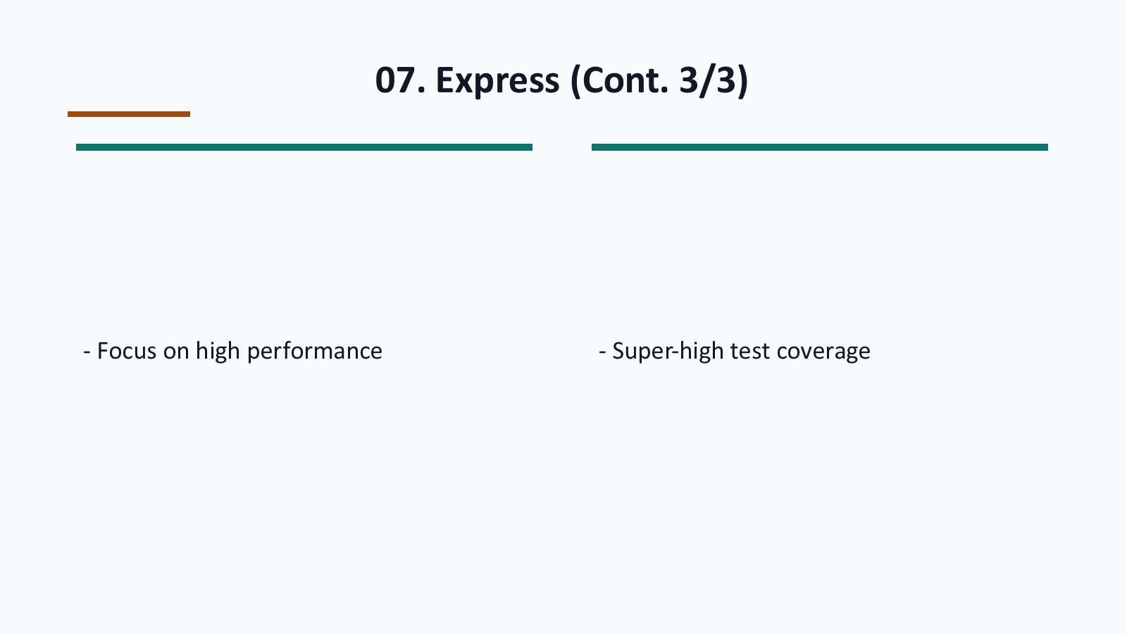
Notes:
Generated from the same visual page image used for the codex-ppt assembly baseline.

Slide 28
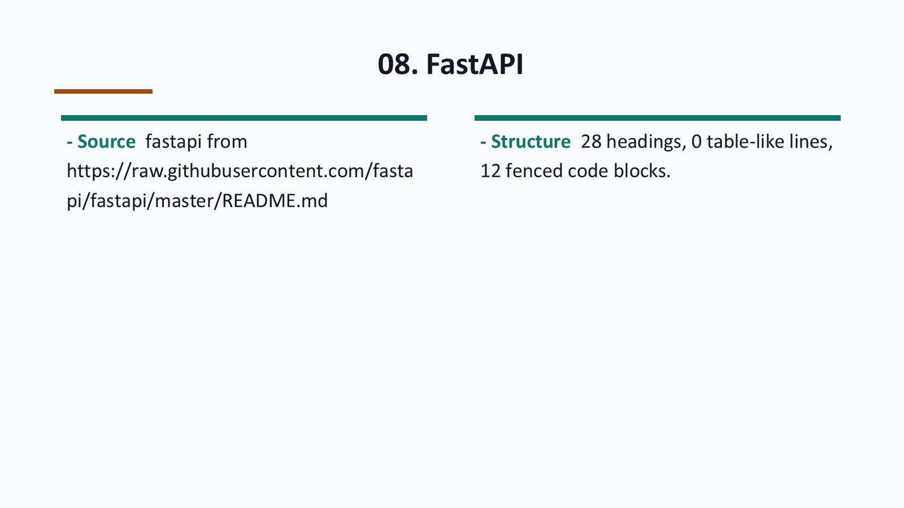
Notes:
Generated from the same visual page image used for the codex-ppt assembly baseline.

Slide 29
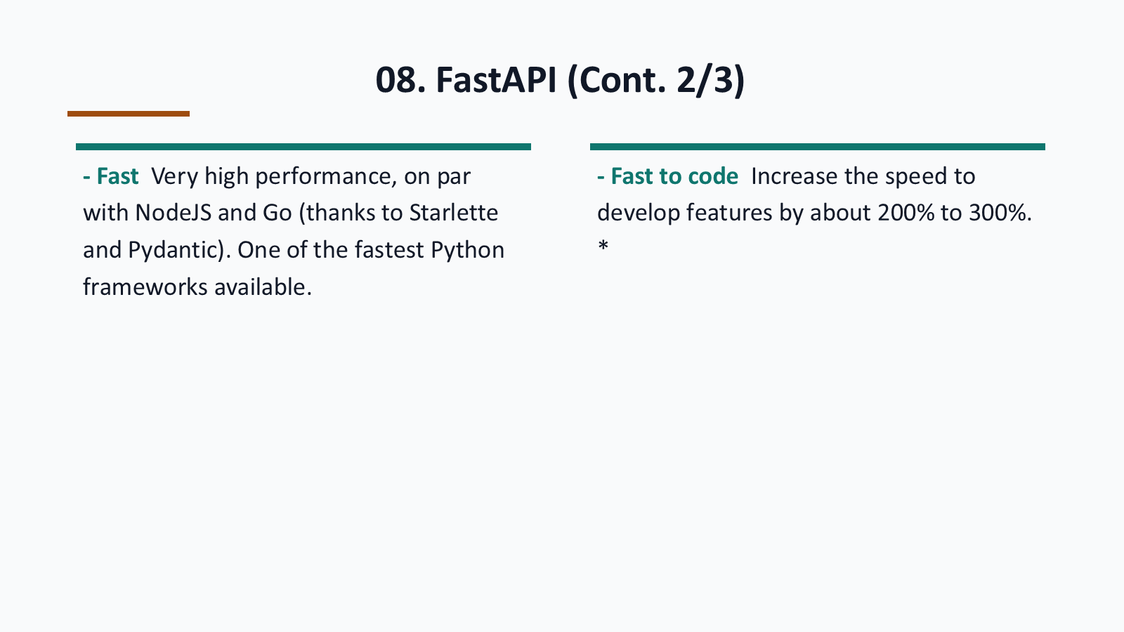
Notes:
Generated from the same visual page image used for the codex-ppt assembly baseline.

Slide 30
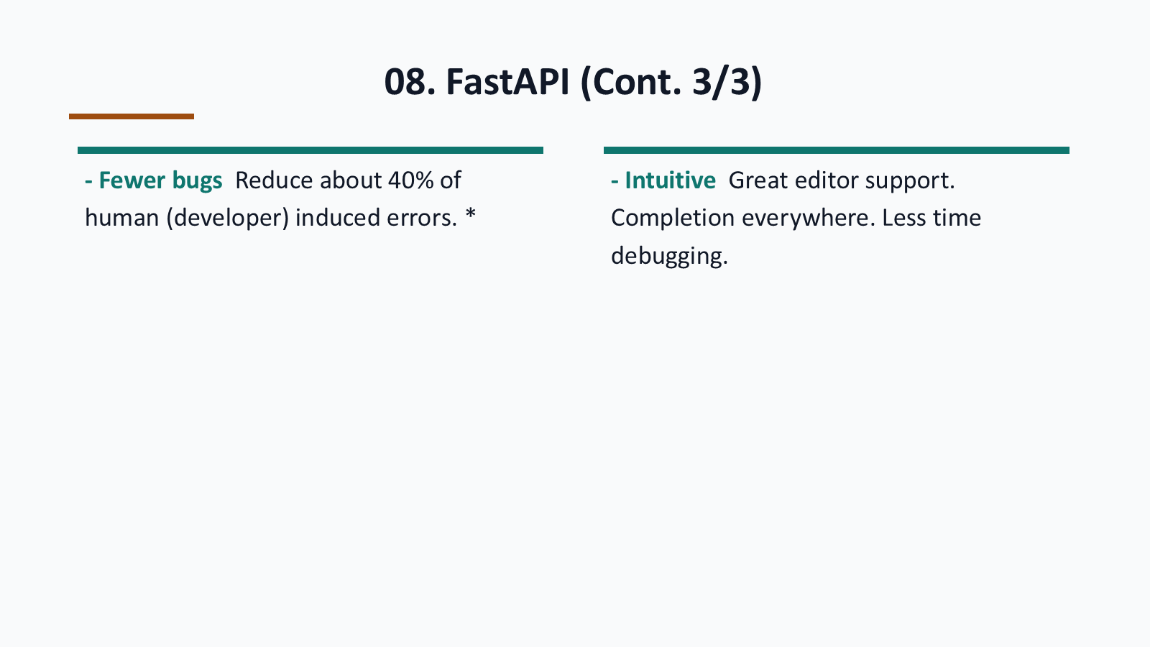
Notes:
Generated from the same visual page image used for the codex-ppt assembly baseline.

Slide 31
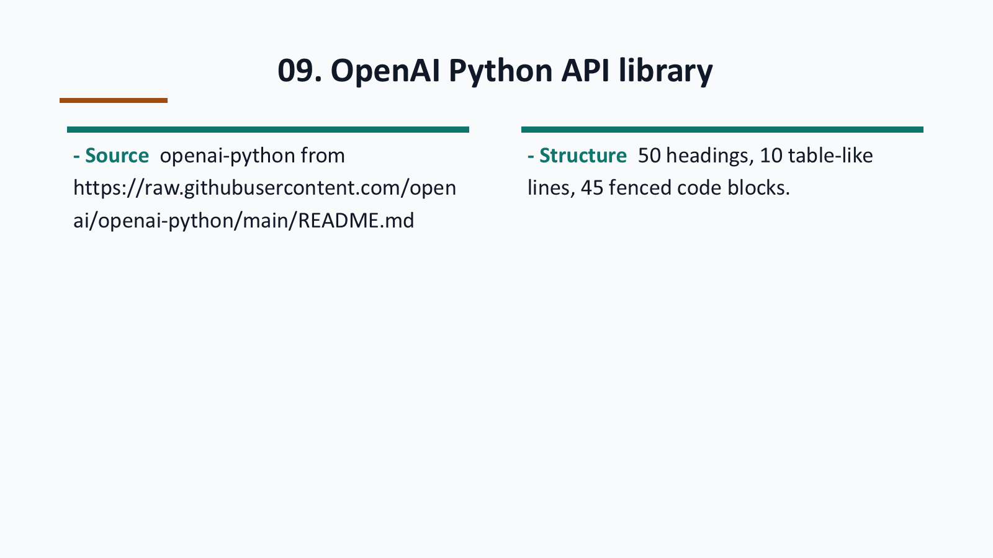
Notes:
Generated from the same visual page image used for the codex-ppt assembly baseline.

Slide 32
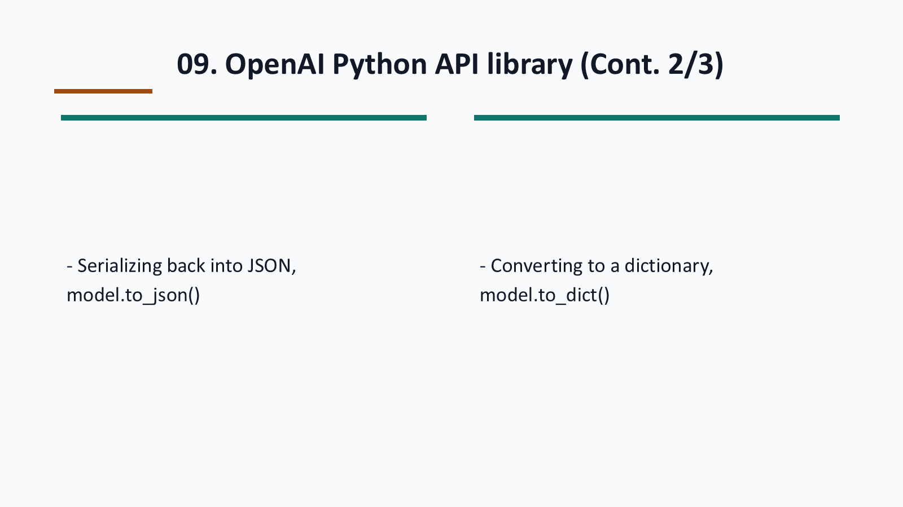
Notes:
Generated from the same visual page image used for the codex-ppt assembly baseline.

Slide 33
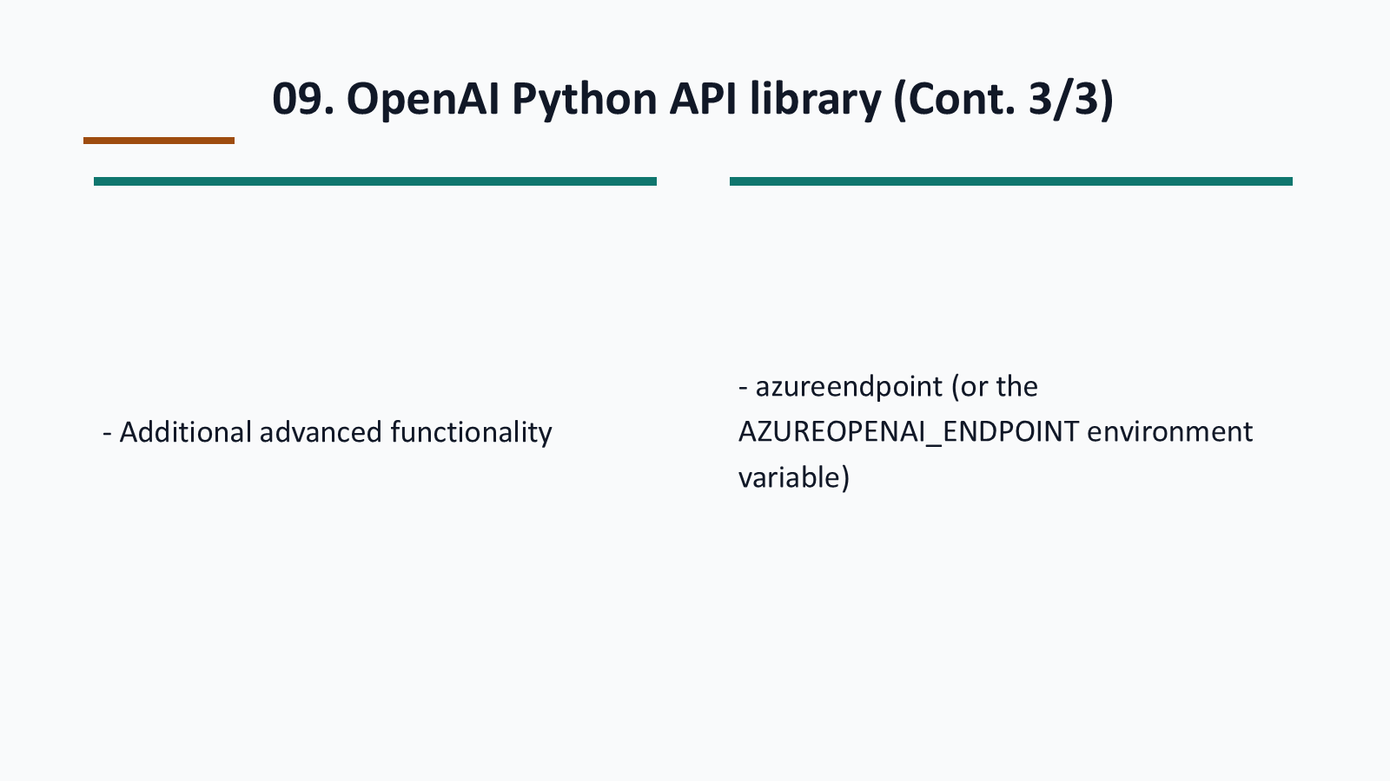
Notes:
Generated from the same visual page image used for the codex-ppt assembly baseline.

Slide 34
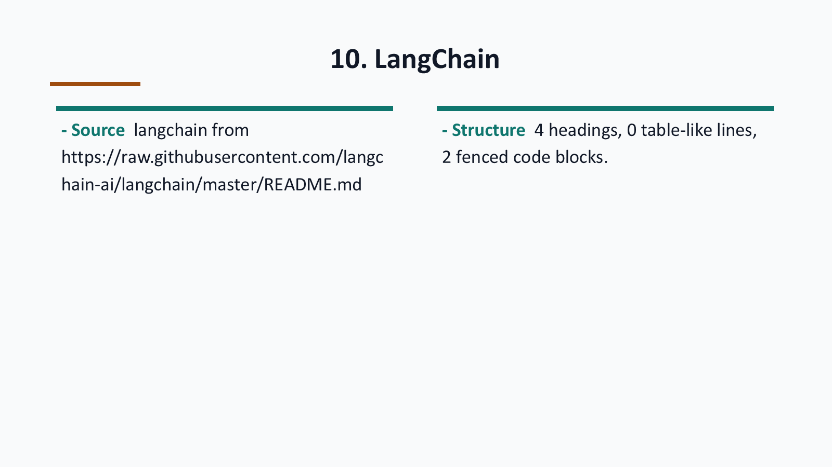
Notes:
Generated from the same visual page image used for the codex-ppt assembly baseline.

Slide 35
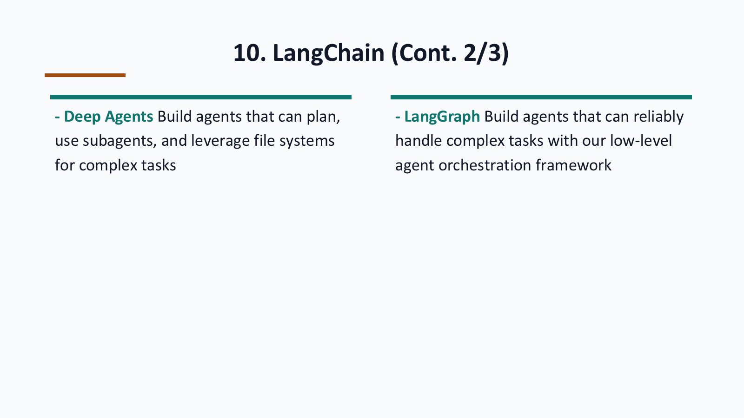
Notes:
Generated from the same visual page image used for the codex-ppt assembly baseline.

Slide 36
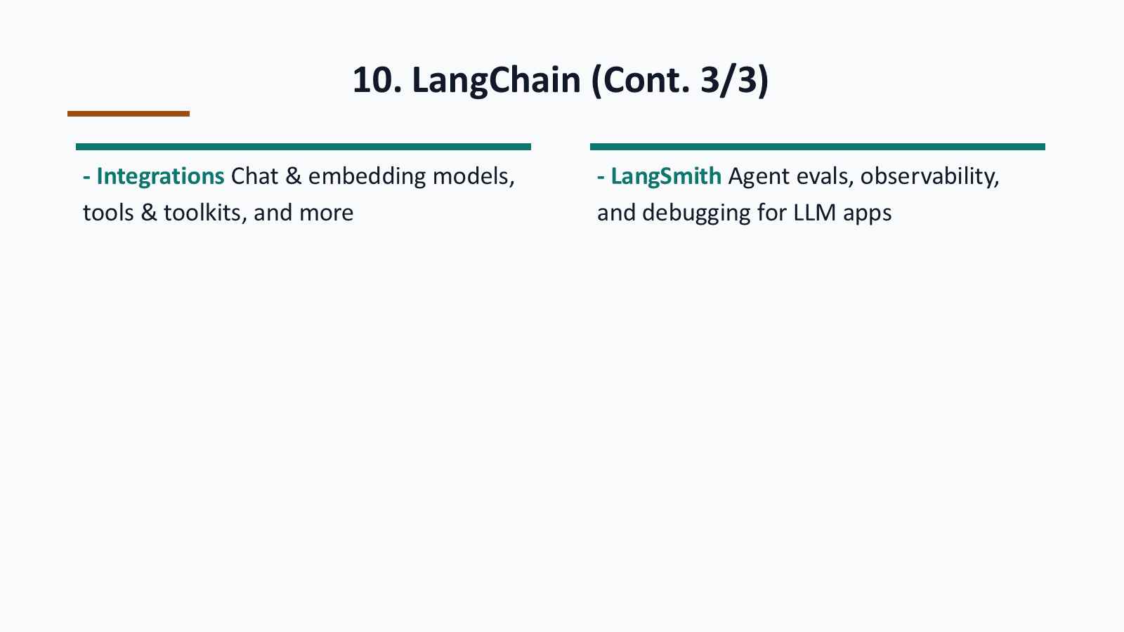
Notes:
Generated from the same visual page image used for the codex-ppt assembly baseline.

Slide 37
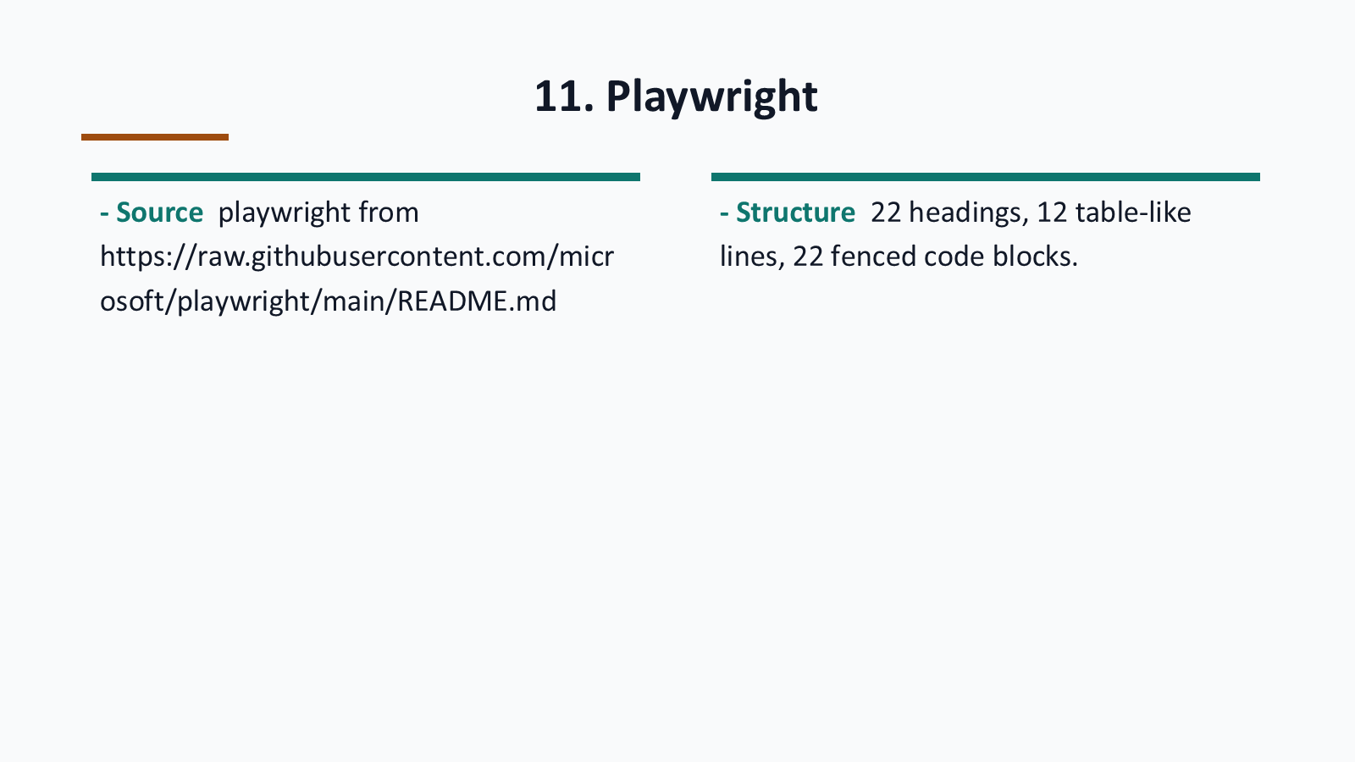
Notes:
Generated from the same visual page image used for the codex-ppt assembly baseline.

Slide 38
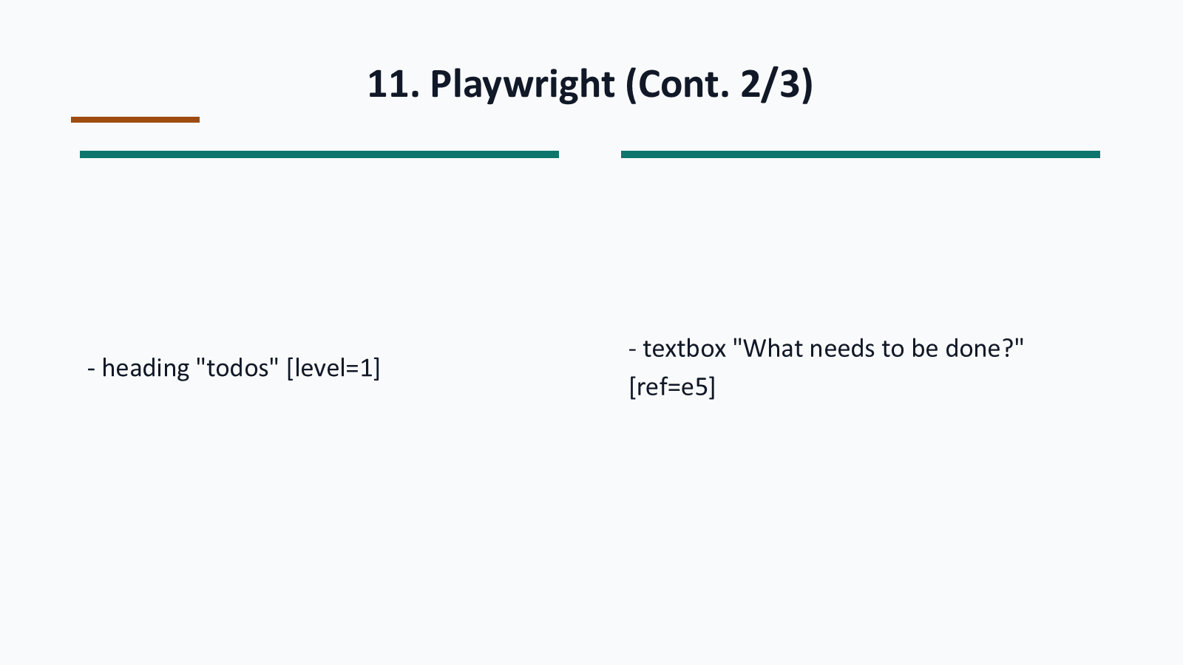
Notes:
Generated from the same visual page image used for the codex-ppt assembly baseline.

Slide 39
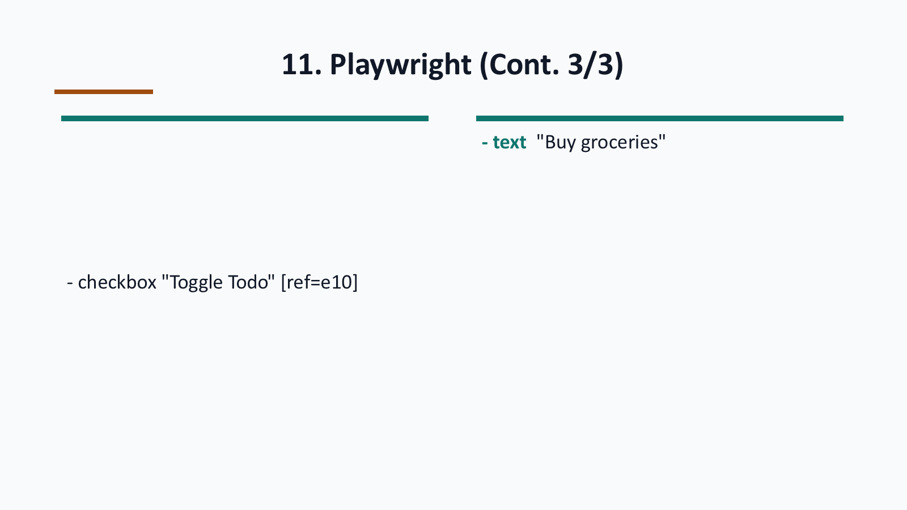
Notes:
Generated from the same visual page image used for the codex-ppt assembly baseline.

Slide 40
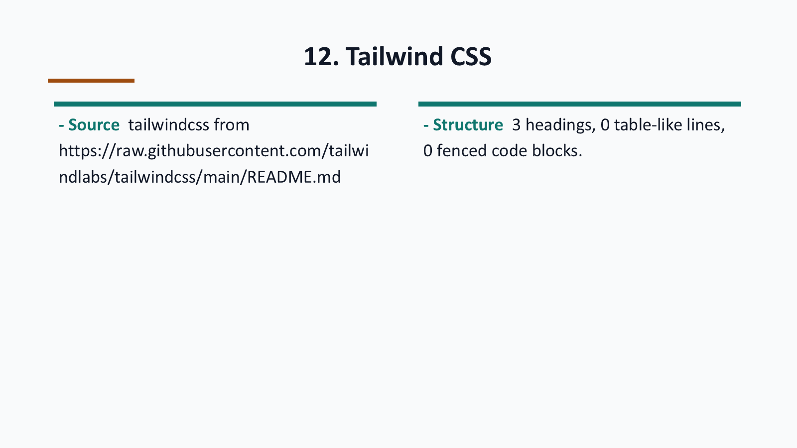
Notes:
Generated from the same visual page image used for the codex-ppt assembly baseline.

Slide 41
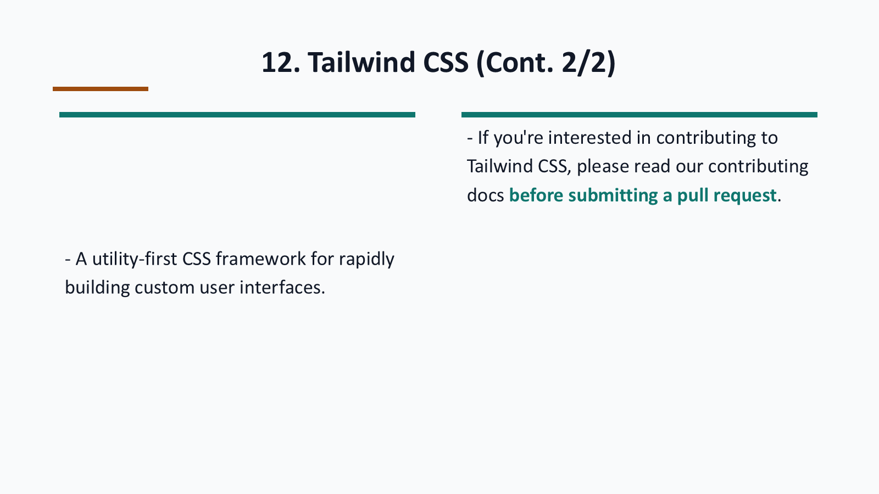
Notes:
Generated from the same visual page image used for the codex-ppt assembly baseline.

Slide 42

Notes:
Generated from the same visual page image used for the codex-ppt assembly baseline.

Slide 43
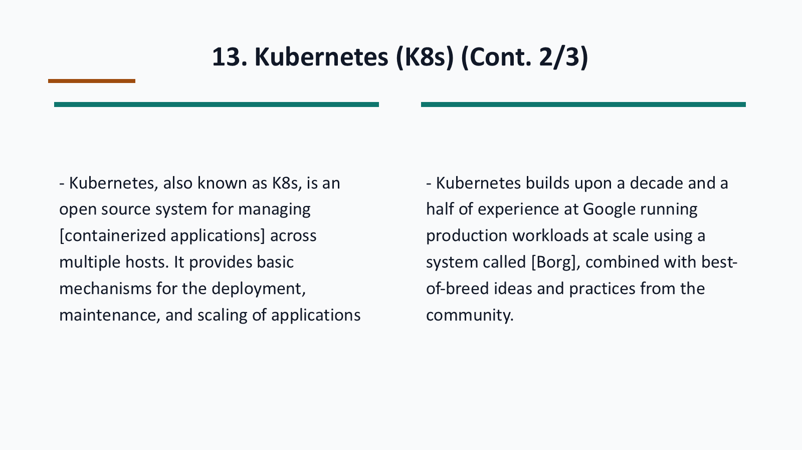
Notes:
Generated from the same visual page image used for the codex-ppt assembly baseline.

Slide 44
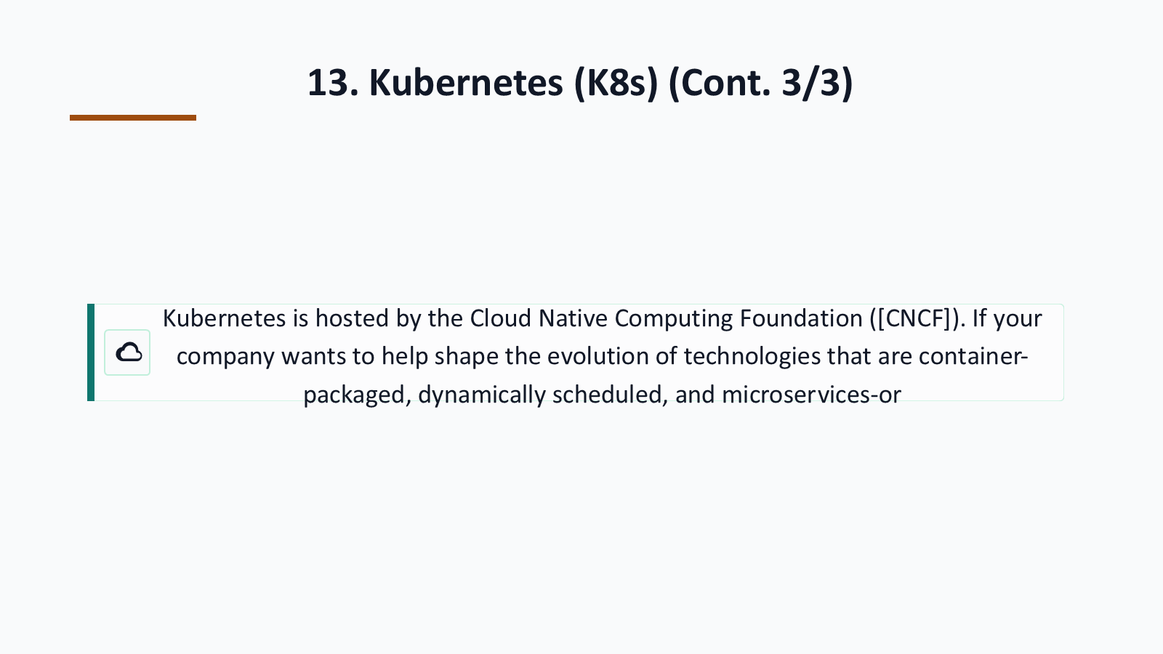
Notes:
Generated from the same visual page image used for the codex-ppt assembly baseline.

Slide 45
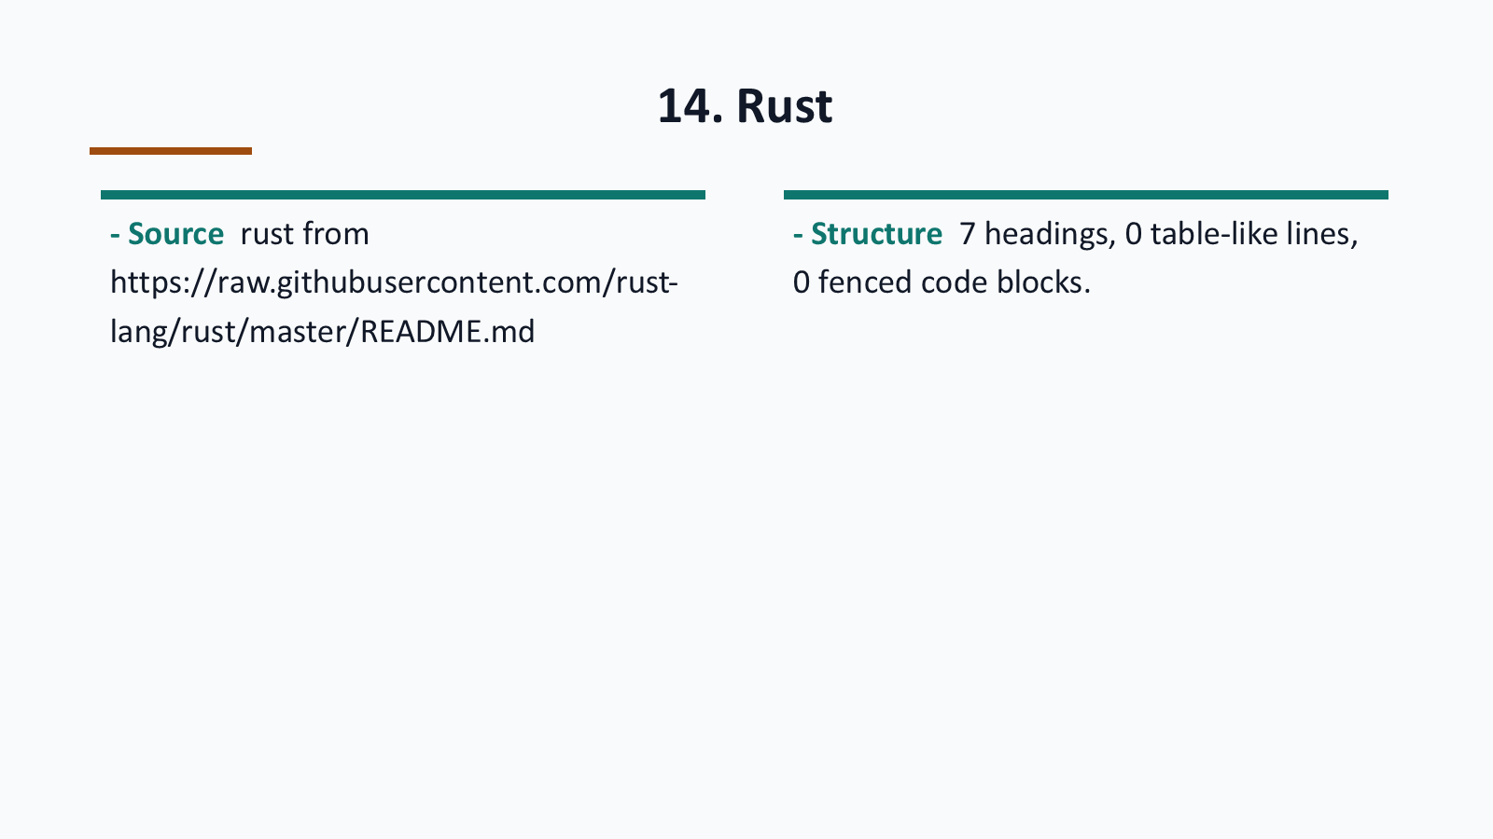
Notes:
Generated from the same visual page image used for the codex-ppt assembly baseline.

Slide 46
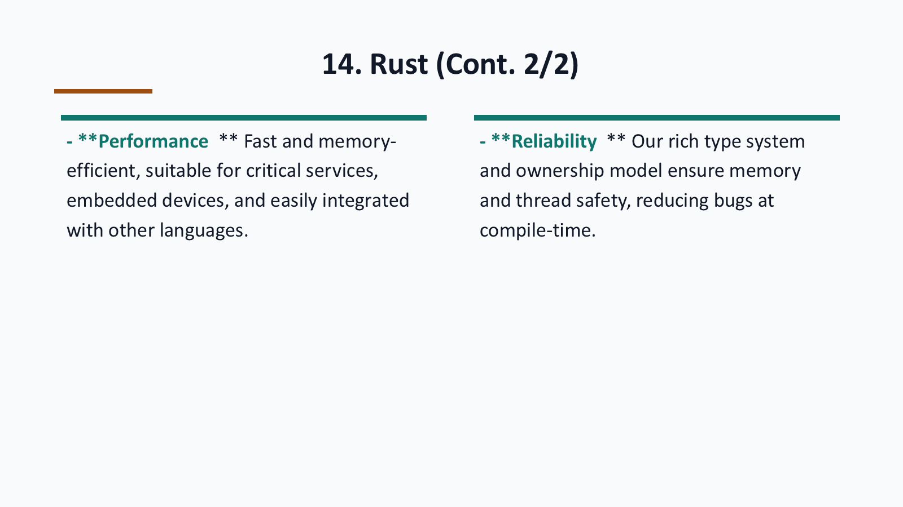
Notes:
Generated from the same visual page image used for the codex-ppt assembly baseline.

Slide 47
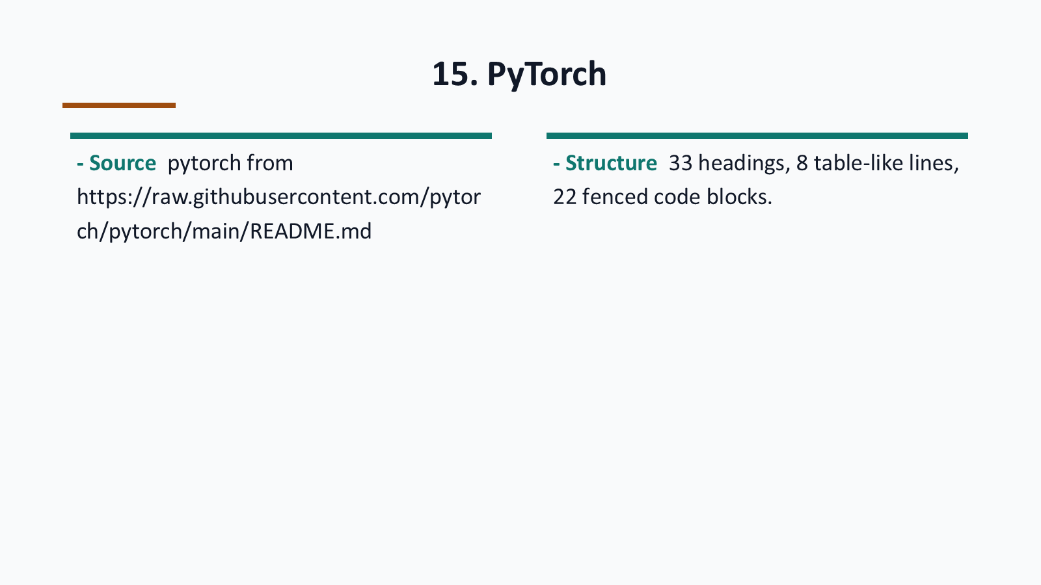
Notes:
Generated from the same visual page image used for the codex-ppt assembly baseline.

Slide 48
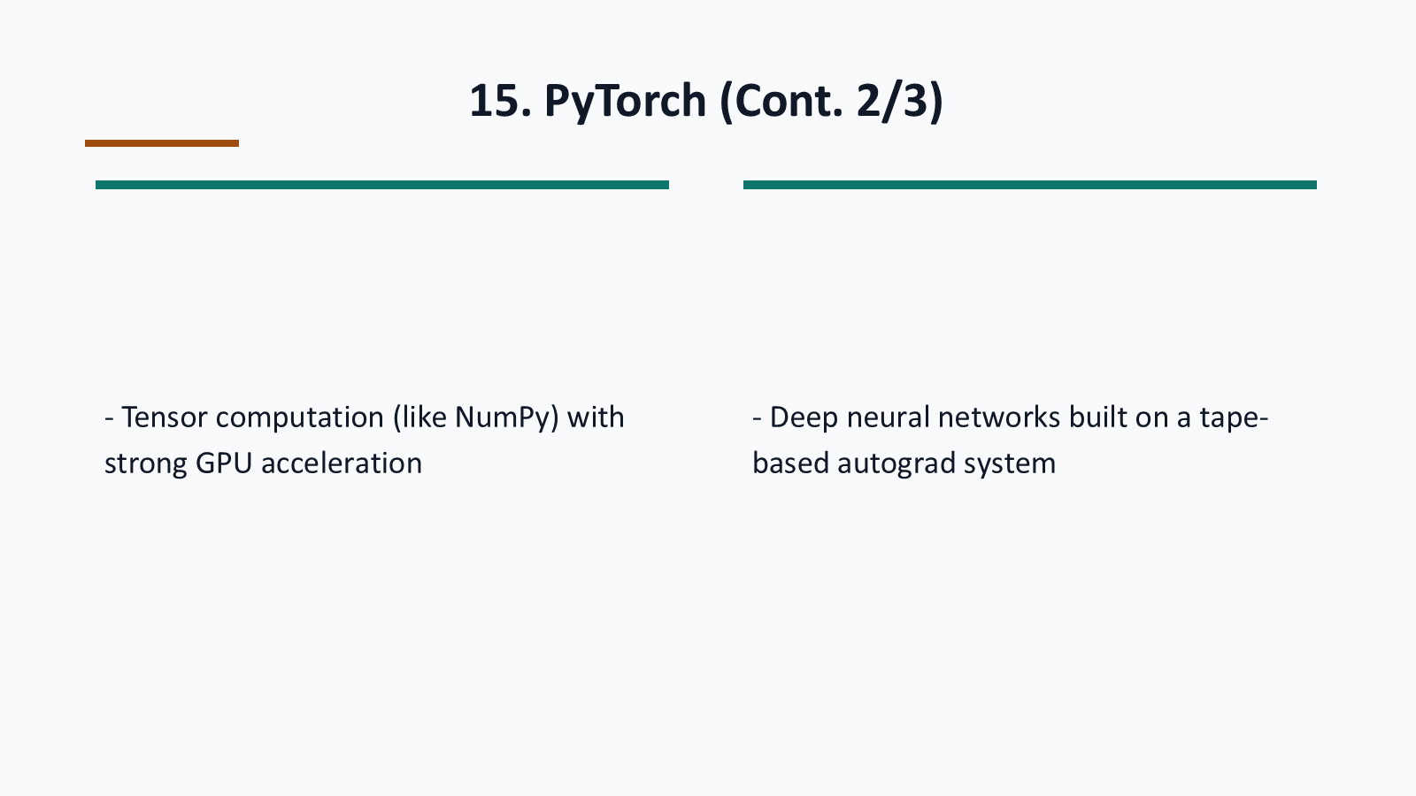
Notes:
Generated from the same visual page image used for the codex-ppt assembly baseline.

Slide 49
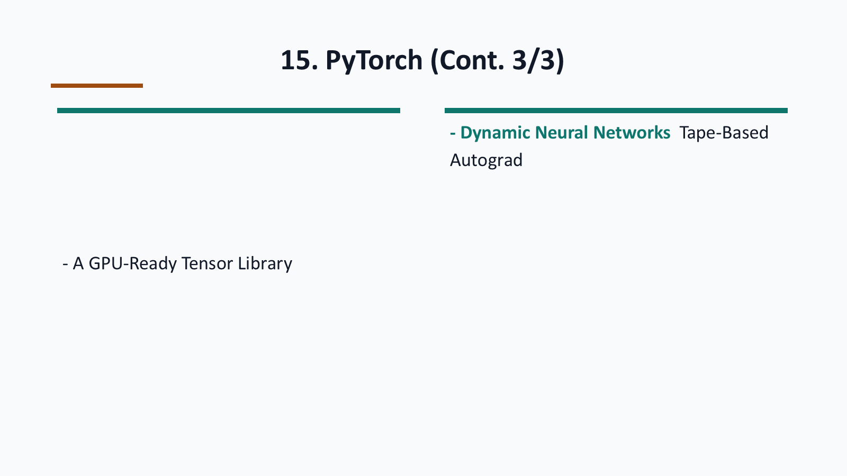
Notes:
Generated from the same visual page image used for the codex-ppt assembly baseline.

Slide 50

Notes:
Generated from the same visual page image used for the codex-ppt assembly baseline.

Slide 51
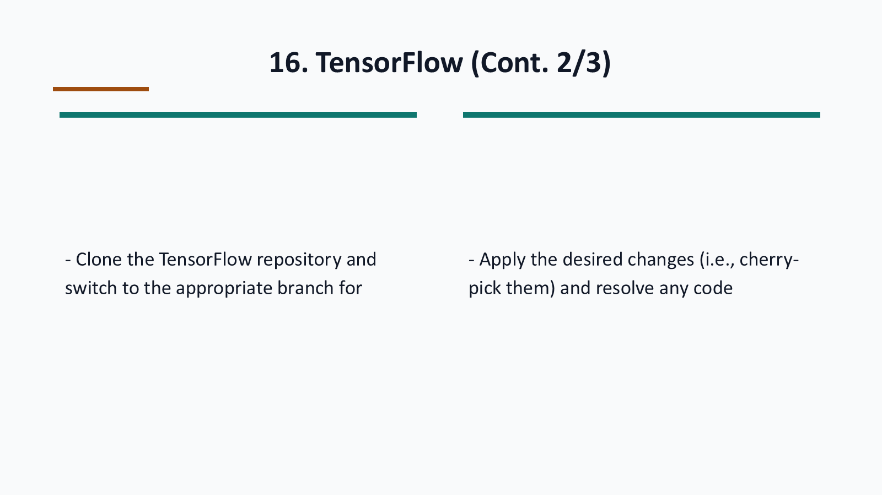
Notes:
Generated from the same visual page image used for the codex-ppt assembly baseline.

Slide 52
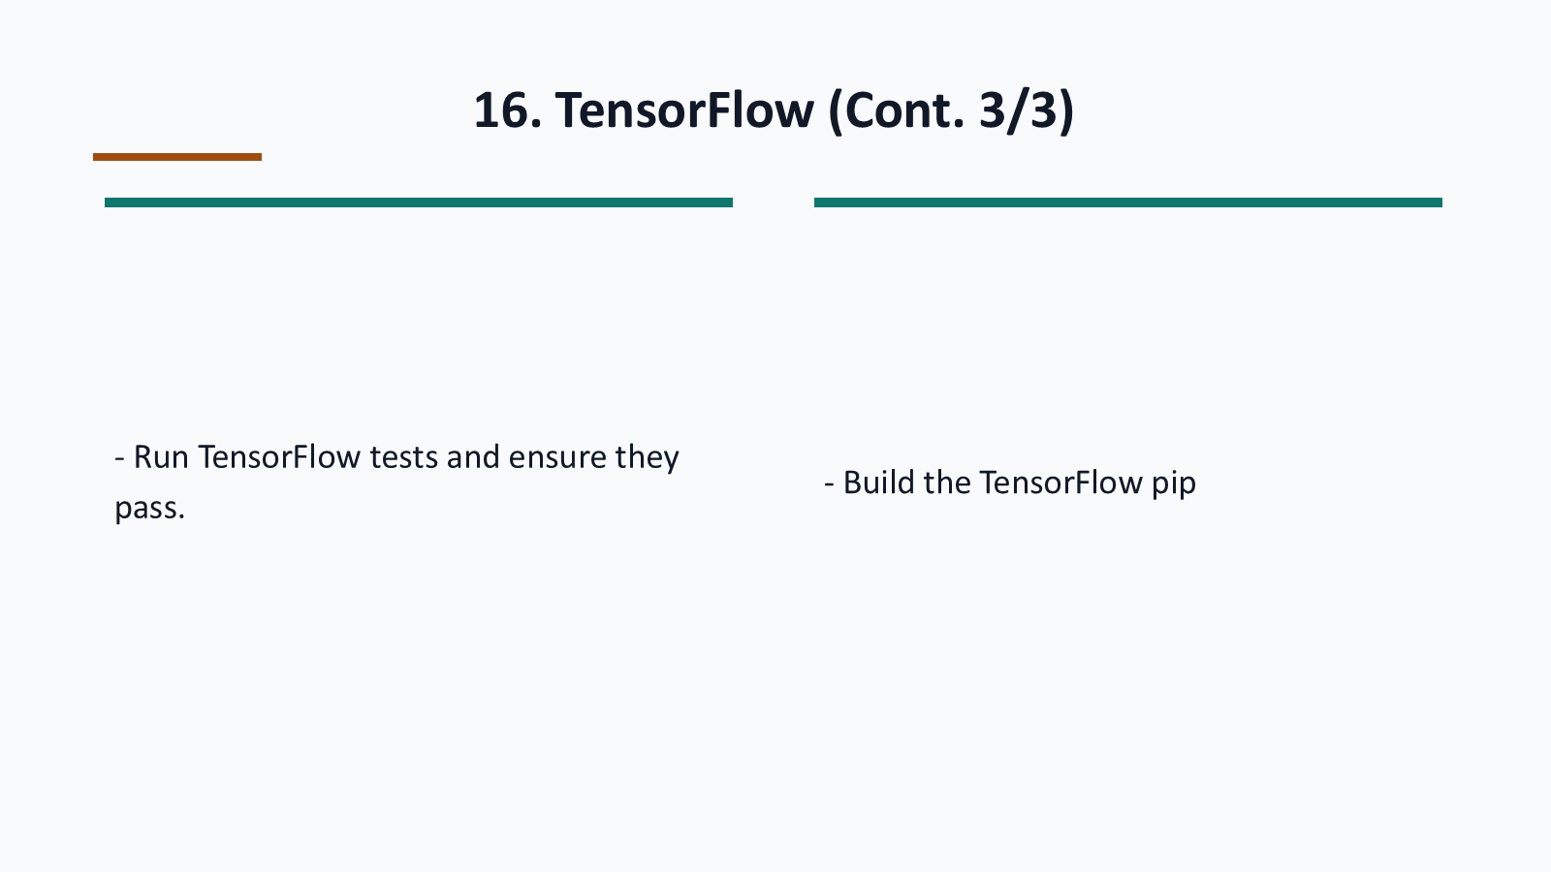
Notes:
Generated from the same visual page image used for the codex-ppt assembly baseline.

Slide 53
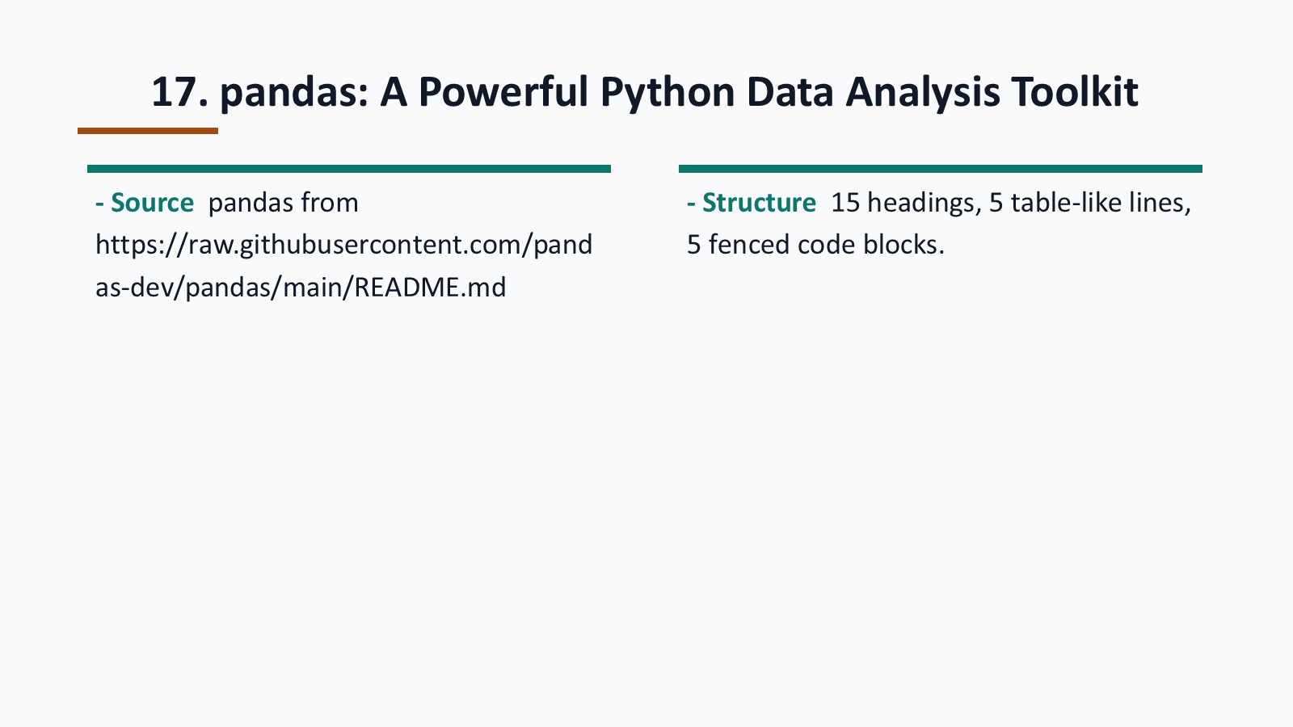
Notes:
Generated from the same visual page image used for the codex-ppt assembly baseline.

Slide 54

Notes:
Generated from the same visual page image used for the codex-ppt assembly baseline.

Slide 55
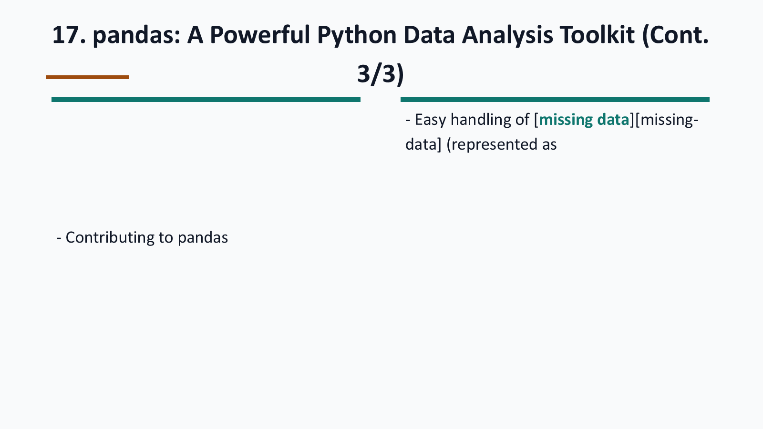
Notes:
Generated from the same visual page image used for the codex-ppt assembly baseline.

Slide 56
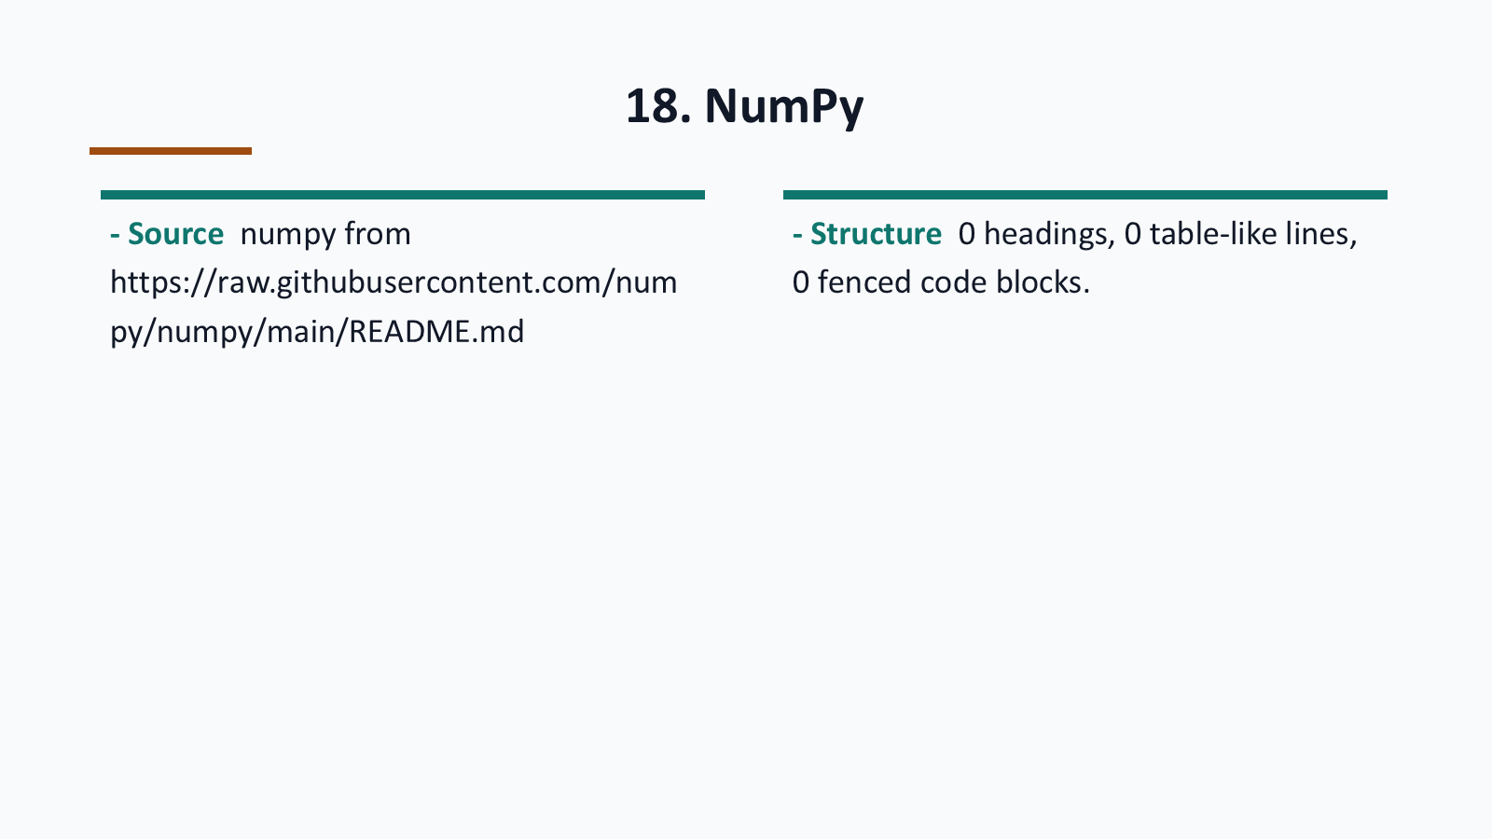
Notes:
Generated from the same visual page image used for the codex-ppt assembly baseline.

Slide 57

Notes:
Generated from the same visual page image used for the codex-ppt assembly baseline.

Slide 58

Notes:
Generated from the same visual page image used for the codex-ppt assembly baseline.

Slide 59

Notes:
Generated from the same visual page image used for the codex-ppt assembly baseline.

Slide 60

Notes:
Generated from the same visual page image used for the codex-ppt assembly baseline.

Slide 61

Notes:
Generated from the same visual page image used for the codex-ppt assembly baseline.

Slide 62

Notes:
Generated from the same visual page image used for the codex-ppt assembly baseline.

Slide 63

Notes:
Generated from the same visual page image used for the codex-ppt assembly baseline.

Slide 64

Notes:
Generated from the same visual page image used for the codex-ppt assembly baseline.

Slide 65

Notes:
Generated from the same visual page image used for the codex-ppt assembly baseline.

Slide 66

Notes:
Generated from the same visual page image used for the codex-ppt assembly baseline.

Slide 67

Notes:
Generated from the same visual page image used for the codex-ppt assembly baseline.

Slide 68

Notes:
Generated from the same visual page image used for the codex-ppt assembly baseline.

Slide 69

Notes:
Generated from the same visual page image used for the codex-ppt assembly baseline.

Slide 70

Notes:
Generated from the same visual page image used for the codex-ppt assembly baseline.

