Slide 1
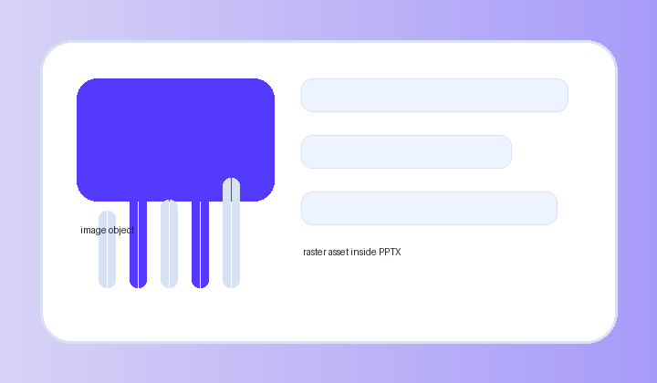
Mixed Object Stress Test
stress
Image, table, native chart, KPI, timeline, badge, callout, and text objects share one coherent profile.
Image frame
PNG
Native chart
Object matrix
Type | Editable | Status
Text | Yes | Pass
Image | Picture | Pass
Chart | Object | Pass
PPT picture + editable overlay metadata
Timeline
Coherence lock
Parse
Map
Compose
Render
One radius, one shadow family, one accent role per deck.
radius
shadow
accent
OBJECTS
MIN TEXT
IMAGE
47
8pt
ok
text
shape
picture
table
chart
timeline

Slide 2
Editorial Brief
notion
Notion-style warm neutral documentation slide with compact evidence cards
Renderer-neutral mapping
Coherence lock
One radius, one shadow family, one accent role per deck.
Design Components components map to editable PowerPoint text, shapes, charts, and tables.
radius
shadow
accent
Radius, shadow, spacing, type, accent, and effect policies stay stable inside one deck profile.
Top slide patterns
1
stat-card
92
One visual decision per axis.
2
chart-card
87
3
insight-card
76

Slide 3
Sharp Technical Review
linear
Linear-style compact UI · deterministic trace, lint, and code-capable recipes
selection.trace.ts
Top slide patterns
hardReject: highDensity + heroOnly
1
stat-card
92
score.intentFit += 30
2
chart-card
87
score.elementFit += chart + kpi
3
insight-card
76
stableSort(score desc, id asc)
emit rejectReasons[]
Coherence lint
raw hex: pass · z-order: pass

Slide 4
Layered Product Launch
stripe
Stripe-style layered depth · pricing, conversion, and rollout components
Weekly activation
7D
30D
90D
REVENUE ENGINE
$1.28M
Projected ARR from rule-based deck variants
72%
Conversion 18.4%
Retention 42%
58%
84%
Coherence lock
63%
One radius, one shadow family, one accent role per deck.
radius
shadow
accent

Slide 5
Friendly Dashboard
toss
Design Components skin: toss · editable PPT shapes · coherent soft depth
•
REVENUE
•
RETENTION
Top slide patterns
$128K
42%
+18.4%
+6.1%
1
stat-card
92
2
chart-card
87
Weekly activation
7D
30D
90D
3
insight-card
76
Coherence lock
One radius, one shadow family, one accent role per deck.
Conversion 18.4%
Retention 42%
radius
shadow
accent

